Slide 1
Class Lecture
Composition of Milk
&
Dr. Sanjeev Kumar
Associate Professor & Head
Department of Dairy Technology
SGIDT, Patna-14

Slide 2
Introduction
Milk is the substance created by nature to feed the mammalian offspring.
All species of mammals produce milk for this purpose.
Definition:
Defined as the whole, fresh, clean, lacteal secretion obtained by the complete milking of one or more healthy milch animals, excluding that obtained within 15 days before or 5 days after calving or such periods as may be necessary to render the milk practically colostrum-free, and containing the minimum prescribed %age of milk fat and SNF.
Market milk:
Refers to fluid whole milk that is sold to individuals usually for direct consumption.
Excludes milk consumed on the farm and that used for manufacture of dairy products.

Slide 3
India ranks in the world :
first in respect of cattle and buffalo,
second in goat
third in sheep population.
India has
about 13% of the global cattle population (www.fao.org).
Of these, nearly, 13% are crossbred of the total cattle population.
about 55% of the world buffalo population.
India’s position as the highest producer of milk
Productivity per animal is only 987 kg/lactation as compared to the world average of 2038 kg/lactation (www.dahd.nic.in).

Slide 4
Milk Constituents:
Milk
a complex biological fluid
consisting of seven main components: WATER, FAT, PROTEIN, SUGAR (LACTOSE), MINERALS, VITAMINS and ENZYMES.
It is a white opaque fluid in which
fat is present as an emulsion,
protein and some mineral matters in colloidal suspension
lactose together with some minerals and soluble proteins in true solution.

Slide 5
The opacity of milk is due to its content of suspended particles of fat, proteins and certain minerals.
The colour varies from white to yellow depending on the carotene content of the fat.
Milk has a pleasant, slightly sweet taste, and pleasant odour.
It is an excellent source of calcium, phosphates and riboflavin.

Slide 6
Milk Constituents:
Major Constituent
Water
Fat
Protein
Lactose
Ash(minerals)
Minor Constituent
Phospholipidis
Sterols
Vitamins
Enzymes
Pigments
True Constituent
Milk fat
Casein
Lactose

Slide 7
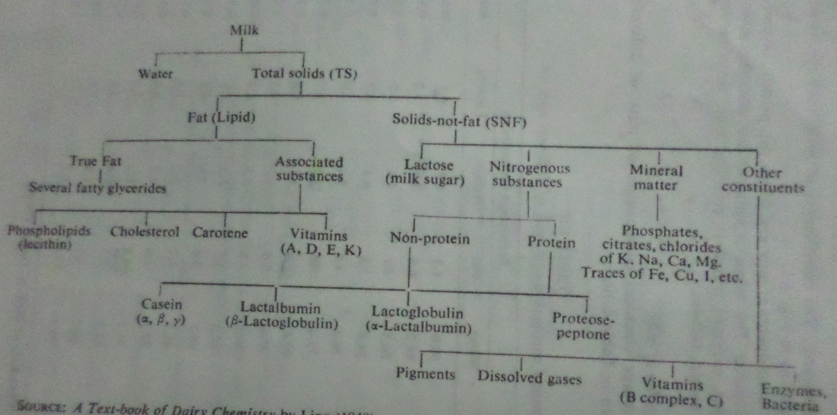

Slide 8
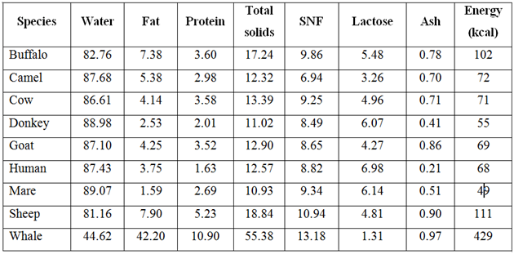
Composition of Milk
Average composition of milk of different mammals (%)

Slide 9
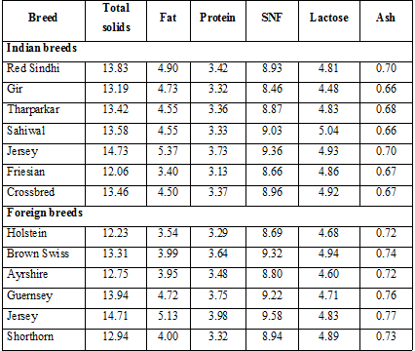
Average composition of milk of selected breeds of cows (%)

Slide 10
Factors affecting chemical composition of milk:
Species
Individuality of the animal
Breed variation
Seasonal changes
Weather
Age and health of the animal
Managerial practices (nature and quality of feed, interval of milking, frequency of milking etc)
Stage of lactation
Quarter of the udder of the animal from which milk is drawn, etc.

Slide 11
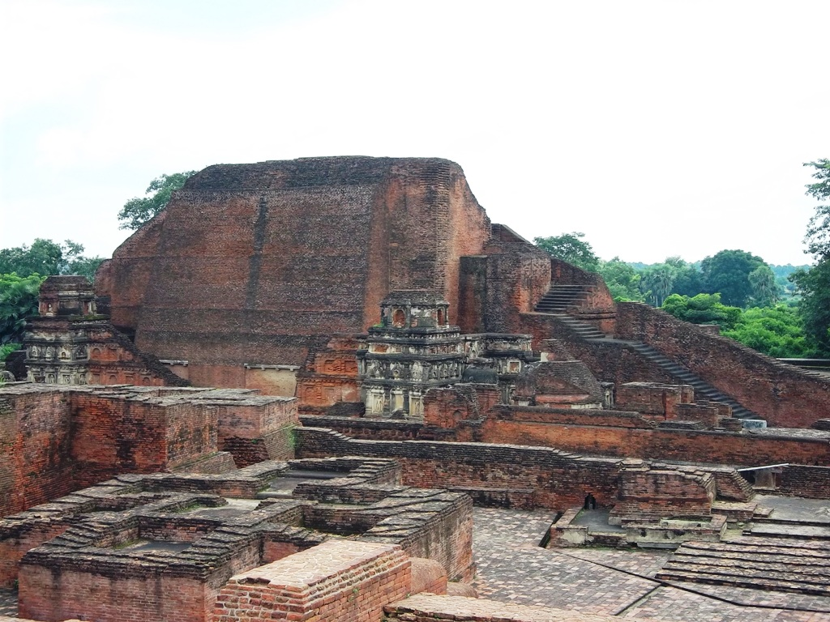
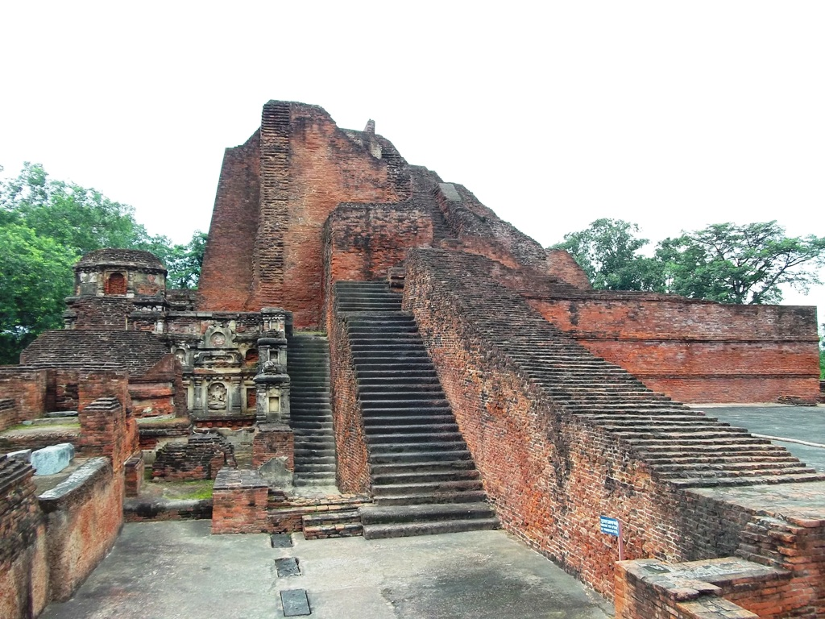
THANKs

