Slide 1
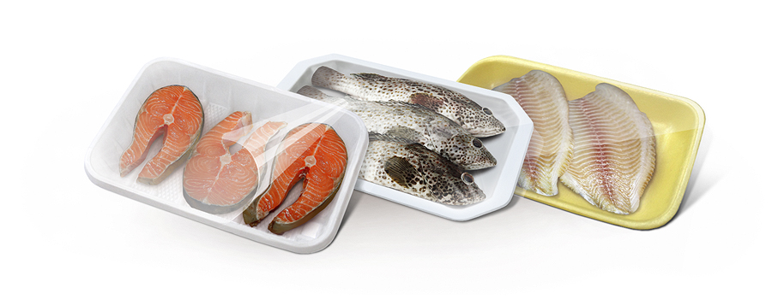
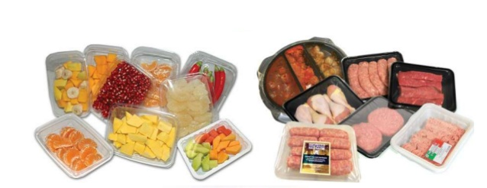
MODIFIED ATMOSPHERE PACKAGING
Subject: Fish Packaging Technology
Date of Lecture: 27.07.2020
By
Dr. Abhishek Thakur
(Assistant Professor)
College of Fisheries, Kishanganj
BASU, Patna

Slide 2
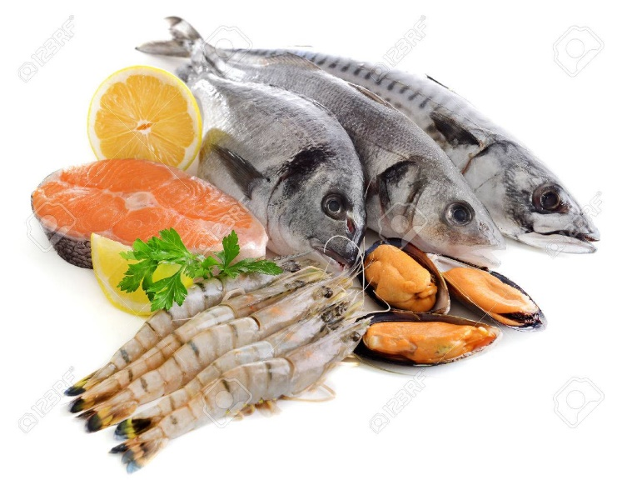
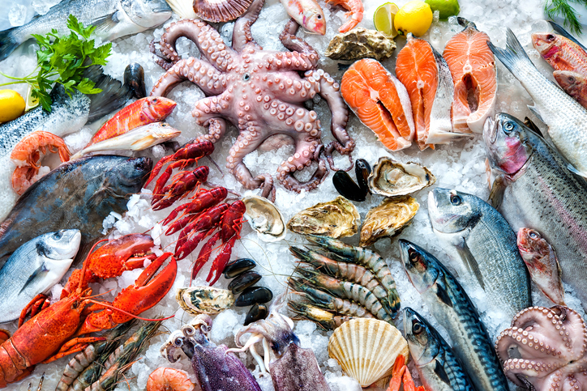
Background
Consumers always prefer fresh fish to preserved/processed fish if the former is readily available.
Chilling and freezing bring least changes in the intrinsic qualities of fish and the product is nearest to fresh fish in characteristics.

Slide 3
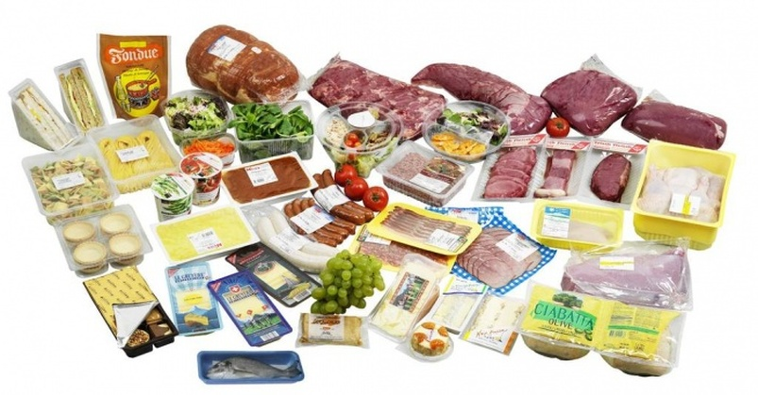
Background
Demand for fresh and chilled ‘convenience foods’ containing few or no preservatives are increasing day by day.
A method of extending the shelf life of foods that can more or less meet the above demands of the consumers is packaging them in modified atmosphere.

Slide 4
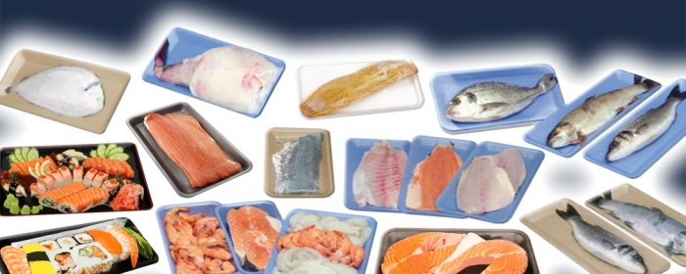
Methods of Modifying Atmosphere for Packaging
The types of modifications that are generally brought about in the packaging of foods, particularly fish and fish products are:
Modified Atmosphere Packaging (MAP).
Controlled Atmosphere Packaging (CAP).
Vacuum packaging (Hypobaric storage).
Hyperbaric storage.

Slide 5
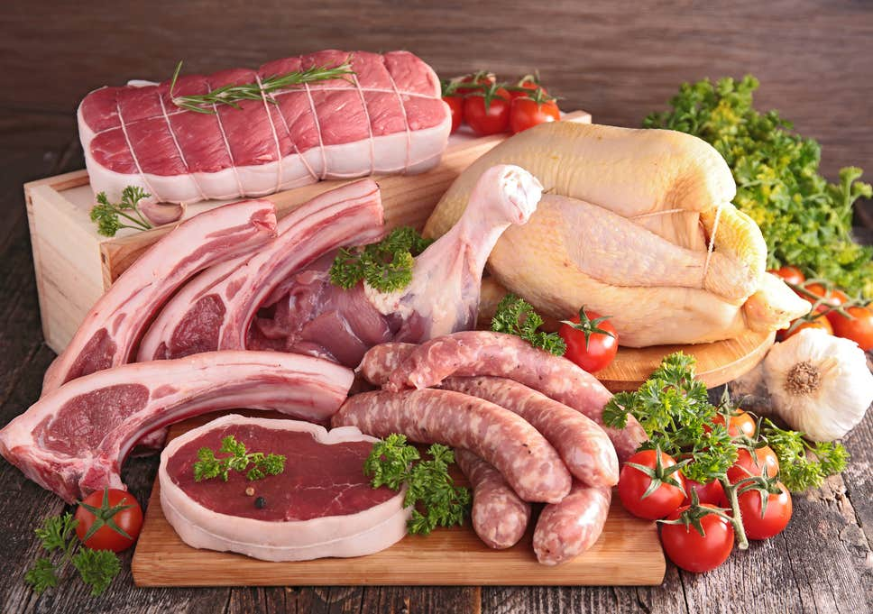
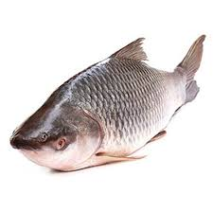
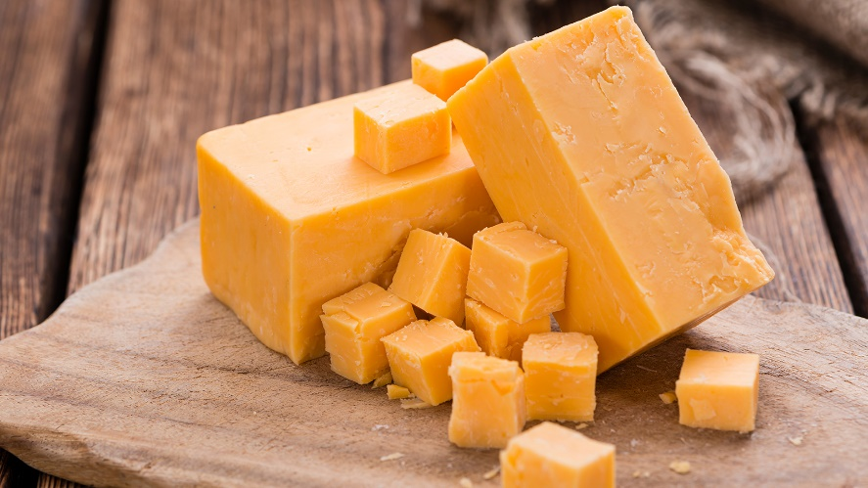
Modified Atmosphere Packaging (MAP)
Mostly employed in case of no-respiring products, e.g., meat, cheese, fish, baked goods etc.

Slide 6
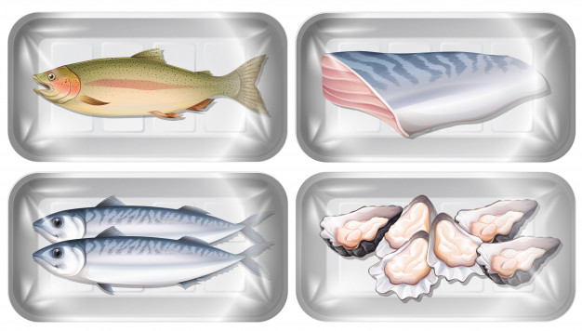
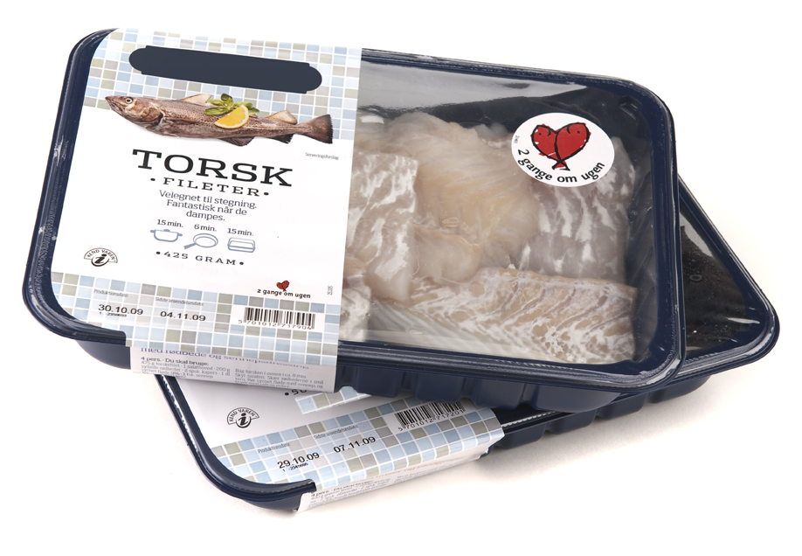
Modified Atmosphere Packaging (MAP)
It is a form of packaging involving the removal of air from the pack and the replacement with single gas or mixture of gases (Parry,1993)

Slide 7
Modified Atmosphere Packaging (MAP)

Slide 8
Modified Atmosphere Packaging (MAP)
Carbon dioxide, nitrogen and oxygen are the gases generally used in modifying the atmosphere.
Composition of the gases will vary depending on the nature of the product.
The proportion of each component gas will be no further control of any sort on the composition of the gases.
It cannot be expected that the composition of the atmosphere at the time of sealing will be maintained throughout the storage period even if the packaging film is intact and properly sealed.

Slide 9
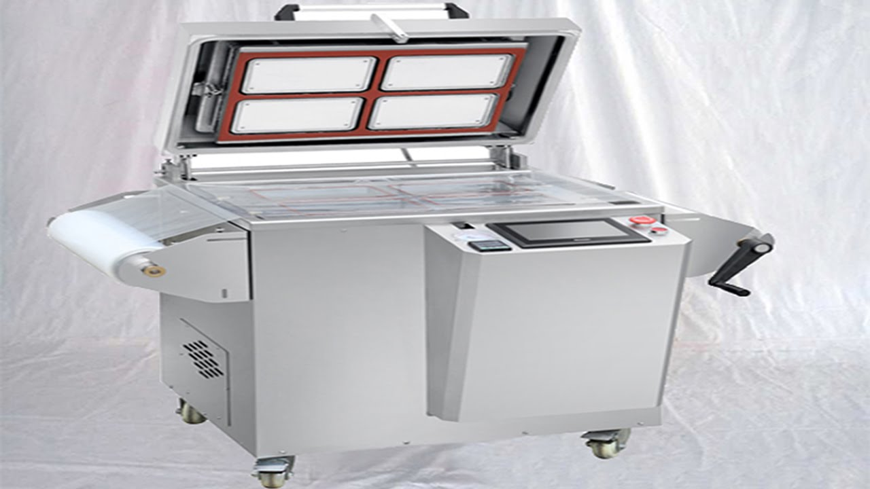
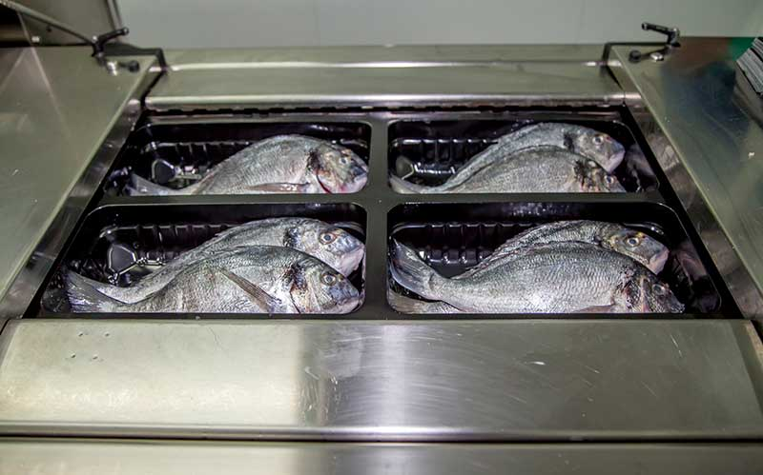
Modified Atmosphere Packaging (MAP)
The gas mixture may undergo through changes during the period of storage.
Biochemical activity also may modify the atmosphere.

Slide 10
Modified Atmosphere Packaging (MAP)
Role of Gases in Shelf Life Extension
Carbon dioxide
It is the major gas employed in the modified atmosphere packaging of fish and fishery products.
It has powerful inhibitory effect on the growth of bacteria and mould when present at or above 20 per cent.
Some anaerobic and facultative bacteria also inhibited by carbon dioxide.

Slide 11
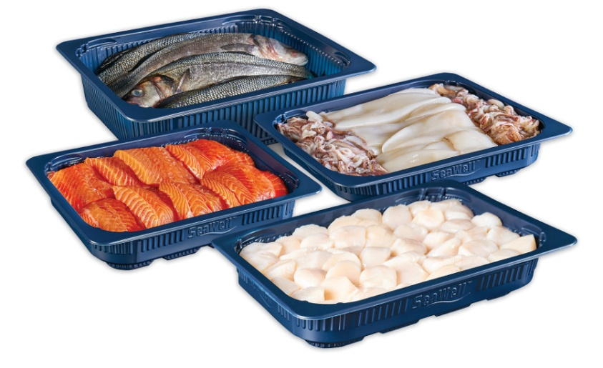
Modified Atmosphere Packaging (MAP)
Role of Gases in Shelf Life Extension
Carbon dioxide
Carbon dioxide is soluble in lipids and water.
High concentration of carbon dioxide may lead to the production of carbonic acid in the fish and this will lower the pH of the muscle, produce an acid taste, reduce the water holding capacity of the proteins and hence, may result in the formation of drip in the pack.

Slide 12
Modified Atmosphere Packaging (MAP)
Role of Gases in Shelf Life Extension
Carbon dioxide
High concentrations of carbon dioxide also produce organoleptic changes coarsening of the texture and alteration of the colour of the belly flaps, cornea and skin of the fish.
Excessive absorption of carbon dioxide by high moisture/high fat foods like fish or meat will lead to lowering of internal pressure in the pack and becomes a potential reason for the phenomenon known as ‘pack collapse’.

Slide 13
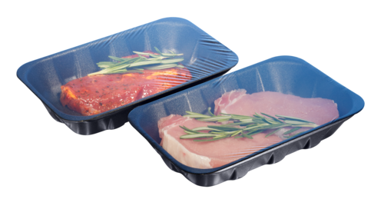
Modified Atmosphere Packaging (MAP)
Role of Gases in Shelf Life Extension
2. Nitrogen
Nitrogen is an inert, tasteless gas with low solubility in lipids and water.
It is mainly used to displace oxygen in the packs so that the onset of oxidative rancidity can be delayed and inhibit the growth of aerobic microorganisms.

Slide 14
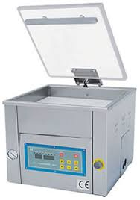
Modified Atmosphere Packaging (MAP)
Role of Gases in Shelf Life Extension
2. Nitrogen
It can also be used as a filler gas to prevent any likely pack collapse in packs with high concentrations of carbon dioxide.
Nitrogen also helps to prevent mould growth and insect attacks.

Slide 15
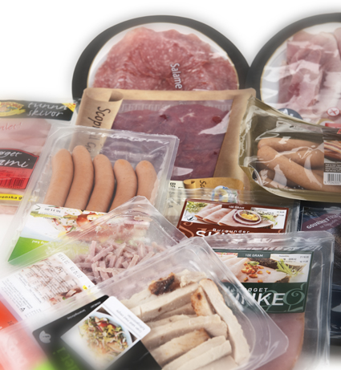
Modified Atmosphere Packaging (MAP)
Role of Gases in Shelf Life Extension
3. Oxygen
Oxygen will inhibit the growth of strictly anaerobic bacteria, but will stimulate the growth of aerobic bacteria.
Oxygen is usually excluded from the atmospheres used for fatty fish.

Slide 16
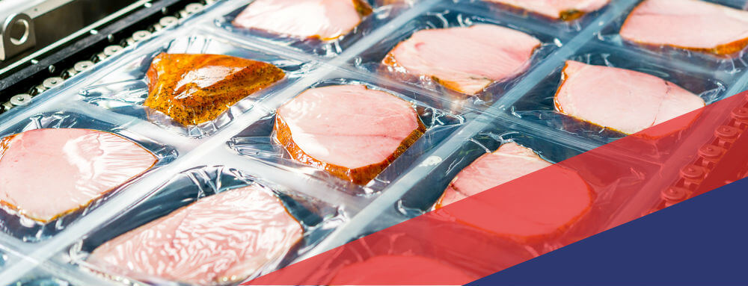
Modified Atmosphere Packaging (MAP)
Role of Gases in Shelf Life Extension
3. Oxygen
Oxygen may be included for lean fish packs.
For respiring fruits inclusion of oxygen in the atmosphere is necessary for the basic metabolism.
If the level of oxygen is maintained below 2 per cent in the atmosphere, the development of rancid odours and flavours can be greatly retarded.

Slide 17
Modified Atmosphere Packaging (MAP)
Composition of Gas Mixture:
For lean fish is 40 per cent carbon dioxide, 30 per cent nitrogen and 30 per cent oxygen.
For fatty fish, a combination of 60 per cent carbon dioxide and 40 per cent nitrogen has been found most suitable.
Extension of shelf life may achieved at 0˚C is up to nine days for lean fish, whereas at 2˚C it is only five days.

Slide 18
Thank You

