Slide 1
Class Lecture
PRINCIPLE AND METHODS OF PASTEURIZATION
Dr. Sanjeev Kumar
Associate Professor & Head
Department of Dairy Technology
SGIDT, Patna-14

Slide 2
Conti---
Conti---
Word pasteurization is derived from the name of an eminent French scientist Louis Pasteur (1860)
Pasteurization came into use on a commercial scale in the dairy industry shortly after 1880 in Germany and Denmark
Definition
According to International Dairy Federation (IDF), : ‘A process applied to a product with the object of minimizing possible health hazards arising from pathogenic microorganisms associated with milk by heat treatment, which is consistent with minimal chemical, physical and sensory changes in the product’. In general, the term pasteurization as applied to market milk refers to the process of heating every particle of milk to at least 63°C for 30 min or 72°C for 15s or to any temperature-time combination which is equally efficient, in a properly operated equipment. After pasteurization, the milk is immediately cooled to 5°C or below.

Slide 3
Conti---
Importance of Pasteurization
To render milk safe for human consumption by destroying all the pathogenic microorganisms.
To improve the keeping quality of milk by killing almost all spoilage organisms (88-99%)
Time-Temperature Combination for Specific Requirements
All pathogenic organisms ---- destroyed by pasteurization, except spore forming organisms.
The thermal death point of tuberculosis germs (Mycobacterium tuberculosis) --- slightly higher than that for inactivation of phosphatase enzyme.
Pasteurization --- carried out at a heat treatment temperature above that for phosphatase inactivation and yet below that for cream line reduction.
The pasteurization ensures complete destruction of pathogens, a negative alkaline phosphatase test and least damage to the cream line

Slide 4
Limitations of Pasteurization
Encourage slackening of efforts for hygienic milk production and may mask low quality milk. • Diminishes the cream line or cream volume. • Pasteurized milk---- increase the renneting time. • Fails to destroy bacterial toxins • In India, pasteurization -- not necessary as milk is invariably boiled by the consumers

Slide 5
Methods of Pasteurization
Low-temperature long-time (LTLT)/Batch pasteurization Milk --- heated to a minimum of 62.7°C and held at this temperature for minimum 30 min. It is then cooled as rapidly as possible to 4°C
LTLT pasteurizer of three types
Water – jacketed vat
Water–spray type
Coil-vat type

Slide 6
High-Temperature Short-Time (HTST) Pasteurization
First developed ---- A.P.V. Co. in the United Kingdom in 1922
Modern method of pasteurizing milk -- invariably used where large volumes of milk .
HTST pasteurizer gives a continuous flow of milk - heated to 72°C/15s followed by promptly cooled to 5°C or below.

Slide 7
Advantages
Capacity to heat treat milk quickly and adequately, while maintaining rigid quality control
. Less floor space required
Lower initial cost
Milk packaging can start as soon as milk is pasteurized
Easily cleaned and sanitized (system adapts itself to CIP)
Lower operating cost (due to regeneration system)
Reduced milk losses
Development of thermophiles is not a problem
Automatic precision controls ensure proper pasteurization

Slide 8
Disadvantages
system -- not well-adapted to handling small quantities of liquid milk products
Gaskets require constant attention for possible damage and lack of sanitation
Complete drainage --- not possible (without losses exceeding those from the holder system)
Margin of safety in product sanitary control --- so narrow that automatic control precision instruments required in its operation
Lethal effect on high-thermoduric bacteria in raw milk is not as great as compared to LTLT system
Accumulation of milk-stone in the heating section.

Slide 9
Conti---
Conti---
Steps or stages -- involved as milk passes through the HTST pasteurizer:
Balance tank
Pump
Regenerative heating
Holding
Flow diversion valve (FDV)
Regenerative cooling
Cooling by chilled water or brine
An arrangement for incorporation of the filter/clarifier, homogenizer, etc., in the circuit --- also made possible
2. 3. 4. 5. 6. 7.

Slide 10
Conti---
Testing of Holding Time
Holding time -- calculated between the points at which the heated milk leaves the heating section and reaches the FDV
Efficiency of pasteurization in the HTST system depends on attaining the requisite temperature along with the desired holding time
Methods - used for determining the holding time
Electrical conductivity method (of a salt solution);
Dye injection method;
Electronic timer method

Slide 11
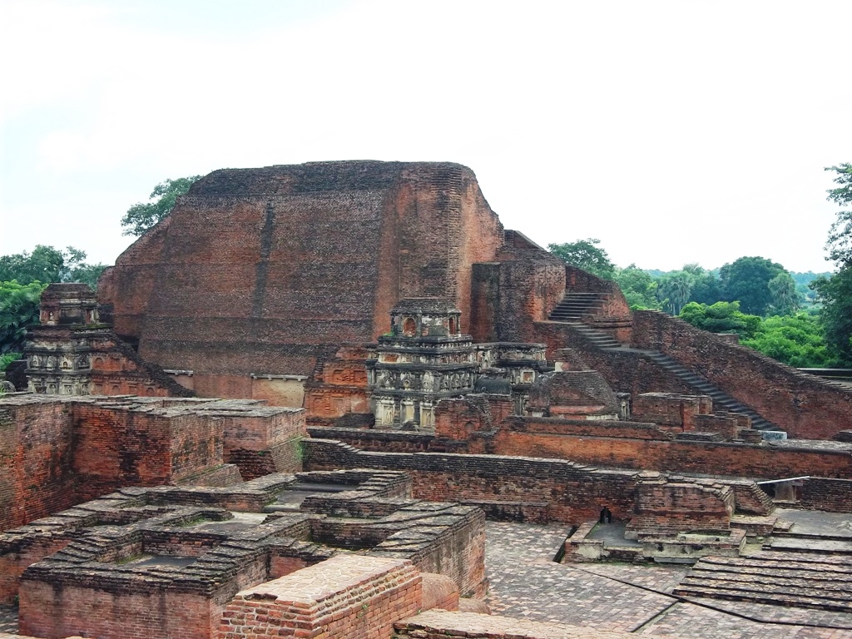
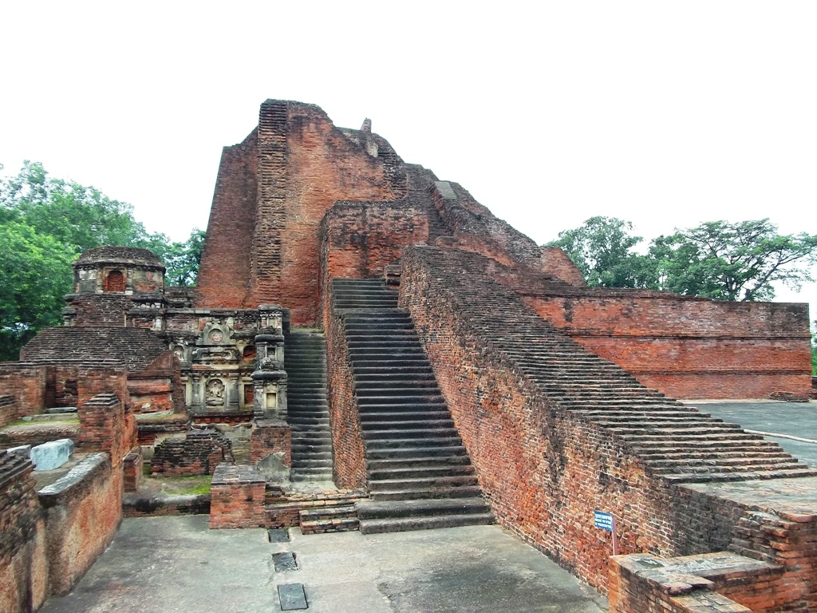
THANKs

