Slide 1
STANDARDIZATION OF MILK
Dr Sanjeev Kumar
Associate Professor & Head
Dairy Technology,
SGIDT,Patna (BASU, Patna)

Slide 2
Standardization:
Defined as the adjustment of one or more of the milk constituents to meet the legal requirement or nominated level.
In market milk industry, normally involves reducing the butterfat content by addition of skim milk or
Through the removal of cream

Slide 3
Objectives
To comply with the legal requirements for particular milk/dairy products.
To provide the consumer with a uniform product.
To ensure economics in production.
Addition of skim milk increases the volume of milk available for sale
and
Removal of cream allows the production of other value added dairy products s/a table cream, butter or other Dairy products

Slide 4
Methods of Calculation
For standardization of milk or cream for product manufacture, usually the proportions of the various ingredients of known composition to be mixed, -- required to be estimated.
Done by:
Pearson's Square method
Algebraic equations

Slide 5
Pearson’s square Method
Draw a square and place in the Centre of it the desired fat percentage.
Place at the left hand corners of the square, the fat percentage of the materials
to be mixed.
Next, subtract the number in the Centre from the larger number at the left hand side of the square and place the remainder at the diagonally opposite right hand corners.
The number on the right hand side now represents the number of parts of each of the original materials that must be blended to have the desired fat content in resultant mix
The number at the upper right corner refers to the parts of material whose fat test was placed at the upper left corner.
The number at the lower right corner refers to the parts of material whose fat test was placed at the lower left corner.
If the numbers on the right are added, the sum obtained will represent the parts of the finished product.

Slide 6
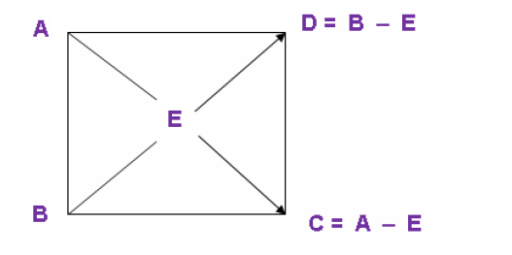

Slide 8
Numericals
Examples Problem 1
600 kg of cow milk testing 4% fat is to be standardized to toned milk by removing 33% fat cream. Calculate the amount of toned milk
Examples Problem 2
1000 kg of double toned milk (DTM) is to be prepared by mixing whole milk, testing 5.5% fat and skim milk testing 0.2% fat. Calculate the amount of whole milk and skim milk required.

Slide 9
Algebraic equations
Algebraic equations
Algebraic Equations
We have to know the composition of the products to be mixed, the final product and the quantity of any one product.
Mass balance equations are formed and solved
The formula for determining the quantities of skim milk and raw milk on this basis as follows:
Skim milk (kg) = kg standard milk required x (% fat in raw milk - % fat in standard milk)
• Whole milk (kg) = kg standard milk required x (% fat in standard milk - % fat in skim milk)

Slide 10
Conti---
Problem
Prepare 500 kg milk testing 3.0% fat and 8.5% SNF. You are provided with whole milk having 5.0% fat and 9.0% SNF and skim milk powder having 0.5% fat and 96.0% SNF.
Solution:
Let the quantity of the whole milk = X kg
Quantity of SMP = Y kg
Quantity of water = Z kg
Fat equation:
SNF equation:
X + Y + Z = 500

Slide 11
Methods of Standardization
Batch standardization
Process most commonly used in the dairies
The demerits of batch standardization -- the time taken for agitation, testing and final mixing.
Continuous standardization
Employs an inline sampler in association with a testing device, which samples,
measures and displays the fat content every 20 seconds.
Automatic standardization
An extension of the continuous process.
The separator is replaced by a microprocessor/controller unit linked to the sampler/tester system
The merits of this automatic process are time and labour savings and ensure more accurate standardization than other methods

Slide 12
Conti---
Tri-Process Machine
Tri-process machine - designed to clarify, separate, standardize milk in a single unit.
The general construction -- similar to that of standard cream separator.
The tri-process separator --- external valves in the discharge lines of cream and skim milk
A precise needle valve is fixed in the outlet for cream, which controls the cream flow rate
There is a bypass line connected from the cream discharge line to the skim milk discharge line.

