Slide 1
UNIT-I
Transport across Membranes

Slide 2
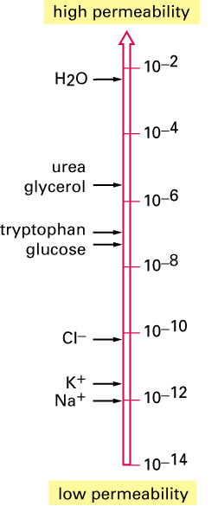
Molecules Related to Cell Permeability
Depends on
  Molecules size (electrolytes more permeable)
  Polarity (hydrophillic)
  Charge (anion vs. cation)
  Water vs. lipid solubility

Slide 3
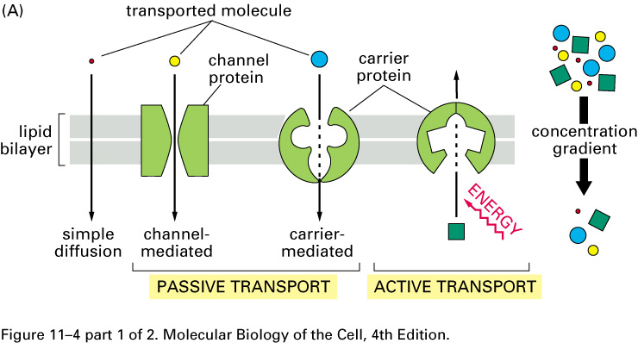
Modes of Transport

Slide 4
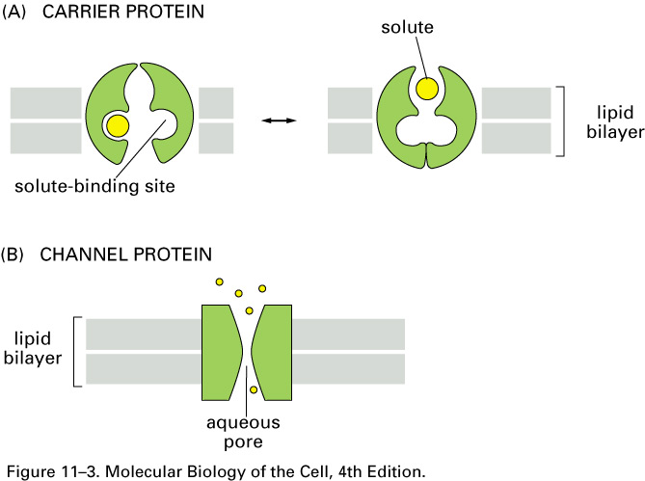
Carrier-Mediated Transport
  Integral protein binds to the solute and undergo a conformational change to transport the solute across the membrane
T

Slide 5
Channel Mediated Transport
Proteins form aqueous pores allowing specific solutes to pass across the membrane
Allow much faster transport than carrier proteins

Slide 6
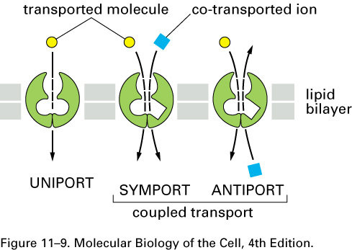
Coupled Transport
Some solutes “go along for the ride” with a carrier protein or an ionophore
Can also be a Channel coupled transport

Slide 7
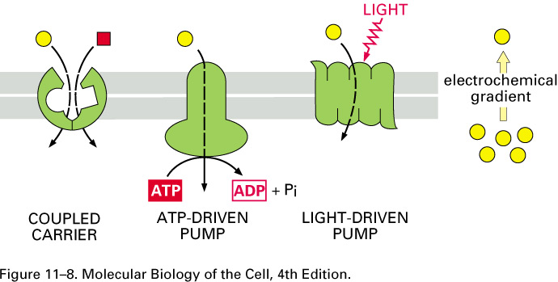
Active Transport
Energy is required

Slide 8
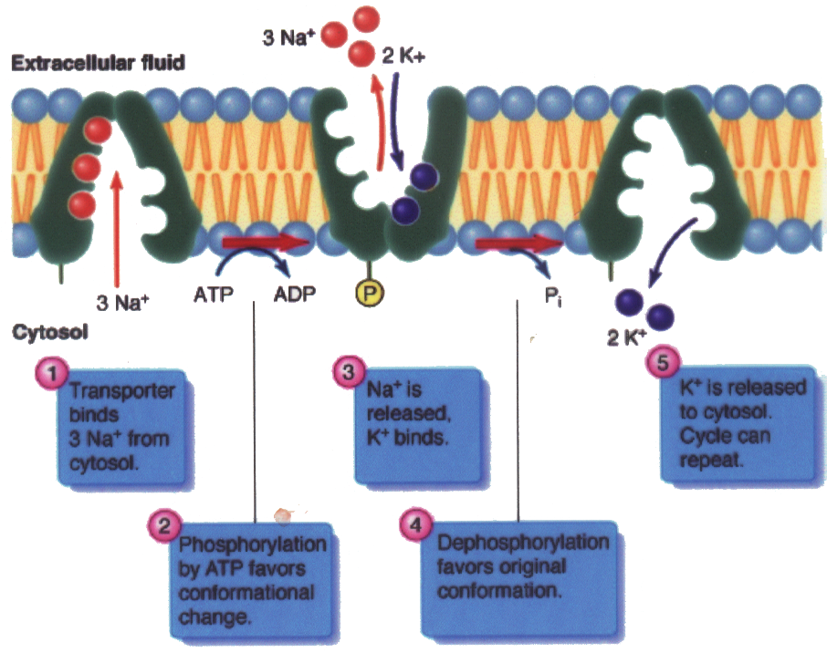
Na⁺/K⁺ Pump
Actively transport Na⁺ out of the cell and K⁺ into the cell
Against their electrochemical gradients
For every 1 ATP, 3 Na⁺ out, 2 K⁺ in

Slide 9
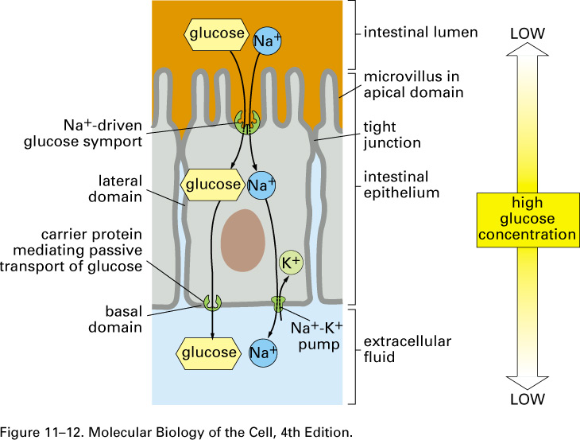
Na⁺/K⁺ Pump
Na⁺ exchange (symport) is also used in epithelial cells in the gut to drive the absorption of glucose from the lumen, and eventually into the bloodstream (by passive transport)

Slide 10
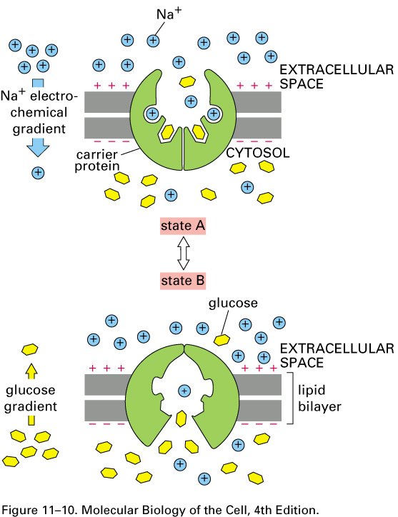

Slide 11
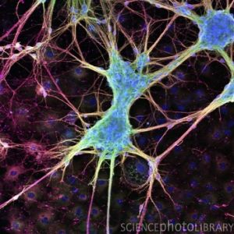
Na⁺/K⁺ Pump
About 1/3 of ATP in an animal cell is used to power sodium-potassium pumps
In electrically active nerve cells, which use Na⁺ and K⁺ gradients to propagate electrical signals, up to 2/3 of the ATP is used to power these pumps

Slide 12
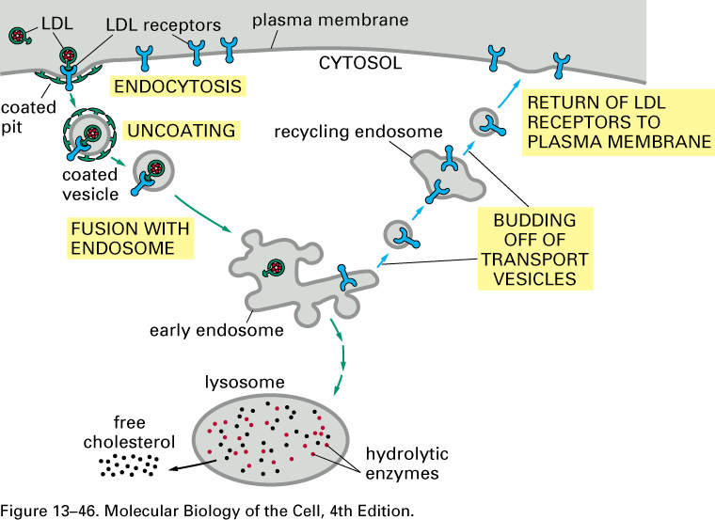
The Plasma Membrane:
3. Mechanisms for Macromolecule Transport across the PM:
B. Endocytosis:
1. Clathrin-mediated:
a. Receptors mediate binding to ligands (lipids, ligands, sol. proteins, viruses).

Slide 13
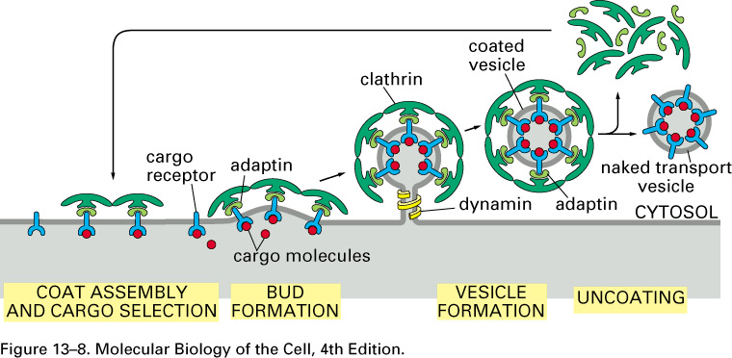
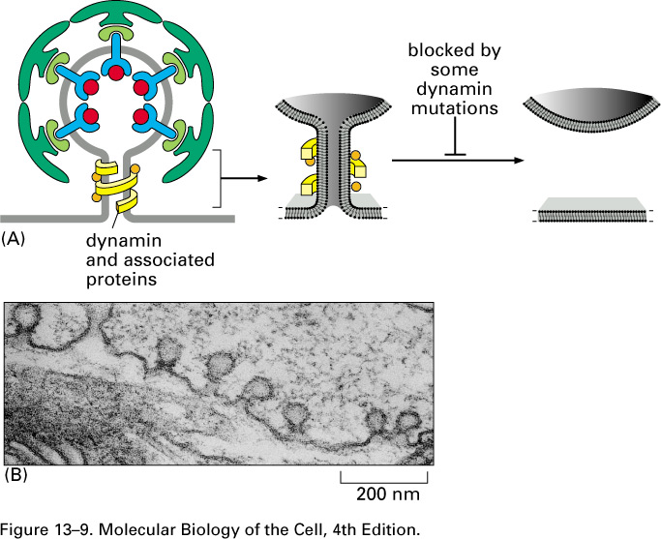
Plasma Membrane:
3. Transport Across PM:
B. Endocytosis, cont.:
1. Clathrin-mediated:
Diagrams showing
Clathrin assembly/
disassembly, and dynamin

Slide 14
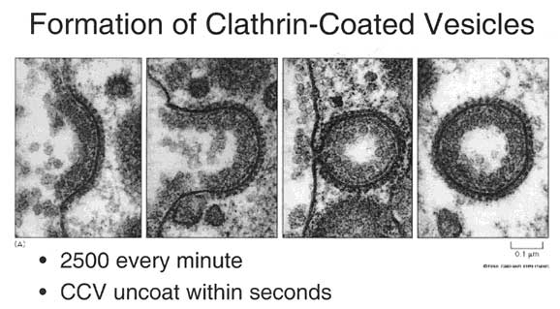
Receptor Mediated Endocytosis

Slide 15
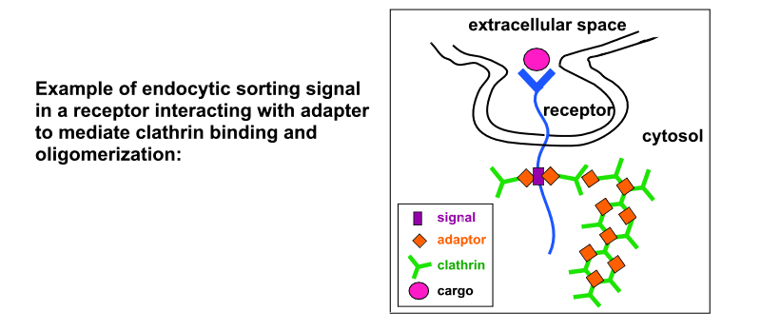
Plasma Membrane:
3. Transport Across PM:
B. Endocytosis:
1. Clathrin-Mediated:
Four types of endocytic sorting signals on cytoplasmic domain of membrane proteins that direct endocytosed proteins into clathrin-coated pits:
a. tyrosine based signals, i.e. YXXφ (φ = large hydrophobic aa); adapter= AP2
b. dileucine (LL) -containing signals; adapter = AP2
c. phosphorylated serine rich domain at the C-terminus

Slide 16
3. Mechanisms for Transport across the PM, cont.:
B. Endocytosis, cont.: Caveolar uptake
Caveolae: flask-shaped or flat, non-coated membrane invaginations, 50 - 100 nm Like lipid rafts: contain cholesterol, glycoshpingolipids, GPI-anch. proteins, receptors
Unlike lipid rafts: contain caveolin-1: 178aa, TM protein; interacts w/signaling molecules
Centers for signalling activity as well as endocytosis
Exclude receptors involved in clathrin-dependent uptake
Cholesterol depletion disturb rafts & caveolar uptake (not clathrin)
Pinching off and delivery into caveosomes which are much more stable than endosomes; these deliver cargo to ER, Golgi
Site of entry for nutrients, hormones, chemokines; also selected viruses, bacteria, parasites, and bacterial toxins.
Entry via caveolae allows pathogen to evade fusion with lysosomes and degradation.

Slide 17
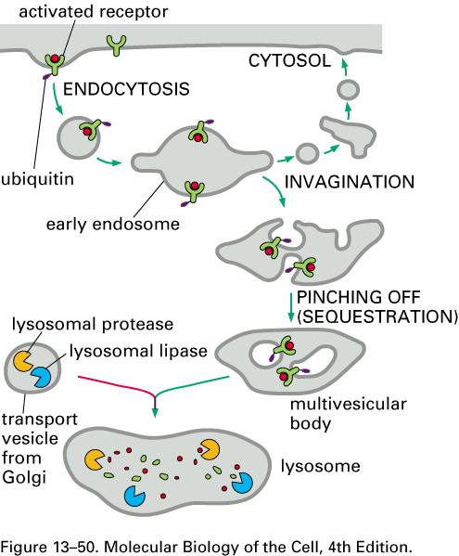
The Plasma Membrane:
3. Mechanisms for transport of macromolecules, cont.
B. Endocytosis, cont.:
3. Ubiquitin-mediated endoctyosis (UME):

Slide 18
Endocytosis and Exocytosis
Exocytosis
- membrane vesicle fuses with cell membrane, releases enclosed material to extracellular space.
Endocytosis
- cell membrane invaginates, pinches in, creates vesicle enclosing contents

Slide 19
Plasma Membrane
4. Vesicle Targeting and Fusion:
B. Machinery Involved:
NSF - (N-ethylmaleimide sensitive factor) a tetramer of identical subunits that binds and hydrolyzes ATP. Required for disassembly of SNARE complex.
SNAPs - (soluble NSF attachment protein). Act as a cofactor mediating NSF attachment to SNAREs.
SNAP-NSF Receptors (SNAREs) - a family of cognate membrane proteins. Vesicular (v)-SNAREs on vesicles form complexes with target (t)-SNAREs on target membranes, either on the same membrane (cis) or different membranes (trans). SNAREs alone can cause fusion of membranes, although most likely in cells they act as direct catalysts of fusion along with other regulatory and triggering proteins.

Slide 20
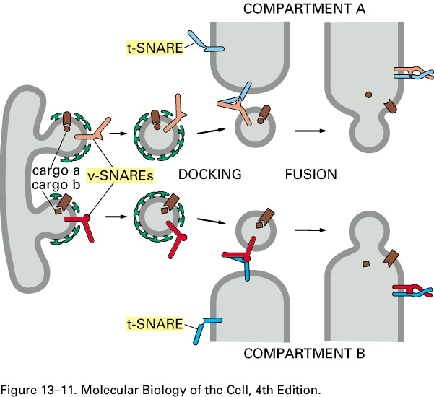
Plasma Membrane
4.Vesicular Transport & Fusion, cont.:
A. Steps in Vesicular Targeting:
3. Fusion is facilitated by SNAREs.
4. The trans-SNARE complex (now cis-SNARE) is then disrupted by the action of NSF and SNAP, which are recruited to the complex after formation of the SNARE complex, making the SNAREs available to form new complexes.
5. Recycling of the v-SNARE back to the donor compartment.

Slide 21
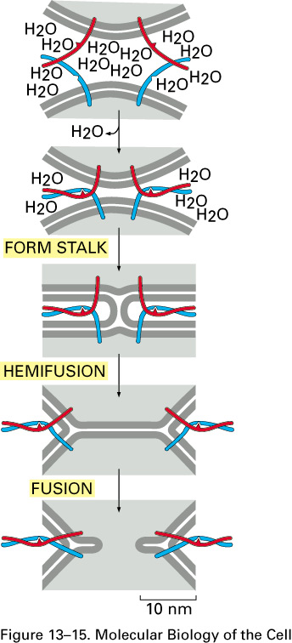
Plasma Membrane
4. Vesicle Targeting and Fusion:
C. Fusion Mechanism:
1. Docking and fusion are separate steps.
2. Fusion involves displacement of water and lipids flowing from one bilayer to the other.
3. SNARE complexes may squeeze out water molecules and pull lipid bilayers together to form fusion intermediates.
4. SNAREs are the minimal machinery required for membrane fusion
5. In vivo, other regulatory events, like calcium influx, may also be involved in triggering fusion.

Slide 22
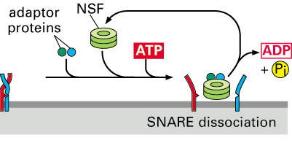
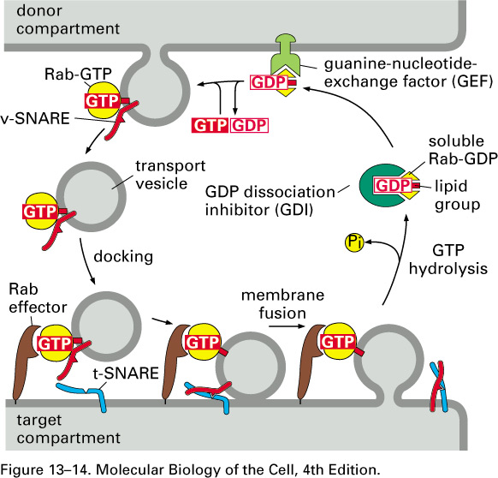
Plasma Membrane:
4. Vesicle Transport and Fusion
A. Steps in Vesicular Targeting:
1. Transport vesicle with v-SNARE is tethered to target mb by a Rab GTPase.
2. If v-SNARE on vesicle and t-SNARE on target match, then loosely tethered vesicle becomes tightly "docked".

Slide 23
Lipid Raft
A cholesterol-enriched microdomain in cell membrane.
A liquid-ordered phase dispersed in a liquid disordered matrix of cell membrane, which is thought to minimize the free energy between the two phases.
Can include and exclude proteins to variable extents.
Resistent to non-ionic detergents, such as Triton X-100 or Brij-98 at low temperatures (e.g., 4℃).
Also called DRM, DIG, DIC, GPI domain, Glycosphingolipid signaling domain, caveolae-like domain, microdomain, LDM, lipid-ordered domain, DIM, GEM and TIFF.

Slide 24
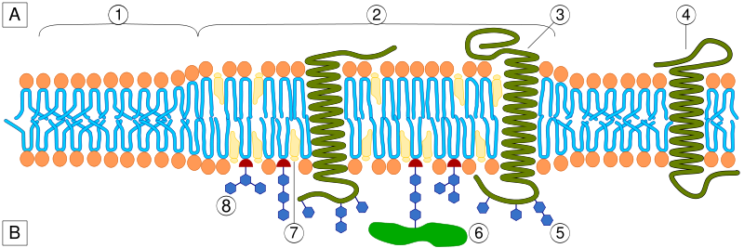
  A Intracellular space or cytosol
  B Extracellular space or vesicle/Golgi apparatus lumen
(1)Non-raft membrane (2)Lipid raft (3)Lipid raft associated transmembrane protein (4)Non-raft membrane protein
(5)Glycosylation modifications (6)GPI-anchored protein (7)Cholesterol (8)Glycolipid

