Slide 1
UNIT-I
Structure of Biological Membranes

Slide 2
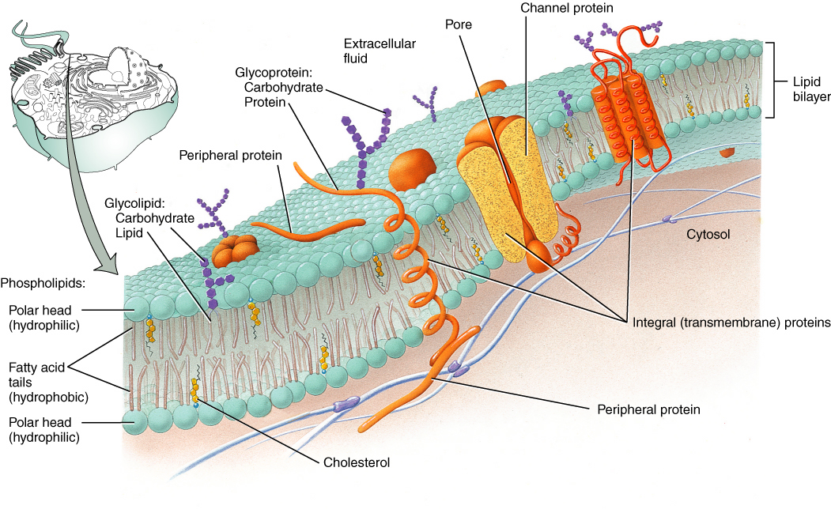
Cell Membrane

Slide 3
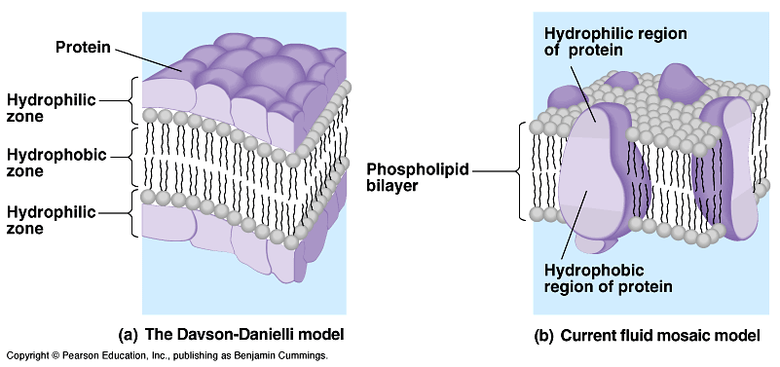
Two generations of membrane models
Notes:
3

Slide 4
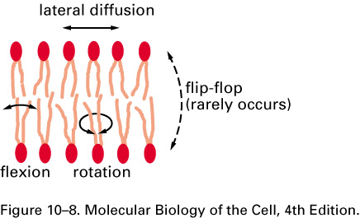
The Plasma Membrane (PM):
2. Structure: lipid bilayer ~ 5 nm thick
A. Phospholipid (PL) bilayer - impermeable to water soluble molecules.
1. Importance of lipid bilayer organization.
a. Hydrophobic fatty acid tails on inside
b. Hydrophilic fatty acid heads on outside
c. Viscous fluid: allows PLs and proteins to diffuse laterally within PM
d. limitations to fluid mosaic model:
Rafts inhibit lateral mobility
Flippase enzymes catalyze flipping to other half of bilayer

Slide 5
Fatty acids (FAs) form the basic structures of phospholipids
Simplified structure of lipid bilayer and phospholipids
Phospholipid molecule
Hydrophilic head on surface
Polar group
Hydrophilic head
water
Phosphate
Glycerol
Hydrophobic core of lipid bilayer
Hydrophobic fatty acid tails
Fatty acid-(unsaturated)
Fatty acid (saturated)
Hydrophilic head to cytoplasm
Notes:
5

Slide 6
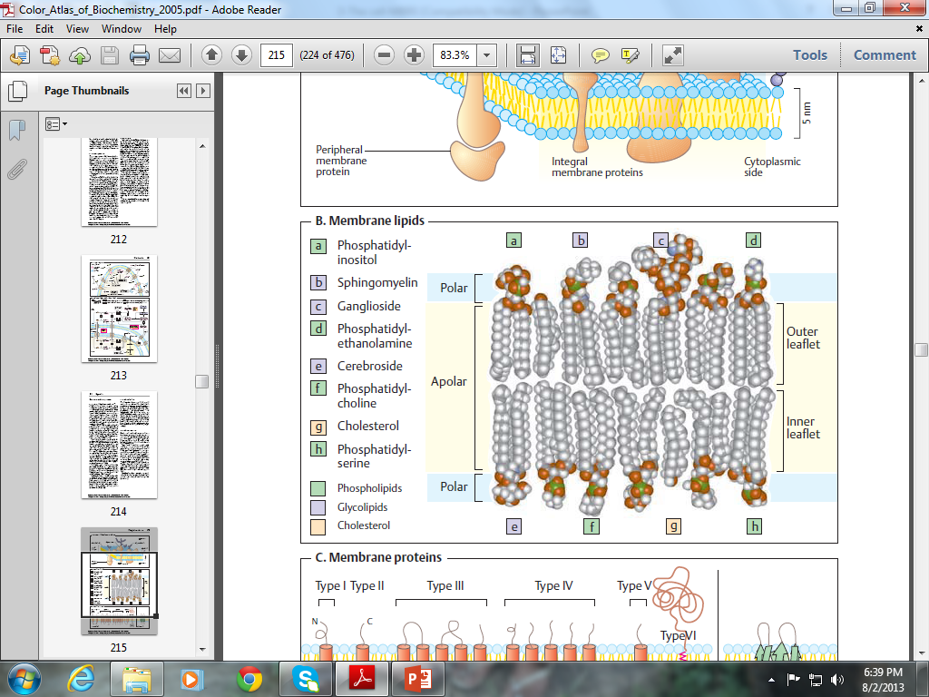

Slide 7
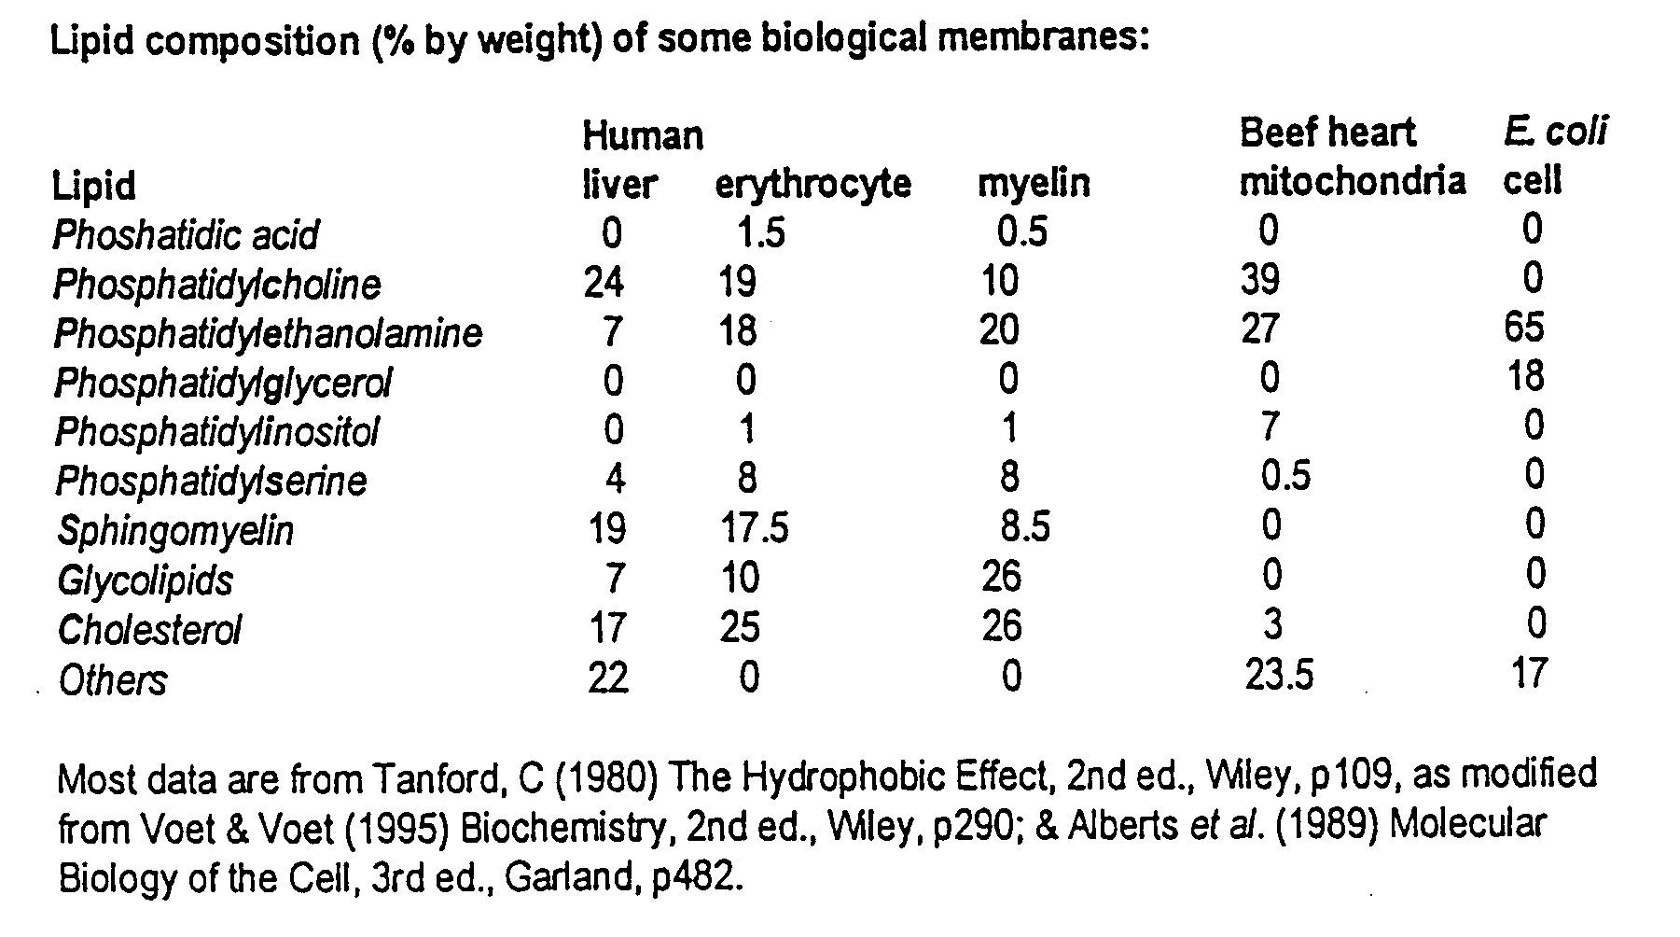
Lipid composition of different plasma membranes
Notes:
7

Slide 8
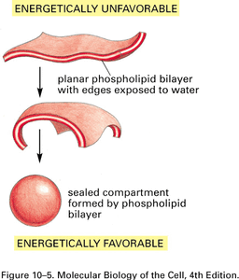
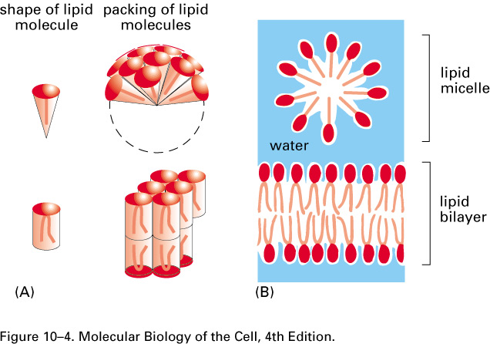
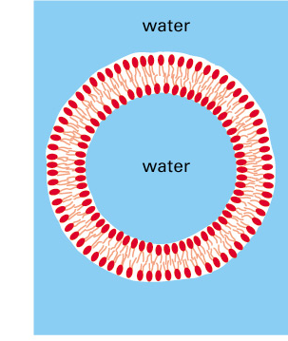
The Plasma Membrane (PM):
2. Structure: lipid bilayer ~ 5 nm thick
A. Phospholipid (PL) bilayer - impermeable to water soluble molecules.
1. The behavior of lipids: micelles vs. vesicles.

Slide 9
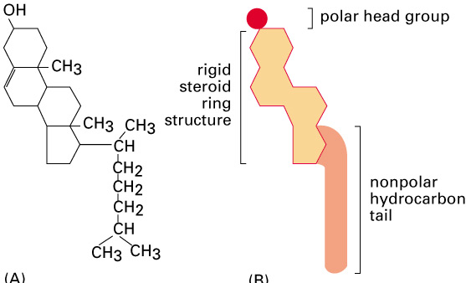
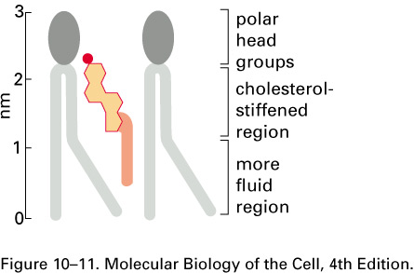
The Plasma Membrane (PM):
2. Structure, cont.:
A. Phospholid Bilayer.:
2. Phospholipid (PL) composition, mammalian cells:
4 major PL (~50% of PM lipid); 1 minor PL:
  a. phosphatidylcholine (PC) & sphingomyelin (SM) - mainly in outer leaflet.
  b. phosphtidylethanolamine (PE) & phosphatidylserine (PS) - inner leaflet
  c. phosphatidylinositol (PI) - minor component in cytosolic leaflet but important for signaling.
  d. PS and PI - negatively charged, giving net negative charge to cytosolic face.
  3. Glycolipids: ~2 % of PM lipid; exclusively in out leaflet (non-cytosolic)
4. Cholesterol: rigid with polar hydroxyl group facing out. 5 % of PM lipid
maintains membrane structure at High/Low temps
not present in bacteria
Cholesterol with phospholipids
Cholesterol

Slide 10
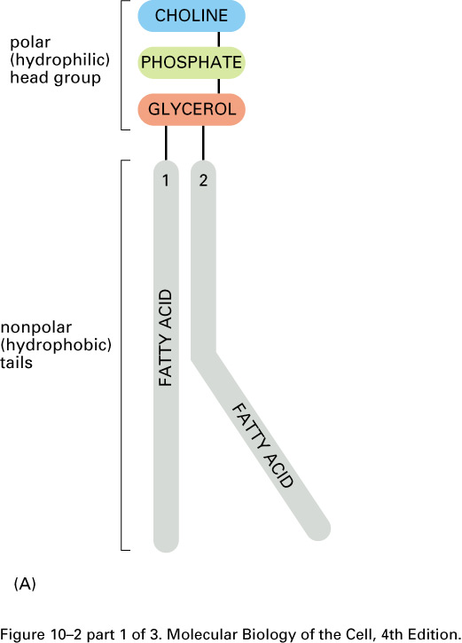
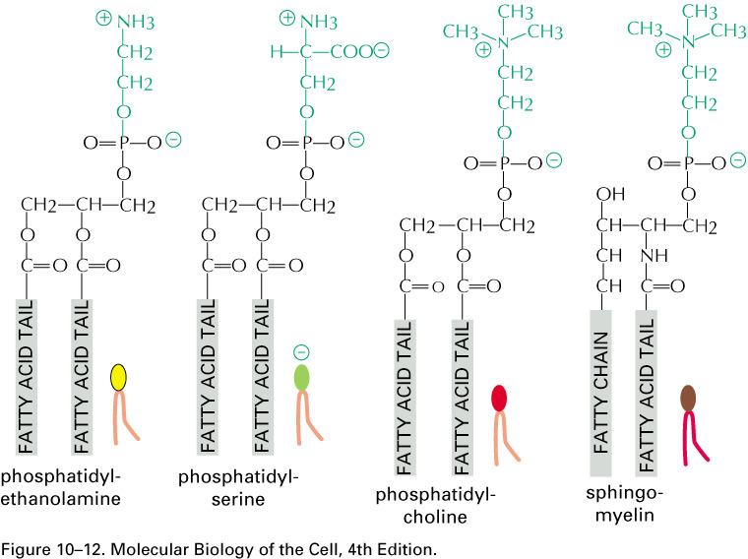
The Plasma Membrane (PM):
2. Structure, cont.
A. Phospholipid Bilayer:
4. Molecular Structures: all are amphipathic
a. PL = glycerol attached to 2 FA phosphate and different side groups (PE, PS, PC)
b. SM = serine attached to 2FA phosphate and choline side group
c. PI = minor phospholipid critical for signaling; inositol ring can be phosphorylated
d. Cholesterol = complex hydrocarbon ring structure
Phospholipids

Slide 11
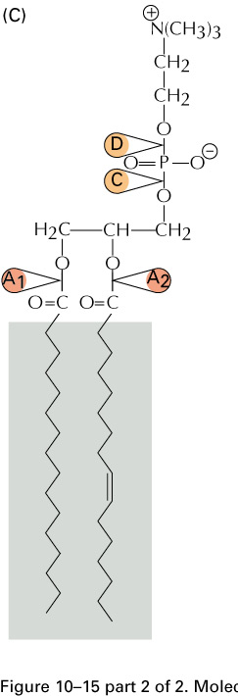
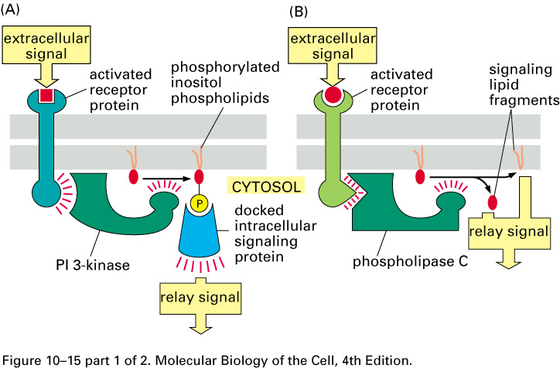
The Plasma Membrane (PM):
2. Structure, cont.
A. Phospholipid Bilayer:
4. Phosphoinositol - has a ring structure that can be phosphorylated; also cleavage of this ring results in formation of 2 new structures that are both active in signaling (DAG and IP3).
Phospholipase cleavage
Signaling by PI in PM:

Slide 12
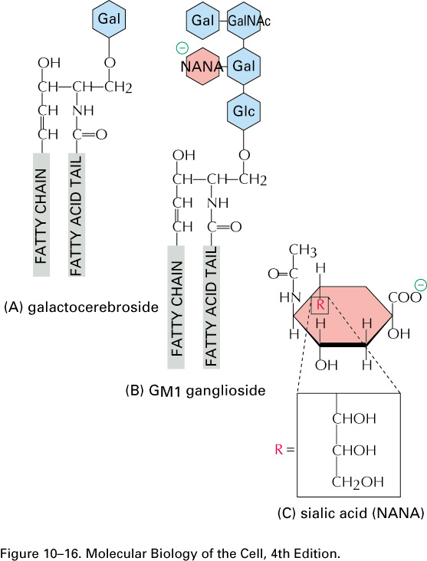
The Plasma Membrane (PM):
2. Structure, cont.
A. Phospholipid Bilayer:
4. Molecular Structures: all are amphipathic
e. Glycolipids = lipid with sugar molecules attached
Glycolipids

Slide 13
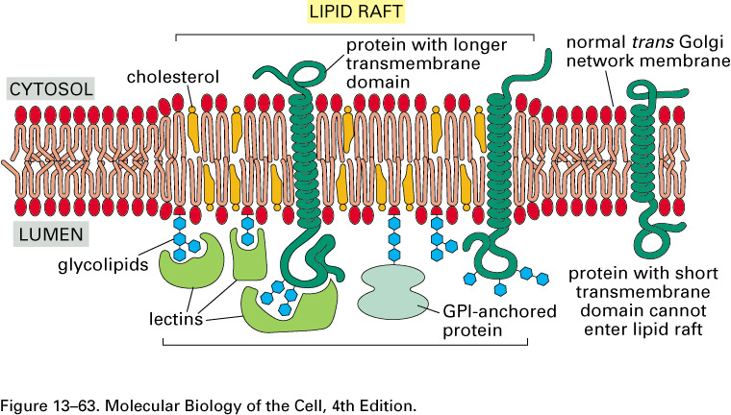
The Plasma Membrane (PM):
2. Structure, cont.:
A. Phospholipid Bilayer:
5. "Lipid rafts": dynamic regions of the plasma membrane enriched in cholesterol, sphingomyelin, glycolipids, GPI (glycosylphosphatidylinositol)-anchored proteins and some membrane proteins.
  Important for signaling.
Important as sites for entry of viruses.
Markers for clathrin-mediated endocytosis are NOT PRESENT in rafts.
Insoluble in cold detergent; dispersed by cholesterol depletion (methyl-β-cyclodextrin).

Slide 14
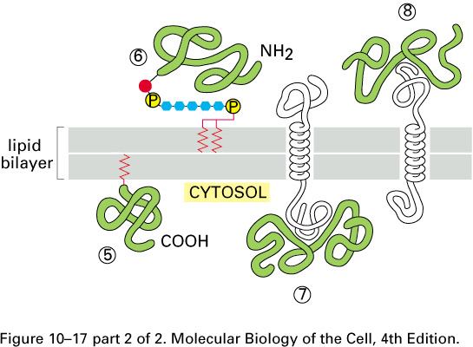
The Plasma Membrane:
2. Structure:
B. Membrane associated proteins (MP):
a. PM consists of 50% protein; 50% lipid.
b. MP mediate selective traffic of molecules into and out of cell.
c. Peripheral MP: dissociate from PM with high pH or high salt (carbonate extraction, pH 10). hydrophilic, assoc.via prot.-prot. interactions.
d. Integral MP: released from PM only by solubilizing membranes with detergents. many are transmembrane proteins that span the bilayer.
Membrane associated proteins (MP):

Slide 15
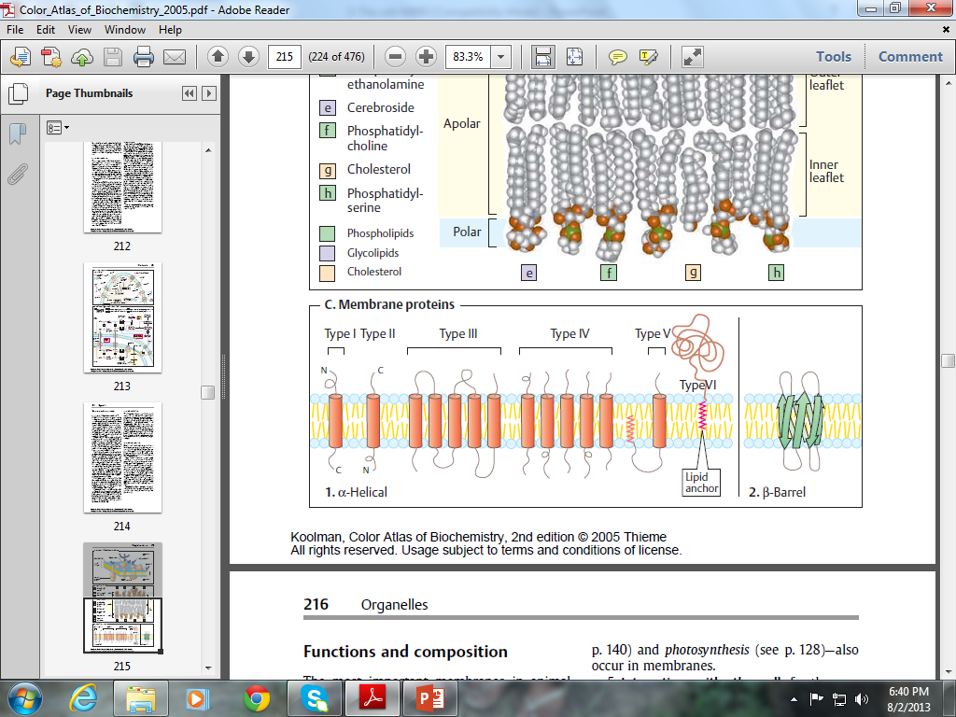

Slide 16
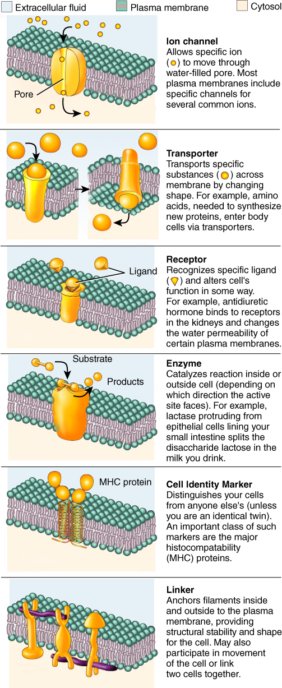
Ion channel
Transporter
Receptor
Enzyme
Cell Identity marker
Linker

Slide 17
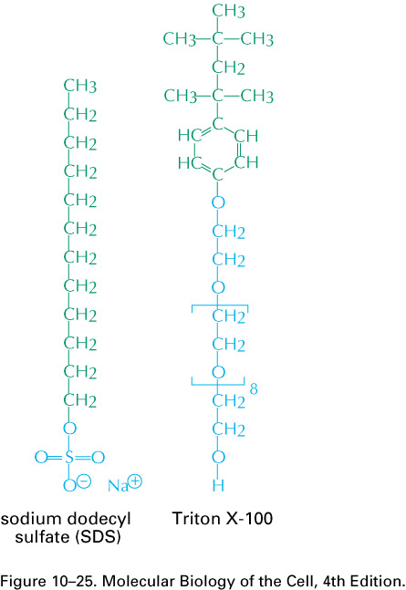
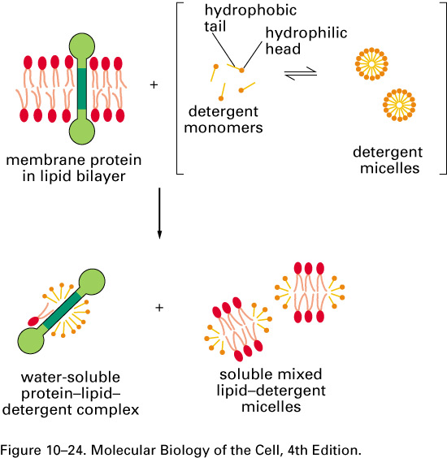
The Plasma Membrane:
2. Structure:
C. Use of Detergents:
a. Non-ionic detergents solubilize membranes and membrane proteins without denaturing proteins
b. Ionic detergents solubilize membranes and denature proteins

Slide 18
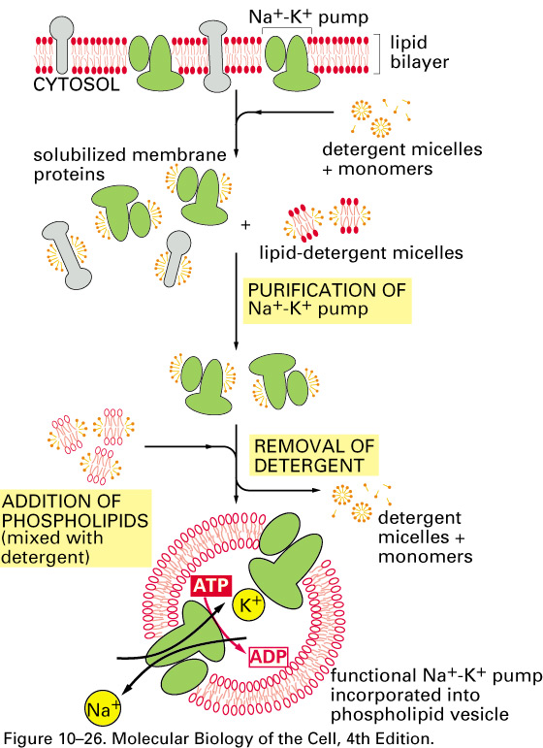
The Plasma Membrane:
2. Structure:
C. Use of Detergents:
Vesicle Reconstitution

