Slide 1
Class Lecture
CHEMICAL PROPERTIES
&
NUTRITIVE VALUE OF MILK
Dr. Sanjeev Kumar
Associate Professor & Head
Department of Dairy Technology
SGIDT, Patna-14

Slide 2
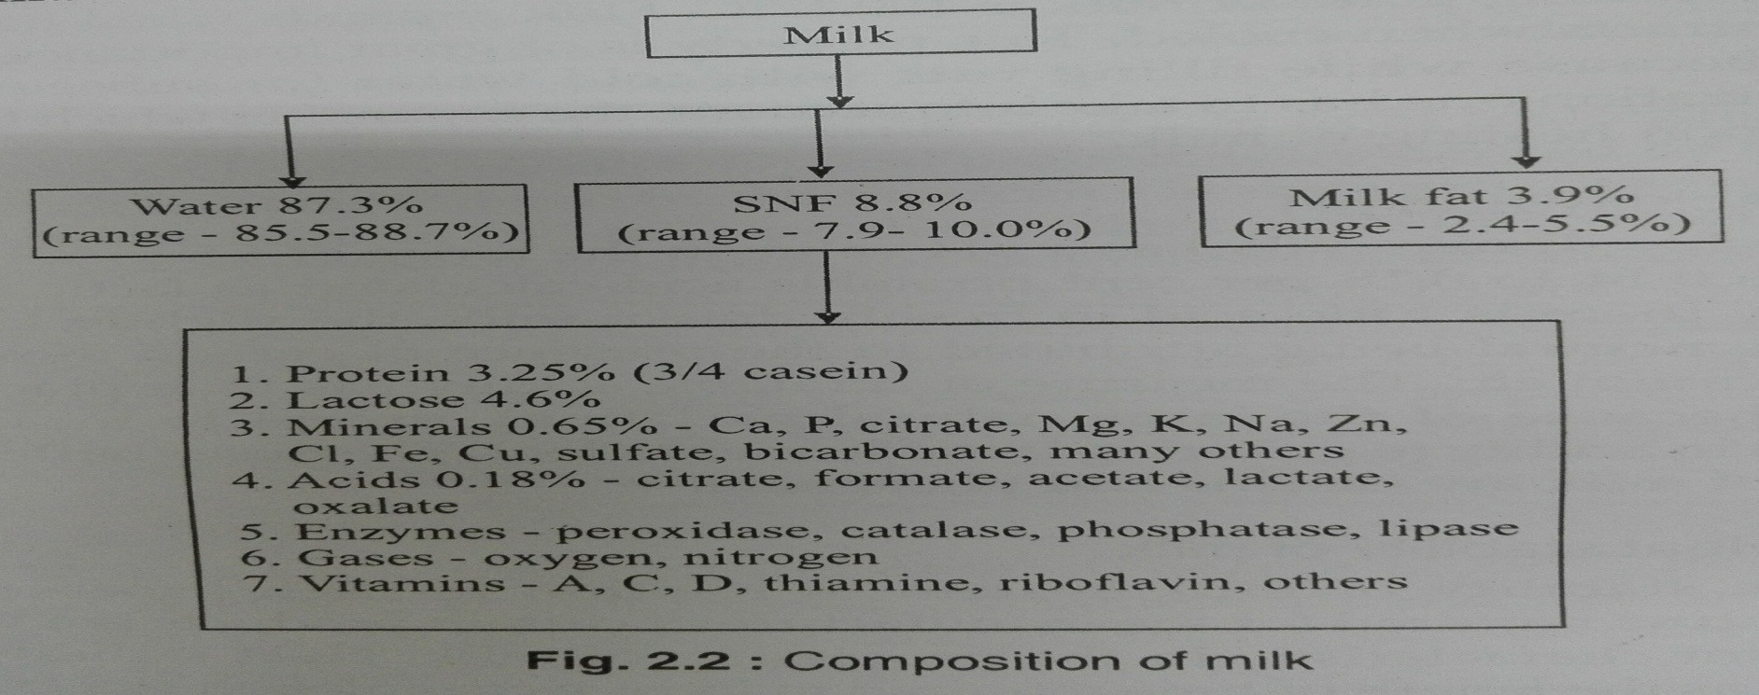
Chemical Properties of Milk
Milk is a true aqueous solution of lactose, salts and a few other minor compounds, which is emulsified with fat and supports a colloidal dispersion of proteins.

Slide 3
Water
Water forms the largest fraction of milk and ranges from 83-87%
Water content of milk varies from species to species and breed to breed
Water serves as a carrier for the other constituents of milk
A small amount of water in milk is hydrated to lactose and salts and also bound in the proteins.

Slide 4
Fat
Fat - the most commercially significant constituent of milk
Also the most variable fraction in milk
Fat contents varies from breed to breed and also among individuals of the same breed, the variation being caused by many factors
Milk fat - present as a suspension of small globules of varying diameter (cow milk fat: 3-8 µm, buffalo milk fat: 4-10 µm)
Fat comprises of different glycerides of low melting point
Composition of fat varies with the feed plan, nutrition, stage of lactation, breed and species, the first being the most important

Slide 5
Fat
Size and number of fat globules vary depending on the breed of the animal and method of milking
Globules become smaller and more numerous as lactation advances
Machine milking produces fat globules of more uniform size than hand milking
Buffalo milk fat -- more easily churned into butter than cow milk fat.
Milk of animals in advance lactation is less suitable for being churned into butter.
Milk fat is quite bland in taste and imparts smoothness and palatability to fat-containing dairy products.

Slide 6
Fat
Mixed glycerides make up to 98-99% of the milk fat.
Numerous triglycerides may be present in milk fat, since milk contains as many as 64 fatty acids.
Butyric, Caproic, caprylic and capric acids, present in high proportions, --
characterized by strong odours and flavour.
Milk fat also contains cholesterol, thus differentiating-- vegetable fats, which contains phytosterols.
Milk contains 0.1 to 0.23% phospholipids, viz. lecithin, phosphatidyl serine, sphingomyelin, inositol and cerebrosides

Slide 7
Major fatty acids in milk (in 100 g)

Slide 8
Physical properties of milk fat

Slide 9
Physical properties of milk fat
Four most abundant fatty acids in milk -- myristic, palmitic, stearic and oleic acids
Presence of a high content of high-melting fatty acids, such as palmitic acid, results in harder fat
Fat with a high content of low-melting oleic acid makes soft butter
Melting points of individual triglycerides range from -75°C for tri-butyric glycerol to 72°C for tri-stearin
Nevertheless, the final melting point of milk fat is at 37°C because higher melting triglycerides dissolve in the liquid fat
Trans-unsaturation increases melting points, whereas odd-numbered and branched chains decrease melting points

Slide 10
Chemical properties of milk fat
All fats belong to a group of chemical substances--esters, compounds of alcohols and acids
Milk fat is a mixture of different fatty acid esters --- triglycerides, composed of an alcohol called glycerol and various fatty acids
Fatty acids make up about 90% of milk fat
A fatty acid molecule -- composed of a hydrocarbon chain and a carboxyl group (formula R-COOH).
Saturated fatty acids, such as myristic, palmitic, and stearic constitute two thirds of milk fatty acids
Oleic acid with a single double bond -- the most abundant unsaturated fatty acid in milk

Slide 11
Chemical properties of milk fat
Distribution of fatty acids on the triglyceride chain -- important when determining the physical properties of the lipids
In general, the position 1 binds mostly longer carbon length fatty acids, and the position 3 binds mostly shorter carbon length and unsaturated fatty acids
For example, 97% of C4 and 84% of C6 are associated with position 3 whereas 58% of C18 binds to position 1
Certain other classes of lipids include phospholipids (0.8%) and cholesterol (0.3%), -- mainly associated with the fat globule membrane and core of the in the fat globule, respectively

Slide 12
Creaming
Most of the (> 95%) milk fat exists in the form of globules of 0.1-15 μm diameter
A thin membrane (8-10 nm thick) covers these liquid fat droplets
The major components of the native fat globule membrane are protein and phospholipids
IgM - an immunoglobulin in milk, forms a complex with lipoproteins. This complex, known as cryoglobulin, precipitates onto the fat globules and causes flocculation. This is known as cold agglutination. Thus cream layer forms very rapidly (within 20 to 30 minutes) in cold raw milk.

Slide 13
Milk proteins
Amino acids form the building blocks of proteins.
Contain both a weak basic amino group, and a weak acidic carboxyl group, both connected to a hydrocarbon chain, which is unique to different amino acids.
Joined together in random order by the peptide linkage to form the polypeptide chains.
May further be cross-linked by disulphide bridges forms -primary structure of proteins.
If the protein - tightly coiled and folded into a somewhat spherical shape, -called a globular protein.

Slide 14
Milk proteins
If the protein consists of long polypeptide chains which are intermolecularly linked, - Fibrous proteins.
The caseins, whey proteins and non-protein nitrogen (NPN) make up the nitrogen content of milk.
Caseins : 76%
whey proteins: 18%
Non-protein nitrogen: 6%

Slide 15
Concentration of proteins in milk

Slide 16
Caseins
Casein constitutes about 80% of the total proteins present in milk. It is a phosphoprotein.
The viscosity and white colour of milk are largely due to casein.
All caseins precipitate at pH 4.6. Compositionally, -- all conjugated proteins, most with phosphate group(s) esterified to serine residues.
Phosphate groups are important to the structure of the casein micelle.
In addition, calcium binding by the individual caseins is proportional to the phosphate content.
Caseins -- distinguished by the absence of disulphide bonds and a large number of proline residues which cause bending of the protein.

Slide 17
Conti----
This peculiar bending prevents the formation of a tightly packed secondary structure.
Caseins -- stable to heat denaturation because of the lack of tertiary structure, leading to little structure that will unfold.
Insolubility of caseins in water also --- to the absence of tertiary structure, which results in the exposure of large umber of hydrophobic residues.
Casein micelles aggregate by the action of enzymes, acid, heat or due to age- gelation.

Slide 18
Properties of casein fractions

Slide 19
Whey proteins
Green clear liquid that separates out of milk after precipitation of caseins at pH 4.6 --- whey and
Proteins contained therein are whey proteins.
Native whey proteins ---- good gelling and whipping properties.
Denaturation increases their water holding capacity.

Slide 20
Major whey protein fractions

Slide 21
Beta-lactoglobulin including eight genetic variants, comprises approximately half the total whey proteins
Coagulated by heat, explaining why colostrum curdles when heated
Binds fat soluble vitamins, making them more available to the body and provides an excellent source of essential and branched chain amino acids
Help prevent muscle breakdown and spare glycogen during exercise
May be required in some individual with liver conditions, such as Cirrhosis

Slide 22
Alpha lactalbumin --- not coagulated by rennet or acids
but precipitated by heat, the extent of coagulation being governed by temperature of holding, salt concentration and pH of milk
The primary protein found in human breast milk
Alpha lactalbumin -- an excellent source of essential amino acids
Potential benefits include sleep regulation and mood improvement under stress
Only whey protein component capable of binding calcium.

Slide 23
Immunoglobulins provide non-specific humoral protective effect to the offspring against entero-pathogenic micro-organisms.
Predominant whey protein component found in colostrum.
Bovine milk contains only traces of IgA.
Bovine serum albumin (BSA) -- a large sized protein with a good essential amino acid profile and fat binding properties.

Slide 24
Lactoferrin - a red-coloured protein, capable of chelating iron
Inhibits enteropathogenic organisms due to its ability to bind iron, as iron is an essential nutrient often required for bacterial growth
Promotes the growth of beneficial bacteria such as bifidobacteria
Lactoferrin -- an anti-oxidant that naturally occurs in many body secretions such as tears, blood, breast milk, saliva and mucus
Lactoperoxidase and Lysozyme -- enzymes that have antibacterial activities.
Exhibits immunity enhancing properties.
Although lysozyme from egg white - more industrial applications in the past,
Enzyme isolated from human or bovine milk - far greater lytic activity compared to egg lysozyme

Slide 25
Milk enzymes
Milk contains both indigenous and exogenous enzymes
Exogenous enzymes mainly consist of heat-stable lipases and proteinases produced by psychrotropic bacteria
The indigenous enzymes that have been isolated from milk are lipase, aryl esterase, alkaline phosphatase, acid phosphatase, xanthine oxidase, peroxidase, protease, amylase, catalase and lactase (β-galactosidase)
The most significant group is the hydrolases, comprising of lipoprotein lipase, plasmin and alkaline phosphatase
Lipoprotein lipase is found mainly in the plasma in association with casein micelles

Slide 26
Milk enzymes
Plasmin is a proteolytic enzyme that attacks both β-casein and α-s2-casein
It is very heat stable and responsible for the development of bitterness in pasteurized milk and UHT processed milk
It also plays a role in ripening and flavour development of certain cheeses, such as Swiss cheese
Alkaline phosphatase splits specific phosphoric acid esters into phosphoric acid and the related alcohols
Unlike most milk enzymes, it has a pH and temperature optima differing from physiological values; pH of 9.8
The enzyme is destroyed by minimum pasteurization temperatures and, therefore, its absence is an indicator of efficient pasteurization

Slide 27
Non-protein nitrogenous (NPN) substances
Besides proteins, milk contains NPN substances like amino acids, creatine, urea, uric acid, creatinine and hipuric acid

Slide 28
Lactose
In addition to lactose, fresh milk contains other carbohydrates in small amounts, including glucose, galactose, and oligosaccharides
Lactose constitutes 4.8 to 5.2% of milk, 52% of milk SNF, and 70% of whey solids
Lactose is the least variable, yet most unstable constituent of milk being quickly fermented by micro-organisms
Lactose is not as sweet as sucrose. It is a disaccharide (2 sugars) made up of two monosaccharides, glucose and galactose.
This sugar crystallizes in an alpha form and results in the defect called sandiness

Slide 29
Molecular structure of lactose

Slide 30
Vitamins
They are essential to normal life processes, but cannot be synthesized by the body
Milk contains the both water and fat soluble vitamins
As milk fat is an important dietary source of vitamin A, low fat products are normally supplemented with vitamin A
Grass feeding enhances its level in the milk
Milk is fairly good source of water soluble B vitamins such as thiamine (B1), riboflavin (B2), niacin(b3), pantothenic acid (B5), pyridoxine (B6) and cyanocabalamin (B12).
Milk is a poor source of vitamin C (ascorbic acid). The little that is present in raw milk is very heat-labile and easily destroyed by pasteurization.

Slide 31
Vitamin content of fresh milk per (100g)

Slide 32
Minerals
Minerals have many roles in the body including enzyme functions, bone formation, water balance maintenance, and oxygen transport.
Although they constitute less than 1% of milk, they influence the heat stability and clumping of fat globules after homogenization.
All 22 minerals considered essential to the human diet are present in milk.
Milk is an important source of dietary calcium. It is also a good source of magnesium, phosphorus, potassium, selenium and zinc.

Slide 33
Minerals
In milk approximately 67% of the calcium, 35% of the magnesium, and 44% of the phosphate are salts bound within the casein micelle and the rest are soluble in the serum phase.
The nutritional availability of calcium and phosphate are not affected by their association with salts and protein.
Milk contains very small amounts of copper, iron, manganese, and sodium and is not consider a major dietary source of these minerals.
Other minerals such as aluminium, boron, zinc, cobalt, iodine, fluorine, molybdenum, nickel, lithium, barium, strontium and silica are also present in milk.

Slide 34
Mineral content of fresh milk (per 100 g)

Slide 35
Buffalo Milk
Buffalos convert poor quality roughages and crop residues into milk more efficiently, thus contributing more significantly towards milk production in India.
The main source of marketable surplus of milk in India is buffalo milk.
It has certain unique technological advantages compared to cow milk, because of the innate differences in qualitative and quantitative aspects of various constituents and physico-chemical properties of the two milks.

Slide 36
Gross composition of milk – Buffalo Vs Cow

Slide 37
Buffalo milk fat
Buffalo milk is richer than cow milk in fat content, which contribute to its unique taste.
The fat globules are larger than those in cow milk.
The average cholesterol content of buffalo milk is 20 mg/100 ml which is significantly higher than that of cow milk.
Buffalo milk has higher proportions of butyric, stearic and palmitic acids and lower levels of caproic, caprylic, myristic and linoleic acids.
It contains higher levels of tetraenoic and pentaenoic acids in its fat makeup. The total level PUFA and free fatty acids (FFA) are lower than that in cow milk.

Slide 39
Buffalo milk proteins
Buffalo milk protein is particularly rich in casein and whey proteins.
The proportions of protein fractions, however, are similar in milk of both species.
Almost all the casein in buffalo milk (94.8%) is in micellar form.
The casein micelle size is large and varies from 80-250 nm in contrast to cow milk where the casein micelle size ranges from 70-110 nm.
Buffalo milk is richer in lactoferrin content than cow milk. Raw buffalo milk exerts greater inhibitory action on growth of bacteria than cow milk, which is attributed to higher lactoferrin content of buffalo milk.

Slide 40
Buffalo milk vitamins and minerals
Buffalo milk contains similar contents of vitamins and higher levels of minerals than cow milk.

Slide 41
Buffalo milk vitamins and minerals

Slide 42
Enzymes in buffalo milk
It contains lower concentration (one third) of alkaline phosphatase than cow milk. The activity of the enzyme in buffalo milk is ~ 0.12-0.18 units/ml.
Buffalo milk has slightly lower lipase activity (13.2 units) as compared to 17.2 units in cow milk.
It has nearly 24% higher peroxidase activity than cow milk.
The thermal stability of buffalo milk lactoperoxidase is also higher than that of cow milk.
Lysozyme content of buffalo milk is 15.2 mg/100 ml which is lower than cow milk.

Slide 43
Microbiology of milk
Useful, spoilage causing and pathogenic
Milk in the mammary gland is almost sterile
bacteria can be found in mammary glands of unhealthy animals
Once milk lefts the animal body, microflora from udder, coat of the animal, atmosphere, utensils and workers easily pass into the milk
Therefore, even under scrupulously clean conditions, freshly drawn milk may have a few thousand bacteria

Slide 44
Lactic acid bacteria
Fermented lactose to lactic acid, employed as starter cultures
Lactococci – Lactococcus lactis subsp. lactis, Lactococcus lactis subsp. cremoris
Lactobacilli – Lactobacillus casei, Lactobacillus delbrueckii subs. lactis, Lactobacillus delbrueckii subs. bulgaricus
Leuconostoc - Leuconostoc citrovorum

Slide 45
Spoilage causing microorganisms
Streptococcus liquifaciens – Forms acid and gas with objectionalble proteolysis
Aerobactor aerogenes, Bacillus polymyxa, Clostridium butyricum – Gas forming bacteria
Alcaligenes viscosus – Ropy or slimy milk forming
Bacillus cereus – Sweet curdling
Pseudomonas flourescenes and Pseudomonas fragi – can grow at low temperatures (phycrotrophic) – produce heat resistant proteolytic and lipolytic extracellular enzymes can cause spoilage

Slide 46
Pathogenic microorganisms
Bacillus cereus
Listeria monocytogenes
Salmonella spp.
Escherichia coli O157:H7
Campylobacter jejuni

Slide 47
Nutritive value of milk
Lipids
Energy dense, fat soluble vitamins (A,D,E, K)
Phospholipids – vital parts of brain and nervous system
Conjugated linoleic acid (CLA) isomers present in milk – anti-carcinogenic effect

Slide 48
Nutritive value of milk
Proteins
Proteins contribute to building and repair of body, acts as antibodies, supply energy
One litre of milk provides bout 50% of recommended daily allowance of protein for adults
Casein has protein efficiency ratio (PER) = 2.89 to 3.10
Beta-lactoglobulin – binder and transporter of retinol, carrier of antibodies

Slide 49
Nutritive value of milk
Lactose
Promotes growth of lactobacilli in intestine that synthesize many B vitamins
Lactose fermentation by lactobacilli bacteria produces lactic acid – it will check growth of undesirable microorganisms
Lactose improves the absorption of calcium, phosphorous and magnesium
Lactose being slowly digested and absorbed – used in slimming diets and it also discourages fat absorption in body

Slide 50
Nutritive value of milk
Minerals
Function as components of skeletal tissues, activators of enzymes, acid-base regulators, osmotic pressure regulators, controllersof muscle excitability
Bone building
The absorption of calcium from milk is high and is promoted by presence of lactose, amino acids lysine and arginine, citric acid and vitamin A
Even though, Iron is present in very less amount in milk, it is completely absorbed from milk than any other iron rich foods

Slide 51
Nutritive value of milk
Vitamins
Acts as biochemical regulators and co-enzymes
Vit A – vision, keeps skin clear, keeps mucous membranes healthy
Vit E- antioxidant activity
Vit D – helps in absorption of calcium and phosphorous
Vit K – required for synthesis of prothrombin hence helps in normal blood clotting

Slide 52
Nutritive value of milk
Vitamins
Riboflavin – aids in oxygen uptake, and helps in adapting the eye to light
Thiamine – required for normal appetite and digestion
Vit B12 and Folic acid – required for synthesis of red blood cells and nucleic acids
Niacin – aids in keeping nervous and digestive system healthy

Slide 53
Milk Procurement Systems

Slide 54
Rural Milk Collection
At village level, milk brought by the individual farmers is first tested for quality
Milk from Individual farmers
Weighing
Fat
Taste
Take representative sample for quality check
Smell
SNF
Sediment
Acidity
Accept or Reject the milk
After acceptance, Milk received from individual farmers is collected in milk cans (generally 40 lit capacity Al/Steel/Plastic cans are used)

Slide 55
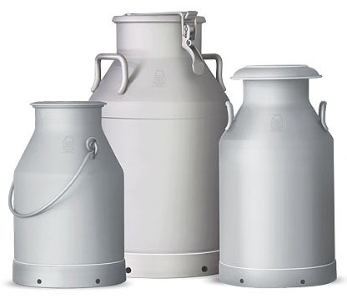
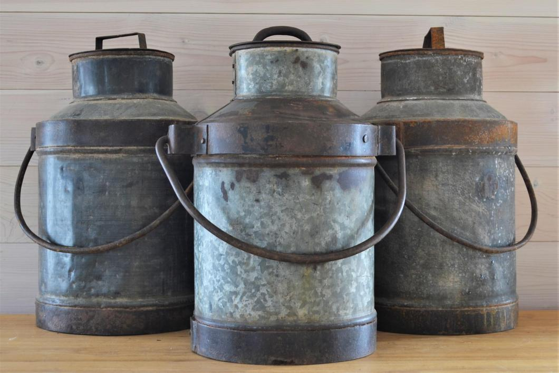
Rural Milk Collection

