Slide 1
Department of Veterinary Medicine Bihar Veterinary College, Patna – 800 014 (Bihar Animal Sciences University, Patna)
Avian Mycoplasmosis
(Chronic Respiratory Disease, CRD)
Dr. Ranveer Kumar Sinha Assistant Professor cum Junior Scientist

Slide 2
INTRODUCTION
Etiology:-
Mycoplasma gallisepticum (MG)
It is also known as:
1. Chronic respiratory disease (CRD) of chickens.
2. Infectious sinusitis of turkeys. Several strains of M. gallisepticum have been reported, including the R strain in poultry.
It causes CRD of domestic poultry, especially in the presence of managemental stresses and/or other respiratory pathogens.
It causes significant economic losses on poultry farms from:
1. Chronic respiratory disease (CRD).
2. Reduced feed efficiency.
3. Decreased growth rate.
4. Decreased egg production.
5. Carcasses downgrades.

Slide 7
Incubation Period
Experimentally infected poultry develop symptoms after 6 -21 days.
In natural infections, the incubation period is variable; infected birds may be asymptomatic for days or months until stressed.
Stressors such as: 1. Viral infections 2. Vaccination with live viruses 3. Cold weather 4. Crowding Can trigger disease outbreaks in infected flocks.
Morbidity and Mortality:-
In chickens with uncomplicated infections, the morbidity rate is high and the mortality rate low.
More severe disease occurs if the birds are concurrently infected with other viruses or bacteria.

Slide 8
CLINICAL SIGNS
M. gallisepticum infections vary from asymptomatic to severe, depending on the infecting strain and other factors, such as the infection with other respiratory pathogen:-
1. NDV
2. IBV
3. E. coli

Slide 9
Cont-----
Infected chickens usually develop respiratory symptoms that may include:
1. Depression
2. Rales
3. Coughing
4. Sneezing
5. Nasal discharges
6. Dyspnea
7. Decreased weight gain, feed efficiency and egg production

Slide 10
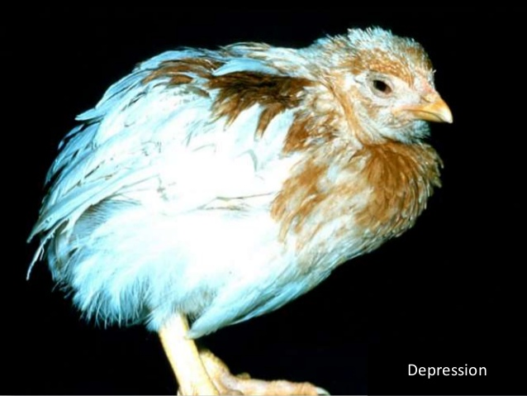

Slide 11
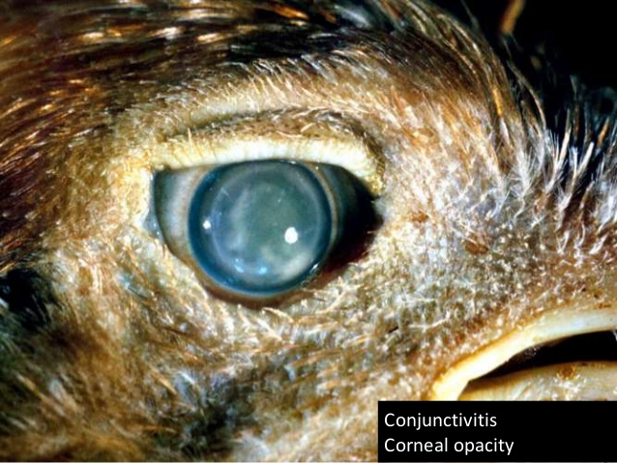

Slide 12
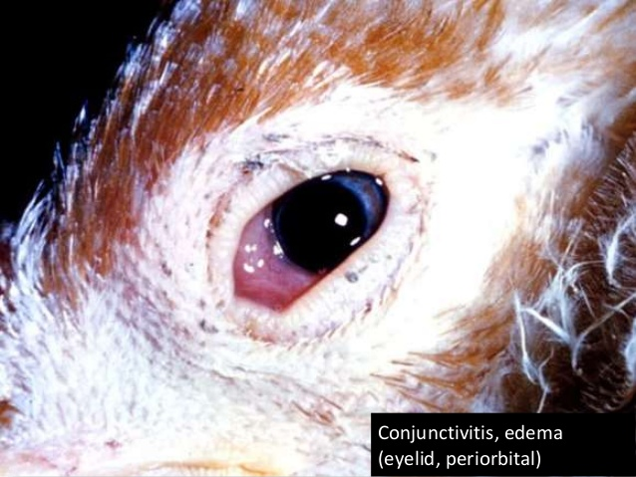

Slide 13
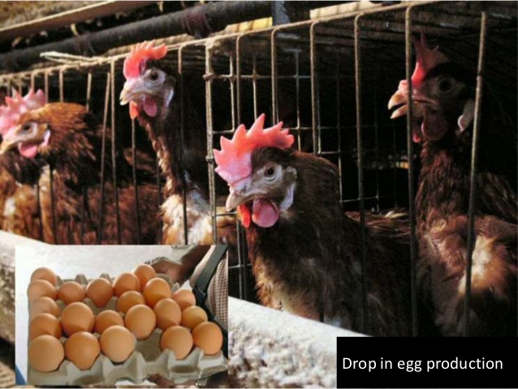

Slide 14
Post Mortem Lesions
In uncomplicated cases in chickens, the lesions typically include:
1. Mild sinusitis
2. Tracheitis
3. Airsacculitis
If chicken is infected concurrently with E. coli:
1. Thickening and turbidity of the air sacs
2. Exudative accumulations
3. Fibrinopurulent pericarditis
4. Perihepatitis

Slide 15
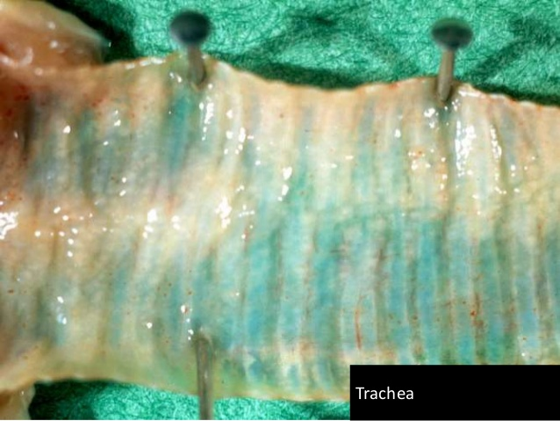

Slide 16
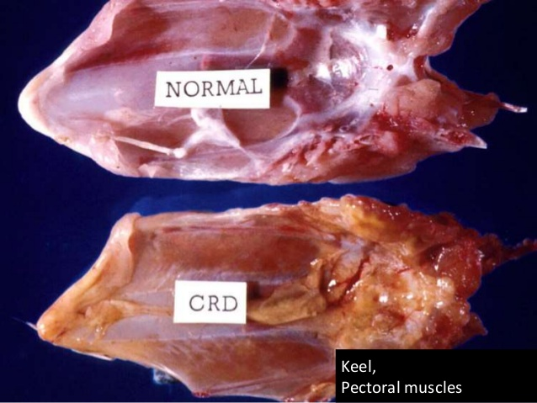

Slide 17
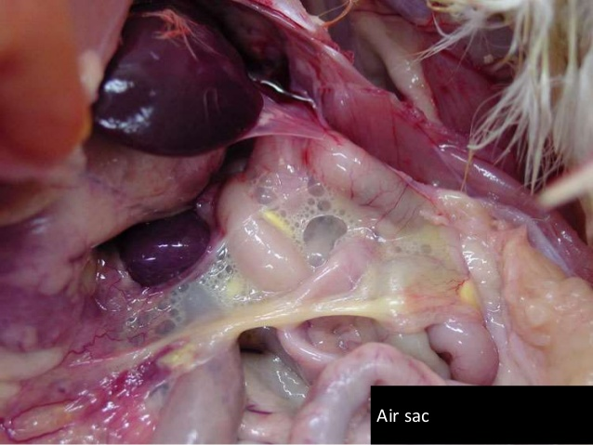

Slide 18
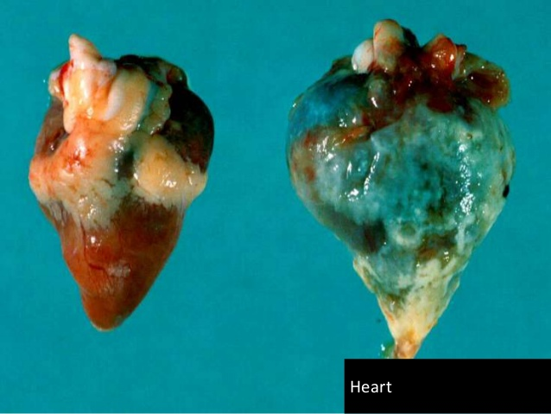

Slide 19
Treatment
Tylan-50(tylosin) @1g/lit of water or
Tiamutin 45% @55g/100 lit of water 5-7 days
Limitations of treatment:
1. Mycoplasma develops resistance against the antibiotics
2. Expensive
3. Medication can not fully prevent an infection.
4. It is useful for a relatively short period of time,

Slide 20
Cont--
Egg Transmission, If a flock proves to be positive for M.G. there are several possibilities to prevent vertical transmission to the broiler flocks:
1. The P.S. Flock can be killed. – This is the only completely safe procedure to prevent further spread of the disease, but of course it is not always practical.
2. Treatment of the hatching egg :- Egg dipping in a 2500 ppm containing tylosin solution before incubation

Slide 21
Biosecurity
1. Limit visitors and movement of vehicles
2. Make sure that all visitors change clothes and footwear on the entrance of the farm and disinfect their hands.
4. As most Mycoplasma’s are killed within two days, we keep two days as a minimum safety period between visiting possibly infected farm and visiting a M.G. clean farm.
5. Staff should not be allowed to have any contact with poultry outside their work. Otherwise, the same period of two days counts.

Slide 22
Vaccination
1. Live vaccines 2. Killed vaccines
Live vaccines F-strain (Avipro MGF, LAH)Can produce immunity.
Killed Vaccines. Killed vaccines are safe to use and give generally a reasonable protection.

