Slide 1
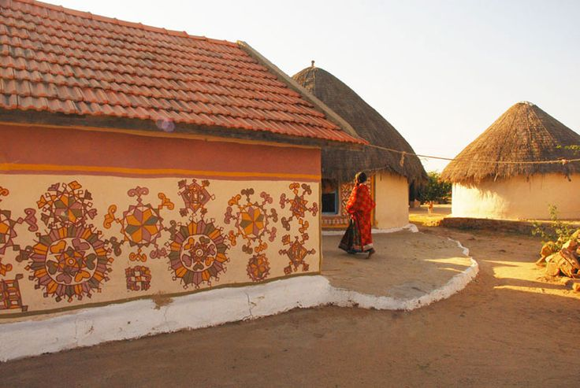
UNIT-02 (EXTENSION EDUCATION AND DEVELOPMENT)
Lecture- 1st day
Dr. Puspendra Kumar Singh
Department of Veterinary & Animal Husbandry Extension Education, BVC

Slide 2
Extension Education and Development
3rd Year, VAHEE

Slide 3
Topics covered
Extension education: Concept, levels, objectives and dimensions. Philosophy and functions of extension education.

Slide 4
Meaning of EXTENSION
Latin roots ‘ex’ & ‘tensio’
Out of school education

Slide 5
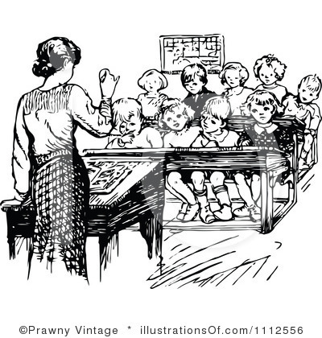
Meaning of EDUCATION
Process of bringing desirable changes into the behavior of human
Informal, Formal & Non-formal

Slide 6
EXTENSION EDUCATION
Extension as an out of school education and services for the members of the farm family and others directly or indirectly engaged in farm production, to enable them to adopt improved practices in production, management, conservation and marketing (National Commission on Agri. 1976)

Slide 7
EXTENSION EDUCATION
as an educational process to provide knowledge to the rural people about improved practices in a convincing manner and to help them to take decisions within their specific local conditions (Dahama)

Slide 8
EXTENSION EDUCATION
involves the conscious use of communication of information to help people to form sound opinions and make good decisions (van den Ban & Hawkins -1996)

Slide 9
EXTENSION EDUCATION
is a science which deals with the creation, transmission & application of knowledge designed to bring about planned changes in the behaviour–complex of people, with a view to help them live better by learning the ways of improving their vocations, enterprises & institutions. (Leagan)

Slide 10
V. & A. H. EXTENSION EDUCATION
is a special branch of extension education which deals with the people through educational procedures, in improving livestock farming methods & techniques, increasing the animals & birds production, efficiency & income, stepping up the level of living & elevating the social & educational standards of rural life.
(P. Mathiyalagan)

Slide 11
These definitions indicate that Extension is for -
Extending educational advantages
Forming sound opinions to make good decisions
Inducing changes in voluntary behavior

Slide 12
Formal education | Extension education
Confined teaching | Outside the four walls
Homogeneous learner with common goals | Heterogeneous learner with diverse goals
Strict norms & no free choice to learners | Choice of subject matter left to the learners
Fixed curriculum, exam, awarded degrees | Flexible, need based
Class attendance is compulsory | Participation is voluntary
Knowledge flows from teachers to learners | Extension agent may learn from learner
Teaching is only through instructors | Also through local leaders
Starts with theory & works up-to practical | Starts with practical and develops into theoretical understanding
More theoretical | More practical & intended for immediate application
Pre-planned & pre-decided | Based on expressed desires, need

Slide 13
NEED OF EXTENSION
Research
Farmers
Extension

Slide 14
Objectives of Extension Education
To bring desirable changes in the knowledge, attitude, skill, action etc.
To assist people to realize their needs & problems
To develop rural leadership, mobilizing people & their resources
To provide research information of economic and practical importance
To collect and transmit feedback information for solving management problems

Slide 15
Ultimate aim of extension
Aim of extension
Means
Resources
RAISE STANDARD OF LIVING of livestock owners INCREASE PRODUCTION of animals thereby income through application of scientific knowledge EDUCATION OF LIVESTOCK OWNERS & other stakeholders LIVESTOCK OWNERS RESOURCES (labour, livestock, land, capital etc) with minimum govt. assistance

Slide 16
Philosophy of Extension Education (Ensminger)
Education for all people
Changing knowledge, skill & attitude
Working with men & women & all, to answer needs & wants
Helping people to help themselves
Learning by doing & seeing is believing
Teaching what to want & ways of satisfying it & inspiring to achieve desires.
Development of individuals, their leaders, society & world
Working together to expand welfare & happiness
Working together in harmony with the culture
Living relationship, respect & trust for each other, share joys & sorrows
Extension is a two way channel
A continuous educational process

Slide 17
Philosophy of Extension Education
According to Kelsey & Hearne (1967)
To teach “how to think, not what to think.
Extension specific job is furnishing the inspiration, supplying specific advice and technical help, and counseling to see that the people as individuals, families, groups and communities work together as a unit in blue ‘printing’ their own problems, charting their own courses, & launch forth to achieve objectives.
According to Bhatnagar and Desai (1987)
Educational, co-operative, collaborative, democratic, persuasive and never-ending process that generates harmony, leadership, effective communication, participation and involvement of the people in organizing self-help activities and projects.
System of ‘learning by doing’ & ‘seeing is believing’, “mutual learning”

Slide 18
Philosophy of Extension Education (Mildred Horton)
The individual is supreme in a democracy
The home is the fundamental unit in a civilization
The family is the first training group of the human race
The foundation of any permanent civilization must rest on the partnership of man and land

Slide 19
Functions of extension education-
Change in
Knowledge
Attitude
Skills
Action
Understanding
Goal
Confidence

Slide 20
NEED FOR STUDYING EXTENSION
To be a successful extension worker he should not only know what to teach, but also how to teach people
Should know the nature of the people with whom he lives and works

