Slide 1
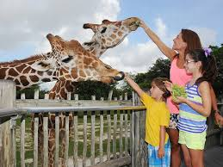
Prevention, control and treatment of nutritional and metabolic diseases of zoo and wild animals Part-I
Dr. Vivek Kr. Singh
Assistant Professor
Department of Veterinary Clinical Complex

Slide 2
Metabolic Diseases mean the diseases that occur due to the “imbalance” between the rate of “input” of dietary nutrients and the “output” of products (product like new born, milk for young one etc.) and lead to the occurrence of metabolic derangements in the affected wild animal species

Slide 3
METABOLIC AND NUTRITIONAL DISEASES IN WILD ANIMALS
RICKETS AND OSTEOPOROSIS
OSTEOMALACIA AND FIBROUS OSTEODYSTROPHY
METABOLIC BONE DISEASE IN CAPTIVE AVIARY SPECIES
RICKETS
GOUT
HYPOTHYROIDISM
DIABETES MELLITUS IN MAMMALS AND BIRDS
FATTY LIVER IN MAMMALS AND BIRDS
NEONATAL HYPOGLYCEMIA IN WILD ANIMALS
KETOSIS (ACETONEMIA) IN WILD RUMINANTS
LACTATION TETANY IN WILD EQUIDS
PARTURITIENT PARESIS (MILK FEVER) IN WILD RUMINANTS

Slide 4
RICKETS AND OSTEOPOROSIS
Rickets occurs due to lack of vitamin D3
In case of rickets, malformation of the growing bone (bowing of limbs/curving in limbs) occurs
Osteoporosis occurs in both the adults and juveniles (but may be frequent in senile female reptiles)
Already hardened bones become weakened by the withdrawal of calcium for metabolic purposes and the wild animals become more prone for the development of fractures

Slide 5
OSTEOMALACIA AND FIBROUS OSTEODYSTROPHY
These disorders are often seen in the young hatchlings of crocodiles which subsequently reveal failure of hardening of bones due to lack of calcium
Among mammals, bone eaters (eg. hyaena) if deprived of bones during feeding will end up in metabolic bone diseases

Slide 6
Etiology
Feeding diet with less calcium (provision of mince with liver and heart without bone or with less bones)
Failure in proper absorption of calcium (diseases of GI tract / excessive phosphorus in diet)
Insufficient calcium supplement and hormonal imbalances due to multiple causes
Lack of vitamin D esp. in indoor-kept wild animals.
Prolonged storage of ration leads to less vitamin D3

Slide 7
Clinical signs
Persisting of kyphokoliosis ( hunch backed appearance) esp. in subadults and adult crocodiles
Weakness of hatchling to walk on land while they still can move freely if in water or can swim freely in water
Falling of teeth and poor calcification of teeth
Jaw bones become more pliable as evidenced in case of hatchlings(rubber jaws)
Weakness in hatchlings along with sluggish movements
In chelonians, lump like appearance of carapace (compare with normal nearby chelonian)

Slide 8
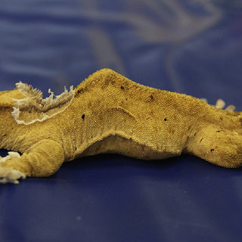
Kyphokoliosis

Slide 9
Diagnosis
Clinical signs and history of feeding and management
Radiographical examination
Serum estimation of calcium and phosphorus

Slide 10
Thanks

