Slide 1
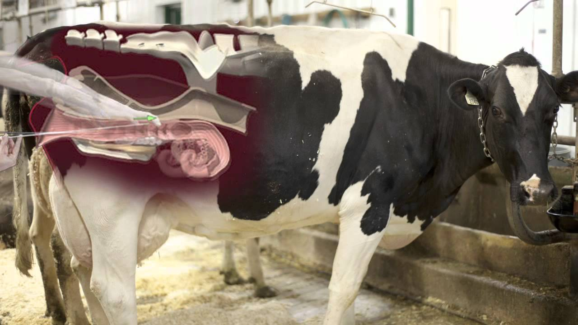
Introduction of Artificial Insemination
Dr. C. S. Azad
Assistant Professor cum Jn. Scientist
Veterinary Gynaecology and Obstetrics
drazadvet@gmail.com

Slide 2
Artificial Insemination
The term “Artificial Insemination,” commonly called “AI” implies the deposition
of Semen into the female reproductive tract by the use of Artificial
means (instruments) rather than by natural service involving the male.
(Tomar,1970)
Artificial Insemination means the deposition of the semen from a male into the
female genitalia during oestrus by mechanical means rather than by the direct
service of the respective male.
In natural mating, the male ejaculates semen directly into the vagina or near
the os uteri of the female. With the technique of Artificial Insemination semen
is collected into an artificial vagina exteriorly. It is evaluated for its qualities and is extended and preserved with suitable media prior to use. The processed
semen is inseminated into the reproductive tract of receptive females.
A.I is a technique in which semen are collected from the male, processed, stored and artificially introduced into the estrous female reproductive tract at proper time for the purpose of conception.

Slide 3
HISTORY AND DEVELOPMENT
Year | Author | Development
1322 A.D. | Arab Horse Breeders | Inseminated Mares with Stallion’s semen.
1677 | Antoni van Leeuwenhock and Johann Hamm | Demonstrated motile cells in semen and referred it as “Animalcules.”
1780 | Lazzaro Spallanzani (Father of Modern A.I) | A. I. in amphibians and in a bitch, he also proved that the fertilizing power of semen resided in the spermatozoa carried by spermatic fluid
1786 | John Hunter Narrated | semen are mawkish and unpleasant Taste - first it is insipid & later pungent and the first discharge is bluish white in color & creamy in consistency.
1799 | John Hunter | Artificial Insemination in Human beings.
1890 | French veterinarian Repiquet | A.I. in Horses and advised it as a means of overcoming sterility.
1890 | Sand and Stribolt | Obtained 4 successful conceptions after Artificial insemination in 8 mares.

Slide 4
Year | Author | Development
1909 | Ivanovich Ivanoff (Russian) | First man who successfully did A.I in cattle, sheep and birds
1914 | Professor Amantea (Human Physiologist) | Designed artificial vagina for dogs
1933 | Walton | Described the handling of semen
1934 | Miller and Evans | Ampullary massage technique in bulls.
1935 | Gunn | Electroejaculator for rams.
1936 | Edward Sorensen and Jens Gylling Holm | first co-operative artificial breeding association in Denmark
1938 | E.J.Perry | first co-operative artificial breeding association at New Jersey in U.S.A.
1938 | Milovanov | Devised artificial vagina for bull, stallion and ram and extenders for diluting the semen.
1938 | Laplaud, Thiabault and Cassou | Devised electroejaculator for bulls
1949 | Polge, Smith and Parkes | Cryoprotective effect of glycerol in frozen semen.
1951 | Stewart | Birth of first calf born from frozen semen
1952 | Smith and Polge | Glycerol as a cryoprotective agent and freezing of semen at -196 ° C in liquid nitrogen
1955 | Perks | Cattle breeding association First time used pellets as packaging materials
1957 | American Breeders Service of Madison, Wisconsin | Practiced the use of long distance transport of semen in dry ice or in liquid nitrogen.

Slide 5
Indian Scenario
1939 Sampatt kumaran
First man who did A.I in cattle at the palace dairy herd of Maharaja of Mysore. Inseminated Hallikar cows with semen collected from Friesian bulls.
1942 P. Bhattacharya established A.I centre at IVRI, Izatnagar
1943 reported the birth of first buffalo calf born through A.I. at Agricultural Institute, Allahabad.
1944 Four regional centers were established throughout India to implement A.I on large scale at Izatnagar, Patna, Bangalore, Calcutta and Montgomery (Pakistan).
1948 Dr. Veeramani Iyer first did A.I in Tamil Nadu at Madras Veterinary College, Chennai
1961 Frozen semen technology was first introduced in India at NDRI, Bangalore.

Slide 6
First five year plan (April, 1951 to March, 1956) a master project the key village scheme was launched.
To bring about rapid genetic improvement in the stock, artificial insemination was accepted as a major activity of the scheme for the improvement of cattle and buffaloes in the country
Under the scheme 600 key villages and 150 artificial insemination centres were established during the period 1952 to 1956.
Second Five-year plan (April, 1956 to March, 1961) the scope of work has been further extended by 1957, 400 artificial insemination centre’s were operating.
Some private agencies or co-operative organizations dealing with livestock have also adopted artificial insemination for breeding work.

Slide 7
Advantages of A.I.
Quick genetic improvement
Control of venereal diseases
Maximum possible use of best sires
Quick progeny testing
Economical
Correct breeding records
Quality of semen
Overcome size difference of animal
Overcome physical inability of bull
Easy transportation
Cryopreservation of semen
Early detection of undesirable genetic traits in the progeny
Good programme for small holding dairy farmers

Slide 8
Disadvantages of A.I.
Requires high standards of technical efficiency
Proper and timely detection of estrus
Proper knowledge of reproduction is required to avoid AI in unwanted conditions.
Genetic defects may be transmitted quickly if selection of a bull is not perfect.
High risk of inbreeding
Costly equipments are required

