Slide 1
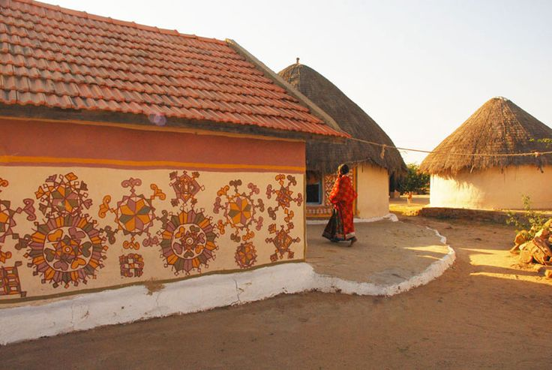
AHE 608 (Animal Husbandry Development Programmes)
Dr. Pankaj Kumar
Department of Veterinary & Animal Husbandry Extension Education, BVC

Slide 2
INTENSIVE CATTLE DEVELOPMENT PROJECT (ICDP)
Introduce by GOI, almost on the similar lines of IADP
Started as a Special Development Programme during 3rd Five Year Plan
It was envisaged in the breeding tracts of indigenous breeds of cattle and buffaloes and in the milk sheds of large dairy projects.
Linked with the dairy plants
Each ICDP was expected to cover one lakh breedable female bovine population and to provide necessary inputs and technical services.

Slide 3
Why ICDP did not succeed in accomplishing objectives?
Considerable time lag in providing organizational structure and various inputs
Set back in transferring ICDPs to state sector with financial cuts resulting in dilution of inputs and
Wastage of semen to the tune of 30 - 40 percent out of supplied to project area.
Dairy extension officer post not filled up in most of the ICDPs and where posted confined mostly to non-extension activities.
At present, in many states are merged with AH programmes and no funds are allocated separately to ICDPs.

Slide 6
