Slide 1
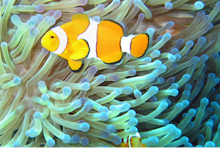
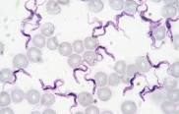
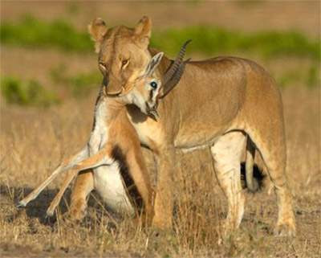
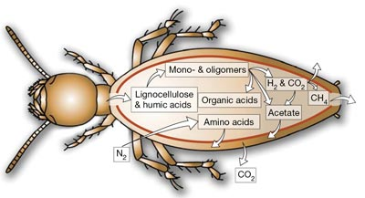
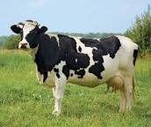
Animal Association
( General Veterinary Parasitology)
Dr. AJIT KUMAR
Department of Veterinary Parasitology
Bihar Veterinary College
Bihar Animal Sciences University
Patna-800014
Image source: Google image

Slide 2
Animal Association
Symbiosis
Commensalism
Mutualism
Predation
Phoresis
Parasitism

Slide 3
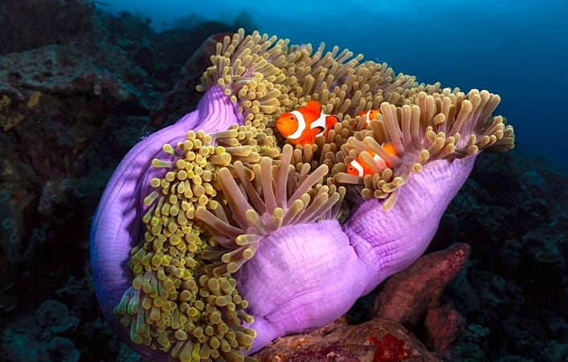
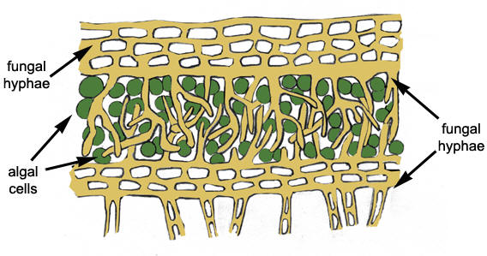
Animal Association
Symbiosis: It is an obligatory and beneficial association of two organisms where both organisms are dependent on each other. Both organisms do not cause damage or harm each other. Both commensalism and mutualism come under it.
Example- Algae and fungi live together in Lichen
Sea Anemone and Clown fish
Lichen: Algae+ Fungi
Image source: Google image

Slide 4
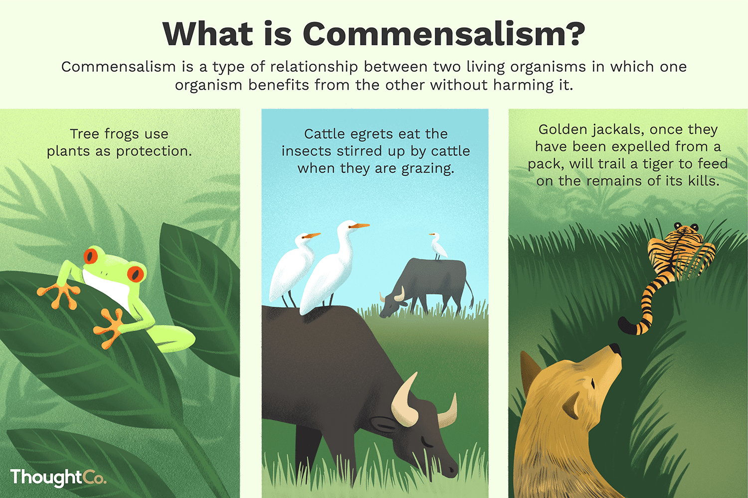
Animal Association
Commensalism: Literally means “eating at the same table”. It is an association between two organisms where one organism benefits nutritionally from another at the same time without harming the benefactor.
Image source: Google image

Slide 5
Animal Association
Mutualism: It is usually obligatory association of two organisms where both are benefited by each other.
Example - Relationship between Sea anemone and clown fish.
Intestinal flagellate protozoan present inside the termite.
Sea Anemone and Clown fish

Slide 6
Animal Association
Predation: It is usually a short term relationship between two individuals in which one individual kills other individual for food.
Image source: Google image

Slide 7
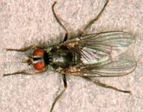
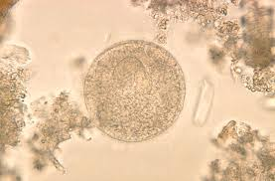
Animal Association
Phoresis: means “traveling together”. In this relationship two partners have no metabolic dependence. One organism is simply transports or shelters by the other organism.
e.g. Bacteria and amoebic cysts are carried on the leg of fly.
Cyst
Fly
Image source: Google image

Slide 8
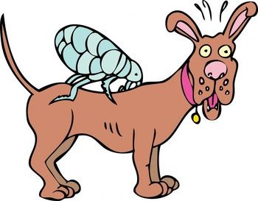
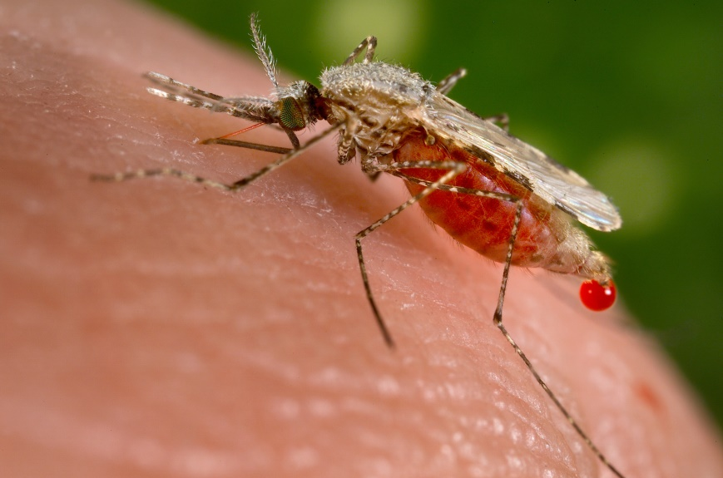
Animal Association
Parasitism: It is a harmful association in which parasite is metabolically dependent on the host
Image source: Google image

Slide 9
THANK U

