Slide 1
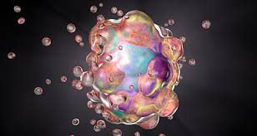
APOPTOSIS Course Title: (VETERINARY PATHOLOGY (Paper-I) UNIT No. : I
DR. KAUSHAL KUMAR
Assistant Professor & Head
Department of Veterinary Pathology
Bihar Veterinary College, BASU

Slide 2
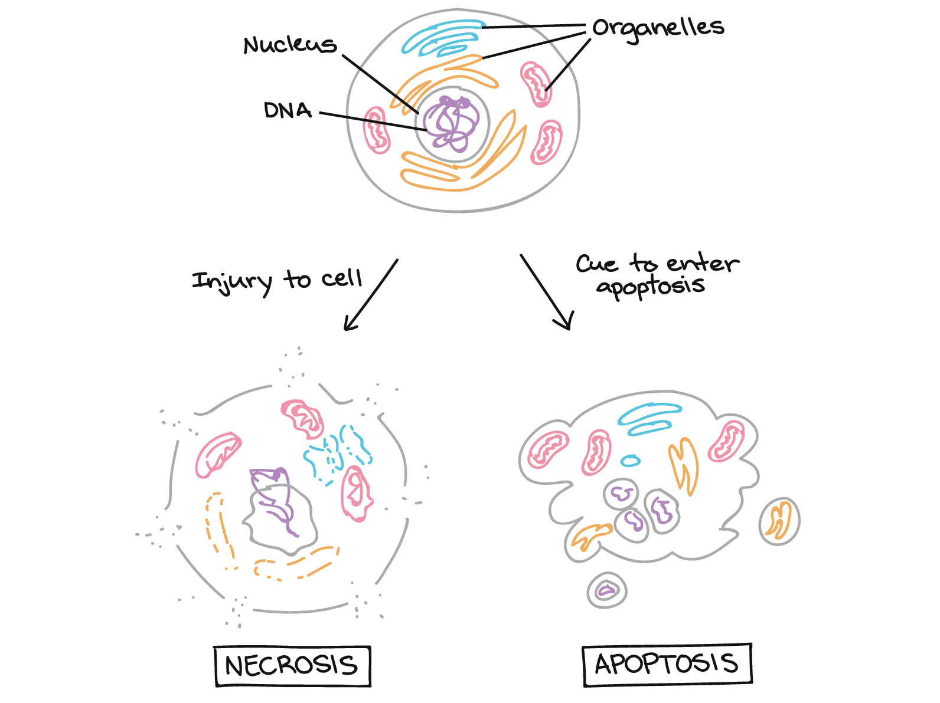
Introduction
Programmed Cell Death
An intricate event
An Tightly regulated
Internal Suicide Program
Function: To eliminate unwanted cell selectively
Dead Cell rapidly cleared before it leaks out.
Apoptosis is fundamentally different from necrosis.

Slide 3
ETIOLOGY
Causes of Apoptosis
May be Physiologic
Programmed destruction of cell during embryogenesis
Hormone –dependent involution of tissue( endometrium)
Death of cell that have served their purpose ( Neutrophils after acute inflammation)
OR May be Pathologic
DNA Damage
Cell death in certain viral infection
Cytotoxic T Cell causes apoptosis in tumours and rejection in transplanted tissue

Slide 4
Morphologic Cahnges
Cell shrinkage
Chromatin condensation & fragmentation
Cellular blabbing
Fragmentation into apoptotic bodies
Followed by phagocytosis of apoptotic bodies by adjacent healthy cell/macrophages

Slide 5
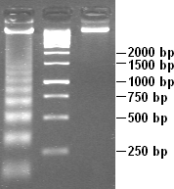
Biochemical Cahnges
Protein breakdown occurs through CASPASES
( having an active site cysteine cleave at aspartate residues)
Cleavage of DNA into fragments(= ladder pattern on AGPT)
Plasma membrane alteration (flipping of phosphati-dylserine in-n-out) allow their recognition

Slide 6
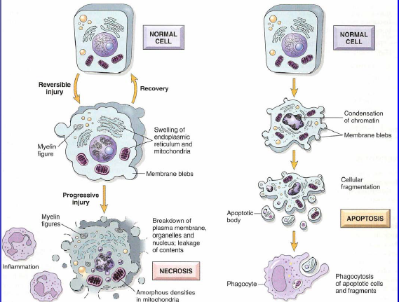
ETIOLOGY
Necrosis Vs Apoptosis

Slide 7
Differential features of Apoptosis & Necrosis
Apoptosis | Necrosis
Affects Single cells | Affects groups of neighbouring cells
No Inflammatory response | Significant inflammatory response
Cell shrinkage | Cell swelling
Membrane blabbing but integrity maintained | Loss of membrane integrity
Increased mitochondria membrane permeability, release of pro-apoptotic proteins and formation of apoptotic bodies | Organelle swelling and lysosomal leakage
Chromatin condensation and non-random DNA fragmentation | Random degradation of DNA
Apoptotic bodies ingested by neighbouring cells | Lysed cells ingested by macrophages

Slide 8
References:
Book : “Pathologic Basis of Disease” By Robbins and Cotran, Eighth edition
Pictures are taken from www.google .com

