Slide 1
Department of Veterinary Medicine Bihar Veterinary College, Patna – 800 014 (BASU, Patna)
ANIMAL WELFARE(CLASS-2)
(DUTIES OF AWO)
Dr. Ranveer Kumar Sinha Assistant Professor cum Junior Scientist
E-mail: ranveervet@rediffmail.com

Slide 2
DUTIES OF AWO
1. An AWO (Animal Welfare Officer) should have a thorough knowledge of all the Animal Welfare Laws :
The Prevention of Cruelty to Animals Act, 1960.
The Wild Life (Protection) Act, 1972 as amended in 2006.
Breeding of and Experiments on Animals (Control and Supervision) Amendment Rules, 2005.

Slide 3
DUTIES OF AWO
The Animal Birth Control (Dogs) Rules, 2001.
The Performing Animals (Registration) Rules, 2001.
The Performing Animals Rules, 1973.
The Prevention of Cruelty to Draught and Pack Animals Rules, 1965, amended 1968.
The Transport of Animals (Amendment) Rules, 2001.

Slide 4
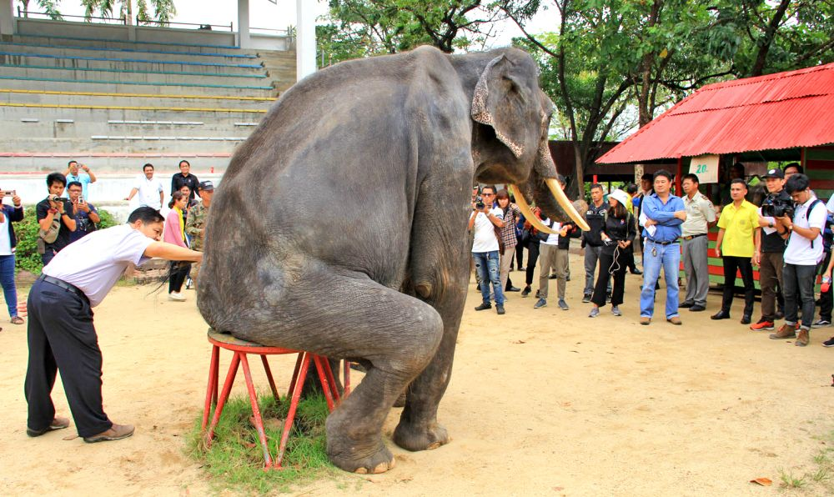

Slide 5
DUTIES OF AWO
2. Does not entitle to take direct law enforcement action such as raids, checking of premises, stopping of vehicle on roads etc. He entitled to lodge a police compliant in the event of any cruelty being seen or reported.
3.To prevent illicit slaughter and if any report of illicit slaughter is made, the case must be immediately reported to the concerned authorities.
4.During natural calamites, organize immediate rescue operations and emergency relief for the helpless animals with like-minded people.

Slide 6
DUTIES OF AWO
5.Prevent the misuse and abuse of oxytocin in milking animals by educating the dairy farmers.
6.Participation in coordinating or organizing training programs for villagers on setting up self sustaining gaushalas.
7.To organize first aid, veterinary care, food and shelter for sick and destitute animals.
8. Attention towards the proper care and management of birds and fish maintained in aviaries and aquaria.

Slide 7
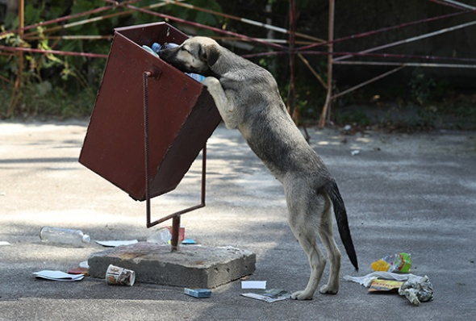

Slide 8
DUTIES OF AWO
9.He/she should be able to conduct training programs on legislation issues in animal welfare for police personnel and lawyers.
10.Organize mobile clinics and veterinary care for stray animals and where veterinary services are not available.
12.To sensitize the community and take appropriate remedial measures to prevent cruelty to animals from happening – e.g. animal sacrifice, bull fights, cock fights and ram fights.
13.Establishing good rapport with the press and electronic media to create extensive public awareness on animal welfare issues.

Slide 9
DUTIES OF AWO
14.The use of animals by the entertainment industry should be vigilantly monitored by the AWO by attending the film shoots.
15.AWOs are expected to keep close liaison with Police, Forest, Customs & Excise, etc. for effective enforcement of animal welfare laws and work in close co-ordination with AWBI.
16.AWO is not entitled to collect any fine or accept cash from offenders. Such action will amount to bribery.

Slide 10
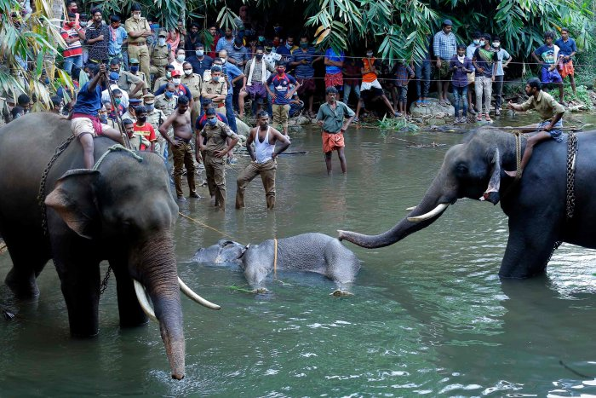

Slide 11
THANKS YOU !

