Slide 1
Department of Veterinary Medicine Bihar Veterinary College, Patna – 800 014 (BASU, Patna)
Routes & techniques of administration of medicine in animals(Class -1)
Dr. Ranveer Kumar Sinha Assistant Professor cum Junior Scientist
E-mail: ranveervet@rediffmail.com

Slide 3
Routes of administration
Oral
Parenteral
IV
IM
IP
IC
SC
Other
Topical
Rectal
Intrauterine
Intramammary

Slide 4
Advantages & Disadvantage of Different Routes
Oral
Advantages
Usually least painful
Can be administered by client
Skin not penetrated, less risk of introducing infection
Disadvantages
Aspiration of medication - choking, pneumonia (eg paraffin to cats)
Variable rate of absorption depending on patient, contents of gut, etc.
Vomiting, irritation of gut (eg aspirin)
Patients may not tolerate administration
May be difficult to ensure correct dosage

Slide 5
Different form of Oral medications
Tablet
Capsule
Granule
Powder
Paste
Liquid

Slide 6
Tablet
Compressed drug in a carrier such as sugar
Often coated
to protect drug inside from moisture
to disguise unpleasant tastes
to protect from gastric juices, slow down the breakdown of the drug for a slower release
to avoid irritation
to give the tablet a recognizable colour
Usually scored into halves or quarters for ease of breakage for more accurate dosing
Most common form of medication

Slide 7
Capsule, Granules/Powder & Paste
Capsule
Bullet-shaped, gelatin container
Contains powder, granules or liquid
Easier to swallow (smooth)
No need for 'carrier‘
Gelatin dissolves in stomach
Granules/Powder
Solid preparations
Dissolved in water
Mixed with feed
Paste
Semi solid preparation
Usually in a water soluble base
Via syringe
Easy for owner to use
Rabbit, guinea pig
Horse (worming paste)
Cat (worming paste)

Slide 8
Liquid
Syrup
Drugs contained in a concentrated sugar solution.
Good for young animals/small doses
Solution
Drug in liquid form or dissolved in water (eg glucose solution).
Suspension
Insoluble particles float in liquid but settle when standing
Needs to be mixed before use (shaken)
Emulsion
Two immiscible liquids (eg water and paraffin)
Routes
Directly into the mouth
By stomach tube
Very young animals, to reduce the risk of aspiration
Large volumes of fluid.

Slide 9
Parenteral Preparations
These are drugs that can be given by injection. All drugs in this form must be sterile. The most common routes of injection of drugs in small animal practice are iv ,im,ip,sc,ic.
Injection Route depends on
Type of drug
Condition and temperament of patient
Volume of the drug
Required speed of action

Slide 10
Routes of injection
Intradermal
Intramuscular
Intravenous
Intraperitoneal
Intracardiac
Intrapleural
Intra-articular
Epidural
Subconjunctival

Slide 11
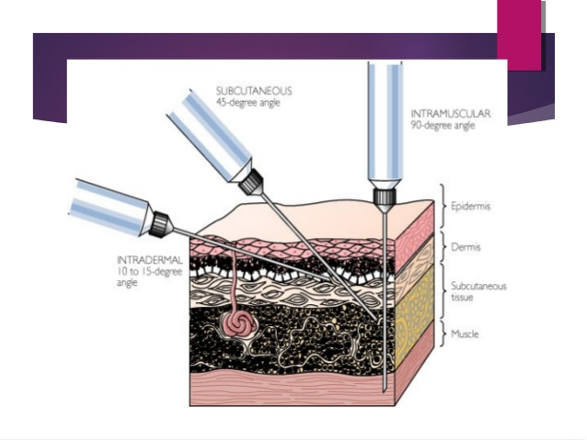

Slide 12
Intradermal (ID)
Into the dermis
The living part of the surface layer
Needs a very fine needle
Causes a blister like appearance (bleb) if performed correctly
allergy testing
tuberculin testing
Subcutaneous(S/C)
Under the skin
Most common site
Loose skin over shoulder blades a good site
Less painful than intramuscular injections
Only for low irritant drugs
Slow absorption if dehydrated
Used for most vaccines

Slide 13
Systemic Drugs
Some drugs cannot be applied directly where they are needed. Instead they need to travel through the animal’s system until they get to where they are needed. These drugs are said to be given Systemic . Exam.
Oral preparations
Injections

Slide 14
THANKS YOU !

