Slide 1
Department of Veterinary Medicine Bihar Veterinary College, Patna – 800 014 (BASU, Patna)
ANIMAL WELFARE(CLASS- 3)
(ROLE OF VETERINARIANS)
Unit 7
Dr. Ranveer Kumar Sinha Assistant Professor cum Junior Scientist
E-mail: ranveervet@rediffmail.com

Slide 2
ROLE OF VETERINARIANS IN ANIMAL WELFARE
Introduction:-
In 1960, less than 2% of veterinarians were female; today 45% are female—will have an impact on the way the profession deals with animal welfare and animal rights. Public opinion polls find that women are about 15 percentage points more positive toward animal welfare issues than men.
At the present time behaviour biologists still struggle with the difficult task of "measuring happiness" in the animals.

Slide 3
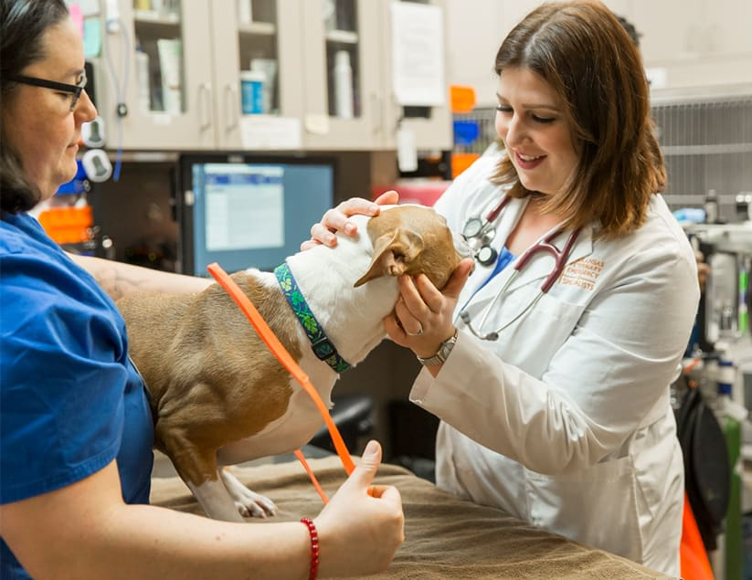

Slide 4
Continu---
Poor health contributes to poor welfare, the opposite is not necessarily the case.
Pet animals are now considered members of the household, people are requesting advanced veterinary services—and paying more for them.

Slide 5
Continu---
Veterinarian role in animal welfare through:-
Veterinarian daily practices.
Veterinary advocacy to animal owners.
Education and promotion of animal welfare to the wide public.
Animal welfare scientific research.

Slide 6
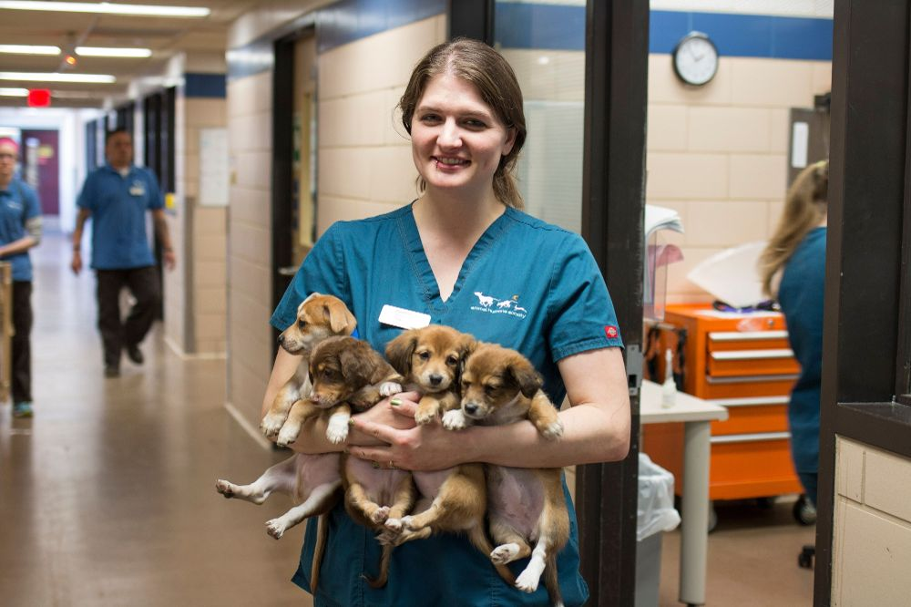

Slide 7
Continu---
Veterinarians play a central role in biomedical , wildlife and farm animal research.
Management of laboratory animal production and maintenance colonies
It may be seen that the laboratory animal veterinarian is jack of all trades. Indeed they are masters of most of the component disciplines.
Veterinarians and institutional animal ethics committees

Slide 8
Continu---
Training of investigators and technical staff is an important function carried out by veterinarians in many institutions using animals
Act as information or publicity officers with potential for interaction with the media and the general community in public forums.
Drafting animal welfare legislation and participating in programs and projects.
Collaboration with other interested parties on animal welfare

Slide 9
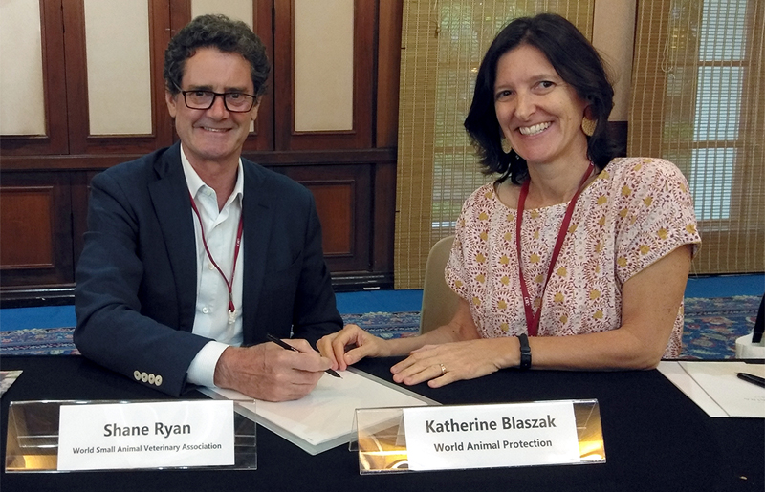

Slide 10
THANKS YOU !

