Slide 1
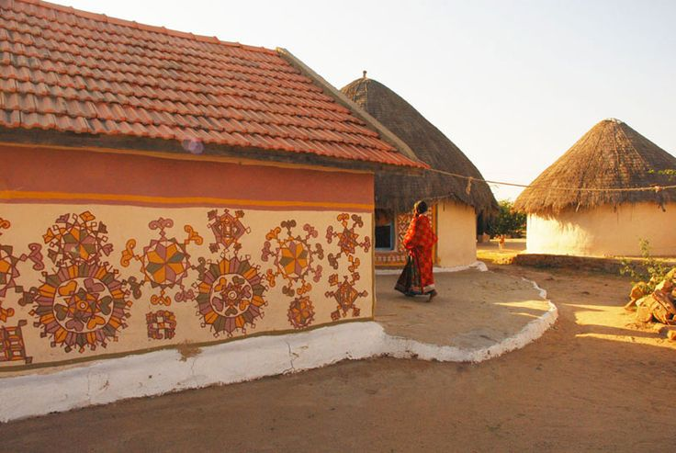
UNIT-02 (EXTENSION EDUCATION AND DEVELOPMENT)
Dr. Puspendra Kumar Singh
Department of Veterinary & Animal Husbandry Extension Education, BVC

Slide 2
Extension Education and Development
3rd Year, VAHEE

Slide 3
Topics covered
Rural Development: Concept, Significance and Importance of Rural Development Programmes for Poverty Alleviation

Slide 4
Development: Concept
Development is an abstract idea.
Development implies on overall positive change in the physical quality of life (economic as well as social aspects).
“Growth with Justice”
Implies gradual and sequential phases of change
Development means development of men, the satisfaction of their basic needs –food, shelter, clothing and access to safe drinking water, sanitation, public transport, health and educational facilities.

Slide 5
Growth | Development
Sustained expansion in the productive capacity of an economy (rise in its GDP) | Sustained improvement in material welfare, particularly for poor, afflicted by poverty, illiteracy and poor health conditions.
Growth mainly focuses on quantitative improvement | Development is associated with qualitative improvement.

Slide 6
Elements of Development
Removal of inequality and poverty;
Increase in material welfare of the people;
Increase in social well-being (education, health, housing, etc.);
An equitable distribution of the gains of development among different groups of people in a region or country;
An enhancement in technology and the capacity to produce a wider range of goods and services in the economy leading to a better quality of life;
Building institutional structures which permit participation in decision-making at all levels, equalization of opportunities for development and removal of disparities

Slide 7
Development evolution
Ist Phase
Economic development
Trickle down effect
IInd Phase
Institutional factors modifications
Alterations in attitude and values in society
IVth Phase
Knowledge & Competition
Capital formation and raise output
IIIrd Phase
Nationalisation of Banks, Radio & TV
Human Centered Development
Mobilization of humans in planning
Democratic Decentralization (Panchayati Raj)
Due to Globalization, Liberalization and ICT’s

Slide 8
Dimensions of Development
Human Dev: It is process by which an individual develops self-respect and becomes self-confident, self-reliant, cooperative and tolerant of others through becoming aware of his/her shortcomings as well as his/her potential for positive change.
Economic Dev.: It is a process by which people through their own individual and / or joint efforts boost production for direct consumption and have a surplus to sell for cash.

Slide 9
Political Dev.: To participate in decision making at local level and to choose their own leaders, to plan and share power democratically and to create and allocate communal resources equitably and efficiently among individual groups.
Social Dev.: Investments and services carried out or provided by a community for the mutual benefit of the people of that community. These services include health, education, water, energy, transport, communication.

Slide 10
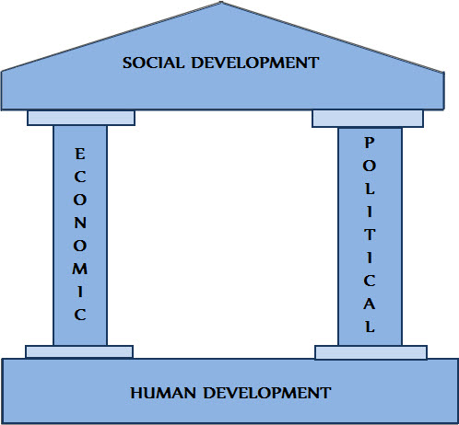
Relationship B/w Resources
Development is a complex and slow process involving people on one hand and the factors of production and organisation on the other

Slide 11
Scope of Development
To check following characteristics of developing country
Mass poverty;
Low levels of income and concentration of incomes in a few hands;
Low levels of productivity and backward technology
High levels of unemployment and under-employment;
Poor nutrition, health, housing, literacy and welfare status;
Preponderance of primary sector and low levels of industrialization; and
Lower status of women and that of a variety of social groups such as scheduled castes in India

