Slide 1
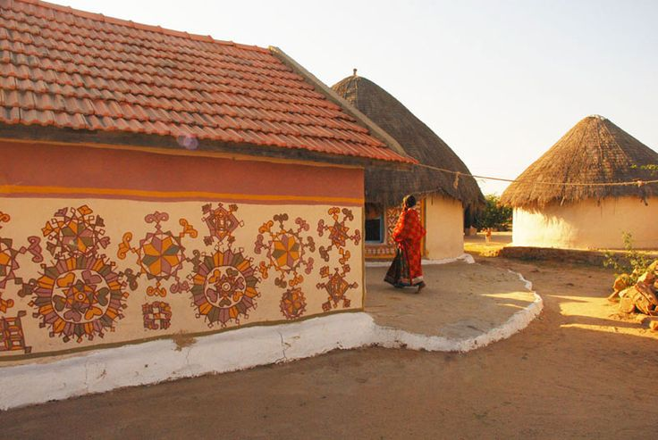
UNIT-02 (EXTENSION EDUCATION AND DEVELOPMENT)
Dr. Puspendra Kumar Singh
Department of Veterinary & Animal Husbandry Extension Education, BVC

Slide 2
Extension Education and Development
3rd Year, VAHEE

Slide 3
Topics covered
Concept of need

Slide 4
Effective Extension Education is an intentional effort, carefully designed to fulfill certain specifically predetermined and presumably important needs………………… J. P. Leagan

Slide 5
Need
Difference between ‘what is’ (present state, existing situation) and
‘what ought to be’ (an ideal/desired situation)
Interest: Feeling of curiosity or concern about something
What is (present state, existing situation)
Gap
What ought to be (an ideal/desired situation)
Need determination: observing and situation understanding
Degree of need: Estimation of gap
‘Wider the gap, greater the need’

Slide 6
Need Characteristics
Needs vary in nature, scope and significance
Can be at individual level or at group level
Changes with time and progress
Changes with age, education, growth and with social, economic and family status situations

Slide 7
Classification of Needs
Need
Based on Hierarchy
Physiological
Safety
Belonging/Affection
Esteem
Self-Actualization
Based on Forms
Biological
Educational
Human
Derived
Based on Psychology
Felt
Unfelt
Based on Psychology
Security
Affection
Recognition
New Experience
Organic
Based on General Purpose
Physical
Social
Integrative

Slide 8
Types
A: On the basis of psychological point of view
Felt/Consciously recognized needs: farmers’ aware of
Unfelt/Unrecognized needs: farmers’ not aware of
By motivation unfelt need can be converted to felt need
B: On the basis of purpose
Physical: food, water, oxygen
Social: relationship with other
Integrative: communicating with others by media

Slide 9
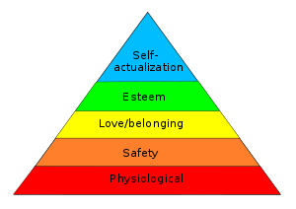
C. Based on Hierarchy (Need Hierarchy Theory, Maslow)
Human needs in the form of hierarchy
5 Needs
One need met it lost its power to motivate
Meditation, Nirvana
Power, Prestige, Status
Group, Marriage
Economic, Physical, Social
Food, Water, Shelter

Slide 10
D) Based on Desires
Security: Economic, Social, Psychological and spiritual security.
Affection: High need of affiliation usually derived pleasure from being loved and tend to avoid the pain of being rejected by social group.
Recognition: Status, prestige, achievement and being looked at top, considered important by his fellowman
New Experience: Adventure, new interest, new friends. Wants thrill of something new, something different
Organic: Hunger, thirstiness etc. Concerned with living

Slide 11
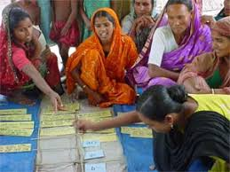
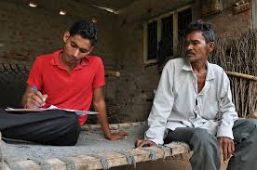
Estimation of Needs
Participatory method
Primary Source method
Secondary Source method

