Slide 1
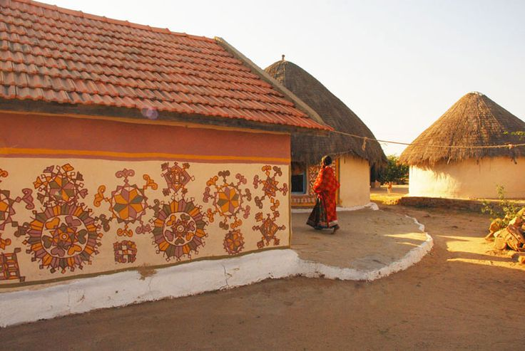
UNIT-02 (EXTENSION EDUCATION AND DEVELOPMENT)
Dr. Puspendra Kumar Singh
Department of Veterinary & Animal Husbandry Extension Education, BVC

Slide 2
Extension Education and Development
3rd Year, VAHEE

Slide 3
Topics covered
Types of education: Formal, non-formal and informal education. Principles of Extension Education.

Slide 4
Some Key Points
The term Extension Education was formally used 1st time in 1873 by Cambrige University.
Father of Extension – James Stuart
Father of University Extension – J P Leagan
Father of Extension in India – Dr. K N Singh
SMART- Simple, Measurable, Attainable, Realistic, Time bound

Slide 5
Education
Education: It is the production of desirable changes in knowledge (things known), attitude (things felt), and skills (things done), either in all (or) one or more of human behavior.

Slide 6
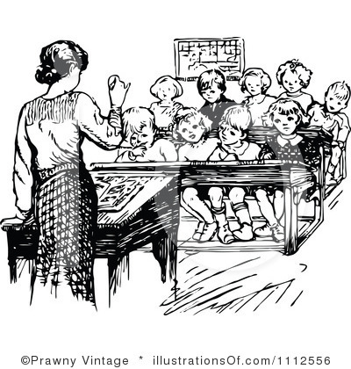
Meaning of EDUCATION
Process of bringing desirable changes into the behavior of human
Informal, Formal & Non-formal

Slide 7
Type of education
Coombs & Ahmed (1974) drew a distinction between the three types of education as follows:
Informal Education : The day to day process of learning, whereby knowledge is transferred in the context of the family, the neighborhood, the daily working relationships between the people and through experience.
Formal Education: The education which takes place in the schools and colleges. It starts from theory to practice. It can either be general or vocational. Three is a fixed curriculum and set pattern of examination mostly leading to the award of degrees or diplomas.
Non-formal Education : all organized education outside the formal education system. It is mostly practical and problem oriented.

Slide 8
Principles of extension education
Principles of Interests and needs
2. Grass roots principle
3. Principles of Cultural difference
4. Principle of indigenous knowledge
5. Principle of learning by doing
6. Principle of participation
7. Family principle
8. Principle of leadership
9. Principle of adaptability
10. Principle of evaluation
11. Principle of satisfaction

Slide 9
Principles of Extension
Principles are generally guidelines, which form the basis for decision and action in a consistent way. The universal truths in extension, which have been observed and found to hold good under varying conditions and circumstances, are presented.
I - Principles of interests and needs: People’s interests and people’s needs are the starting point of extension work. To identify the real needs and interest of the people are challenging tasks. The extension agents should not pass on their own need and interests as those of the people. Extension work shall be successful only when it is based on the interests and needs of the people as they see them.
II - Grassroots principle: Extension programmes should start with local groups, local situations and local problems. It must fit to the local conditions. Extension work should start with the people where they are and what they have.
III - Principle of cultural difference: Culture simply means social heritage. There is cultural difference between groups of farmers also. The differences may be in their habits, customs, values, attitudes and way of life. Extension work, to be successful, must be carried out in harmony with the culture of the people.

Slide 10
IV - Principle of indigenous knowledge: People have indigenous knowledge systems which they have developed through generations of work experience and problem solving in their own specific situations. It encompass all aspects of life and people consider it essential for their survival. Instead of ignoring this as outdated, the extension agent should try to understand before proceeding to recommend something to them.
V – Principle of learning by doing: Learning remains far from the perfect, unless the people get involved in actually doing the work. It is most effective in changing people’s behaviour. This develops confidence as it involves maximum number of sensory organs.
VI – Principle of participation: Most people of the village community should willingly cooperate and participate in identifying the problem, planning of projects for solving the problems and implementing the projects in getting the desired results. This is of fundamental importance for the success of an extension programme. People must share in developing and implementing the programme and feel that it is their own programme.

Slide 11
VII – Family principle: Family is the primary unit of society. The target for extension work should, therefore, be the family. That is, developing the family as a whole, economically and socially. Not only the farmers, the farmwomen and farm youth are also to be involved in extension programmes
VIII – Principle of leadership: Identifying different types of leaders and working through them is essential in extension. Local leaders are the custodians of local thought and action. The involvement of local leaders and legitimization by them are essential for the success of a programme. Leadership traits are to be developed in the people so that they of their own shall seek change from less desirable to a more desirable situation. The leaders may be trained and developed to act as carriers of change in the villages.
IX – Principle of adaptability: Extension work and extension teaching methods must be flexible and adapted to suit the local conditions. This is necessary because the people, their situation, their resources and constraints vary from place to place and time to time.

Slide 12
X –Principle of Evaluation: Evaluation prevents stagnation. There should be a continuous built-in method of finding out the extent to which the results obtained are in agreement with the objectives fixed earlier. Evaluation should indicate the gap and steps to be taken for further improvement
XI – Principle of satisfaction: The end product of extension should produce satisfying results for the people. Satisfying results reinforce learning and motivate people to seek further improvement.

