Slide 1
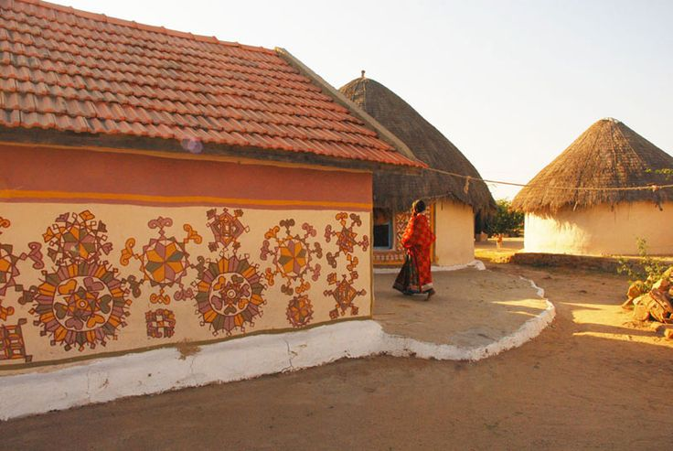
UNIT-02 (EXTENSION EDUCATION AND DEVELOPMENT)
Dr. Puspendra Kumar Singh
Department of Veterinary & Animal Husbandry Extension Education, BVC

Slide 2
Extension Education and Development
3rd Year, VAHEE

Slide 3
Topics covered
Teaching Learning Process and Steps in Extension Teaching

Slide 4
TEACHING LEARNING PROCESS

Slide 5
Teaching:
Teaching is the process of providing situations in which learning takes place.
The ultimate purpose of teaching is not merely to inform people but to transform them, to bring about the desired change in their behaviour.
If the learner has not learnt, the teacher has not taught.
Teaching is not filling a bucket; it is lighting a lamp.
Teaching is an intentional or purposeful process, not a hit or miss undertaking.
Effective teaching is done according to design, not drift; it is done by plan, not by trial and error.
Good teaching, therefore, requires careful planning of content, procedures, methods and techniques.
Good teaching is essentially good communication and good communication requires sympathetic sharing, and clear explaining.

Slide 6
Learning:
Learning is a process by which a person becomes changed in his behaviour through seIf-activity. Learning is a process of progressive behaviour adaptation.
Learning is something that takes place within the learner.
It takes place within the individual when he feels a need, strives for fulfilling it, and experiences satisfaction with the fruits of his labour.
Learning is the goal of teaching. We must, however, avoid any artificial separation, since teaching and learning are really one process; they are, so to say the obverse and the reverse of the same coin. We can symbolize this interaction as the
Teaching < -- > Learning process

Slide 7
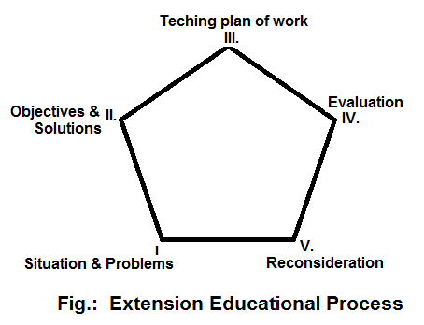
Extension Education Process
This process has five essential phases in the extension educational process as given in the figure.

Slide 8
Analysis of the situation:
This required a large amount of facts about all aspects of the situation.
Facts are needed about :
The people, their interests, education, what they think they need, their social customs, habits and folkways.
The physical situation such as soils, type of farming, markets, size of farms, cropping systems, housing condition, community services and communications.
Some of these facts shape up into problems. Other facts show the resources that are available through organizations and agencies.
A thorough analysis will examine changing conditions and take a careful look ahead, comparing "what is" with "what should be".

Slide 9
Deciding upon objective:
It is necessary to distinguish between levels of objectives by separating the general objectives from the specific or working objectives.
The planning process must enable the people to select a limited number of problems and to state their objectives clearly. The solutions to be offered must give satisfaction.
Objectives should express the behavioral changes in people as well as the economic or social outcomes which are desired.

Slide 10
Teaching:
This involves choosing:
The content or what is to be taught and
Methods and techniques of communication.
The first two phases are inherently teaching opportunities, but now we must create learning situations.
We must use different methods of communication to stimulate learning.
These will be chosen from mass media, group, and personal methods.

Slide 11
Evaluation:
This should determine to what extent objectives have been reached.
This will also be a test of how accurately and clearly the objectives have been stated.
The process of evaluation may be simple and informal or it may be formal and very complex.

Slide 12
Reconsideration:
This step consists of a review of previous efforts and results which reveal a new situation.
If this new situation shows the need for further work, then the whole process may begin again, with new or modified objectives. Hence this process is continuous.
The new situation is different because:
The people have changed;
The physical, economic and social changes may have occurred;
The extension worker is better prepared to recognize new needs and interests.

Slide 13
In Summary, this concept is intended only to clarify the steps necessary in carrying out a planned educational effort. It is not intended to imply that these steps are definitely separate from each other. Experience shows that planning, learning and evaluation are taking place continuously, in varying degrees, throughout all phases of extension activities

Slide 14
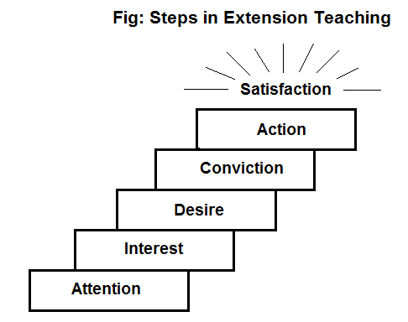
Steps in Extension Teaching:
According to Wilson and Gallop the teaching learning process has six steps:

Slide 15
Attention: The first task of the extension worker is to attract attention of the learner to the new and better ideas. Farmers are to be made aware of the improvements . Attention is the starting point to the arousing of interest.
Mass methods like radio, television, exhibition etc., and personal contact by the extension worker, contact through local leaders are important at this stage.
Interest: Once attention has been captured it becomes possible for the teacher to appeal to the basic needs and arouse his interest in further consideration of the idea.
Extension worker reveals how new practice will contribute to the farmer’s welfare. The message should be presented attractively.
Personal contact by the extension worker, farm publications, radio, television etc., is important at this stage

Slide 16
Desire: The desire is concerned with the continuing learner’s interest in the idea until that interest becomes a desire or motivating force. The extension worker explains the farmer that the information applies directly to the farmer’s situation that the doing of this would satisfy his needs.
Field visit, method demonstrations, farm publications, personal contact by extension worker, group discussion etc., are important at this stage
Conviction: In this step learner knows what action is necessary, and just how to take that action. He also makes sure that the learner visualizes the action in terms of his own peculiar situation and has acquired confidence in his own ability to do the thing.
Field day or field visit, slide show, personal contact by extension worker, and training are important at this stage.

Slide 17
Action: Unless conviction is converted in to action, the efforts are fruitless. It is the job of extension worker to make it easy for the farmers to act. If action does not quickly follow the desire the new idea will fade away. Therefore this phase should never be neglected.
Demonstration, personal contact by extension worker, supply of critical inputs, and ensuring essential services are important at this stage.
Satisfaction: This is the end product of teaching Process. Follow by the extension worker helps the farmer to learn to evaluate their progress and strengthen satisfaction. Satisfaction helps to continue his action with more confidence. It is the motivating force for further learning.
Use of mass media, local leaders and personal contact by extension worker are important at this stage.

