Slide 1
FOOT AND MOUTH DISEASE
Unit-6(Medicine) Dr. Anil Kumar
4th Professional Asst. Professor Dept. of VCC

Slide 2
FOOT AND MOUTH DISEASE
(Aphthous fever)
An acute, febrile, highly contagious disease of almost all cloven hoofed animals (Both domestic and wild animals)characterized by the formation of vesicles (fluid-filled blisters) and erosions in the mouth, nose, teats and feet.
high morbidity and low mortality
Etiology:
positive sense, ss-RNA virus.
7 serotypes of the virus: Types O, A, C, South African Territories 1, 2 and 3 (SAT-1, -2, -3) and Asia-1
India-four major serotypes, O, A, C and Asia 1
Infection with one serotype does not confer immunity against another
Host:
Cattle >pigs >
the disease is rare in sheep and goats
Horse is refractory to infection

Slide 3
Transmission:
Inhalation and aerosol route
Direct or indirect contact with infected animals such as through abraded skin, conjunctiva, ingestion of contaminated garbage
Mechanical transmission may also occur
Primary bovine tongue epithelium or bovine thyroid cells, primary pig kidney, calf kidney and lamb kidney cells are used for propagation.
Cell lines such as Baby Hamster Kidney-21 (BHK-21) and IB-RS-2 cells are highly suitable
Experimental animals (Guinea pigs, suckling mice, hamsters and rabbits)

Slide 4
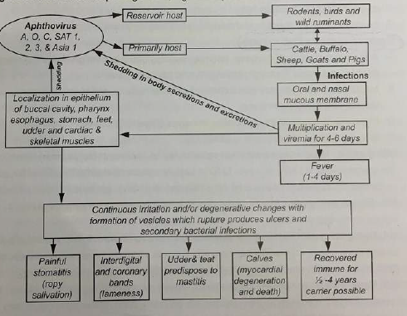

Veterinary Infectious Diseases

Slide 5
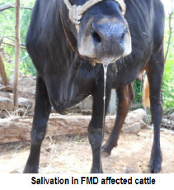
Symptoms:
Fall in milk yield and a high fever (40-410C) accompanied by loss of appetite, depression.
Followed by appearance of painful stomatitis and the temperature subsides
Profuse salivation, the saliva hanging in long, ropy strings
Smacking of the lips
Vesicles (containing straw coloured fluid) appear on the buccal mucosa, dental pad, udder and tongue. feet, particularly in the clefts and on the coronet
Courtsey:
Dr. G. Selvaraju and Dr. M. Geetha, TANUVAS

Slide 6
Sequel:
Anemia
Over growth of hair
Lack of heat tolerance described as panting
Myocardial degeneration (Tigroid heart)and death in calves
Sheep and goats
• There is sudden and acute lameness.
• The vesicles formed in the interdigital space and rupture in about 2-3 days.
Sometimes, the upper layer of the hoof is lost.
Oral lesions are rare or the tongue may only be affected and upper palate but there is no salivation
Pigs
• Lesions occur in the snout and feet and these may rupture to expose large
raw surface.
• Lameness is the first sign.
The foot lesions are very painful.
Vesicles in the mouth are very less prominent.

Slide 7
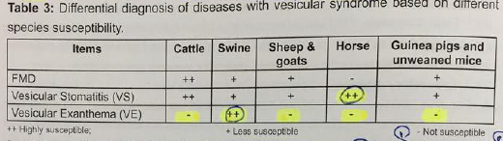
DIAGNOSIS:
Profuse salivation and vesicles with blanched covering epithelium filled with a clear straw colour fluid are pathognomonic.
By Serological tests:
Complement fixation test (CFT)-To know the type
Enzyme Linked Immunosorbent Assay (ELISA) and Polymerase Chain Reaction (PCR)
Mouse inoculation
Differential Diagnosis:

Slide 8
Control:
Spread by air borne route-difficult, but movement of livestock is to be stopped
In non- endemic areas policy of quarantine, slaughter and disinfection is effective and economical.
Vaccines may be monovalent, bivalent, trivalent or polyvalent
two
2 Inoculations are required, at 2-4 weeks apart, followed by revaccination every 4-12 months o achieve good level of immmunity.
first vaccination to calves is given at the age of 4 months, followed by booster at 2-4 weeks interval, revaccination every 6 months or 4-12 months once
Sheep and pigs vaccinated at 6 months of age and the dose is 1/3rd of cattle
The first vaccination leads to immunity in ruminants for about 3-6 months. Subsequent vaccinations may give protection for a year in cattle but only about 6 months in sheep.

