Slide 1
Fever(Pyrexia)
Dr. Bipin Kumar, Assistant Professor
Department of Veterinary Medicine
Bihar Veterinary College, Patna
(Bihar Animal Sciences University, Patna)

Slide 2
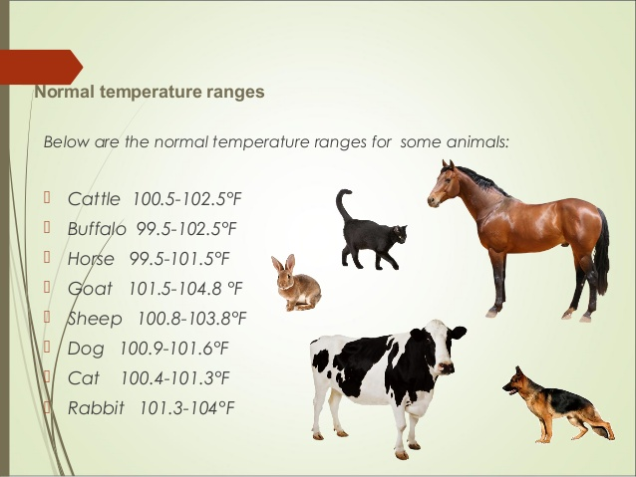
Fever(Pyrexia)
It is syndrome in which hyperthermia and toxaemia are produced by substance circulating in bloodstream.
Increase in body temperature over the normal value of an individual.

Slide 3
Etiology
Septic
Bacteria
Virus
Aseptic
Foreign protein
Dinitrophenol
Protozoa
Fungi etc
Surgery
Necrosis
Immune reaction eg Anaphylaxis,angioneurotic oedema

Slide 4
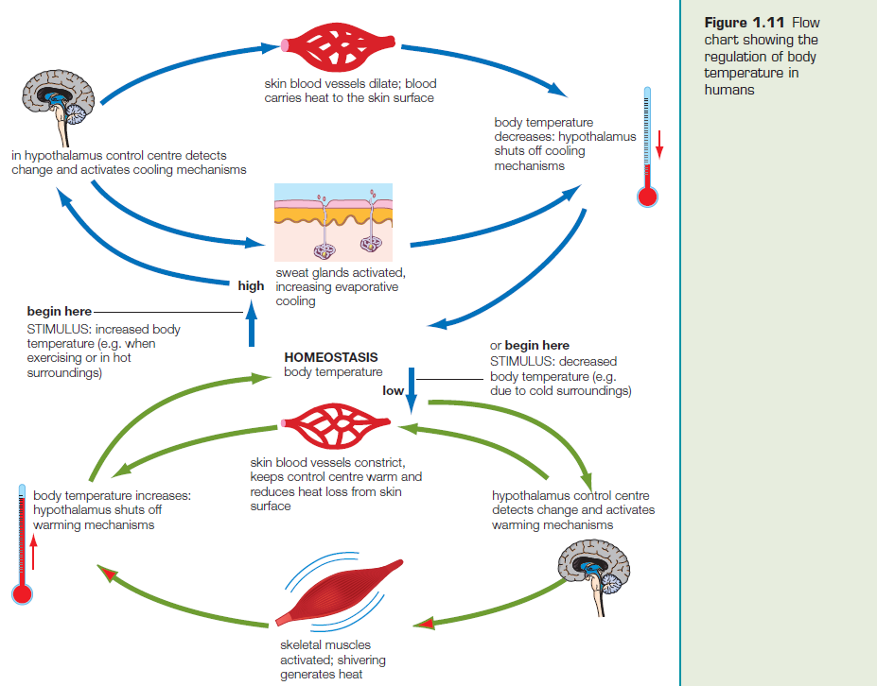

Slide 5
Pathogenesis
Pyrogens ( bacteria, virus, fungi, malignancy, connective tissue disorders , trauma )
Endogenous pyrogens → IL-1 , TNF ,interferons, IL-6, IL-11, stimulates.
Produced by Leukocytes.
Exogenous pyrogens →bacterial cell wall components (LPS) , enterotoxins , exotoxins.
Most potent exo. pyrogen is LPS.
IL-1 initiates fever through synthesis of PGE2 in antr. hypothalamus.
PGE2 raise the thermostatic set point followed by vasoconstriction and shivering.

Slide 6
Stages of fever
Period of increment.
Fastigium or constant temperature.
Decrementi or fever defervescence.

Slide 7
Clinical findings
Anorexia
Dryness of mouth
Oliguria
Depression
Increased HR,RR and depth.
Cold and pale skin
Shivering

Slide 8
Treatment
Management of fever: Two methods of antipyresis
1.Non-pharmacological ;
Environmental measures
Hydration (fluids)
Hydrotherapy (sponging)
2.Pharmacological therapy ;
Drugs; paracetamol, ibuprofen,mefenemic acid

Slide 9
Thank you

