Slide 1
FUEL METABOLISM
P.G.
VBC-608
Unit-2

Slide 2
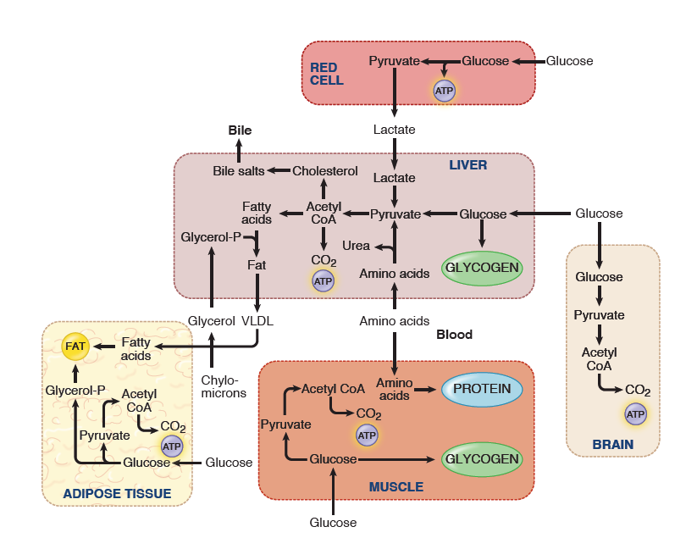
Metabolic Profile of the Well-Fed (Absorptive) State

Slide 3
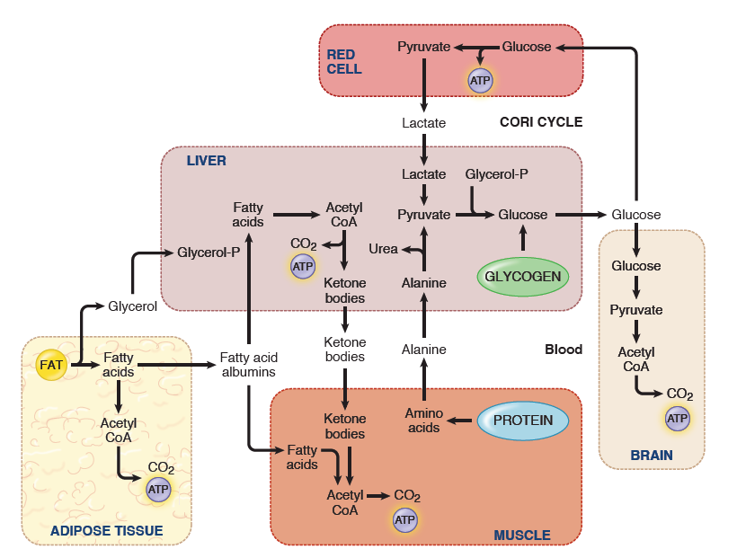
Metabolic Profile of the Postabsorptive State

Slide 4
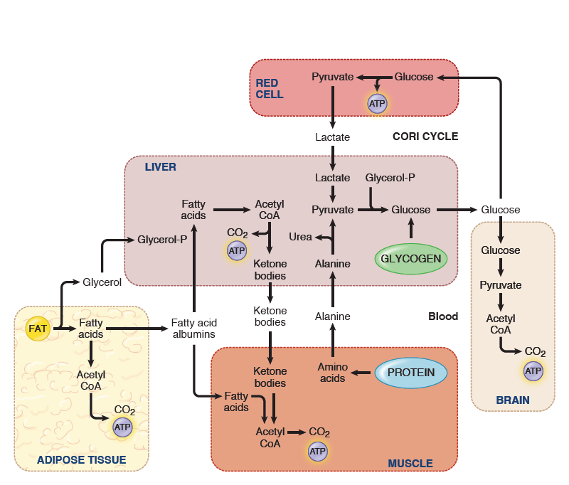
Metabolic Profile of the Postabsorptive State

Slide 5
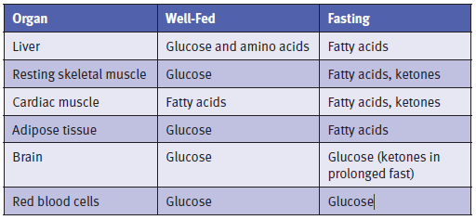
Preferred Fuels in the Well-Fed and Fasting States

Slide 6
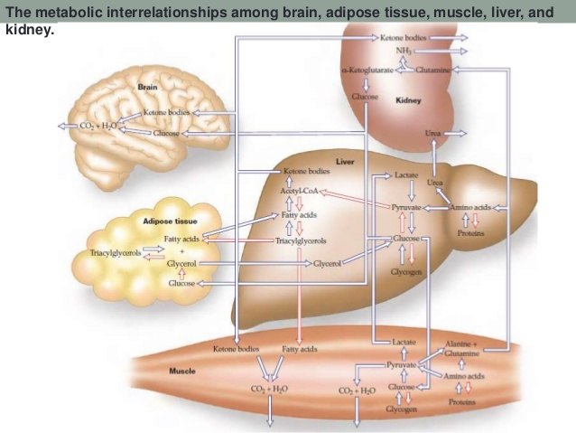
Metabolic Interrelationship

Slide 7
Fuel metabolism : In Brain
brain represents 2% of total body weight
obtains 15% of the cardiac output, uses 20% of total O2, and consumes 25% of the total glucose
It consumes about 120 g daily, which corresponds to an energy input of about 420 kcal (1760 kJ), accounting for some 60% of the utilization of glucose by the whole body in the resting state
glucose is the primary fuel for the brain
glucose uptake into the brain via GLUT 1 and GLUT 3 transporters
glycogen levels in the brain are minor, normal function depends upon continuous glucose supply
In hypoglycemic conditions, centers in the hypothalamus sense a fall in blood glucose level, and the release of glucagon and epinephrine is triggered

Slide 8
Fatty acids cannot cross the blood–brain barrier and are therefore not used at all
in prolonged fasts does the brain gain the capacity to use ketones for energy, and even then ketones supply only approximately 2/3 of the fuel; the remainder is glucose
Much of the energy, estimates suggest from 60% to 70%, is used to power transport mechanisms that maintain the Na+-K+ membrane potential required for the transmission of the nerve impulses
Overall, glucose metabolism remains unchanged during mental activity

Slide 9
GLUT3 has a low value of K_{M} for glucose (1.6 mM), which means that it is saturated under most conditions
the brain is usually provided with a constant supply of glucose
danger point is reached when the plasma-glucose level drops below about 2.2 mM (39.6 mg/dl) and thus approaches the KM value of GLUT3
Fatty acids do not serve as fuel for the brain, because they are bound to albumin in plasma and so do not traverse the blood-brain barrier

