Slide 1
GASTRITIS AND GASTRIC EROSIVE-ULCERATIVE DISEASE
Gastric mucosal injury and inflammation
Aetiology:
Dietry
Spoiled foods
infectious
Viral
Drugs
Nonsteroidal antiinflammatory drugs (NSAIDs)*
Chemical/TOXINS
Food sensitivity
Foreign body
Parvovirus
Distemper
Infectious hepatitis
Coronavirus
Bacterial
Helicobacter spp.*
Parasitic
Physaloptera spp.*
Ollulanus spp
Corticosteroids
Cleaning products
Ethylene glycol
Herbicides
Fertilizers
Petroleum distillates
Organophosphates
Heavy metals
Plant toxins
Repeated exposure to dietary antigens, drugs, chemicals, toxins, or infectious agents is thought to initiate an allergic or immune-mediated response, ultimately causing chronic gastritis.

Slide 2
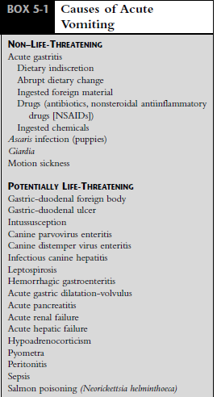

Slide 3
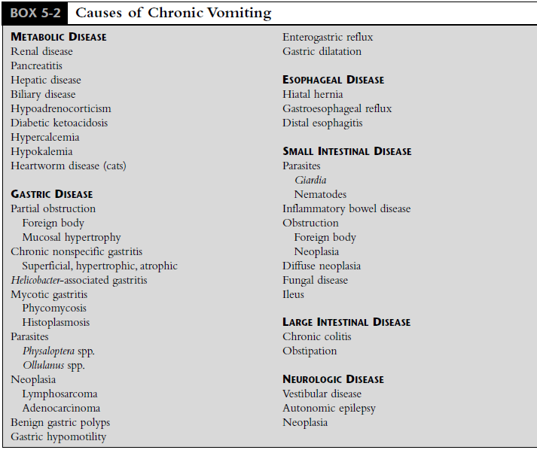

Slide 4
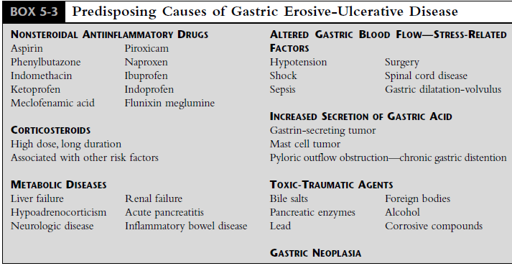
Causes of gastric erosion-ulcer (GEU):

Slide 5
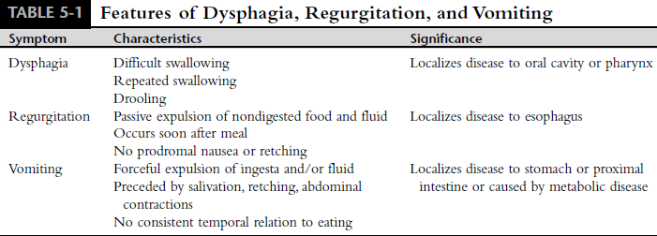

Slide 6
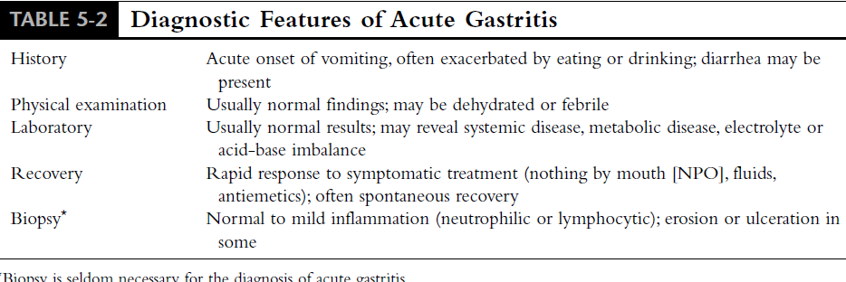

Slide 8
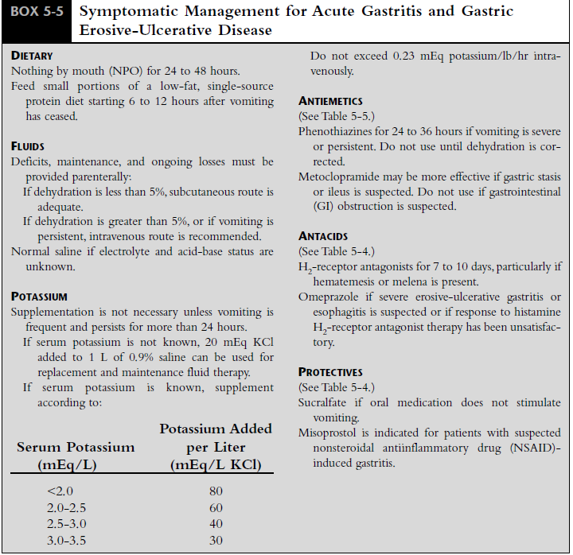

Slide 9
Source: HANDBOOK OF SMALL ANIMAL GASTROENTEROLOGY

