Slide 1
GENERAL SYSTEMIC STATES (HORSES)
Guided by:-Dr. Bipin Kumar
(A.Professor)
Department of Veterinary Medicine
Bihar Veterinary College
Prepared by: Dr. Pinky Rani
M.V.Sc. (Veterinary Medicine)

Slide 2
Temperature
The normal rectal temperature of a horse is 99.5 to 101.5°F (37.5 to 38.6ºC).
Foals less than 1 month of age have a normal temperature of 100.0 to 102.0°F (37.7 to 38.8ºC).
Newborn foals can easily suffer from hypothermia (low body temperature), so if the foal’s temperature is below 98.0°F (36.6ºC),

Slide 3
Sick foals are prone to hypothermia but cold stress can be reduced by good management procedures, including the Following :
The foal should be housed in an environment with minimal drafts, in which the air temperature is controlled at a steady value, set according to the foal's needs.
Air temperature should be at, or a few degrees above, the lower critical temperature.

Slide 4
This temperature may exceed 24°C for a sick, uncovered, recumbent foal.
Radiant heaters are useful but should not be placed too close to the foal
Excessive moisture should be removed from the foal's hair coat

Slide 5
Pulse
The normal heart rate for an adult horse is about 32 to 36 beats per minute.
Foal heart rates vary depending on age. Newborn foals have a heart rate of between 80 to 100 beats per minute.
Foals which are a few weeks to a few months of age will have heart rates of 60 to 80 beats per minute

Slide 6
SHOCK
An equine that is in a state of shock will appear anxious or agitated, have low or no urine output, may have diarrhea, have a rapid, but weak pulse accompanied by shallow breathing, will sweat profusely and show signs of confusion.

Slide 7
ENDOTOXEMIA
Endotoxemia occurs when gram negative organisms proliferate in tissues.
Endotoxemia remains the leading cause of death in horses, being intimately involved in the pathogenesis of gastrointestinal disorders that cause colic and neonatal foal septicemia.
Endotoxins, normally present within the bowel, gain access to the blood across damaged intestinal mucosa

Slide 8
Capillary Refill Time
Capillary refill time is tested by pressing your finger firmly on the gum above the front incisors and removing it quickly.
The time it takes for the area to turn from white back to pink is the capillary refill time.
Normal refill time is about 2 seconds.

Slide 9
HEART AND LUNGS
In a horse, of around15 hh (152 cm) that weighs 1,000 lb (450 kg), the heart weighs 10 lb (4.5 kg).
It has a resting rate of about 30–40 beats per minute, during which time it pumps up to 64 pints (40 liters) of blood.

Slide 10
Respiration
The normal respiratory rate for adult horses is eight to 12 breaths per minute.
Newborn foals have respiratory rates that are 60 to 80 breaths per minute.
Older foals have resting respiratory rates from 20 to 40 breaths per minute.
Remember, if your horse or foal becomes excited for any reason, the respiratory rate can be temporarily elevated.

Slide 11
NERVOUS SYSTEM
A horse’s brain weighs about half that of a human.
However, the cerebellum is quite large.
This is the part of the brain that controls muscle activity and balance.
It gives horses, like all flight animals, the ability to run within an hour of being born.

Slide 12
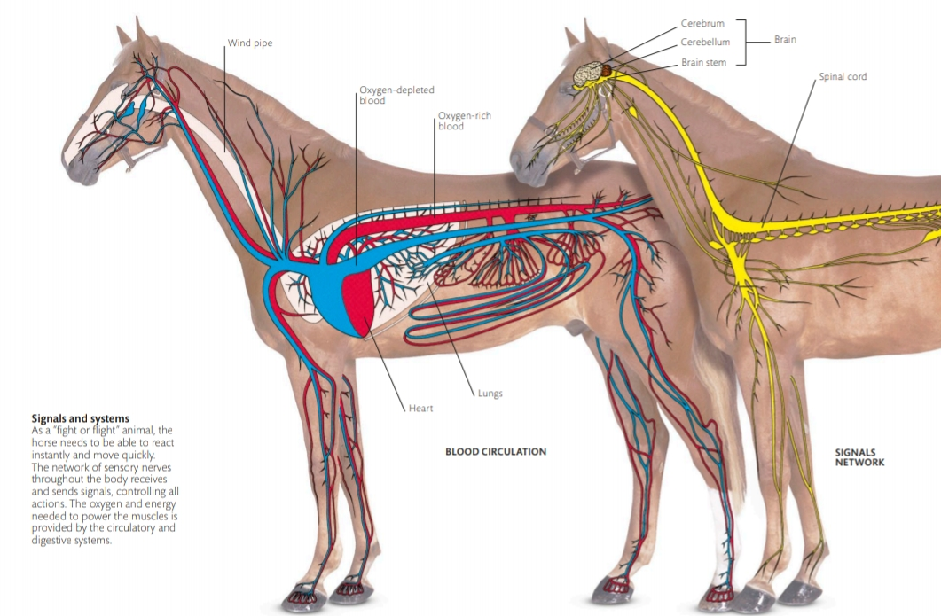

Slide 13
DIGESTION PROCESS
The horse has a small stomach and must eat continuously to get the nutrition it needs
Horses chew their food well before they swallow it. They have grinding teeth which grow continuously until old age
The digestive system of a horse is very large, with over 65½ ft (20 m) of small intestine and 23 ft (7 m) of large intestine.
(This has two 180° bends, where food can easily get stuck and cause colic)
The cecum is found where the large and small intestine meet and is a large sac like organ, over 3 ft (1 m) long, where the cellulose is fermented by gut bacteria.
In comparison to cows, horses can also eat more food since it takes 48 hours to pass through their gut, compared to 70–90 hours in a cow.
Horses cannot vomit, which makes them vulnerable to poisons

Slide 14
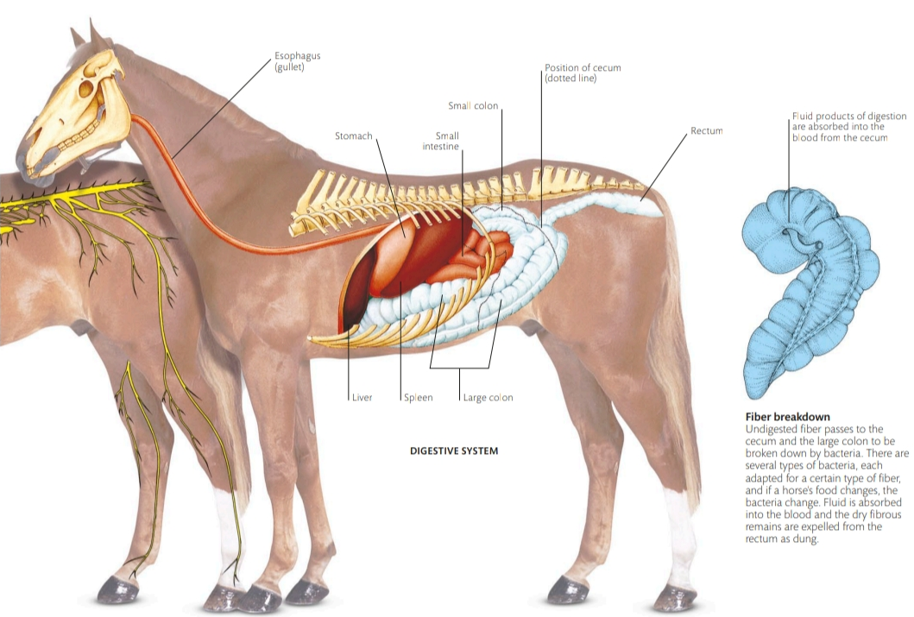

Slide 15
THANK YOU

