Slide 1
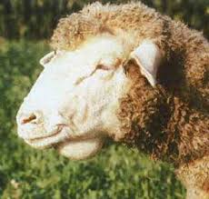
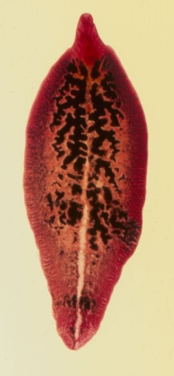
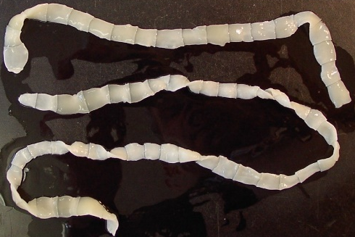
Salient Characters
of
Phylum: Platyhelminthes
Dr. AJIT KUMAR
Department of Veterinary Parasitology
Bihar Veterinary College
Bihar Animal Sciences University
Patna-800014
Image source: Google image

Slide 2
Salient Characters of
Phylum: Platyhelminthes
Parasites are eukaryotic organisms.
Parasites
Helminths
(Metazoa- Multicellular)
Phylum:- Platyhelminthes
Phylum:-Nemathelminthes
Phylum:-Acanthocephala
Arthropods
(Metazoa- Multicellular)
Protozoa
(Unicellular)

Slide 3
Salient Characters of
Phylum: Platyhelminthes
Helminth word has been derived from a Greek word helmins or helminthos which means a worm.
Helminths (worms) are mainly endoparasites.
Helminths
Platyhelminthes
Nemathelminthes
Acanthocephala

Slide 4
Salient Characters of
Phylum: Platyhelminthes
Phylum- Platyhelminthes
General Characters:
Dorsoventrally flattened body and hence, they are called as flatworms
Solid bodies without a body cavity (acoelomate)
Segmented body
Suckers are usually present.
Image source: Google image

Slide 5
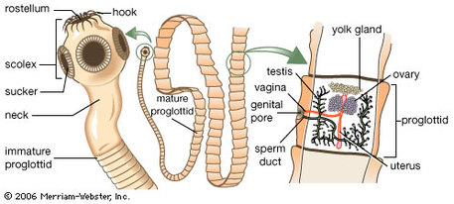
Salient Characters of
Phylum: Platyhelminthes
Phylum- Platyhelminthes
General Characters:
Usually hermaphrodite or bisexual (monoecious)
Excretory organs are flame-cells (protonephridia)
Respiratory and blood-vascular system are absent
Life-cycle usually indirect.
Image source: Google image

Slide 6
Salient Characters of Phylum: Platyhelminthes
Classification
Phylum :- Platyhelminthes
Class:- Trematoda
Class:-
Cestoda
 | Trematodes | Cestodes
Common name | Flukes | Tape worms
Body segmentation | Absent | Present
Alimentary canal | Present | Absent
Operculum in egg | Usually operculated egg | Usually non- operculated egg
Notes:
ic

Slide 7
Salient Characters of
Phylum: Platyhelminthes
Class: Trematoda
Order:- Digenea
Family:-
Family | Genus
Dicrocoelidae | Dicrocoelium ( Lancet Fluke)
Fasciolidae | Fasciola ( Liver fluke) , Fasciolopsis
Paramhistomatidae | Paramhistomum, Cotylophoron, Gigantocotyle, Gastrothylax, Gastrodiscus etc.
Paragonimidae | Paragonimus ( Lung fluke)
Prosthogonimidae | Prosthogonimus ( Oviduct fluke)
Opisthorchidae | Opisthorchis
Schistosomatidae | Schistosoma ( Blood fluke)

Slide 8
Salient Characters of
Class:Trematoda
Flukes are usually dorsoventrally flattened and leaf shaped except schistosomatidae in which worms are cylindrical long whereas amphistomes have thick fleshy bodies.
Body is unsegmented, solid and without a body cavity. All organs are embedded in a parenchyma.
Body covering is called as tegument which is spiny or smooth.
.
Image source: Google image

Slide 9
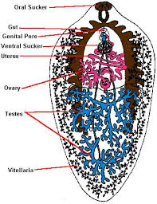
Salient Characters of
Class:Trematoda
There are generally two suckers (Oral & ventral suckers) which serve as organ of attachment.
Digestive system consists of mouth (surrounded by oral sucker) , muscular Phrynx, an oesophagus and intestine which usually divided into two blind caeca.
Excretory organs consist of flame cells (Solenocytes)
Image source: Google image

Slide 10
Salient Characters of
Class:Trematoda
Flukes are usually hermaphrodite except Schistosomatidae. family, which is unisexual.
Schistosoma
Image source: Google image

Slide 11
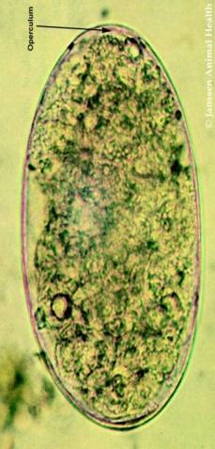
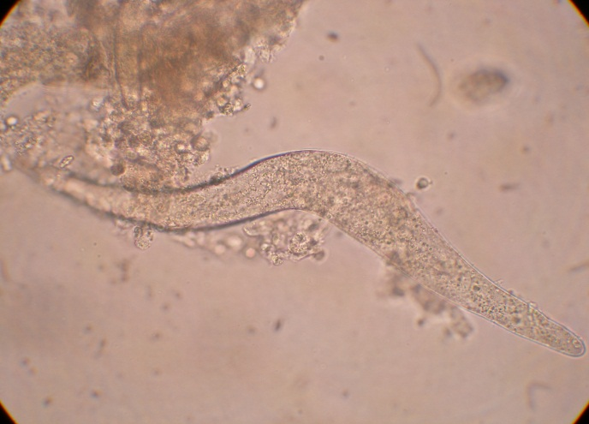
Salient Characters of Class:Trematoda
Egg are generally operculated or lid at one pole except blood fluke eggs which are non-opercualted.
Non-operculated egg of Schistosoma nasale

Slide 12
Life- Cycle of Trematodes ( FLUKES)
Life- cycle is always indirect involving snail as intermediate host.
First Intermediate host always snail and 2nd Intermediate host may be snail or other species.

Slide 13
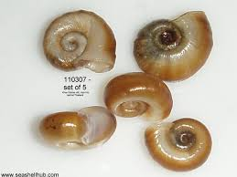
LIFE-CYCLE OF FLUKES
Egg Miracidium
Sporocyst
Redia
Cercariae
cercaria emerge from the aquatic snail and encyst on aquatic vegetation or enter inside 2nd intermediate host & form Metacercaria.
INSIDE
THE
SNAIL
Image source: Google image

Slide 14
Class- Cestoda Two Sub-class Eucestoda Cotyloda (true tapeworms) (Pseudotapeworms) Order- Cyclophyllidea Order- Pseudophyllidea
CLASS- CESTODA

Slide 15
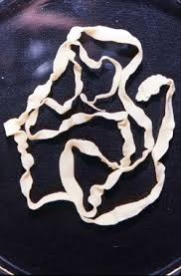
Salient Characters of
Class: Cestoda
Cestoda contain two sub-classes- Eucestoda (true cestodes) & Cotyloda (Fish tape worms).
Worms are like ribbon or tape, hence called tapeworms.
Body is dorsoventrally flattened ribbon like metamerically segmented.
Image source: Google image

Slide 16
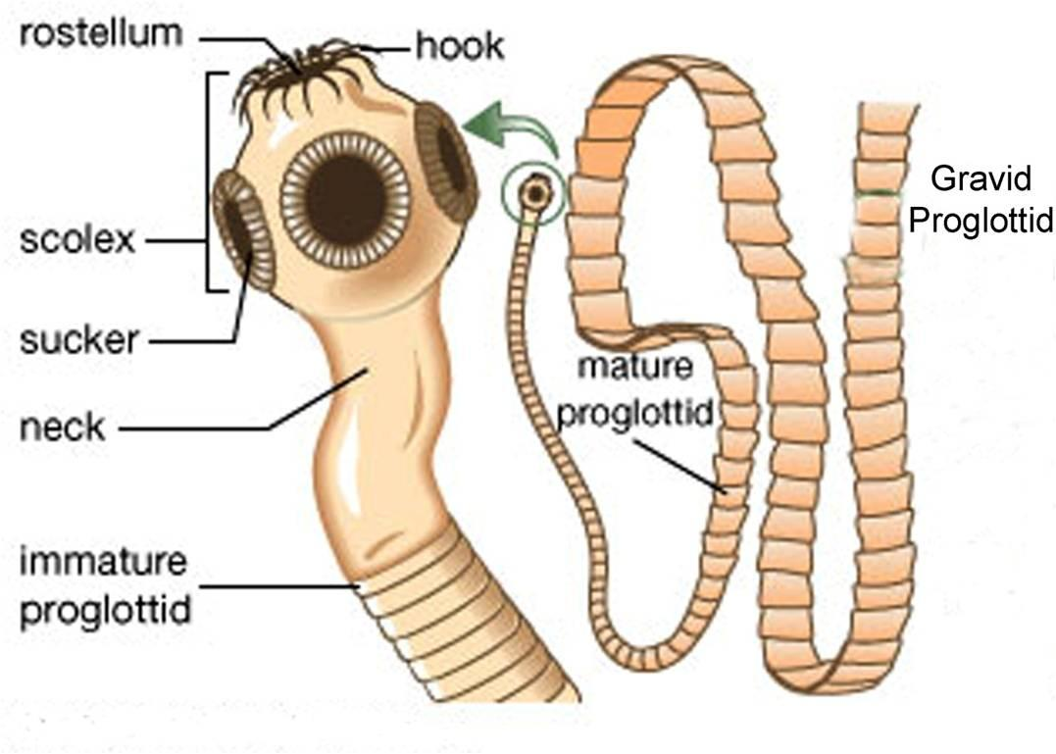
General characters of Cestodes
Body of adult tapeworms consist of
i. Scolex or head ii. Neck iii. Strobila
Body consists of a head i.e. Scolex bearing hold fast organs or suckers, then unsegmented neck followed by strobila which consists of immature (reproductive system and eggs are absent), mature (reproductive organs are mature and functional) and gravid segments of proglottid (reproductive organs degenerate and filled with eggs).
Image source: Google image

Slide 17
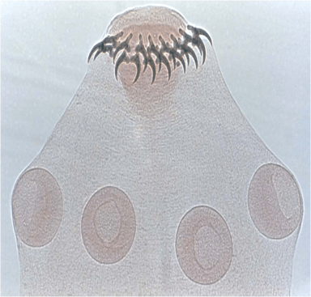
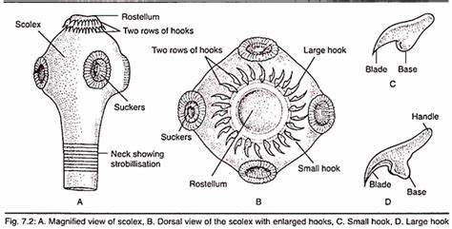
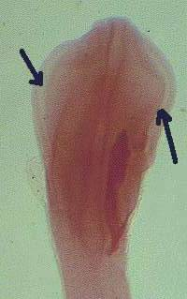
General Characters of Cestodes
In eucestoda, scolex is normally provided with four (4) suckers which may be armed with hooks.
Scolex usually bears anteriorly a mobile protrusible rostellum which may be also armed with one or more concentric rows of hooks.
In cotyloda, the scolex has narrow deep weakly spatula shaped muscular groove known as Bothria as hold fast organ instead of suckers.
Image source: Google image

Slide 18
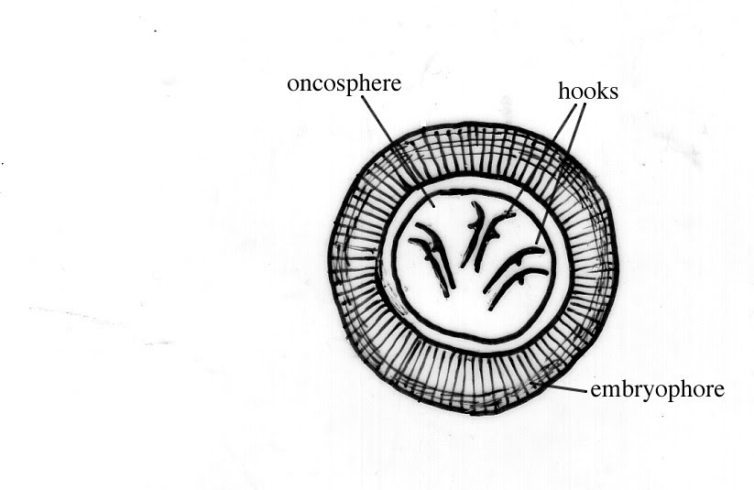
General characters of Cestodes
Excretory system consists of flame cells (Solenocytes) and efferent canal & discharge nutrient at the terminal segments.
Cestode eggs may be embryonated or unembryonated when passed from the host and the fully embryonated egg contains an onchosphere.
Onchosphere is bilaterally symmetrical, spherical or oval and is armed with 3 pairs of hooks.
In cotyloda, eggs hatch in the environment whereas in Eucestoda, eggs hatch after being ingested by intermediate hosts.

Slide 19
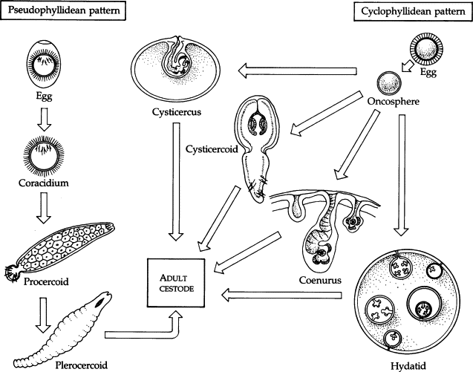
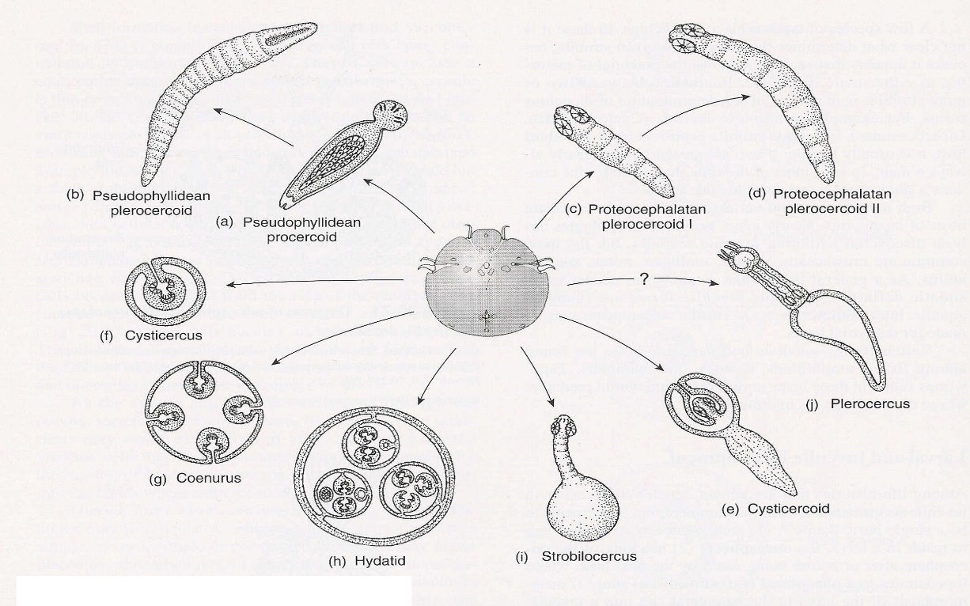
Metacestodes or Bladder worms (Larval stages of Cestodes)
Larval stages of cestode is called metacestodes or bladder worms.
Different metacestodes-
Tetrathyridium is an elongated, solid bodied metacestode with deeply invaginated acetabular scolex. e.g. Mesocestoididae.
Cysticercoid is single non-invaginated scolex embedded in a small solid vesicle. e.g. Dipylidium caninum.
Image source: Google image

Slide 20
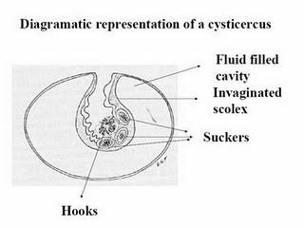
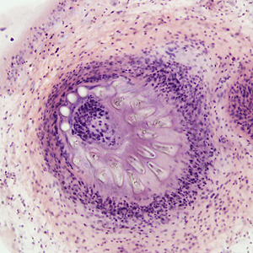
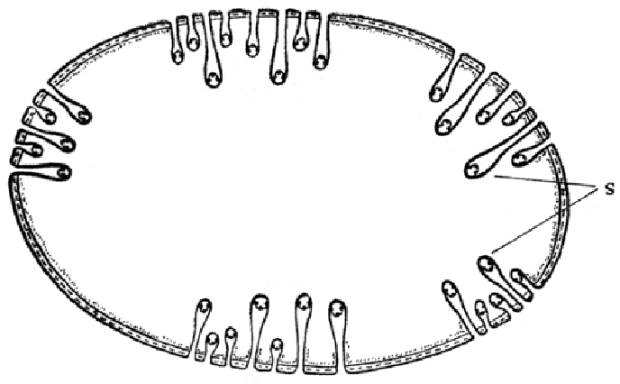
Types of metacestodes
Cysticercus is fluid filled bladder containing an attached single invaginated scloex.
e.g. Taenia saginata, Taenia solium, Taenia pisiformis etc.
Coenurus is a large fluid containing bladder with a no. of invaginated scolices attached to the walls.
e.g. Taenia multiceps.
Scolices
Image source: Google image

Slide 21
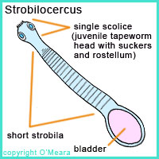
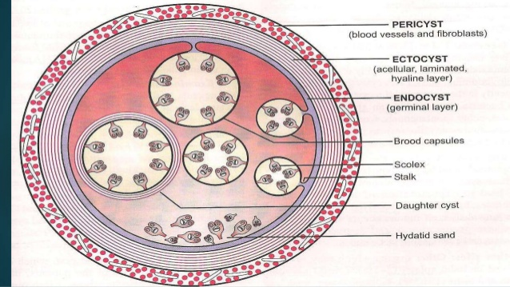
Types of metacestodes
Strobilocercus has a scolex which is not invaginated when fully developed and is attached to the bladder by a long segmented strobila.
e.g. Taenia taeniaeformis.
Hydatid cyst is a thick walled large size fluid containing bladder with a no. of brood capsule inside it and each brood capsule contain a no. of scolices.
e.g. Echinococcus granulosus.

Slide 22
Types of metacestodes
Procercoid is first larval stage of Diphyllobothrium latum occurs in the 1st intermediate host (Cyclops). It is solid bodied and bears 6-hooks on the cercomere in the posterior region.
Plerocercoid is 2nd larval stage of Diphyllobothrium latum occurs in the 2nd intermediate host (Fish). Plerocercoids are elongate, solid bodies metacestodes which bear an adult scolex.
Procercoid
Plerocercoid
Image source: Google image

Slide 23
Class- Cestoda Two Sub-class Eucestoda Cotyloda (true tapeworms) (Pseudotapeworms) Order- Cyclophyllidea Order- Pseudophyllidea
Character | Pseudophyllidea | Cyclophyllidea
Scolex | has two narrow deep grooves called bothria | has Four suckers which may be armed with hooks
Genital pore | found on ventral surface | Marginal except Mesocestoides where it is on mid ventral surface
Egg | Operculated and unembryonated | Embryonated and non-operculated
Intermediate host | Require two intermediate hosts | Require one intermediate host except Mesocestoides
Family (Genus) | Diphyllobothridae (Diphyllobothrium, Spirometra) | Anoplocephalidae (Anoplocephala, Moniezia, Stilesia, Avitelina, Thysanosoma) Dilepididae ( Dipylidium, Amoebotaenia, Choanotaenia) Davaineidae ( Davainea, Raillietina, Cotugnia) Taeniidae (Taenia, Echinococcus) Hymenolepididae ( Hymenolepsis) Mesocestoididae (Mesocestoides)
( true tapeworms) (Pseudotapeworms)

Slide 24
THANK U

