Slide 1
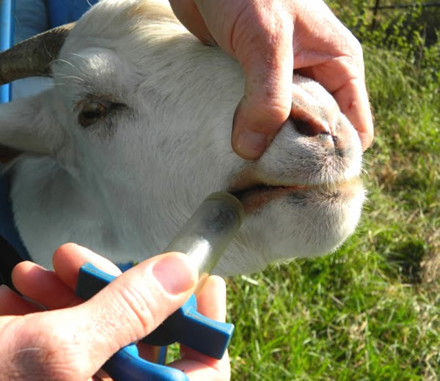
General Control Measures of Parasitic Infections -I
Dr. AJIT KUMAR
Department of Veterinary Parasitology
Bihar Veterinary College
Bihar Animal Sciences University
Patna-800014
Image source: Google image

Slide 2
General Control Measures of Parasitic Infections
Methods used to control parasitic infections are as follows-
Chemotherapy
Immunological control
Biological Control
Intermediate hosts control
Pasture management
Managemental control
Genetic control

Slide 3
General Control Measures of Parasitic Infections
Chemotherapy: -
Chemotherapy (Antiparasitic drugs) is still considered as the most important control measures against parasitic infections.
Anthelmintics
Insecticides
Acaricides
Antiprotozoal drugs

Slide 4
General Control Measures of Parasitic Infections
Chemotherapy: -
Anthelmintics: Drugs use to expel the helminth parasites from the body of the host by either stunning or killing are called Anthelmintics e.g. Albendazole, Levamisole, Piperazine salts etc.
They may also termed vermifuge (those that stun) or vermicide (those that kill).
First chemical class of modern anthelmintics developed was the benzimidazoles.
Thiabendazole was first drug introduced in this class (benzimidazoles) in1961.

Slide 5
General Control Measures of Parasitic Infections
Anthelmintics | Examples | Mechanism of action
Chemical groups | Examples | Mechanism of action
Benzimidazoles | Thiabendazole, Mebendazole Fenbendazole, Albendazole, Triclabendazole, Oxfendazole & Oxibendazole | Interfere with energy metabolism by inhibition of polymerization of microtubules leads to starvation of parasite. Wide margin of safety and frequently develop resistance against nematodes of sheep and horses.
Imidazothiazoles | Tetramisole and Levamisole | Cholinergic agonists result spastic paralysis
Tetrahydropyrimidines | Morantel and Pyrantel | Acetylcholine agonist and depolarizing neuromuscular blocking which result spastic paralysis.
Organophosphates | Dichlorvos, Haloxon and Trichlorphon | Cholinesterase Inhibitor and causes spastic paralysis
Piperazines | Piperazine salts | Anticholinergic action – block neuromuscular transmission leads to flaccid paralysis.
Macrocyclic Lactones (Macrolides) | Ivermectin, Doramectin, Moxidectin and Selamectin | Potentiate GABA or bind to glutamate chlorine channels causing flaccid paralysis
Salicylanilides or substituted phenols | Niclosamide, Oxyclozanide, Closantel and Rafoxanide | Interfering ATP production in parasites by uncoupling oxidative phosphorylation.
Isoquinolones | Praziquantel and Epsiprantel | Paralysis and tegumental destruction of parasite

Slide 6
General Control Measures of Parasitic Infections

Slide 7
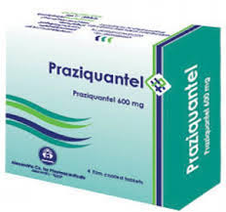
General Control Measures of Parasitic Infections
Anthelmintics :
Anthelmintics | Effective against
Fenbendazole | Usually Nematodes and tapeworms
Praziquantel | Tapeworms & Schistosomes
Oxyclozanide | Fasciola spp. ( Liver fluke) and Amphistomes
Triclabendazole | Fasciola spp.

Slide 8
General Control Measures of Parasitic Infections
Anthelmintics :
Anthelmintic | Effective against
Fenbendazole | usually Nematodes and tapeworms

Slide 9
General Control Measures of Parasitic Infections
Anthelmintics :
Mechanism of action:
Anthelmintic | Effective against
Praziquantel | Tapeworms & Schistosomes ( Blood flukes)

Slide 10
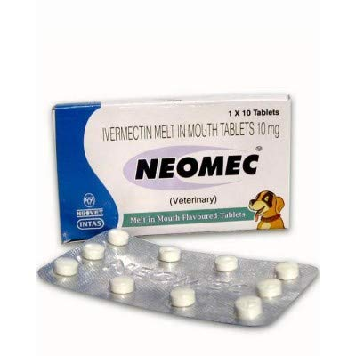
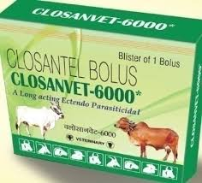
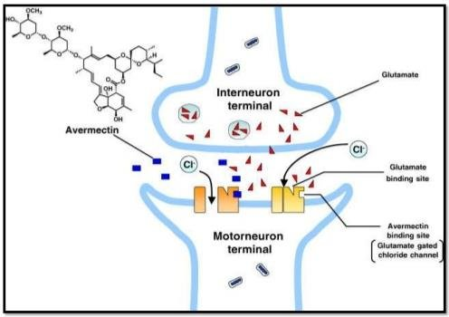
General Control Measures of Parasitic Infections
Edectocidal drugs:
Act against both endoparasites (Helminths etc.) and ectoparasites
( Flies, ticks, mites etc.)
e.g. Ivermectin and Closantel.
Ivermectin is an antibiotic extracted from fermentation of Streptomyces avermitilis.
Mechanism of action of Ivermectin:

Slide 11
General Control Measures of Parasitic Infections
Deworming: It is a process in which an anthelmintic drug uses in human or animal to rid them of helminths parasites ( roundworms, Tapeworms and flukes).
Types of worms | Deworming Schedule in cattle
Round worms | First dose at 10 days of age and thereafter at monthly interval up to 6 months. After 6 months of age, deworming to be done at an interval of 2 months
Liver Flukes | Twice in a year in endemic areas ( before and after monsoon)
Tapeworms | Twice in a year ( January and June in calves in problem herds)

Slide 12
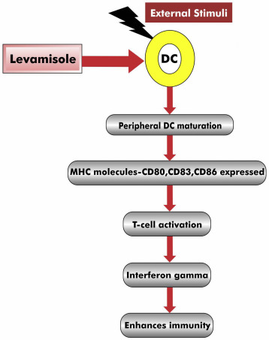
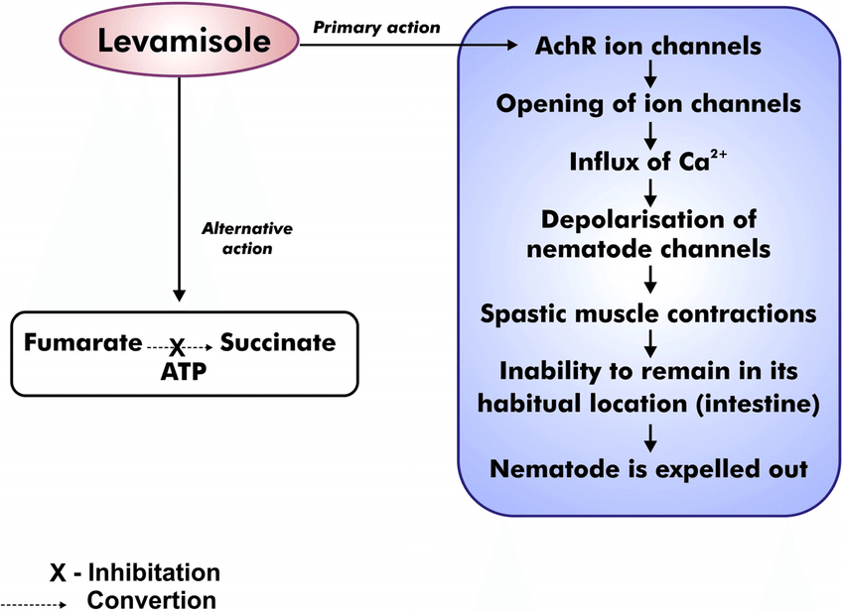
General Control Measures of Parasitic Infections
Anthelmimtic and Immunostimulant:
work as anthelmintic and immunity enhancer.
e.g. Levamsiole
Immunostimulant
Anthelmintic Action
Image source: Google image

Slide 13
General Control Measures of Parasitic Infections
Methods of anthelmintics Administration:
Oral
Drenching ( Liquid or suspension)
Licking –
Through the feed: - Tablets
Injection –
Subcutaneous:- Ivermectin
Intramuscular:- Doramectin
Image source: Google image

Slide 14
General Control Measures of Parasitic Infections
Insecticides :
Act against insects ( Flies, lice, ticks , mites etc.) .
e.g. D.D.T., Cypermethrin, Deltamethrin etc.
Acaricides :
Drugs which act against ticks and mites.
e.g. Amitraz, Deltamethrin etc.
Image source: Google image

Slide 15
General Control Measures of Parasitic Infections
Insecticides | Examples | Mechanism of action
Chemical groups | Examples | Mechanism of action
Organophosphates | Fenthion, diazinon, phosmet, Dichlorvos (used orally), Haloxon and Trichlorphon | Irreversible acetylcholinesterase inhibitor
Chlorinaed hydrocarbons | DDT, Lindane(r-BHC), Aldrin, Dieldrin, Chlordane & Toxophene
Carbamates | Carbaryl, Carbanolate & Propoxur | Reversible cholinesterase Inhibitor
Synthetic pyrethroids | Pyrethrins, Cypermethrin, Deltamethrin, Fenvalerate & Permethrin | Block nicotinic receptors and increase GABA release
Formamidines | Amitraz | Octopamine receptor agonist in insects
Fly repellents | Dimethyl phthalate | Used for mosquitoes.
Growth regulators | Methopreme & Triflumuron | Prevent insects from reaching maturity by arresting larval development.

Slide 16
General Control Measures of Parasitic Infections
Antiprotozoal drugs - Effective against Protozoan parasites
Antiprotozoal drugs | Effective against Protozoa
Buparvaquone (Butalex) | Theileria spp. ( Theileriosis)
Quinapyramine sulphate and Quinapyramine chloride (Triquin) | Trypanosoma spp. (Trypanosomosis)
Isometamedium chloride | Trypanosoma spp.
Diminazene aceturate | Babesia spp. ( Babesiosis), Trypanosoma spp., Theileria spp.
Imidocarb | Babesia spp.
Metronodazole | Entamoeba spp. ( Amoebic dysentery )

Slide 17
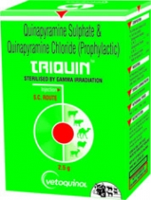
General Control Measures of Parasitic Infections
Chemical control-
Antiprotozoal Drugs:
Trypanosoma spp.
Theileria spp.
Babesia spp.

Slide 18
General Control Measures of Parasitic Infections
Chemoprophylaxis :-
it is a type of prophylactic measure where the drugs are used in susceptible animals to prevent the infection.
e.g. Quinapyramine chloride for Trypanosoma evansi.
Broad spectrum anthelmintics like Albendazole, Fenbendazole etc. used for round worms infections as chemoprophylaxis.
Trypanosoma spp.

Slide 19
THANK U

