Slide 1
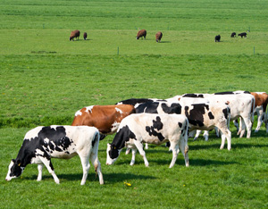
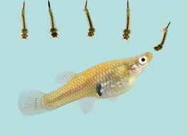
General Control Measures of Parasitic Infections-II
Dr. AJIT KUMAR
Department of Veterinary Parasitology
Bihar Veterinary College
Bihar Animal Sciences University
Patna-800014
Image source: Google image

Slide 2
General Control Measures of Parasitic Infections
Methods used to control parasitic infections are as follows-
Chemotherapy
Immunological control
Biological Control
Intermediate hosts control
Pasture management
Managemental control
Genetic control

Slide 3
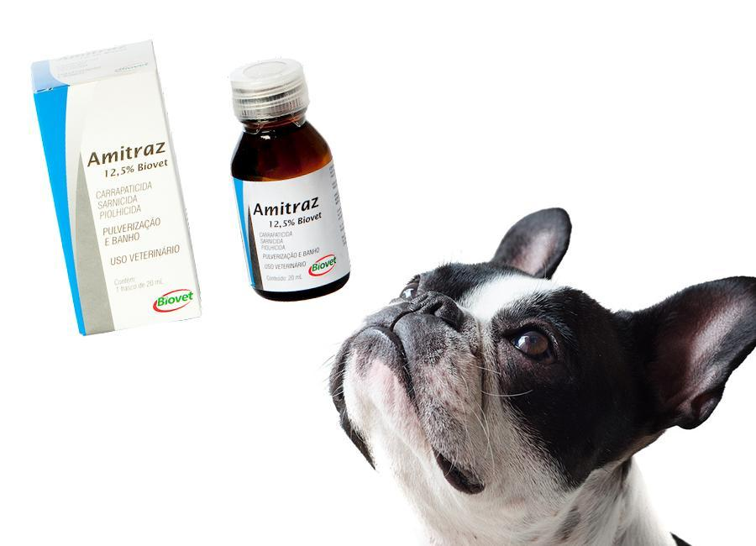
General Control Measures of Parasitic Infections
Insecticides :
Act against insects ( Flies, lice, ticks , mites etc.) .
e.g. D.D.T., Cypermethrin, Deltamethrin etc.
Acaricides :
Drugs which act against ticks and mites.
e.g. Amitraz, Deltamethrin etc.
Image source: Google image

Slide 4
General Control Measures of Parasitic Infections
Insecticides | Examples | Mechanism of action
Chemical groups | Examples | Mechanism of action
Organophosphates | Fenthion, diazinon, phosmet, Dichlorvos (used orally), Haloxon and Trichlorphon | Irreversible acetylcholinesterase inhibitor
Chlorinated hydrocarbons | DDT, Lindane(r-BHC), Aldrin, Dieldrin, Chlordane & Toxophene | -
Carbamates | Carbaryl, Carbanolate & Propoxur | Reversible cholinesterase Inhibitor
Synthetic pyrethroids | Pyrethrins, Cypermethrin, Deltamethrin, Fenvalerate & Permethrin | Block nicotinic receptors and increase GABA release
Formamidines | Amitraz | Octopamine receptor agonist in insects
Fly repellents | Dimethyl phthalate | Used for mosquitoes.
Growth regulators | Methopreme & Triflumuron | Prevent insects from reaching maturity by arresting larval development.

Slide 5
General Control Measures of Parasitic Infections
Antiprotozoal drugs - Effective against Protozoan parasites
Antiprotozoal drugs | Effective against Protozoa
Buparvaquone (Butalex) , Chloroquine | Theileria spp. ( Theileriosis)
Quinapyramine sulphate and Quinapyramine chloride (Triquin), | Trypanosoma spp. (Trypanosomosis)
Isometamedium chloride | Trypanosoma spp.
Diminazene aceturate | Babesia spp. ( Babesiosis), Trypanosoma spp., Theileria spp.
Imidocarb, Trypan blue | Babesia spp.
Sulphonamides, Amprolium, Lasalocid, , Nitrofurazone | Eimeria spp. ( Coccidiosis)
Metronidazole | Entamoeba spp. ( Amoebic dysentery )

Slide 6
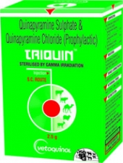
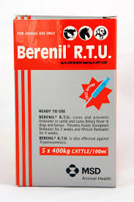
General Control Measures of Parasitic Infections
Chemical control-
Antiprotozoal Drugs:
Trypanosoma spp.
Theileria spp.
Babesia spp.

Slide 7
General Control Measures of Parasitic Infections
Chemoprophylaxis :-
It is a type of prophylactic measure where the drugs are used in susceptible animals to prevent the infection.
e.g. Quinapyramine chloride for Trypanosoma evansi.
Broad spectrum anthelmintics like Albendazole, Fenbendazole etc. used for round worms infections as chemoprophylaxis.
Trypanosoma spp.

Slide 8
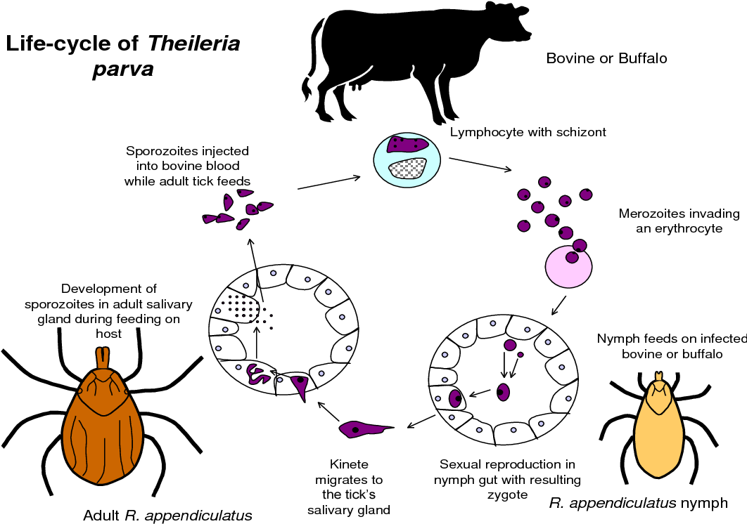
General Control Measures of Parasitic Infections
Chemoimmunoprophylaxis :-
It is a infection- treatment method and as result immunity develop in the host which prevents subsequent infection.
e.g. Ground up tick’s tissue suspension/sporozoites (GUTTS) are used as source of infection and then treated with Oxytetracyline.
Image source: Google image

Slide 9
General Control Measures of Parasitic Infections
Immunological control :
In this prophylactic measures, usually vaccines are used for the immunization or vaccination of susceptible animals.
Commercial available vaccines | Used for the parasitic disease
Raksha vac-T | Theileriosis
Coccivac | Poultry coccidiois
Livacox | Poultry coccidiois
TickGard | Boophilus microplus tick
Gavac | Boophilus microplus tick
Dictol | Dictyocaulus viviparous
Image source: Google image

Slide 10
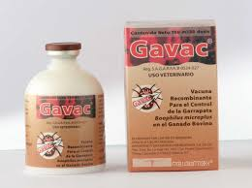
General Control Measures of Parasitic Infections
Immunological control :
Image source: Google image

Slide 11
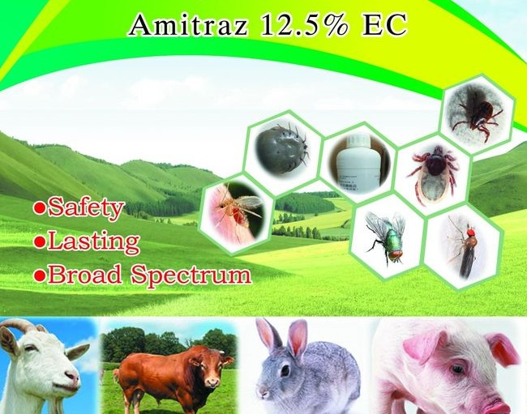
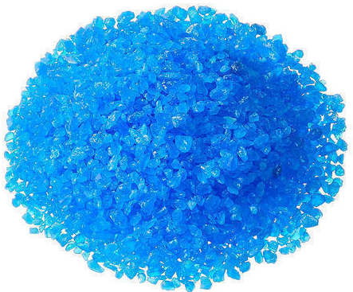
General Control Measures of Parasitic Infections
Intermediate hosts or vectors control-
By chemical method-
Intermediate hosts/vectors | Effective chemical drugs
Snails | Copper sulphate, sodium pentachlorophenate etc.
Flies, lice, fleas, bugs, ticks, mites etc. | Insecticides: (Deltamethrin (Butox), Cypermethrin ( Clinar), Flumethrin, Malathion, Amitraz, Ivermectin etc.)
Copper sulphate
Image source: Google image

Slide 12
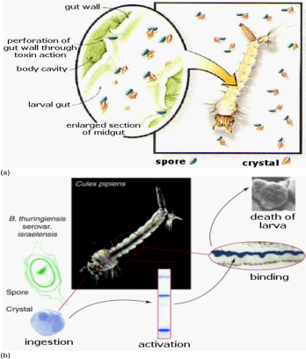
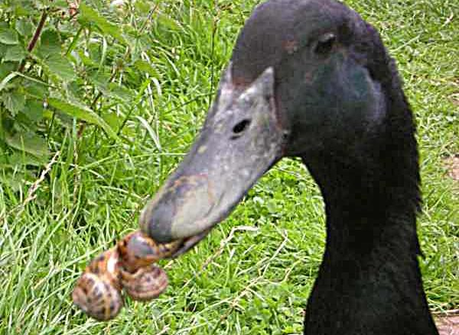
General Control Measures of Parasitic Infections
Intermediate hosts or vectors control-
Biological method-
Duck rearing for controlling snails.
Rearing of Gambusia fishes for mosquitoes larvae control.
Bacillus thuriengiensis subspecies israelensis (Bti) ( bacteria) for mosquitoes larvae control.
Mosquito
larvae
Gambusia fish
Duck feeding on snails
Image source: Google image

Slide 13
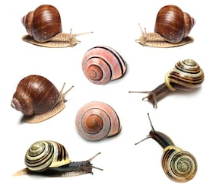
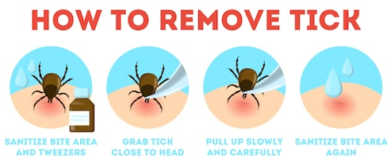
General Control Measures of Parasitic Infections
Intermediate hosts or vectors control-
Mechanical method-
Snails and ticks are collected manually and killed by using a hard object.
Image source: Google image

Slide 14
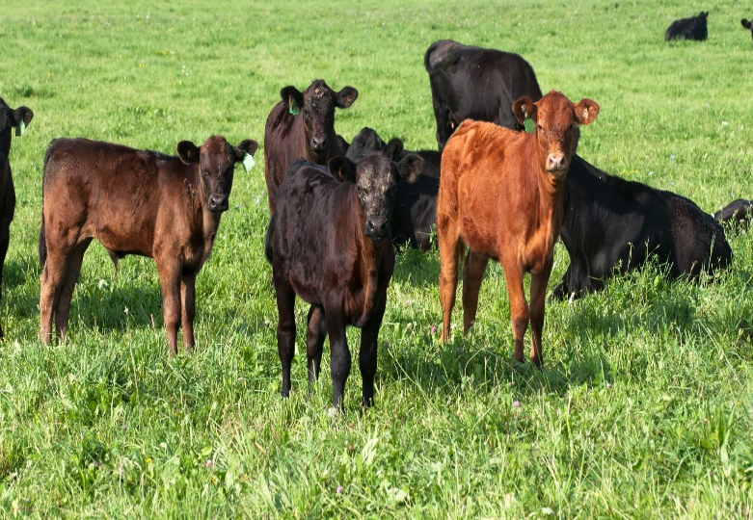
General Control Measures of Parasitic Infections
Pasture management-
Rotational grazing :-
Susceptible younger animals should be grazed ahead followed by the immune adults (Rotational grazing).
It results pasture contamination is greatly reduced which leads to chance of pick up infection by the susceptible animals is low.
Image source: Google image

Slide 15
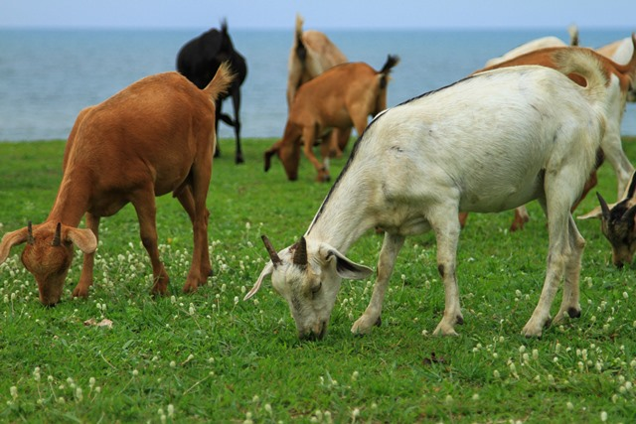
General Control Measures of Parasitic Infections
Pasture management-
Alternate grazing :-
The pasture is grazed by different species of animal like cattle, horse and sheep each with few months.
A pasture grazed by cattle and/or horses is considered safe, since sheep/goats and cattle/ horses do not share the same parasites , so cross infection is inhibited.
Image source: Google image

Slide 16
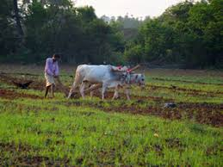
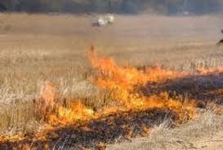
General Control Measures of Parasitic Infections
Pasture management-
Pasture spelling :-
Withdrawal of grazing animals from the infected pasture for at least one year to kill the parasites or its stages by starvation.
Ploughing and burning of parasites to kill the adults or its larval stages.
Image source: Google image

Slide 17
General Control Measures of Parasitic Infections
Managemental control-
Regular and proper disposal of manure.
Providing proper ventilation, adequate feed and clean water.
Regular deworming and vaccination.
Keep sick and healthy animals in separate house.
Image source: Google image

Slide 18
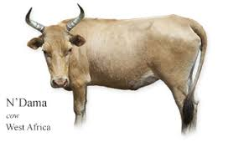
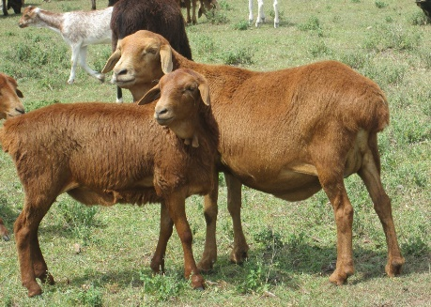
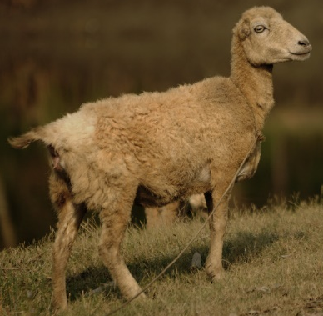
General Control Measures of Parasitic Infections
Genetic control :-
To develop genetically parasite resistance animals.
Examples-
N’ Dama cattle is resistance to trypanosomosis.
Red Massai sheep is resistance to haemonchosis.
Garole sheep is resistance to fasciolosis.
Our Desi breed of cattle i.e. Bos indicus is resistance to tick infestation.
These resistant breed may be exploited further to develop genetically parasite resistance breed
Red Massai sheep
Garole Sheep
Desi breed
Image source: Google image

Slide 19
General Control Measures of Parasitic Infections
Integrated control management (ICM):-
To avoid high cost of the treatment, drug resistance, drug/chemical residual effects and ecological imbalance, a concept of integrated control measures is coming up.
The main goal of ICM will be the manage of parasites and the environment in such a way that the costs, benefits, public health and environment will remain in balance.
Image source: Google image

Slide 20
THANK U

