Slide 1
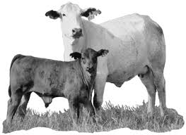
General Harmful Effects of Parasites
Dr. AJIT KUMAR
Department of Veterinary Parasitology
Bihar Veterinary College
Bihar Animal Sciences University
Patna-800014
Image source: Google image

Slide 2
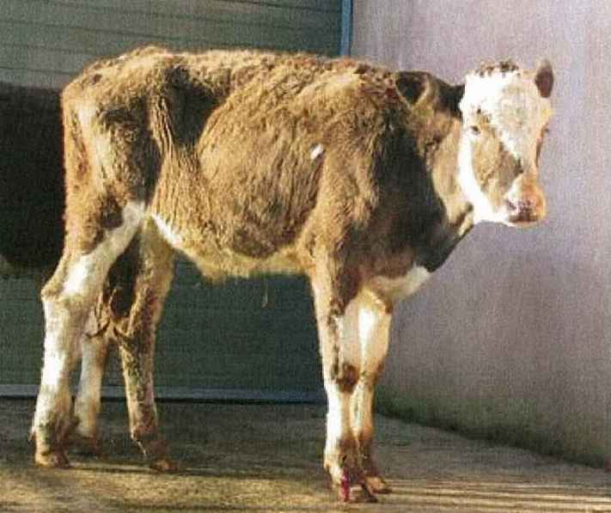
Harmful effects of Parasites
Various types of harmful effects occurred during parasitic infections are as follows-
Anorexia - loss of appetite or decreased food intake.

Slide 3
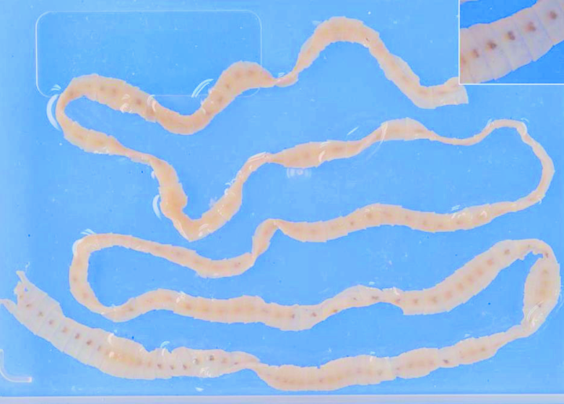
Harmful effects of Parasites
Utilization of host’s food- Parasites utilize the food ingested and digested by the host which results malnutrition in host and weakness.
e.g. Diphyllobothrium latum absorb Vitamin B12 from the host which result pernicious anaemia.

Slide 4
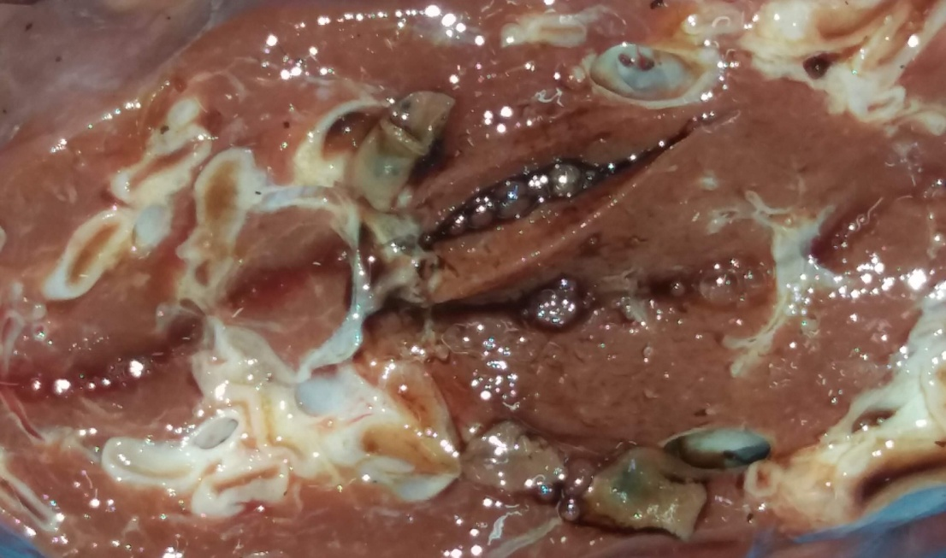
Harmful effects of Parasites
Feeding on the host materials- Parasites take or feed host‘s body tissues, blood , lymph etc. and cause harm to the host.
Body tissues –
Fasciola damage the hepatic tissues.

Slide 5
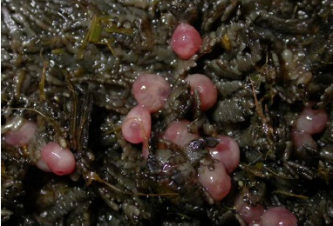
Harmful effects of Parasites
Feeding on the host materials-
Body tissues –
Amphistomes are plug feeder which results ingest the intestinal tissues.

Slide 6
Harmful effects of Parasites
Feeding on the host materials-.
Blood- Haemonchus, Ancylostoma, Ticks etc. can suck blood which results anaemia in the infected host.
Blood suck :-
Parasites | Quantity of blood suck
Ancylostoma caninum | 0.1 ml/worm/day
Haemonchus contortus | 0.05 ml/worm/day
Female tick | 0.5-2 ml/tick/day

Slide 7
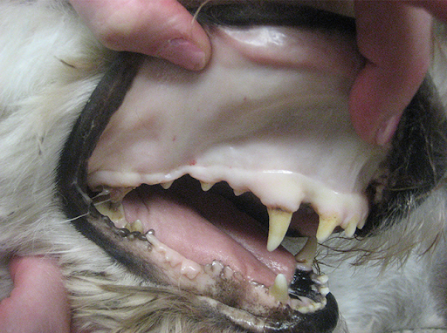
Harmful effects of Parasites

Slide 8
Harmful effects of Parasites
Ticks infested cow

Slide 9
Harmful effects of Parasites
Mechanical blocking of different tracts and ducts-
Intestine- Toxocara, Moneizia etc.
Bile duct- Fasciola, Clonorchis etc.
Respiratory tract- Dictyocaulus ( Lung worms)
Blood vessels- Dirofilaria immitis ( heart worm of dog)

Slide 10
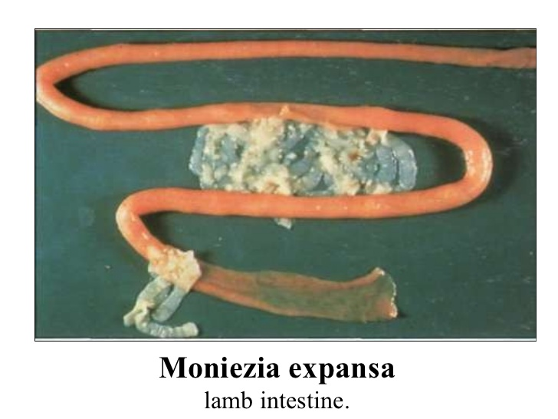
Harmful effects of Parasites
Mechanical blocking of different tracts and ducts-
Intestine- Toxocara, Moneizia etc.

Slide 11
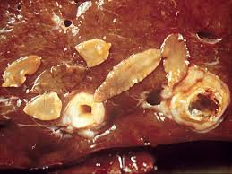
Harmful effects of Parasites
Mechanical blocking of different tracts and ducts-
Bile duct- Fasciola, Clonorchis etc.

Slide 12
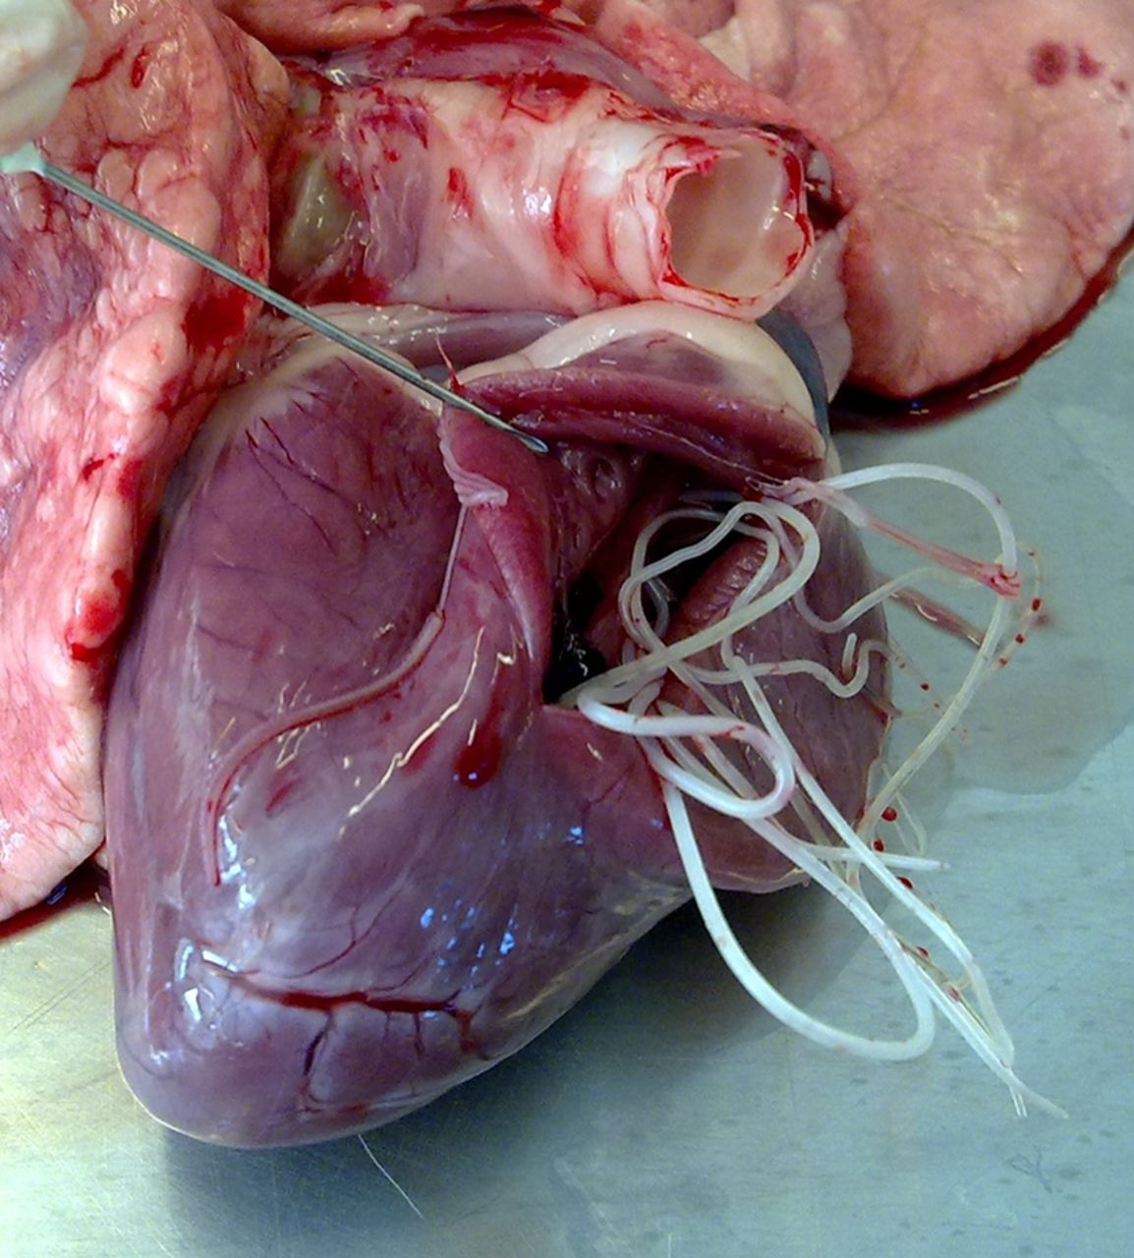
Harmful effects of Parasites
Mechanical blocking of different tracts and ducts-
Blood vessels- Dirofilaria immitis ( heart worm of dog)

Slide 13
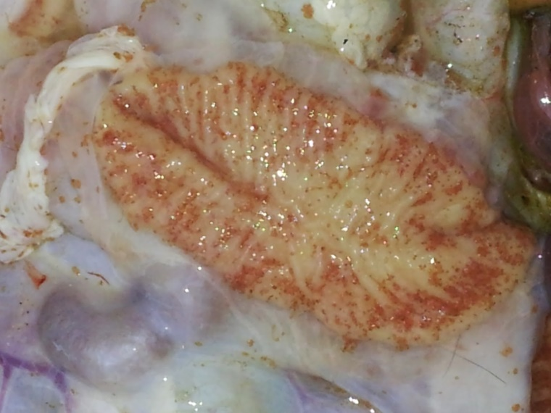
Harmful effects of Parasites
Diarrhoea or Dysentery:
e.g. Fluid foetid diarrhoea ( Shooting diarrhoea) : Immature Paramphistomum cervi result immature amphistomosis.
Amoebic dysentery: Entamoeba histolytica
P. cervi
Entamoeba histolytica

Slide 14
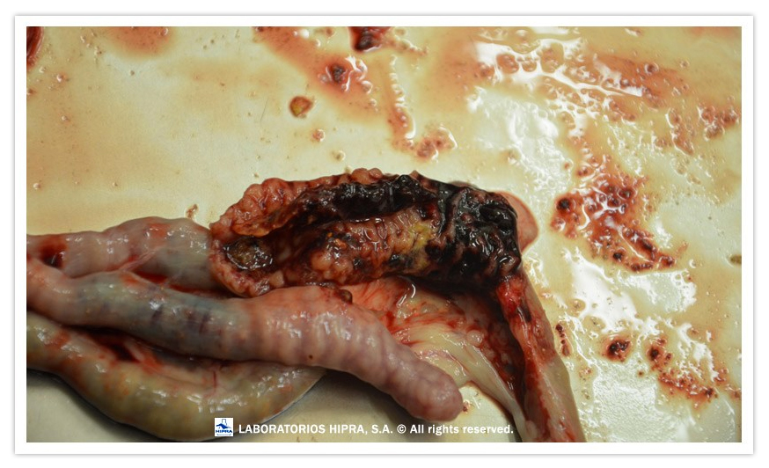
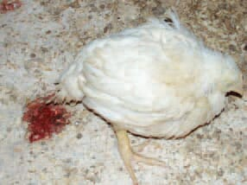
Harmful effects of Parasites
Haemorrhage:-
e.g. Eimeria ( Coccidia) and Fasciola caused haemorrhage in intestine and liver, respectively.

Slide 15
Harmful effects of Parasites
Secretion of toxic products like haemolysin, histolysin, anticoagulant, neurotoxin etc.
Toxic products | Secreted by parasites | Effects
Haemolysin | Trypanosoma evansi | Haemolysis of RBCs
Anticoagulants | Hook worms, Haemochus contortus etc. | Inhibit the coagulation of blood, so the parasites continue to suck blood from the hosts till desired.
Neurotoxin | Ticks | Paralysis In infested hosts

Slide 16
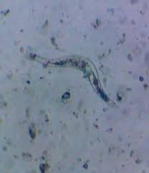
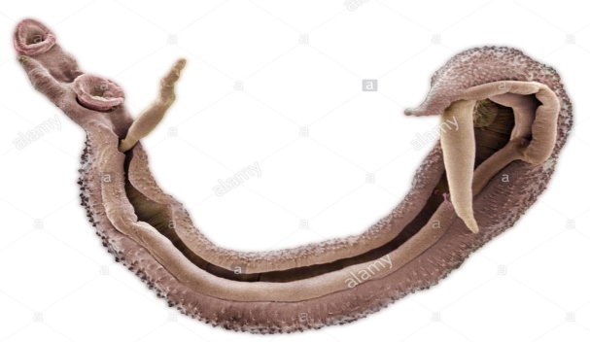
Harmful effects of Parasites
Granuloma formation:
e.g. Schistosoma nasale caused cauliflower like growth in nasal mucosa of infected host.

Slide 17
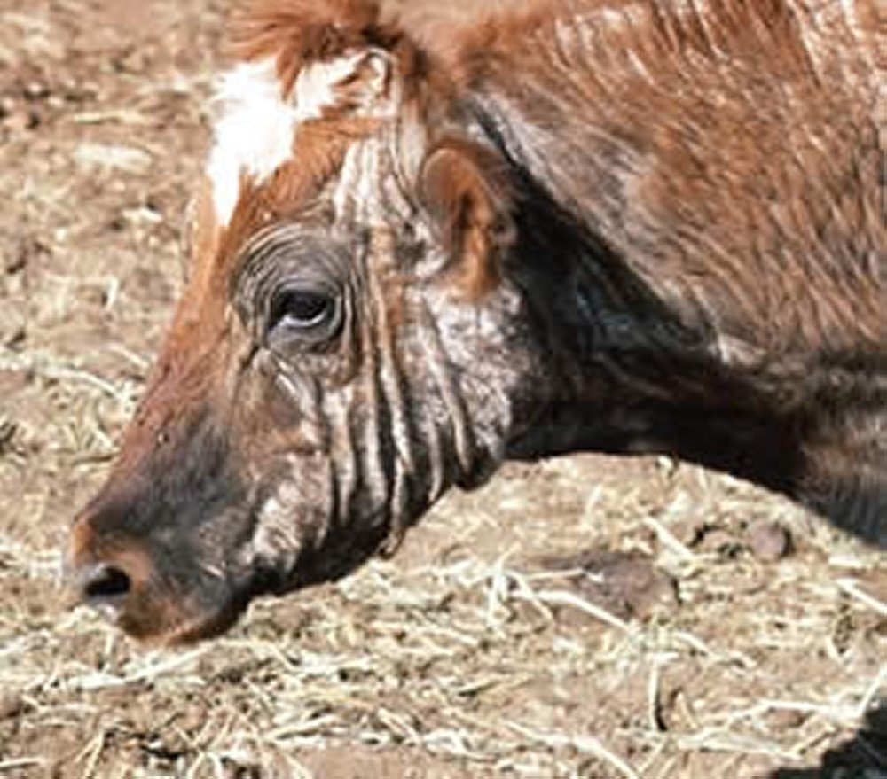
Harmful effects of Parasites
Itching, alopecia, dermatitis etc:
e.g. Mites caused a disease condition known as mange in which itching, alopecia, dermatitis etc, clinical signs found.

Slide 18
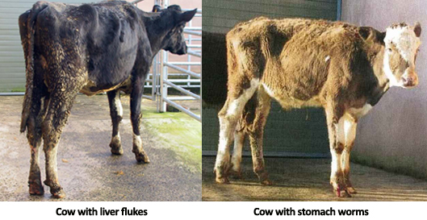
Harmful effects of Parasites
Parasitic infection usually decreased growth rate, body weight, milk production, egg production, reproduction capacity etc.

Slide 19
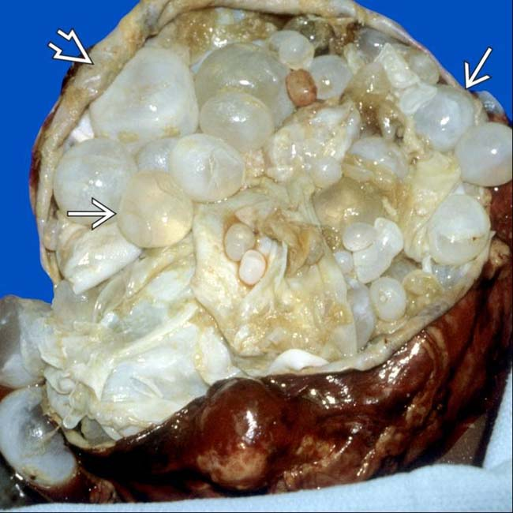
Harmful effects of Parasites
Anaphylactic reaction:
e.g. Rupture of Hydatid cyst of Echinococcus granulosus may results anaphylactic reaction.

Slide 20
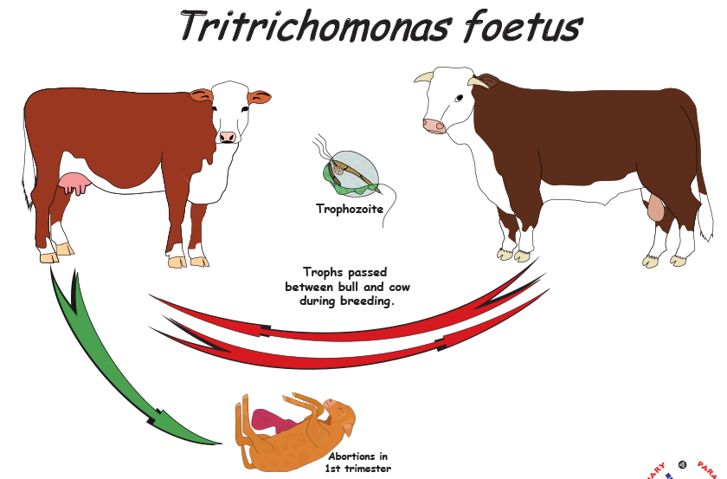
Harmful effects of Parasites
Abortion:-
e.g. Tritrichomonas foetus causes bovine abortion in cattle whereas Toxoplasma gondii causes abortion in sheep and women.

Slide 21
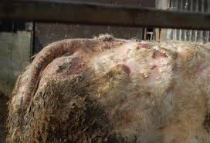
Harmful effects of Parasites
Parasitic infection may leads to reduced the value of hide and skin and even death of the infected animals.
e.g. Ectoparasites like biting flies, warble flies

Slide 22
Harmful effects of Parasites
Transmission of diseases causing micro-organisms :
Parasites may act as vector or intermediate hosts of various diseases producing micro-organisms like virus, bacteria, protozoa, rickettsia etc.
Microorganisms | Vectors
Theileria, Babesia spp. Etc. | Ticks
Dipylidium caninum | Fleas and Louse
Blue tongue virus
Cowdria ruminatum ( Hear water disease in cattle) | Tick
Ehrlichia canis | Tick

Slide 23
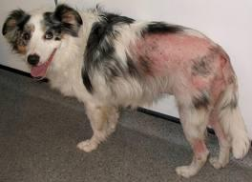
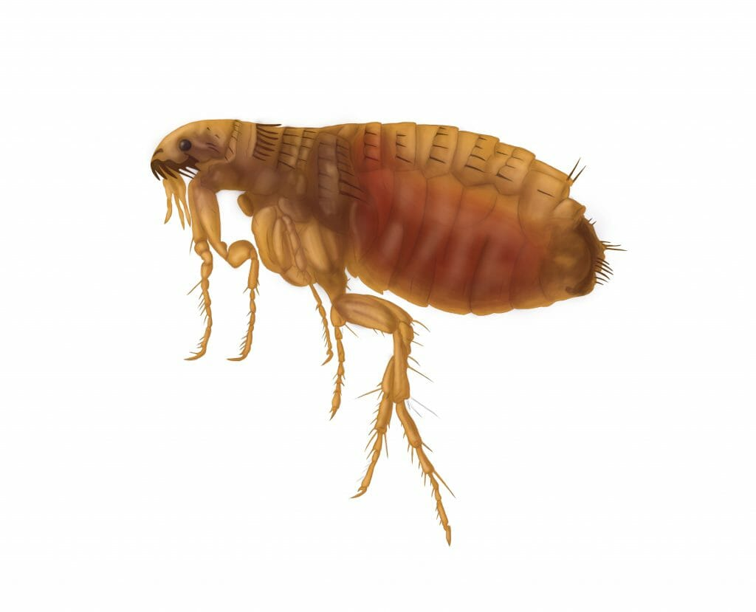
Harmful effects of Parasites
Flea allergy dermatitis-Flea allergy dermatitis (FAD) or flea bite hypersensitivity is the most common dermatologic disease of domestic dogs.

Slide 24
THANK U

