Slide 1
HANDLING AND RESTRAING OF DOG
DR. GYANDEV SINGH
Assistant professor
Department of veterinary surgery and radiology

Slide 2
What is handling or restraining -

Slide 3
Purpose of restraining-
WOUND DRESSING

Slide 4
Restraining [physical] equipments used for dogs-
Shock collor

Slide 5
Noose leashes-

Slide 6
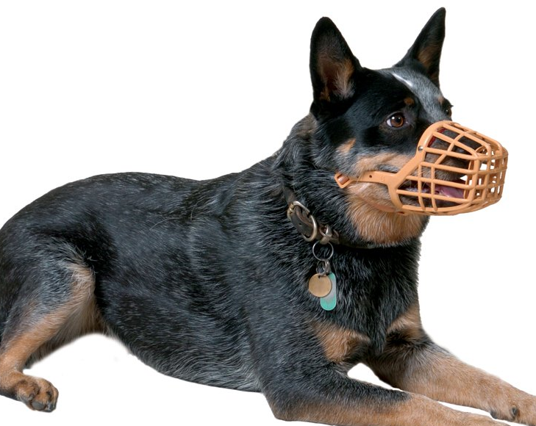
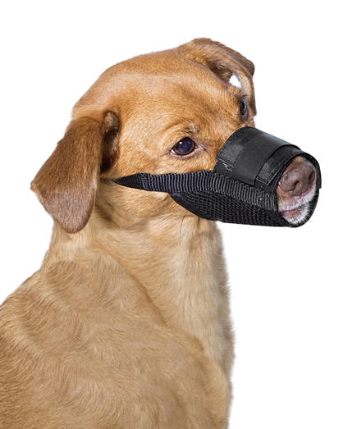
MUZZLE

Slide 7
Strip of cloths and loop

Slide 8
Elizabethan collar- types of collar . Plastic . soft fabric .inflatable .cervical .avian spherical medical reason for e. collar- .injury or surgery .allergies or flea treatment .virus and fungus

Slide 9
Restraining of dog in different position-
It include-
1.restraint of dog in sitting position
2.restraint of dog in standing position
3.restraint of dog in lateral recumbency
4.restraint and positioning for cephalic venipuncture
5.restraint and positioning for saphenous venipuncture
6.restraint and positioning for jugular venipuncture

Slide 10
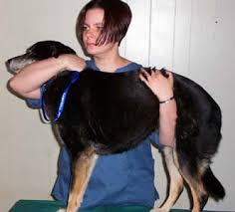
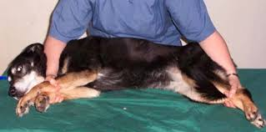
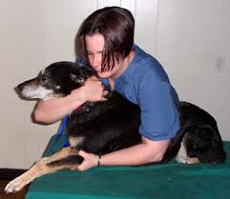
11
2
3
4

Slide 11
Complication of restraint-
Trauma ,including contusion ,bruising,laceration,and nerve paralysis
Metabolic disturbances such as acidosis ,hypoxia ,hypocalcemia hyperglycemia .
Hyperthermia
Regurgitation
Emotional stress

Slide 12
THANKYOU

