Slide 1
Dr. Anil Kumar
Asst. Professor
Dept. of VCC
VMD-412

Slide 2
HS
(Shipping/transport fever, stockyard’s disease, Barbone disease, Galaghotu in Hindi.)
An acute highly fatal disease characterized by acute septicaemia, high fever, swelling at the ventral aspect of throat , neck and brisket causing dyspnoea
Definition
Etiology
Pasteurella maltocida type 1 or B, G –ve, Known as Bipolar organism
Buffalo>Cattle>Pig>Horse>Sheep & Goat
Affect any age and group
Maximum occurrence- During Monsoon
Host Range
Precipitating factors
Stress (Transportation, Heavy worm, Starvation and Viral infections like IBR, Parainflenza-3)

Slide 3
Ingestion or inhalation
The initial site of proliferation thought to be the tonsillar region.
The source of infective bacteria is thought to be the nasopharynx of bovine carriers.
Transmission
Organism→ from environment → enters into terminal bronchioles and alveoli→ causes changes in lungs in presence of predisposing factors→ destroying the leucocytes and macrophages→ and then release of histamines and PGF2alpha and sometimes fibroblastic elements→ leading to septicemic changes in body and inflammatory changes in lung parenchyma--→ and produce pneumonia with the help of secondary invaders (Parainfluenza-II, Bovine herpes virus and other bacteria) → Death due to asphyxia

Slide 4
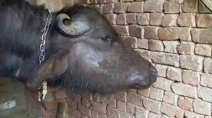
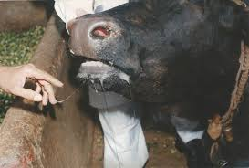
High Fever (106-107º F), Profuse salivation, Petechiae om mucous.
Edematous swelling (Under throat, neck and brisket region)
Swellings are hot and painful
Increased respiration, Grunting sounds followed by dyspnoea
Death
Clinical findings
Clinical findings
Seasonal occurrence make tentative diagnosis
Animal inoculation
Serologiacl (HAT,HIT,CFT etc.)
Diagnosis
HS in buffalo - Vet Extension
Source: vetextension.com

Slide 5
Various sulfonamides (130-150 mg/Kg, IV for 3-5 days), tetracyclines, penicillin and chloramphenicol are effective if administered early.
Anti-inflammatory
Antihistamins
Supportive therapy
Treatment
Prevention is by vaccination.
Three kinds of vaccine are widely used: plain vaccine (HS broth vaccine), alum-type precipitated vaccine, and oil-adjuvant vaccine.
The most effective bacterin is the oil-adjuvant-one dose provides protection for 9-12 month; it should be administered annually.
The alum-precipitated-type bacterin is given at 6 months intervals.
Age of vaccination: Above 5-6 months of age
Prevention and control

Slide 6
THANKS

