Slide 1
Hemodynamic Disorder
Dr Deepak Kumar
Assistant Professor
Department of Veterinary Pathology
Bihar Veterinary College, Patna -14
Bihar Animal Sciences University Patna

Slide 2
Haemorrhage
Definition
It is the escape of blood from a vessel.
Two types
Haemorrhage by rhexis : When there is rupture of a blood vessel
Haemorrhage by diapedesis : When blood leaves through intact blood vessels

Slide 3
Site of haemorrhage
Epistaxis | Bleeding from nose
Haematemesis | Blood in vomit
Haemoptysis | Blood in sputum
Metrorrhagia | Bleeding from uterus
Enterrohagia | Bleeding from intestine
Melena | Blood in stools
Haematuria | Blood in urine
Haemothorax | Blood in thoracic cavity
Haematocoel | Bleeding into tunica vaginalis
Hemosalphinx | Bleeding in oviducts
Hematoma | Tumour-like accumulation of blood
Apoplexy | Haemorrhage into brain

Slide 4
Size of haemorrhage
Petechiae: minute; pinpoint –Size 1-2 mm
Purpura: Medium size, approximately 1cm in size
Ecchymoses: 1 – 2 cm in size, bruises
Extravasation: Larger area
Hematoma = collection of blood in an organ or tissue:

Slide 5
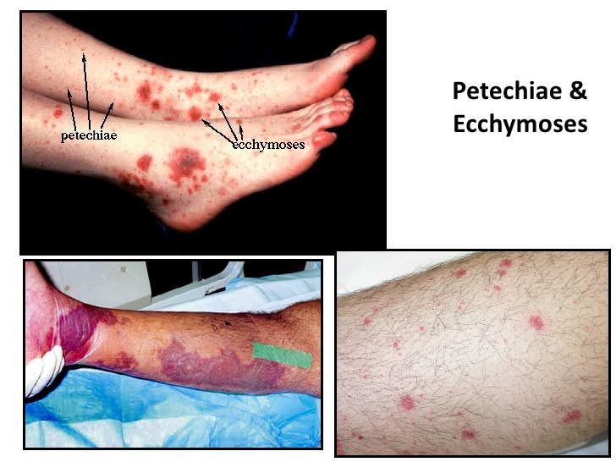
Site of haemorrhage

Slide 6
Source of haemorrhage
Cardiac
Arterial
Venous
Capillary

Slide 7
Causes
Conditions affecting the blood vessels
Conditions affecting the blood

Slide 8
Conditions affecting blood vessels
Trauma: Lacerations, incisions, contusions
Necrosis of vessel wall
Ulcers in gastric mucosa
Neoplasms
Diseass of vessel walls
Aneurysm - e.g. Strongylus vulgaris infection in horses
Atheroma
Toxic injury to capillary endothelium
Bacterial : Anthrax, haemorrhagic septicaemia, black quarter
Viral : Hog cholera
Chemicals : Arsenic, phosphorus, chloroform, cyanide
Enterotoxins : Sheep & calves – Clostridium welchii - ASPHYXIA
Increased blood pressure
Excessive exercise → increased blood pressure → Rupture of blood vessel - Seen in race horses

Slide 9
Conditions affecting blood constituents
Haemophillia: Hereditary sex linked disease; Delayed clotting
Thrombocytopenic purpura: Decrease in platelets seen in toxaemias
Nutition
Deficiency of vitamin K
Vitamin K which is required for prothrombin formation and in its absence clotting will not take place.
Increased use of sulpha drugs may not permit intestinal microflara to synthesis vitamin K
Deficiency of vitamin C
Vitamin C is required for formation of ground substance. Invitamin C defeciency capillary endothelium becomes more fragile leading to haemorrhage
Plant toxins
Brakern fern and sweet clover poisoning prevent prothrombin formation

Slide 10
Microscopically appearance
Presence of erythrocytes outside blood vessels
Recent haemorrhage stains deeply
Haemorrhage disintegrates due to action of tissue enzymes
↓
Haemoglobin ® Haemosiderin (Iron) and hamatoidin (Non iron)
↓
Bilirubin
↓
Phagocytosed by macrophages

Slide 11
Fate of haemorrhage
In small haemorrhage fluid portion is reabsorbed, WBCs move into blood vessels and RBCs are phagocytosed
In larg haemorrhage, RBCs are haemolysed and haemoglobin is split into haeme (Haemosiderin which is iron containing portion of haeme and haematoidin is iron free portion) and globin.

Slide 12
OEDEMA
Abnormal accumulation of fluid in the intercellular tissue spaces or body cavities
Localized : Due to obstruction of venous outflow – leg
Generalized : Chronic venous Congestion or heart failure

Slide 13
Terms used to describe oedema
Anasarca: Generalized subcutaneous oedema
Ascites: Fluid in peritoneal cavity
Hydrothorax; Edematous fluid in thorax
Hydropericardium: Edematous fluid in pericardium

