Slide 1
ICZN and SNOAPAD
( General Veterinary Parasitology)
Dr. AJIT KUMAR
Department of Veterinary Parasitology
Bihar Veterinary College
Bihar Animal Sciences University
Patna-800014
Image source: Google image

Slide 2
ICZN
Image source: Google image

Slide 3
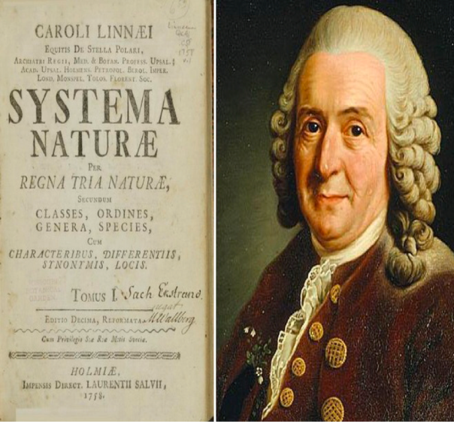
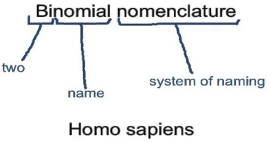
Nomenclature of Parasites
Several thousand of organism in the word.
Several names for same organism and same name for different organisms.
Carolus Linnaeus in the year 1758 given ‘Bionomial nomenclature’ in his book ‘Systema Nature’.
Later, International Code for Zoological Nomenclature ( ICZN) is establish in 1904 to formed rules for naming species and for indicating their relationship.
Image source: Google image

Slide 4
Rules and Regulation of ICZN for Naming Parasites
The name of the genus of any parasite is uninomial, the species is binomial and the subspecies is trinomial.
Scientific names are derived from Latin or Greek word.
e.g. Sarcocystis ( Cyst forming in the muscle of infected host) : derived from Greek word ‘Sarkos’ means flesh and ‘Kystis’ means cyst.
The names of the genus and species or subspecies are expressed (printed) in italics or when written are underlined.
Trypanosoma evansi
Printed
Written

Slide 5
Rules and Regulation of ICZN for Naming Parasites
Author of a scientific name of an animal is that who first publishes it. If it is desired to cite the author’s name it follows the scientific name. This may be followed, separated by a comma, by the yea in which the name was first published.
Taenia Linnaeus, 1758
Written
Written

Slide 6
Rules and Regulation of ICZN for Naming Parasites
Classification of Parasites : -
Any parasites will be placed under the taxonomy which follows rules and regulations of International Code of zoological Nomenclature (ICZN) -
Classification tree-
Kingdom
Subkingdom
Phylum
Subphylum
Class
Subclass
Order
Suborder
Superfamily
Family
Subfamily
Genus
Subgenus
Species
subspecies

Slide 7
Naming of Taxa with Example
The naming of different classification units (Taxa) follows a definite pattern -
Classification Unit (Taxa) | Suffix to be added in naming | Example
Class | -ea | Sporozoea
Subclass | -ia | Coccidia
Order | -ida | Eucoccidiida
Suborder | -ina | Eimeriina
Superfamily | -oidea | Ancylostomatoidea
Family | -idae | Sarcocystidae
subfamily | -inae | Sarcocystinae
Notes:
ic

Slide 8
Classification of Sarcocystis Parasite
Kingdom | Animalia
Subkingdom | Protozoa
Phylum | Apicomplexa
Subphylum | Sarcodina
Class | Sporozoea
Subclass | Coccidia
Order | Eucoccidiida
Suborder | Eimeriina
Family | Sarcocystidae
subfamily | Sarcocystinae
Genus | Sarcocystis
Species | cruzi
Notes:
ic

Slide 9
SNOAPAD
Image source: Google image

Slide 10
SNOAPAD
World Association for the Advancement of Veterinary Parasitology (WAAVP) formulate a guideline to uniform and proper terminology to denominate the animal parasitic disease or infections.
Guidelines was published in 1988 as the Standardised Nomenclature of Animal Parasitic Disease ( SNOAPAD).
Later, the word ‘ Animal’ was dropped and the ‘SNOAPAD’ is changed to ‘SNOPAD’ to denote all parasitic diseases.
Image source: Google image

Slide 11
SNOAPAD
Guideline of SNOPAD is as follows –
The suffix –osis (plural= oses) is to be added to the stem of the names of the parasite taxon by the omission of the last one or two letters-
By adding –osis in the genitive name where taxa end with –x in the nominative .
Taxonomic name of parasite | Addition of suffix | Disease name
Trypanosoma | Trypanosom + osis | Trypanosomosis
Fasciola | Fasciola +osis | Fasciolosis
Genitive name of parasite | Nominative name of parasite | Addition of suffix | Disease Name
Demodex | Demodicis | Demodic +osis | Demodicosis
Pulex | Pulicis | Pulic +osis | Pulicosis

Slide 12
SNOAPAD
Guideline of SNOPAD is as follows –
By adding –osis in the full generic name of the parasite.
Well–established disease names which are not formed from the taxonomic name of the parasite can also be used as alternatives to the related terms offered by SNOAPAD .
e.g. Malaria, surra, scabies, myiasis, echinoccosis etc.
Generic Name of Parasite | Addition of Suffix | Disease Name
Hepatozoon | Hepatozoon+ osis | Hepatozoonosis

Slide 13
SNOAPAD
Guideline of SNOPAD is as follows –
By adding –osis in the full generic name of the parasite.
Any parasitic infection which may or may not produce clinical signs in a host called parasitosis.
e.g. Trypanosomosis, Haemonchosis,
Babesiosis etc.
Generic Name of Parasite | Addition of Suffix | Disease Name
Hepatozoon | Hepatozoon+ osis | Hepatozoonosis
Not Accepted
Parasitiasis

Slide 14
THANK U

