Slide 1
Unit 1
VETERINARY PUBLIC HEALTH AND FOOD SAFETY
(Credit Hours 3+1=4)

Slide 2
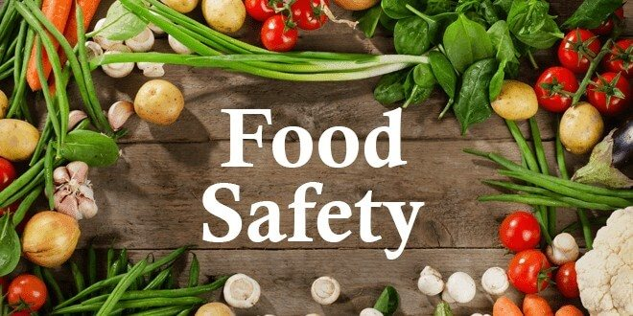
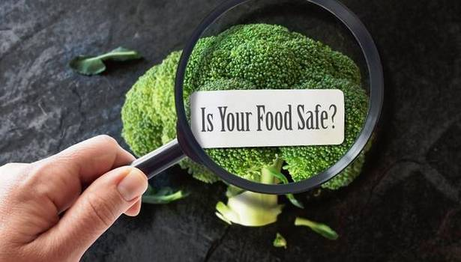
Introduction of Food safety

Slide 3
Food Hygiene is the measures and conditions necessary to control hazards and ensure fitness for human consumption of a foodstuff taking into account its intended use” (European regulations).
Food hygiene comprises two components:
Food safety: is the assurance that food will not cause harm to the consumer when it is prepared and /or eaten according to its intended use.
Food suitability: concerns the intrinsic characteristics of the product, namely taste, smell, texture and presentation, characteristics that can change with the presence of spoilage microbes (bacteria, yeast and mould).
Suitability is the assurance that the food is 'acceptable' for human consumption.

Slide 4
Food safety and suitability must be assured at every link of the food chain

Slide 5
Who is responsible for food hygiene ?

Slide 6
General Principles of Food Hygiene
Primary production
Establishment design and facilities
Control of operations
Maintenance and sanitation
Personal Hygiene
Transportation
Product information and consumer awareness
Training

Slide 7
Primary production
Environmental hygiene
Where the environment/ surrounding poses a threat to food safety.
Hygienic production of Food Sources
Control of contamination from air, soil, water, feed-stock, pesticides, veterinary drugs or any other agent used in primary production. Protect food sources from fecal and other contaminant.
Handling storage and transport
Use appropriate storage materials and equipment. Protect food and food ingredients from contamination by pests, chemicals, microbiological or physical or other objectionable substances during handling storage and transportation. Cross contamination.
Cleaning maintenance and personal hygiene.

Slide 8
Establishment Design and Facilities
Nature of operations, associated risks – Premises and equipment and facilities to minimize risk and ensure food safety
– Location:
Potential sources of contamination from surroundings.
– Internal design, structures and layout of the premises rooms and equipment :
Should facilitate measures that prevent contamination, durable, movable and capable of being disassembled to allow for maintenance, cleaning, disinfecting and monitoring
Facilities especially temporary or mobile facilities :
Directly or indirectly impact food safety: water quality, air quality, drainage and waste disposal, temperature control, personal hygiene, lighting, storage ensure effective protection from contamination during storage.

Slide 9
Control of Operations
Control of food hazards through the use of HACCP system:
Potential sources of contamination from surroundings, Time and Temperature.
Key aspects of hygiene control systems:
Specific process steps, Microbiological and other specifications, microbial cross contamination, physical and chemical contamination.
Incoming material requirements:
Specification to be identified and applied, where possible inspected and sorted before processing.
Packaging:
Design and materials used.
Water:
In contact with food and used as an ingredient Special care for Ice and steam.
Management and supervision:
Size of the business, nature of activity and type of food.
Documentation and records:
Period that exceeds shelf life.
Recall procedures:
Complete recall, handling and communication.

Slide 10
Maintenance and Sanitation
Cleaning methods and procedures:
Appropriate for the type of product and type of machine. Hidden residual food/pest infestation.
Cleaning Programs:
Method, frequency and monitored for their suitability and effectiveness.
Pest Control Systems:
Preventing access, preventing harborage and infestation, monitoring and detection, eradication measures.
Waste Management:
Method, frequency and effectiveness.
Monitoring Effectiveness:
Periodic Audit, microbial sampling.

Slide 11
Personal Hygiene
Health Status of Employees.
Illness and injuries:
Communicable diseases and surface injuries to hands or parts that come in contact with food items.
Personal cleanliness:
Clothing
Personal Behavior
Smoking, spitting, chewing and eating, sneezing , personal effects.
Visitors
Rules and guidelines for entry and access and safety or protective covering.

Slide 12
Transportation
Design of conveyances and bulk containers.
Proper segregation to prevent cross contamination, Time, temperature and humidity controls available and monitored, Appropriate for type of packaging.
Use and maintenance.
Mixed and prior usage, appropriate scheduling and corrective measures.

Slide 13
Product information and consumer awareness
Lot identification
Codex standard & FSSAI rules
Product information
Bear adequate information to enable the next person in the food chain to handle, display, store prepare and use the product safely and correctly.
Labelling
Codex standards and FSSAI rules
Consumer education
Hygiene, nutrition, label instructions

Slide 14
Training
Awareness and responsibility
Training Programs
Nature of food and its ability to sustain growth of harmful micro-organisms.
Manner in which food is handled/packed .
Extent/Nature of processing or further preparation before final consumption.
Conditions under which the food will be stored.
Expected length of time before consumption.
Instructions and supervisions
Refresher Training

Slide 15
Food safety management is the application of food policies, systems and processes in a food operation in order to prevent food borne illnesses and protect consumer health.
The food safety standards addresses the chemical, physical and biological risks through the use of
Good Manufacturing Practices (GMP),
Good Hygiene Practices (GHP) and
Hazard Analysis Critical Control Point System HACCP.

