Slide 1
Lecture 3
Radial paralysis
Bicipital bursitis(intertubercular bursitis)
Capped elbow(Shoe boil/olecranon bursitis)
Capped elbow(Shoe boil/olecranon bursitis)
Omarthritis
Splints
Shore shin

Slide 2
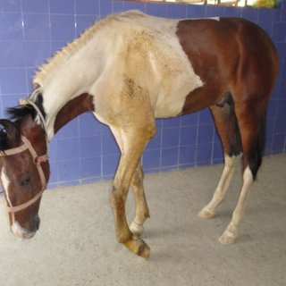
Radial paralysis
Etiology: compression of the nerve while casting on hard ground, overstretching of the nerve, fracture of the ribs.
Symptoms: complete paralysis below elbow are in flexed state(dropped elbow), limb longer and toe rest on ground, toe is dragged.
Extensor of digits: use the limb normally on level ground but on uneven ground it stumbles and foot is dragged on uneven ground.
Triceps muscles: inability to bear weight on the limb(not able to extend the limb), knee is semiflexed but planter surface of foot touches the ground almost normally.

Slide 3
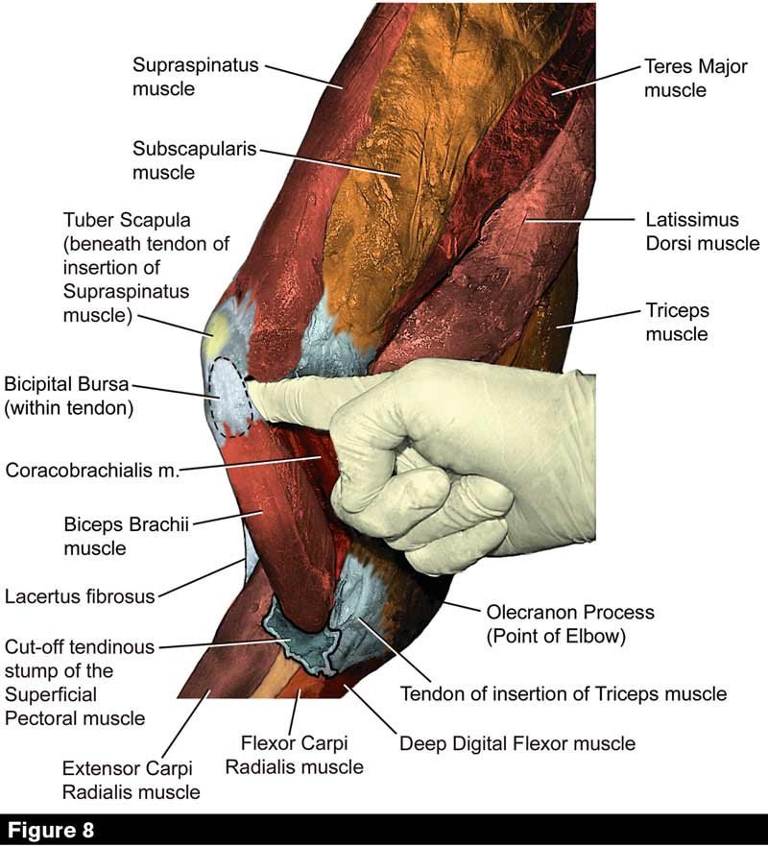
Bicipital bursitis(intertubercular bursitis)
Is a tendon sheath surrounds the tendon of biceps brachii in the region of inter-tubercular groove
Symptoms: pain on pressure over bursa or retraction of limb,septic bursitis may occur, mineralisation within intertubercular bursa may occur as a sequele to a fracture of supra glenoid tubercle.
Treatment: intra-lesional corticosteroid or sodium hyaluronate(20 mg),lavage/surgical debridement, systematic and local antibiotics,NSAIDS.

Slide 4
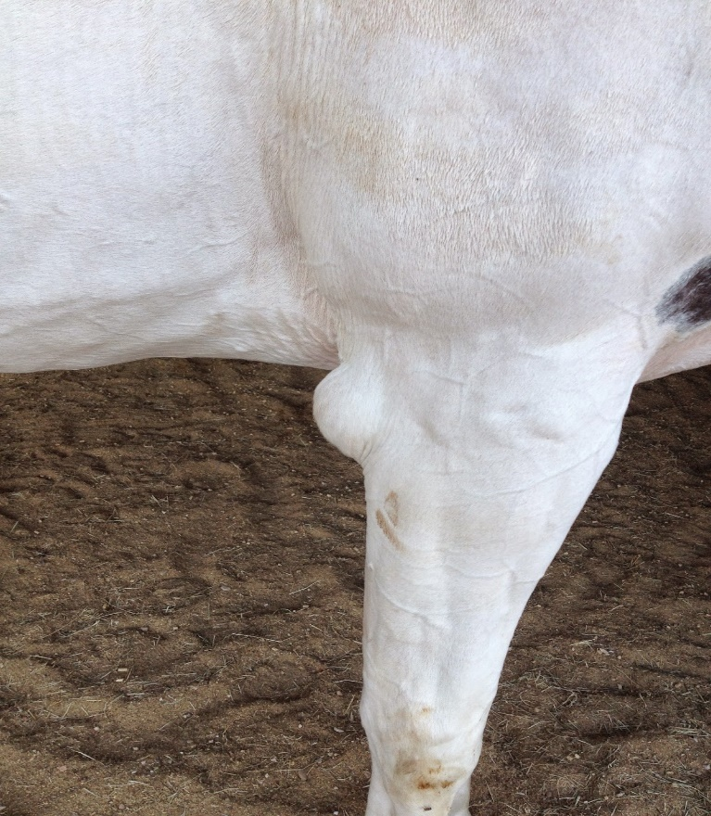
Capped elbow(Shoe boil/olecranon bursitis)
Subcutaneous bursitis at the point of elbow, may occasionlly becomes abscess,common in horses and dogs(great danes), rare in cattle.
Etiology: repeated trauma(contact with rough, hard ground,bad conformation of limb,e.g prominent elbows,hind foot striking against elbow),complication of infectious disease (influenza and strangles)
Symptoms: acute-swelling and pain
chronic-fluctuating fibrous mass due to thickening of walls of bursa and surrounding tissue
Prognosis: favourable

Slide 5
Treatment of capped elbow
Soft bedding
Warm foamentations
If cystic in nature-inject irritant to destruction and obliteration of synovial sac.
Cauterization and insertion of seton
Suppuration- treated as abscess
Fibrous thickening- extirpation of bursa
Asceptic aspiration and corticosteroid injection
Ultrasonic or radiation therapy

Slide 6
Omarthritis: arthritis of shoulder joint
Etiology: any type of trauma
Signs:
Marked lifting of head when affected limb is advanced (due to minimum flexion of shoulder joint)
Imperfect flexion of limb (slight elevation of foot above ground)
Shortened anterior phase of stride, stumbling
Fixation of scapulo-humeral joint
Indifference to the hardness of the ground, circumduction of the limb.
Diagnosis: by blocking median, musculocutaneous, and ulner nerves, radiography (to see growth of osteophytes)
Treatment: no treatment, corticosteroids (temporary relief)

Slide 7
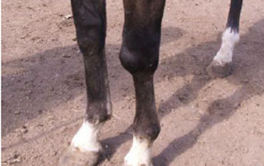
Capped knee: hygroma of carpus
Definition: synovial swelling over the anterior surface of the carpal joint (acquired bursitis). Fairly common in stall fed dairy cattle and occasionally in horses.
Etiology: trauma, sometimes brucella infectioncauses capped knee.
Signs: pain, increased digital pulse, elevated pulse rate and temperature,anxious look, animals lift leg off ground and keep flexed for longer durations, swelling, viscid straw coloured fluid on exploration
Treatment: injection of corticosteroid+antibiotics + counter pressure (repeated weekly maximum of 3-4 occasions)
Chronic and fibrous form: bursectomy

Slide 8
Carpitis(popped knee)
Acute or chronic inflammation of the carpal joint involving joint capsule,associated ligaments and bones.
Fracture of carpal bones:
The radial and third carpal bones are most commonly fractured.
Etiology: Trauma and overstretching of the limb
Treatment: Surgical removal of the fragments or fixation of the fragments

Slide 9
Splints
Exostosis of small metacarpal and metatarsals due to osteoperiosteitis (inner aspect of fore limb and outer aspect of hind limb)
Common in fore limb and young horses below the age of 5 yrs.
Types of splints:
Simple splints
Chain splints
Knee splints
Rod splints
Jack splints
Spongy splints
Etiology: bad conformation, work at very young age, defective shoeing (predisposing factor), excessive concussion, sprain of suspensory ligament (exciting cause).

Slide 10
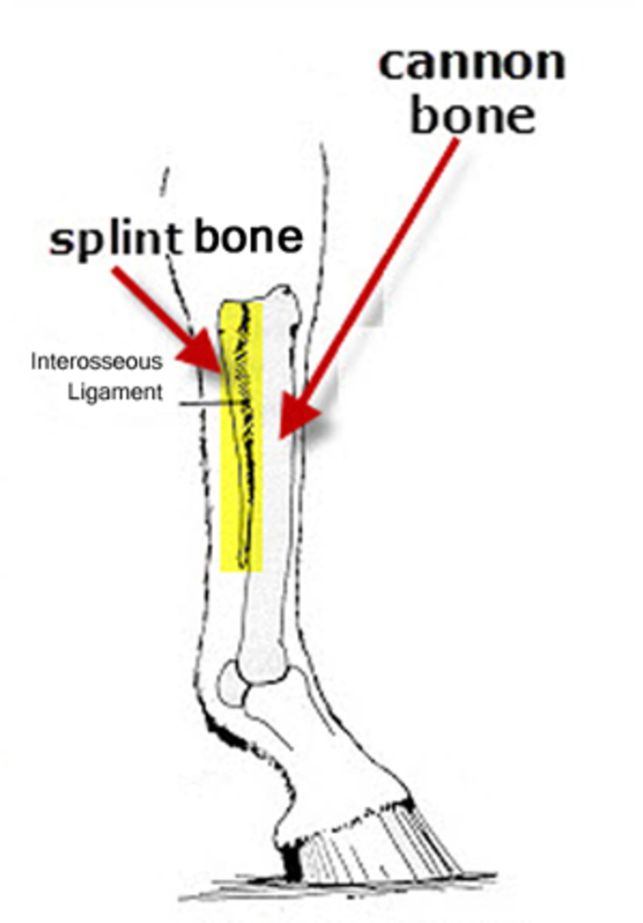
Symptoms of splints
Imperfect flexion of the knee
Marked lameness while trotting and on hard ground
Lameness exaggerated while going downhill
Slight abduction of limb
Lameness not improving with exercise and the gait may be pottery
Treatment: acute case-periosteotomy advised
median and ulnar neurectomy

Slide 11
Sore shin (Buck-shin)
Osteoperiosteitis of the ant. Aspect of large metacarpal or metatarsal bones (young horses below three yrs)
Etiology: trauma. Concussion
Symptoms: painful swelling, collection of exudates and mineralization of exudates causes exostosis (no lameness)
Treatment: rest cold treatment, periosteotomy
Sesamoiditis: inflammation of proximal sesamoids(fore limb)
Symptoms: swelling and lameness, exostosis on inner aspects of sesamoids

Slide 12
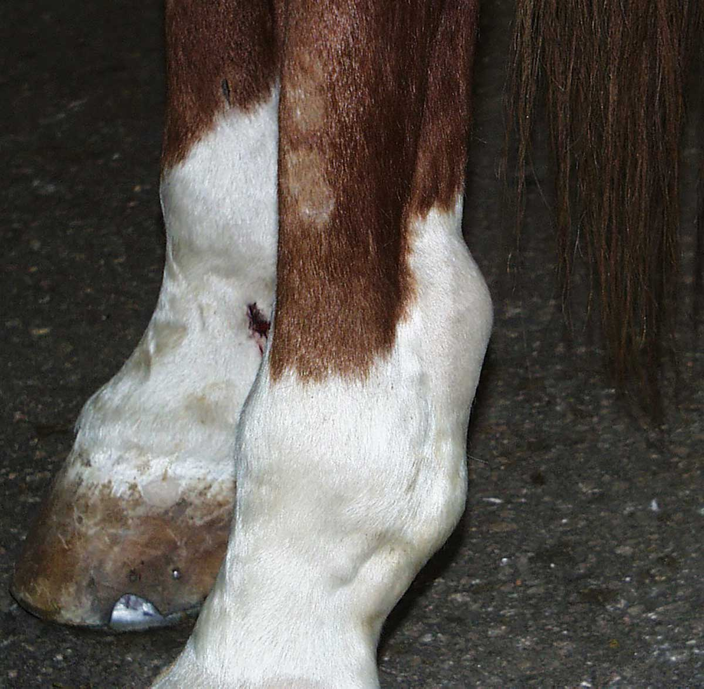
Wind puffs
Distension of great sesamoidean sheath
Often associated with straight fetlocks and young horses under heavy training may develop
Articular wind galls manifest as distension of the metacarpophalangeal or metatarsophalangeal joint.
Symptoms: no lameness, heat or pain should be present, swelling in long standing cases (may hardens as a result of fibrosis)
Treatment: use of pressure wraps and use of osmotic agents

Slide 13
Tendinitis (fast working animals)
Sprain of flexor tendons (sprained tendon i.e sprain of superficial or deep flexor tendons their check ligaments or suspensory ligament)
Site of sprain: upper or middle portion of the metacarpal region (superficial flexor tendon)
Characteristic swelling of posterior aspect of the metacarpal or metatarsal region due to tendinitis and peritendinitis (bowed tendon)
-Middle portion of metacarpal region or posterior aspect of pastern region (deep flexoor tendon)

Slide 14
Etiology of tendinitis
Defective conformation, fast work, slippery ground, muscular fatigue
Symptoms: pain, swelling lameness. At rest the limb is kept with fetlock and phalangeal joint slightly flexed (to relax the tendon)
Treatment: corrective shoeing, acute and chronic cases (as usual)
Through pin: distension of tarsal sheath due to chronic synovitis

Slide 15
Thank you

