Slide 1
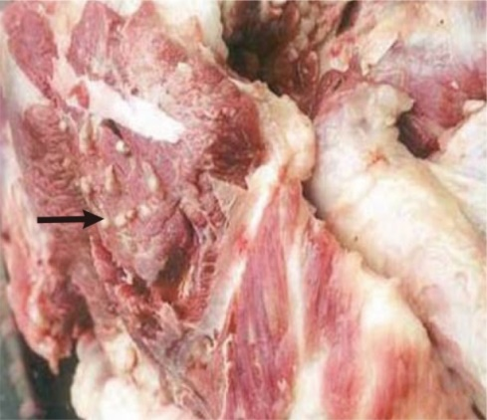
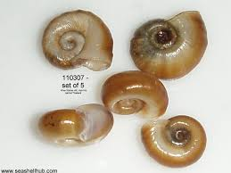
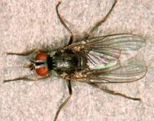
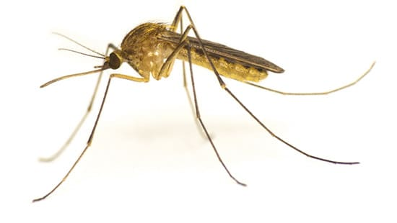
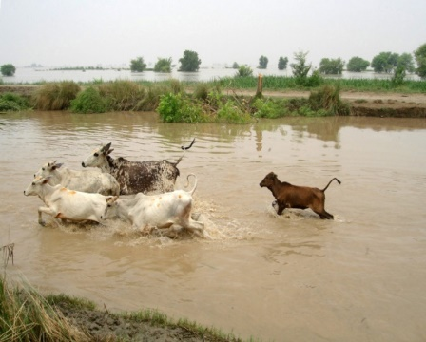
Methods of Dissemination of Parasites
Dr. AJIT KUMAR
HoD
Department of Veterinary Parasitology
Bihar Veterinary College
Bihar Animal Sciences University
Patna-800014
Image source: Google image

Slide 2
Methods of dissemination of parasites
Infective stages of parasite are disseminated by
Water
Aquatic vegetation
Arthropods vectors
Direct contact
Animals transport
Meat export or import
Natural calamity

Slide 3
Methods of dissemination of parasites
Infective stages of parasite are disseminated by
Water –
Major source of dissemination Parasites.
Aquatic snails, fish, cyclops and crabs act as intermediate host for various parasites.

Slide 4
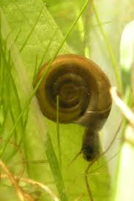
LIFE-CYCLE OF AMPHISTOMES
Egg Miracidium
Sporocyst
Redia
Cercaria
cercaria emerge from the aquatic snail and encyst on aquatic vegetation and form metacercaria..
Final hosts get infection by the ingestion of metacercaria infected aquatic vegetation.
INSIDE
THE
SNAIL

Slide 5
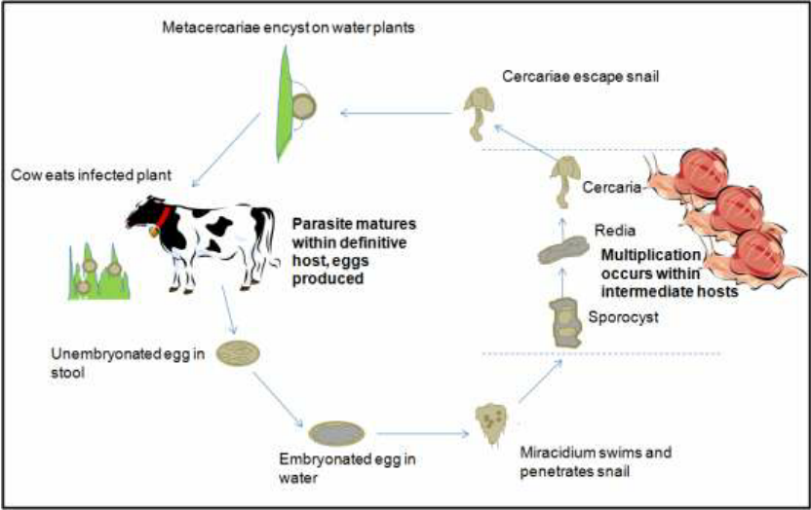
LIFE-CYCLE OF AMPHISTOMES
Final hosts get infection by the ingestion of metacercaria infected aquatic vegetation.

Slide 6
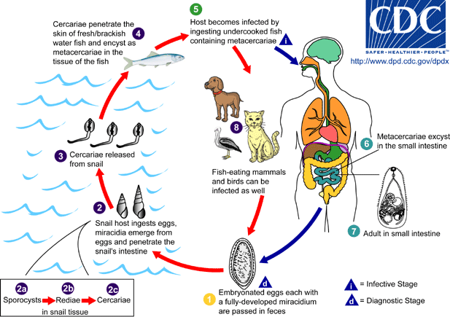
Methods of dissemination of parasites
Infective stages of parasite are disseminated by
Water –
Fish acts as intermediate host for Opisthorchis sinensis ( Chinese liver fluke) .
Final hosts ( Man, dog etc.) get infection by the ingestion of metacercaria infected fish.

Slide 7
Methods of dissemination of parasites
Infective stages of parasite are disseminated by
Water –
Cercaria of Schistosoma spp. ( Blood fluke) swim in water and enter in the hosts, when hosts come in contact with water.

Slide 8
Methods of dissemination of parasites
Infective stages of parasite are disseminated by
Cyclops act as first intermediate host for Diphyllobothrium latum.

Slide 9
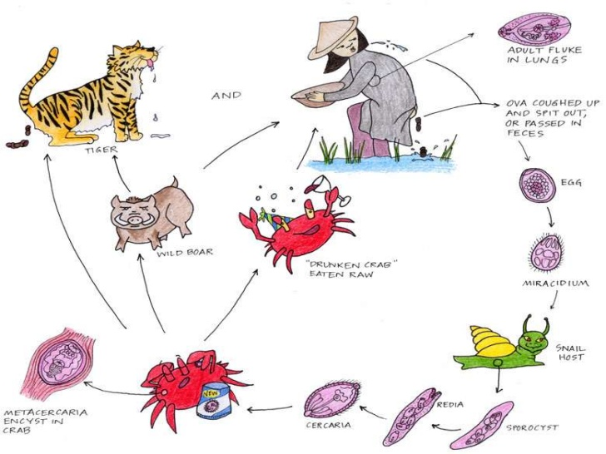
Methods of dissemination of parasites
Infective stages of parasite are disseminated by
Crabs act as intermediate host for Paragonimus wetermani (Lung fluke) .
Final hosts ( Man, dog etc.) get infection by the ingestion of metacercaria infected crab.

Slide 10
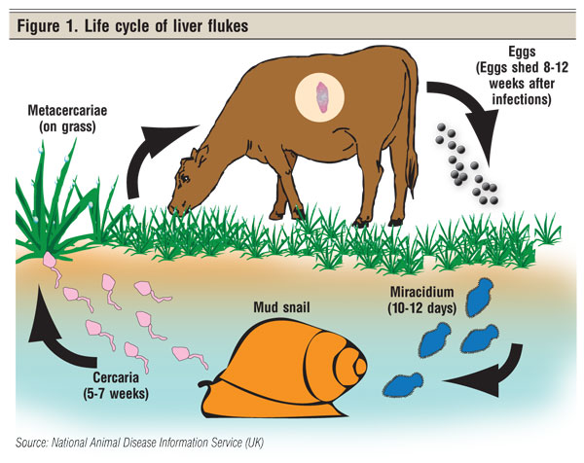
Methods of dissemination of parasites
Infective stages of parasite are disseminated by:-
Aquatic vegetation – Metacercaria of Fasciola species.

Slide 11
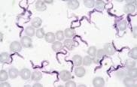
Methods of dissemination of parasites
Infective stages of parasite are disseminated by:-
Arthropod vectors–
Parasite | Disseminated through blood sucking arthropod vectors
Trypanosoma evansi | Tabanus fly
Leishmania spp. | Phlebotomus spp.( Sand Fly)
Babesia spp. | Ticks
Plasmodium spp. | Mosquitoes

Slide 12
Methods of dissemination of parasites
Infective stages of parasite are disseminated by:-
Direct contact- mites ( Sarcoptes, Psoroptes, Demodex etc.), lice etc. infestation.

Slide 13
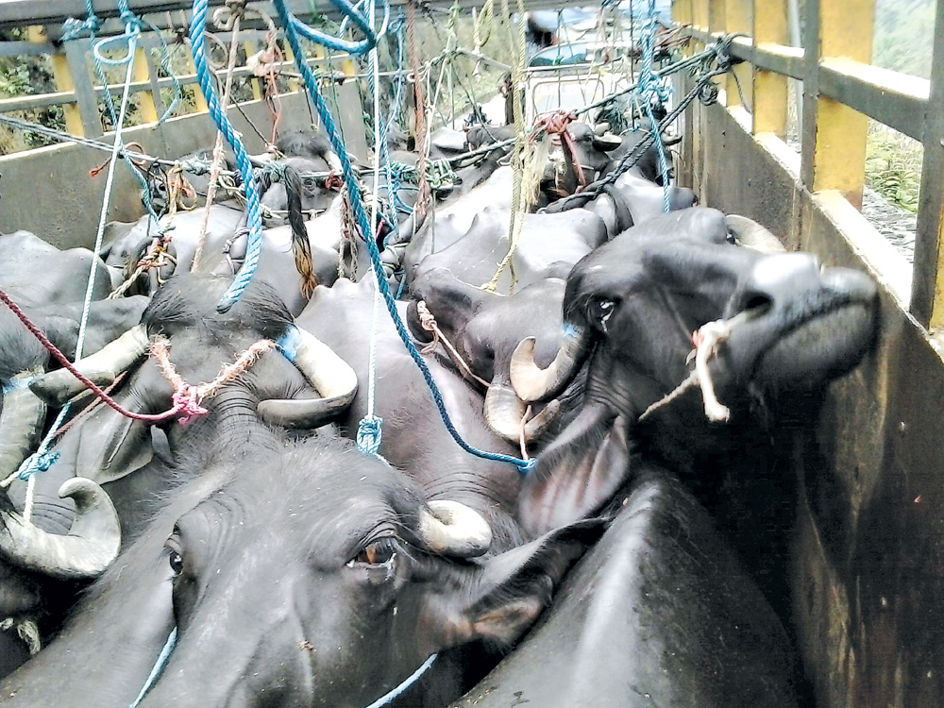
Methods of dissemination of parasites
Infective stages of parasite are disseminated by:-
Transportation of parasite infected animals-

Slide 14
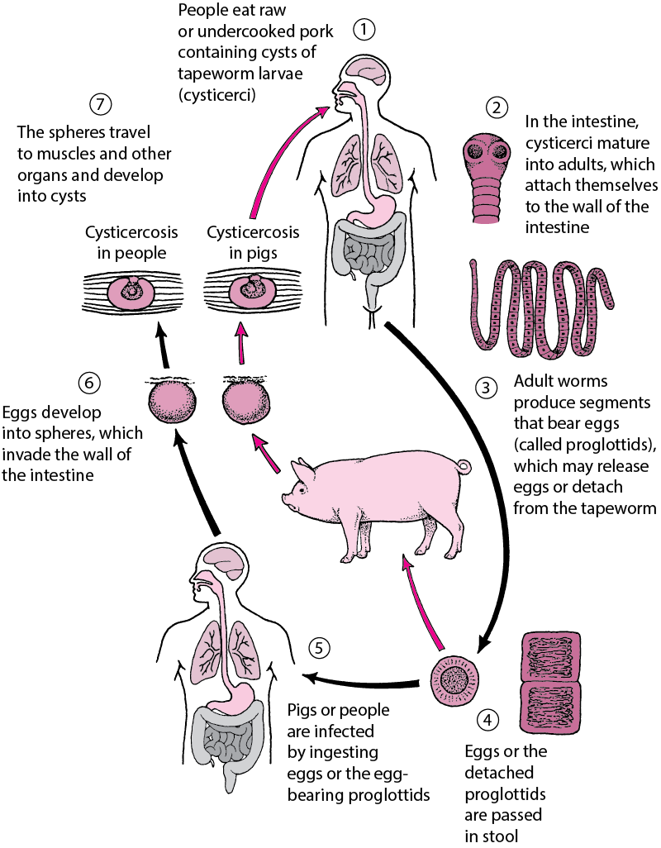
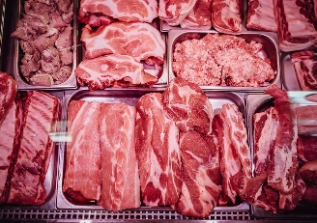
Methods of dissemination of parasites
Infective stages of parasite are disseminated by:-
Export or import of Meat :Taenia solium infection occurs in host ( man) by the ingestion of Cysticercus cellulosae ( metacestode or larval stage) infected raw or measly pork.
Cysticercus cellulosae in pork

Slide 15
Methods of dissemination of parasites
Infective stages of parasite are disseminated by:-
Export or import of Meat: Trichinella spiralis infection occurs in host ( man) by the ingestion of encysted larvae infected raw or measly pork.

Slide 16
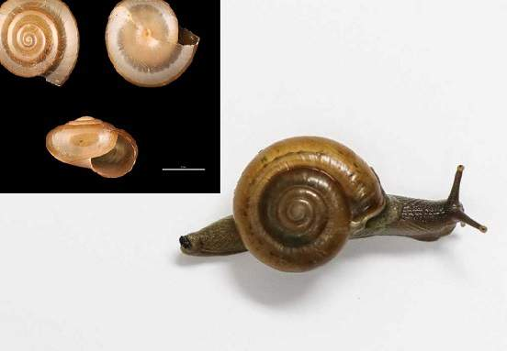
Methods of dissemination of parasites
Infective stages of parasite are disseminated by:-
Natural calamity:- Flood, earthquake etc. helps in dissemination of parasites.
Fasciolopsis, Amphistomosis etc.

Slide 17
Methods of dissemination of parasites
Infective stages of parasite are disseminated by:-
Natural calamity:- Flood, earthquake etc. helps in dissemination of parasites.
Fasciolopsis, Amphistomosis etc.

Slide 18
Methods of dissemination of parasites
Infective stages of parasite are disseminated by:-
Through blood transfusion , soil etc.
Blood Transfusion: through infected transfusion, Theileria, Babesia, Anaplasma etc. are disseminated.
Soil- Larvae of hook worm etc.
Infected blood contaminated syringe, surgical instruments etc.- Anaplasma etc.

Slide 19
THANK YOU

