Slide 1
MICROSCOPY AND MICROMETRY
Dr. Sudha Kumari
Assistant Professor
Department of Veterinary Microbiology
Bihar Animal Sciences University, Patna

Slide 2
INTRODUCTION
DEFINITION
HISTORY BACKGROUND
VARIBLES USED IN MICROSCOPY
TYPES OF MICROSCOPES
COMPOUND MICROSCOPE - Structure and Function
USE OF MICROSCOPE
CARE OF MICROSCOPE

Slide 3
INTRODUCTION
Microscope is a precision instrument which provides
magnification so that it enables us to see an object and its structure otherwise invisible to the naked eye.
Generally the microorganisms are smaller than this and thus a microscope is essential for their observation.

Slide 4
DEFINITION
A microscope ( Greek : micron = small and scopes = aim)
MICROSCOPE - An instrument for viewing objects that are too small to be seen by the naked or unaided eye.
MICROSCOPY - The science of investigating small objects using such an instrument is called microscopy. OR Micrometry is the measurement of microscopic objects (microorganisms).
HISTORICAL BACKGROUND
1590 - Hans Janssen and his son Zacharias Janssen, developed first microscope.
1609 - Galileo Galilei - occhiolino or compound microscope.

Slide 5
1620- Christian Huygens, another Dutchman, developed a simple
2-lens ocular system that was chromatically corrected.
Anton van Leeuwenhoek (1632-1723)
Anton van Leeuwenhoek is generally credited with bringing the microscope to the attention of biologists.
A tradesman of Delft, Holland.
1661 - He discovered bacteria, free-living and parasitic microscopic protests', sperm cells, blood cells, microscopic nematodes etc.
Microscope used by Anton von Leeuwenhoek An old pocket Microscope.

Slide 6
VARIABLES USED IN Microscopy
MAGNIFICATION
Degree of enlargement
No. of times the length, breadth or diameter, of an object is multiplied.
RESOLUTION – Ability to reveal closely adjacent structural details as separate and distinct.
LIMIT OF RESOLUTION (LR) – The min distance between two visible bodies at which they can be seen as separate and not in contact with each other.

Slide 7
TYPES OF MICROSCOPE:-
Simple microscope
Compound microscope
Phase Contrast Microscope
Dark Ground Microscope
Fluorescent Microscope
Electron Microscope
Others

Slide 8
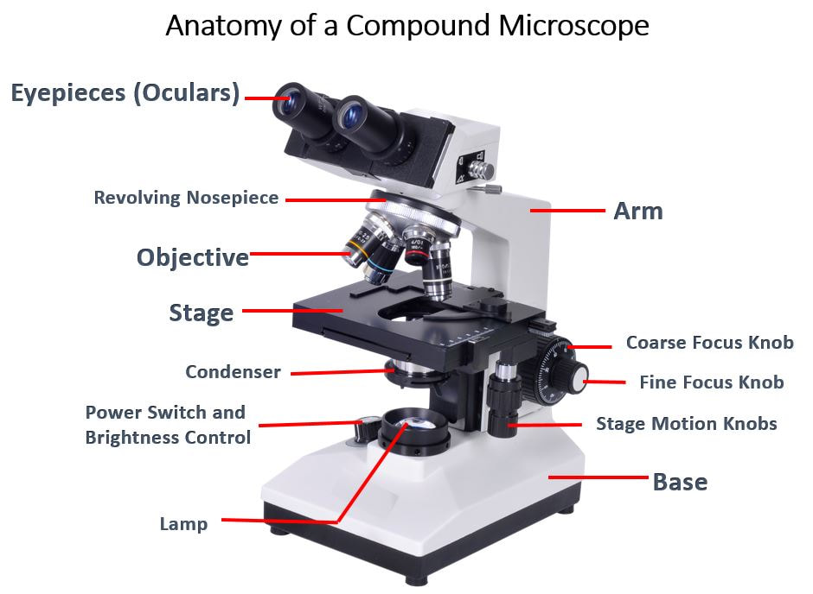

Slide 10
Parts of microscope
• Illuminator - This is the light source located below the specimen.
• Condenser - Focuses the ray of light through the specimen.
• Stage - The fixed stage is a horizontal platform that holds the specimen.
• Objective - The lens that is directly above the stage.
• Nosepiece - The portion of the body that holds the objectives over the stage.
• Iris diaphragm - Regulates the amount of light into the condenser.
• Base – Base supports the microscope which is horseshoe shaped.

Slide 11
• Coarse focusing knob - Used to make relatively wide focusing adjustments to the microscope.
• Fine focusing knob - Used to make relatively small adjustments to the microscope.
• Body - The microscope body.
• Ocular eyepiece - Lens on the top of the body tube. It has a magnification of 10× normal vision.

Slide 12
OBJECTIVE LENS
Mounted on nose piece
It forms magnified real image.
Magnification of objective
= Optical Tube length
Focal Length
Types
1. Scan - 4X , 2. Low Power 10X
3. High Power - 40X , 4. Oil immersion - 100X

Slide 13
OIL IMMERSION OBJECTIVE
Highest magnification
Oil prevents refraction of light outwards and allows it to pass straight in to objective.
USING COMPOUND MICROSCOPE
Grasp the microscopes arm with one hand and place your other hand under the base .
Place the microscope on a bench.
Adjust seat. Clean Lenses.
Turn the coarse adjustment knob to raise the body tube arm.

Slide 14
Revolve the nose piece to set low-power objective lens.
Adjust the Condenser lenses and diaphragm.
Place a slide on the stage and secure with stage clips.
Switch on the light at low intensity and then increase intensity.
Turn the coarse adjustment knob to lower the body tube until the low power objective reaches its lowest point.
Looking through the eyepiece, very slowly move the coarse adjustment knob until the specimen comes into focus.
Adjust distance between eye piece.

Slide 15
Switch to the high power objective lens only after adjusting condenser and iris diaphragm.
Place a drop of oil over specimen before using oil immersion objective.
Lower the objective until oil makes contact with objective.
Looking through the eyepiece, very slowly focus the objective away from the slide.

