Slide 1


Milk and their sources of contamination
Department of Veterinary Public Health & Epidemiology
BVSc & A.H., Third Professional year: Unit 1

Slide 2
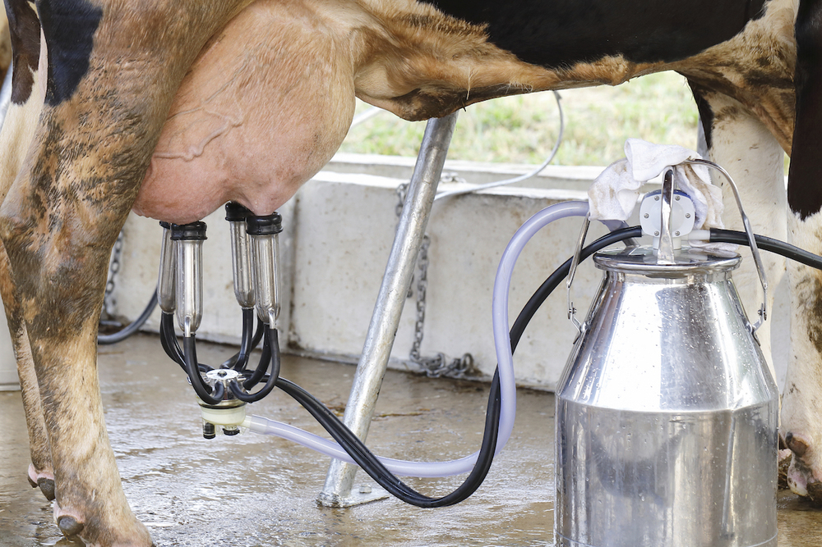
Milk
Milk: The wholesome, fresh, clear lacteal secretion obtained by the complete milking of one or more apparently healthy udders, excluding that obtained within 15 days before or 5 days after calving or such periods as may be necessary to render the milk colostrum free, and containing the minimum prescribed percentage of milk fat and milk solids-not-fat.”

Slide 4
Apparently healthy animal: Milk is relatively free of pathogenic bacteria.
Gets contaminated when comes in contact with external environment.
Serious deterioration in the microbiological quality due to
Lack of hygiene
Unsatisfactory chilling facilities
Improper post production storage
Improper handling of milk and milk products.

Slide 5
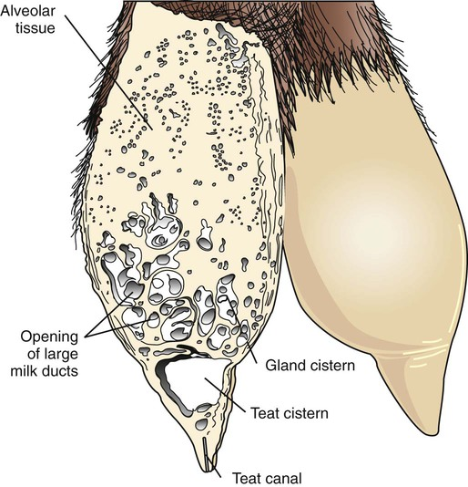
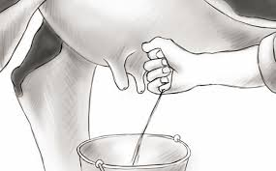
Sources of Contamination of raw milk
Practice at organized and unorganized dairies
Interior of the udder:
Generally acquired from the walls of the ducts along the teat canal.
Introduced in the milk through the teat:
  during treatment with contaminated intra-mammary preparations or
  from the environment of the animal.
Subsequently washed out in the first few streams of milk.
The microbial load in freshly drawn milk varies with individual animals.
The cleanliness of quarters and the health of dairy animals contribute significantly.
Usually the bacterial count of milk varies between 500 and 1000/ml.

Slide 6
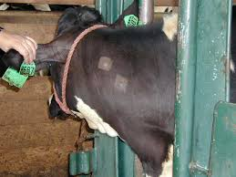
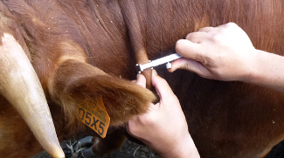
Tests and control for tuberculosis (SID/DID)
Tests and control for Brucellosis
Coliforms
The elimination of disease producing bacteria in milk pose a major public health hazard.
Mycobacterium tuberculosis, Brucella sp. and Streptococcus pyogenes, Coxiella burnetti.
Control measures:
Animals should be tested regularly for tuberculosis and brucellosis.
Cows should be stabled in clean stalls and pastured in drier areas, free of swamps and stagnant water / wash water that contaminate the teat canals mainly with coliforms.
A few streams of milk should therefore, always discarded before collection of milk.

Slide 7
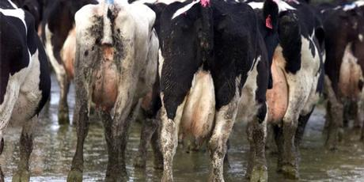
Environmental:
Condition of the cow-shed: contamination of flanks, tail and udder
The microorganisms in soil, discharges, straw, dust etc. accumulated on the surface of body----dislodged during the milking -----contribute a load of 10,000 bacteria or more per ml of milk.
The presence of pathogens such as coliforms (fecal coliforms) may cause summer complaint or infantile diarrhoea.
Control:
Hygienic methods in cow-sheds helps in maintaining clean stalls.
Wipening of flanks and udder with a clean damp cloth soaked in 1% KMnO₄ just before milking
Use of small mouthed container for collection of milk
Properly sterilized milking machine
Faecal coliforms

Slide 8



Milker or Handler:
Suffering from disease such as typhoid fever, diphtheria, scarlet fever, septic sore throat and tuberculosis, coughs and colds may contaminate milk or milk products.
Control:
Regular Health checkup
Diseased individual or carrier should not allowed to handle milk or milk products.

Slide 9
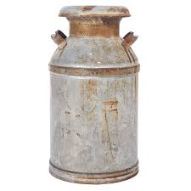
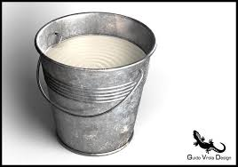
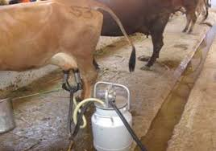
Utensils:
The most prolific source of microorganisms.
A milk can or bucket improperly washed, inadequately sanitised or dried or a dirty milking machine are a fertile source of milk contamination.
Utensils washed with contaminated water: water borne diseases.
Control:
Thorough cleansing, followed by sterilisation of utensils.
After washing, buckets and milk cans should be rapidly dried and kept in a dry place.
At the farm level, there is an utmost need of constant attention to details of hygiene and sanitation.
Since man is a direct / indirect source of contamination, he should exercise every hygienic precaution to ensure safety of milk and milk products.

Slide 10
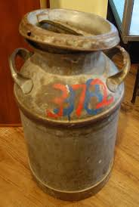
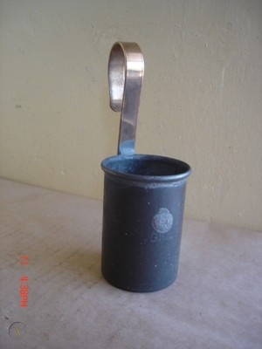
Wholesaler, retailer and the vendor:
The main sources of contamination of milk are milk cans and buckets used for transport of milk as well as the dippers used to draw milk from the cans.
The containers if not cleaned well, are potential sources of pathogens
The pathogens gain entry through contaminated water supplies, carrier individuals handling and fecal contamination.
Improper washing and cleansing of the cans / containers can cause a build up of milk residues that facilitate the growth of micro-organims like Staphylococcus aureus, Bacillus cereus and fungi.

Slide 11
These organisms may get released into milk during refilling of the can.
Spoilage organisms such as Bacillus sp. as well as yeast and molds, thrive in milk adulterated with contaminated water.
Control:
Improve the standard of personal hygiene of the staff.
Cleaning of containers with hot water and caustic soda / bleaching powder (2%) immediately after emptying their contents and allowing them to dry before refilling.
The dipper should also be washed and sterilized in a similar manner.

Slide 12
Storage of raw milk in chilling tanks at milk processing units and bulk containers:
Milk brought to the cities by tankers is first emptied into chilling plants (bulk containers) at the milk processing units (0° - 4°C).
Contamination with S. aureus, yeasts and coliforms at this point occurs through improperly cleaned or sanitized milking equipment and non potable water used for washing.
Mastitic streptococci are derived only from mastitis milk mixed with other milk at the farm level and primary milk collection centers.

Slide 13
Mold contamination occurs mainly through aerosols under humid conditions within improperly cleaned and disinfected plants.
Both yeasts and molds reduce the keeping quality by increasing the acidity in milk and developing off flavours.
Organisms causing enteric fever and dysentry like Shigella sp. are also contracted through bad hygiene.
Control measures:
Immediate washing of bulk containers / tanks with hot water, caustic soda / bleaching powder after emptying milk
Sterilized with the help of hot steam jets.
Proper cleaning of plant premises with hypochlorite also reduces the load of bacteria and molds in the atmosphere of the processing plant.

Slide 14
Transport of raw milk by rail / road tankers:
Improper maintenance of milk tankers adds to the microbiological contamination in milk.
The longer time leads to higher load of bacterial and fungal agents.
The ecological and the local climatic conditions tend to vary from region to region.
The bacterial counts and species differ with seasons.
Pathogenic bacteria, yeasts and mold multiply rapidly in summer as compared to winter or monsoon seasons.
One of the sources of contamination in tankers is accumulation of milk solid residues inside the gauges, taps, pipes etc. which act as a foci for microbial growth.

Slide 15
Some of the psychrotrophs such as Pseudomonas sp. produce extracellular enzymes leads to off flavours.
Heat resistant organisms may survive even after pasteurization resulting in loss of flavour, texture and stability of milk.
Spore formers are found to be least in number during the monsoon season due to availability of fresh green fodder, ample water and a relatively dust free environment.
Presence of pathogens, eg., S. aureus, enterotoxigenic E.coli, B. cereus etc. that originate mainly from the handlers at the source of milking, remain in milk, producing heat stable toxins.
An overall absence or very low level of pathogens is requires to be ensured especially in tanker milk to be pasteurized.
The load of organisms can be lowered by taking adequate hygienic precautions at the farm as well as by regular cleansing and proper maintenance of tankers.

Slide 16
THANKS

