Slide 1
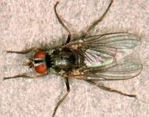
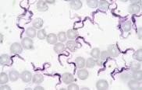
Mode of Transmission of Parasites
Dr. AJIT KUMAR
Department of Veterinary Parasitology
Bihar Veterinary College
Bihar Animal Sciences University
Patna-800014
Image source: Google image

Slide 2
Mode of Transmission of Parasites
Various modes of transmission of parasites or its infective stage:-
Ingestion
Transmammary transmission
Skin penetration( percutaneous)
Inoculation
Direct contact
Venereal transmission
Congenital (Intrauterine) transmission
Auto-infection
Inhalation

Slide 3
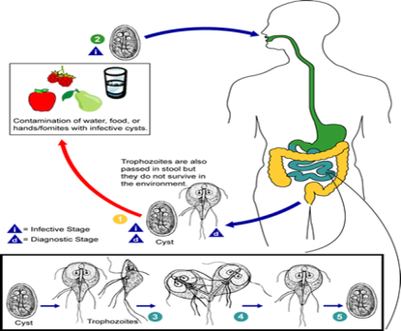
Mode of Transmission of Parasites
Infective stages of parasite are transmitted by
Ingestion – hosts get the infection by ingestion of infective stage of parasites ( egg or cyst or oocyst or larva) through the infected feed or fish or meat or colostrum or milk or aquatic vegetation or intermediate host or paratenic host.

Slide 4
Mode of Transmission of Parasites
Ingestion:
Fasciola hepatica infection occurs in host (cattle etc.) by the ingestion of metacercaria (infective stage) infected aquatic vegetation

Slide 5
Mode of Transmission of Parasites
Infective stages of parasite are transmitted by
Ingestion –
Man gets Giardia protozoa infection by the ingestion of Cyst contaminated food.

Slide 6
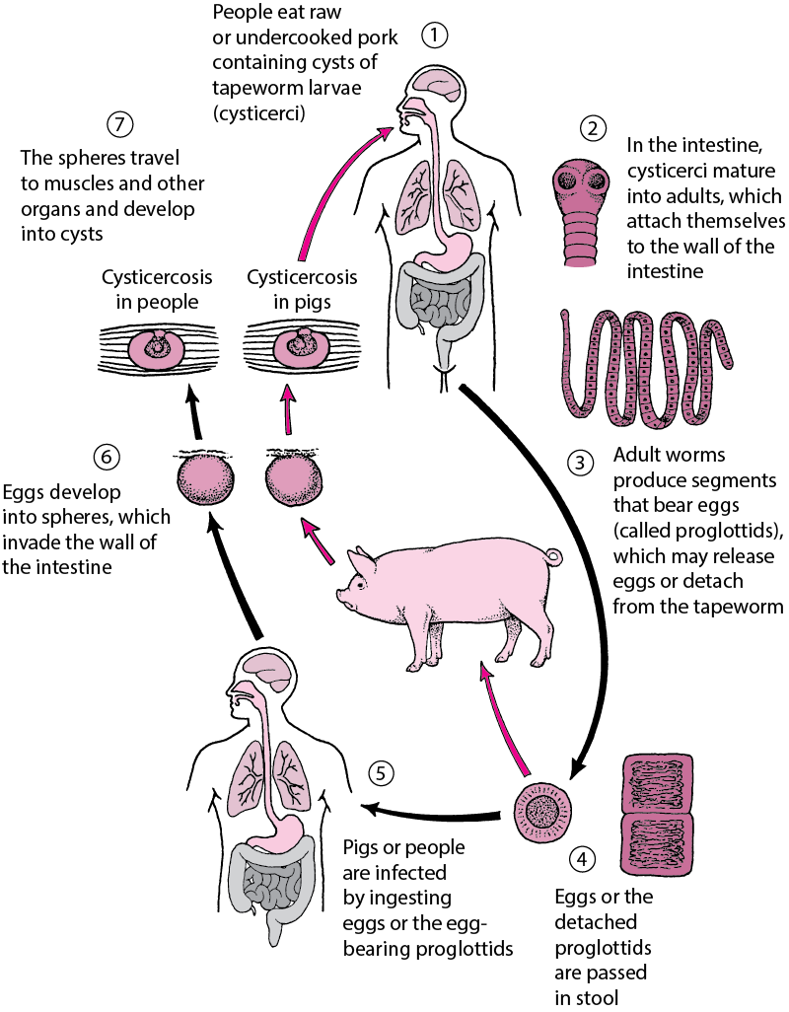
Mode of Transmission of Parasites
Infective stages of parasite are transmitted by
Ingestion:
Taenia solium infection occurs in host ( man) by the ingestion of Cysticercus cellulosae ( metacestode or larval stage) infected raw or measly pork.

Slide 7
Mode of Transmission of Parasites
Infective stages of parasite are transmitted by
Ingestion:
man or dog gets the Diphyllobothrium latum infection by the ingestion of Pleroceroid infected fish ( 2nd Intermediate host).

Slide 8
Mode of Transmission of Parasites
Infective stages of parasite are transmitted by
Transmammary Transmission: Pup may gets the Toxocara canis infection form mother (bitch) through the colostrum/milk.

Slide 9
Mode of Transmission of Parasites
Infective stages of parasite are transmitted by
Transmammary Transmission: Pup may gets the Ancylostoma caninum infection form mother (bitch) through the colostrum / milk .

Slide 10
Mode of Transmission of Parasites
Infective stages of parasite are transmitted by
Skin penetration( Percutaneous) – 3rd stage larva of hook worms, cercaria of Schistosoma species, egg and larva of myiasis causing flies and Trypanosoma cruzi infections.

Slide 11
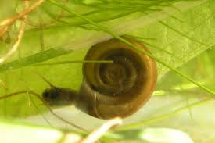
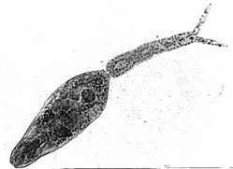
Mode of transmission of parasites
Infective stages of parasite are transmitted by
Skin penetration( Percutaneous) – 3rd stage larva of hook worms, cercaria of Schistosoma species, egg and larva of myiasis causing flies and Trypanosoma cruzi infections.
Cercaria of Schistosoma spp. enter the host body through skin penetration

Slide 12
Mode of Transmission of Parasites
Infective stages of parasite are transmitted by
Inoculation : through blood sucking arthropod vectors- Trypanosoma evansi, Leishmania spp. etc.
Parasite | Transmission through blood sucking arthropod vectors
Trypanosoma evansi | Tabanus fly
Leishmania spp. | Phlebotomus spp.( Sand Fly)
Babesia spp. | Ticks
Plasmodium spp. | Mosquitoes

Slide 13
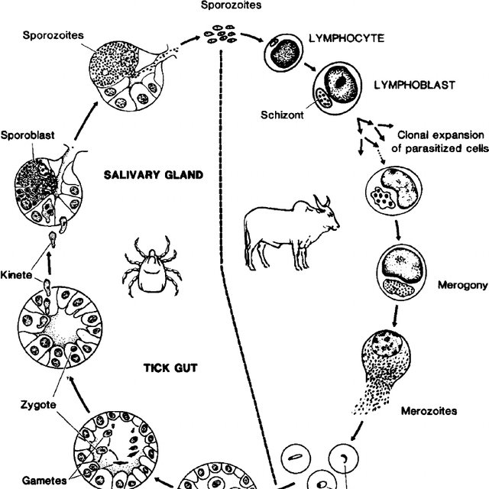
Mode of Transmission of Parasites
Infective stages of parasite are transmitted by
Inoculation (through blood sucking arthropod vectors)
Tick
Babesia spp. transmitted through blood sucking of infected tick

Slide 14
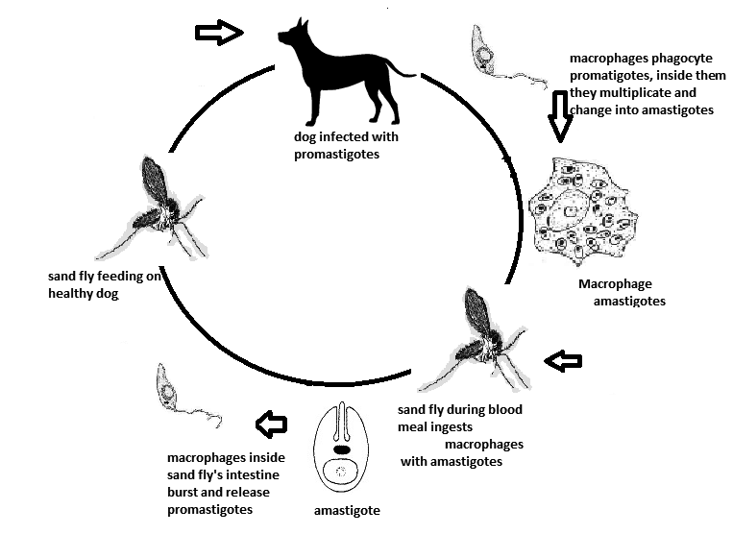
Mode of Transmission of Parasites
Infective stages of parasite are transmitted by
Inoculation (through blood sucking arthropod vectors)
Sand fly
Leishmania spp. transmitted through blood sucking of infected Sand fly

Slide 15
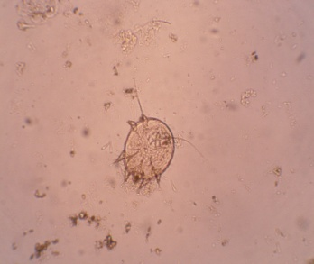
Mode of Transmission of Parasites
Infective stages of parasite are transmitted by
Direct contact- mites, lice, flea etc. infestation.
Mites
Mite

Slide 16
Mode of Transmission of Parasites
Infective stages of parasite are transmitted by
Direct contact- mites, lice, flea etc. infestation.
Louse

Slide 17
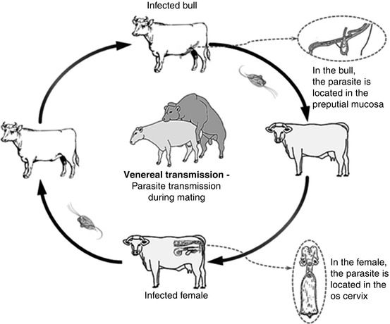
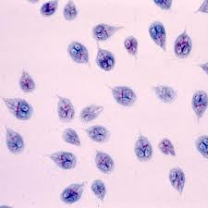
Mode of Transmission of Parasites
Infective stages of parasite are transmitted by
Venereal transmission – by coitus.
e.g. Tritrichomonas foetus and Trypanosoma equiperdum.
Tritrichomonas foetus
T. foetus caused early abortion in cattle

Slide 18
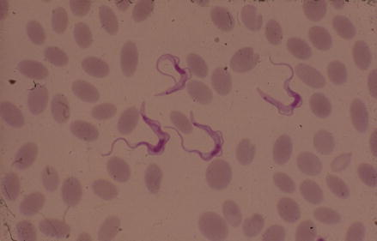
Mode of Transmission of Parasites
Infective stages of parasite are transmitted by
Venereal transmission – by coitus.
e.g. Trypanosoma equiperdum.
Trypanosoma equiperdum caused Dourine disease in horse

Slide 19
Mode of Transmission of Parasites
Infective stages of parasite are transmitted by
Congenital transmission (Intrauterine or prenatal or Transplacental transmission) – Parasite are transmitted from infected mother to their foetus through the placenta.
e.g. Toxocara canis and Ancylostoma caninum in dog.

Slide 20
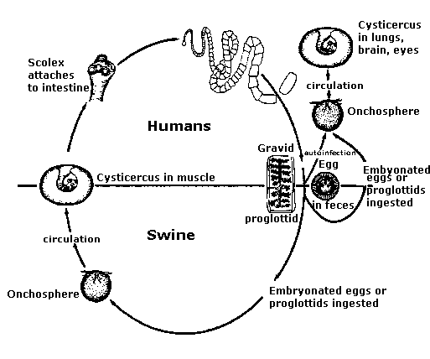
Mode of Transmission of Parasites
Infective stages of parasite are transmitted by
Auto-infection: – Infected host is re-infected due to reverse peristalsis movement of intestine and other routes
e.g. Taenia solium in man, Hymenolepsis nana (Dwarf tapeworm), Cryptosporidium spp. etc.

Slide 21
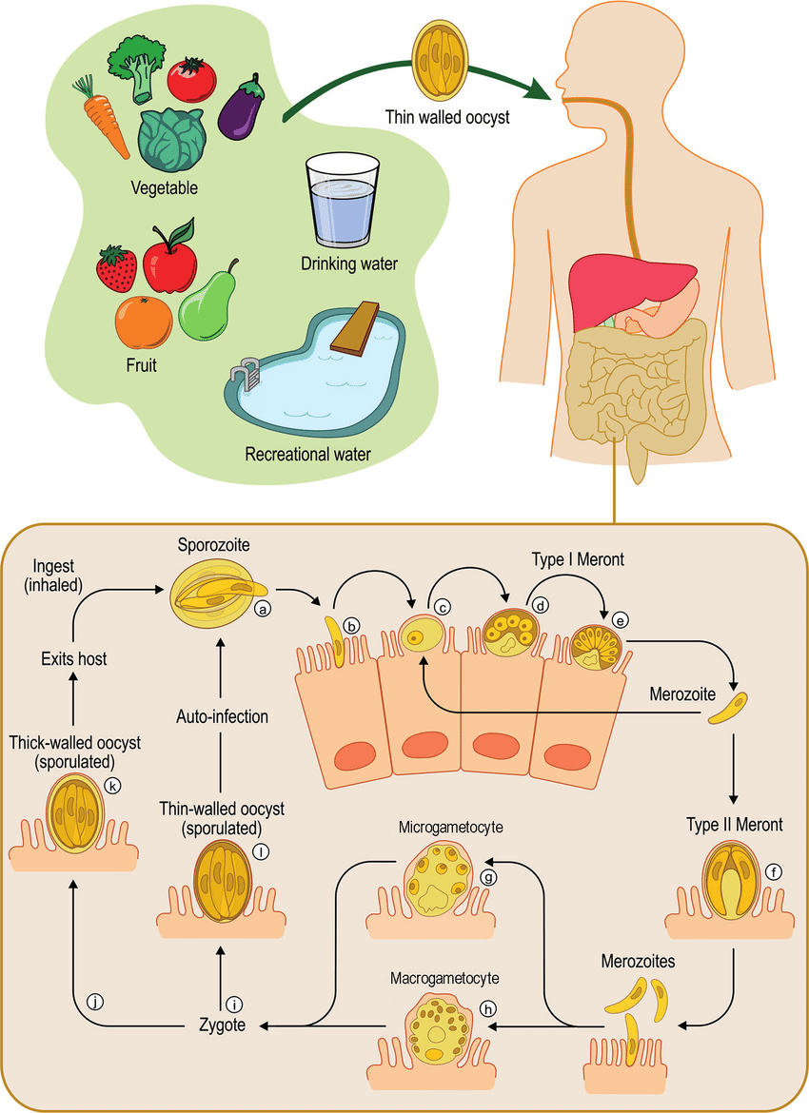
Mode of Transmission of Parasites
Infective stages of parasite are transmitted by
Inhalation: –
e.g. Cryptosporidium spp.,

Slide 22
THANK U

