Slide 1
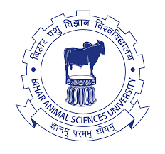


ONE HEALTH CONCEPT
AND
INITIATIVES

Slide 2
INTRODUCTION
Although the term “One Health” is fairly new, the concept has long been recognized both nationally and globally.
Since the 1800s, scientists have noted the similarity in disease processes among animals and humans, but human and animal medicine were practiced separately until the 20th century.
In recent years, through the support of key individuals and vital events, the One Health concept has gained more recognition in the public health and animal health communities.

Slide 3
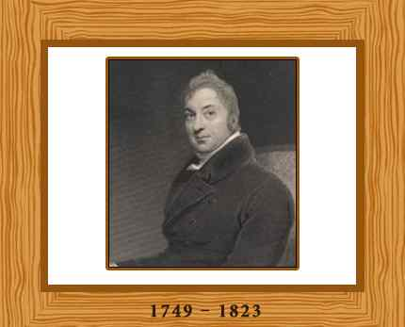
HISTORY
Edward Jenner found that milkmaids exposed to cowpox that were not infected with smallpox.
From this discovery, produced first successful vaccine to prevent smallpox.
E. Jenner, first using dead vaccine to prevent hog cholera – open the way to produce vaccine to prevent Rickettsia and Polio diseases in man.
Sir Edward Jenner

Slide 4
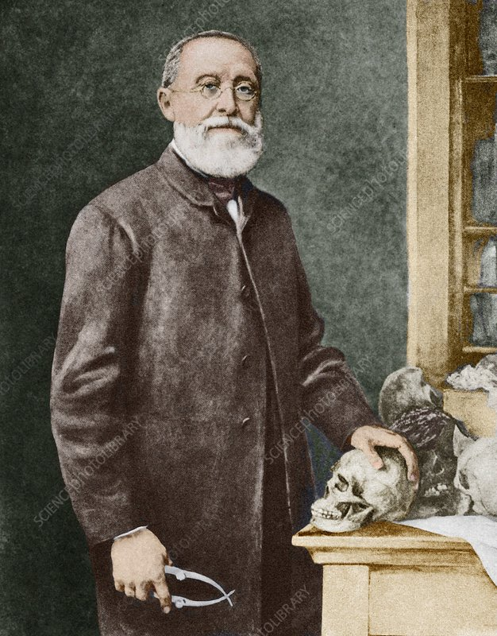
Rudolf Virchow, MD: Most prominent physicians of the 19thcentury
German pathologist: linkages between human and veterinary medicine while studying a roundworm, Trichinella spiralis, in swine.
Coined the term “zoonosis”.
Advocated for the importance of improved veterinary education.
Emphasized, “Between animal and human medicine there are no dividing lines—nor should there be. The object is different but the experience obtained constitutes the basis of all medicine.”
1821-1902

Slide 5
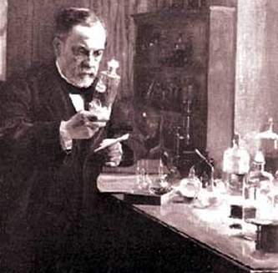
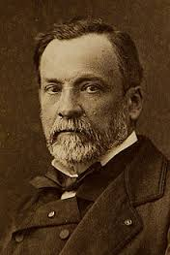
Sir Louis Pasteur – French.
Regarded as father of Immunology.
Produced vaccine to prevent rabies.
Linked medicine and veterinary medicine.
Sir Louis Pasteur
(1822-1895)

Slide 6
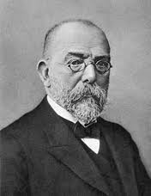
Sir Robert Koch, German physician.
Established the field of bacteria.
Studied on TB, Vibrio cholerae, Anthrax.
Nobel in medicine.
Linked medicine with vet. medicine, especially study on Bacillus anthracis.
Sir Robert Koch
(1843-1910)

Slide 7
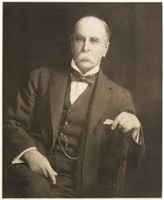
Sir William Osler, Canadian physician
Established the field of vet. pathology as an academic disciplinary in North American.
Father of Veterinary Pathology
A deep interest in the linkages between human and veterinary medicine.
Trained with many well-known physicians and veterinarians, including Dr. Virchow.
His first publications was titled, “The Relation of Animals to Man.”
Sir W. Osler was first to use: “One Medicine” in literature.
Sir William Osler (1849-1919)

Slide 8
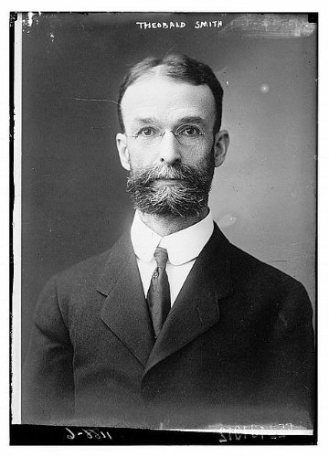
Theobald Smith and F.L. Kilbourne first discovered arthropod play a role vector (1893)
Demonstrated Boophilus transmission Babesia bigemina parasite caused disease in cattle
Based on this discovery, Walter Reed found the vector of Yellow fever.
Sir Theobald Smith
(1859-1934)

Slide 9
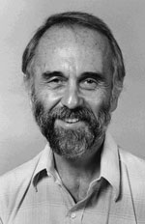
Sir Calvin Schwabe DVM, ScD, MPH: Made many important contributions to veterinary epidemiology (Father of Veterinary Epidemiology).
Studied zoonotic parasitic diseases and directed the programs on hydatid disease and other parasitic diseases.
1964: proposed that veterinary and human health professionals collaborate to combat zoonotic diseases.
In 1966: the founding chair of Department of Epidemiology and Preventive Medicine at the Veterinary School (University of California Davis).
In his textbook, Veterinary Medicine and Human Health, he coined the term “One Medicine.”
Sir Calvin Schwabe (1927-2006)

Slide 10
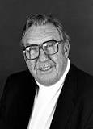
James H. Steele, DVM, MPH, American veterinarian recognized as “the father of Veterinary Public Health”
Founded the Veterinary Public Health Division at CDC in 1947.
He understood the important role of animals in the epidemiology of zoonotic diseases.
Recognized that good animal health is important for good public health.
The Division played an important role in the public health response to diseases such as rabies, brucellosis, salmonellosis, Q fever, bovine tuberculosis, and leptospirosis.
1913-2013

Slide 11
Manhattan Principles on “One World, One Health”
(The Wildlife Conservation Society, 2004)
1. Recognize the essential link between human, domestic animal and wildlife health.
2. Recognize that decisions regarding land and water use have real implications for health.
3. Include wildlife health science as an essential component of global disease prevention, surveillance, monitoring, control and mitigation.
4. Recognize that human health programs can greatly contribute to conservation efforts.
5. Devise adaptive, holistic and forward-looking approaches to the prevention, surveillance, monitoring, control and mitigation of emerging and resurging diseases.
6. Seek opportunities to take part in biodiversity conservation perspectives and human needs.

Slide 12
7. Reduce the demand and to regulate the international live wildlife and bush meat trade.
8. Restrict the mass culling of free-ranging wildlife species for disease control.
9. Increase investment in the global human and animal health infrastructure.
10. Form collaborative relationships among governments, local people, and the private and public sectors to meet the challenges of global health and biodiversity conservation.
11. Provide adequate resources and support for global wildlife health surveillance networks.
12. Invest in educating and raising awareness among the world’s people and in influencing the policy process.

Slide 13
2007 :
International Ministerial Conference on Avian and Pandemic Influenza, New Delhi, India
The One Health Approach is Recommended for Pandemic Preparedness
During this meeting, governments were encouraged to further develop the One Health concept by building linkages between human and animal health systems for pandemic preparedness and human security.

Slide 14
2008:
International Ministerial Conference on Avian and Pandemic Influenza in Sharm el-Sheikh, Egypt.
One Health becomes a recommended approach.
Endorsed a new strategy for fighting avian influenza and other infectious diseases, one that focuses infectious disease control in areas where animals, humans, and ecosystems meet.

Slide 15
2009:
The Environmental and Zoonotic Infectious Diseases hosted the One World, in Winnipeg, Manitoba
The key recommendations emerged for actions that countries could take to advance the concepts of One Health.

Slide 16
2010:
The European Union published the “Outcome and Impact Assessment of the Global Response to the Avian Influenza Crisis” report.
This report states, “The European Union has already taken new initiatives under the One Health umbrella and will continue to do so in the coming years.”
The report emphasizes the need to translate the One Health concept into practical policies and strategies that promote the cross-sectoral collaboration.

Slide 17
2012:
The Global Risk Forum sponsors the first One Health Summit held in Davos, Switzerland.
The Summit presented the One Health concept as a way to manage health threats, focusing on food safety and security.
The conference ended by approving the “Davos One Health Action Plan,” which pinpointed ways to improve public health through multi-sectoral and multi-stakeholder cooperation.

Slide 18
2013:
2nd International One Health Congress is held in conjunction with the Prince Mahidol Award Conference.
The conference encouraged collaboration across disciplines to promote effective policy development related to human, animal, and environmental health.

Slide 19
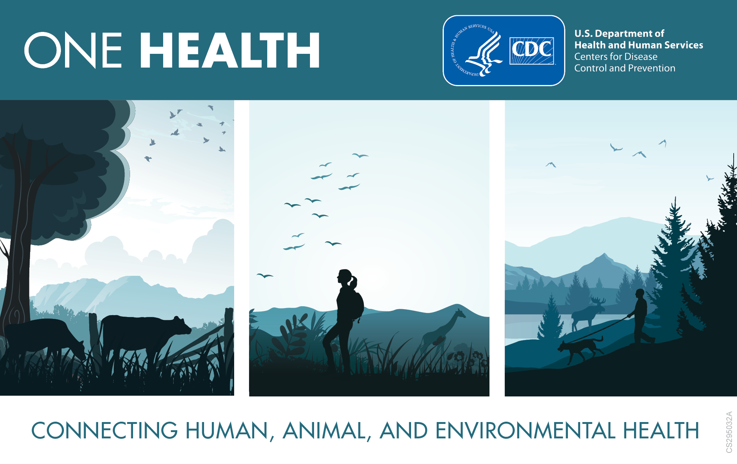
The One Health Concept
ONE HEALTH means “a collaborative, multisectoral, and transdisciplinary approach—working at the local, regional, national, and global levels—with the goal of achieving optimal health outcomes recognizing the interconnection between people, animals, plants, and their shared environment”.
“One Health (formerly called One Medicine) is dedicated to improving the lives of all species—human and animal—through the integration of human medicine, veterinary medicine and environmental science.”
The areas of work in which a One Health approach is particularly relevant:
  Food safety
  The control of zoonoses
  Combatting antibiotic resistance

Slide 20
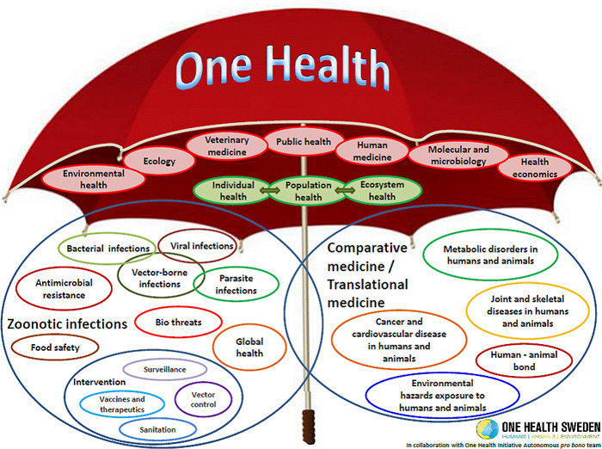

Slide 21
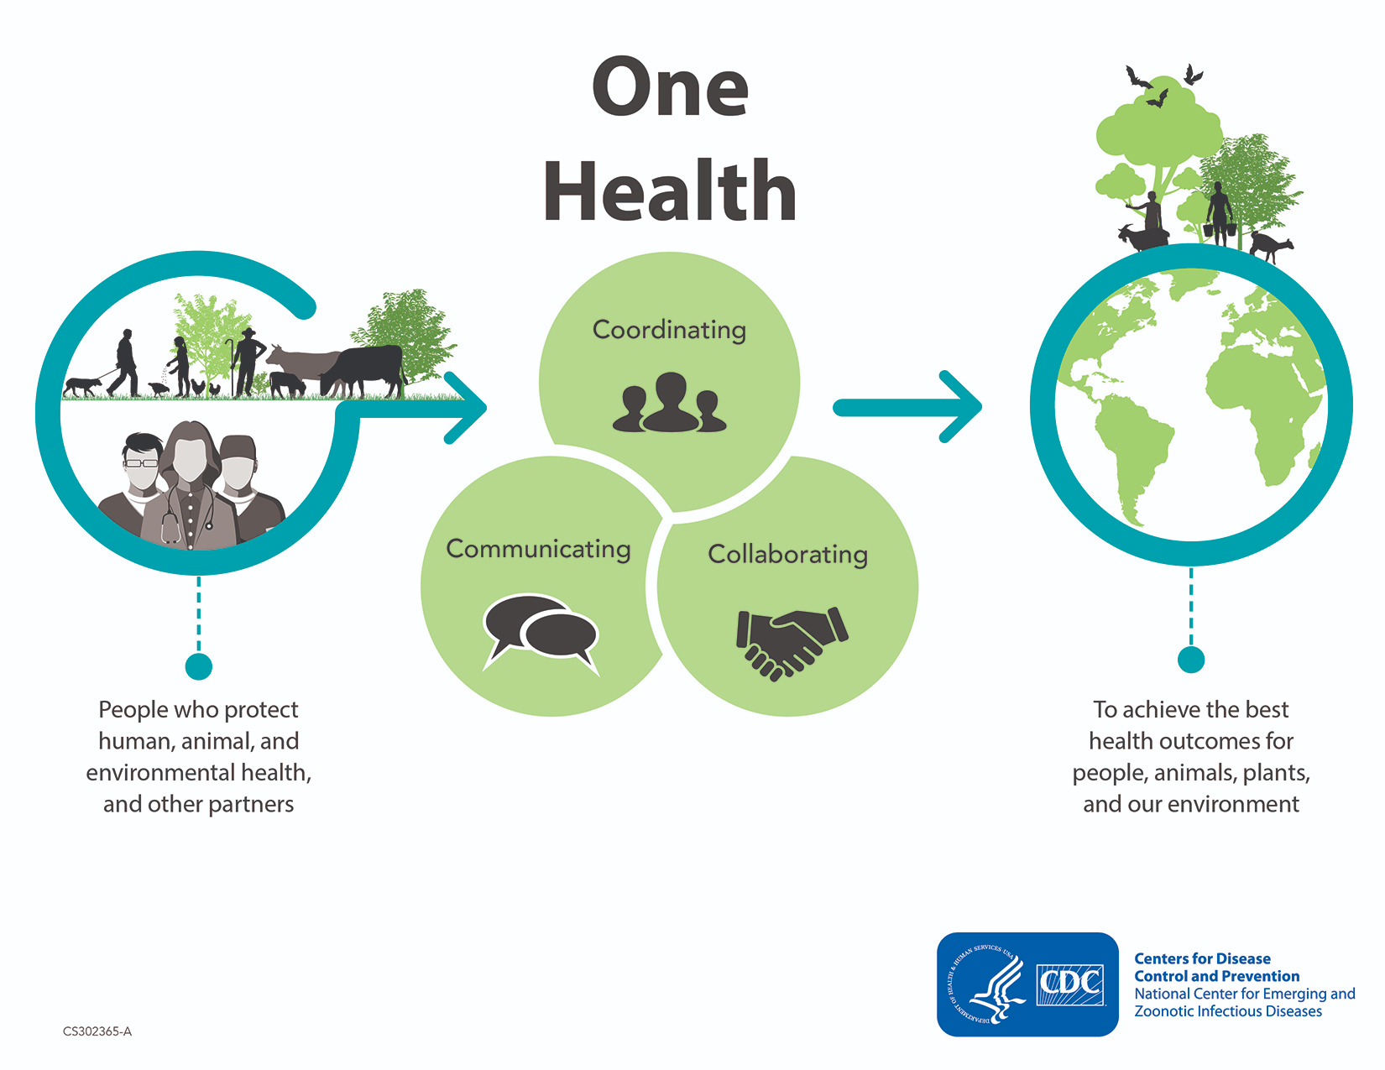

Slide 22
Efforts to achieve One Health
Joint educational efforts between human medical, veterinary medical schools, and schools of public health and the environment.
Joint communication efforts in journals, at conferences, and via allied health networks.
Joint efforts in clinical care through the assessment, treatment and prevention of cross-species disease transmission.
Joint cross-species disease surveillance and control efforts in public health

Slide 23
Joint efforts in better understanding of cross-species disease transmission through comparative medicine and environmental research.
Joint efforts in the development and evaluation of new diagnostic methods, medicines and vaccines for the prevention and control of diseases across species.
Joint efforts to inform and educate political leaders and the public sector through accurate media publications.

Slide 24
Organizations working on one health
World Health Organization (WHO)
Food and Agriculture Organization (FAO)
World Organization for Animal Health (OIE)
One Health Initiative (founded in 2006
US Centers for Disease Control
Eco-Health Alliance
South East Asia One Health University Network (SEAOHUN)
Indonesia One Health University Network (INDOHUN)
Malaysia One Health University Network (MyOHUN)
Thailand One Health University Network (THOHUN)
Vietnam One Health University Network (VOHUN)

Slide 25
Possible members of a one health team
Veterinarian
Physician
Nurse
Public Health Worker
Epidemiologist
Wildlife Scientists
Local Leader/Politician
Environmental Health Worker
Ecologist
Social Scientist
Economist
Communications Specialist
Emergency Responder
Laboratorian
Pharmacist
Logistician
Public Affairs/Marketing
Information Technologist

Slide 26
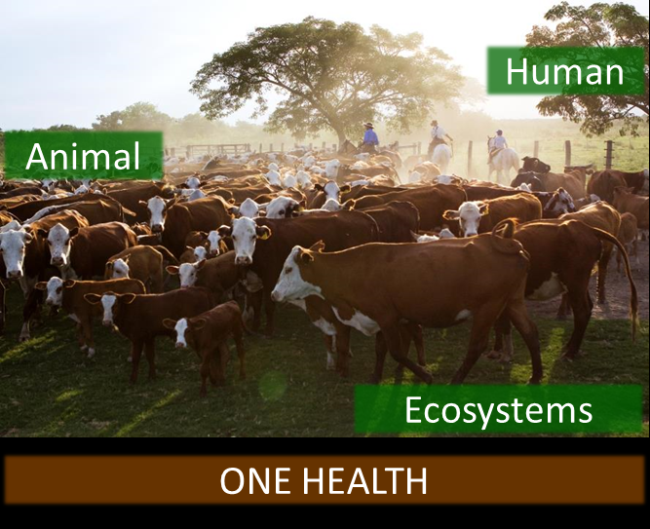

Slide 27
