Slide 1
Basic Concept on Genetics of Dairy Production
Content Creator
Dr. R. K. Singh, M.V.Sc., Ph.D.
Assistant Professor
Dept of Animal Genetics and Breeding
Bihar Animal Sciences University, Patna (Bihar)

Slide 2
What is genetics?
William Bateson defined genetics as: "Genetics is the science dealing with heredity and variation seeking to discover laws governing similarities and differences in individuals related by descent".

Slide 3
Essential vocabulary about genetics
A gene is a section of DNA that determines a trait.
Since chromosomes are paired, genes are also paired.
Therefore, these genes can have different forms which are called alleles.
When the two alleles of a gene are the same (here AA), then the cow is said to be homozygous for the trait coded by the orange traits. However, when the two alleles are different (here Bb), the cow is said to be heterozygous for this trait

Slide 4

Essential vocabulary about genetics
A gene is a section of DNA that determines a trait.
Since chromosomes are paired, genes are also paired.
These genes can have different forms which are called alleles.
When the two alleles of a gene are the same (here AA), then the cow is said to be homozygous for the trait coded by the orange traits.
when the two alleles are different (here Bb), the cow is said to be heterozygous for this trait

Slide 5
The gene combination of an organism defines the genotype of this organism.
Half of these genes will be transferred to the offspring.
We don't know exactly the gene combination of an organism for most of the times.
What we know is its phenotype, which is the way this organism looks.
In dairy cows, we are particularly interested in the phenotype of traits that can be recorded such as the quantity of milk produced by a cow.

Slide 6
Relation between the phenotype and the genotype
How is the phenotype related to the genotype?
Complete dominance
If we mate an homozygous bull with two horned alleles (pp) with an homozygous cow with two polled alleles (PP),
The calf will be heterozygous Pp and its phenotype will be polled.
This mating result into production of three genotypes (pp, PP and Pp)
but we only saw two phenotypes.
Therefore, the polled allele (P) is dominant to the horned allele (p) and the horned allele is recessive to the polled allele.
When a trait is always observed in the offspring even when a recessive allele is present we speak of complete dominance.

Slide 7
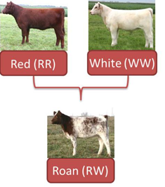
Co-dominance
When we mate an homozygous bull with two red coat alleles
with an homozygous cow with two white coat alleles (WW), the calf will be heterozygous RW and its phenotype will be roan.
Hence, the heterozygote is different from either of the homozygotes.
We have three genotypes (RR, WW and RW) and three phenotypes.
When both alleles are expressed equally in the heterozygous type, we speak of co-dominance.

Slide 8
Expected results for more than one trait
The phenotype is a combination of many traits.
What are the expected results for more than one traits?
When we consider more than one trait, the expected results in the phenotype depend on the relationship between genes.

Slide 9
Independent loci
If the phenotype of each trait is determined separately by allelic genes
The genes determining one trait are independent of the genes for the other trait, then we speak of independent loci.
Example of independent loci: coat color and polled loci

Slide 10
Exercises

Slide 11
Epistatic effect
If a gene masks the effect of another gene at a different locus, it defines the epistatic effect
Example of epistasis: the albino gene

Slide 12
Epistatic Effect Example
We mate two animals homozygous for the black and white color coat (BB) and heterozygous for the albino gene (Cc).
When the offspring are homozygous with two recessive alleles for the albino gene, the phenotype is albino despite the presence of the two dominant alleles for the black and white coat.
Hence, the albino gene is epistatic to the genes for coat color.
Expected results in the offspring

Slide 13
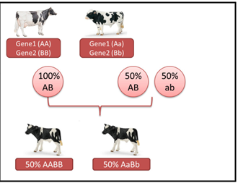
Linked genes
If genes at certain loci tend to be inherited together, then we speak of linked genes.
Genes are mostly linked when their loci are near each other on the same chromosome.
If the loci are linked, during meiosis, recombination gametes and non-recombination gametes are produced according to the recombination frequency, which corresponds to the distance between genes
If the two loci are linked, the heterozygous parent does not produce 50% AB and 50% ab germ cells. Therefore, in the offspring we can't expect 50%AABB and 50% AaBb.

Slide 14
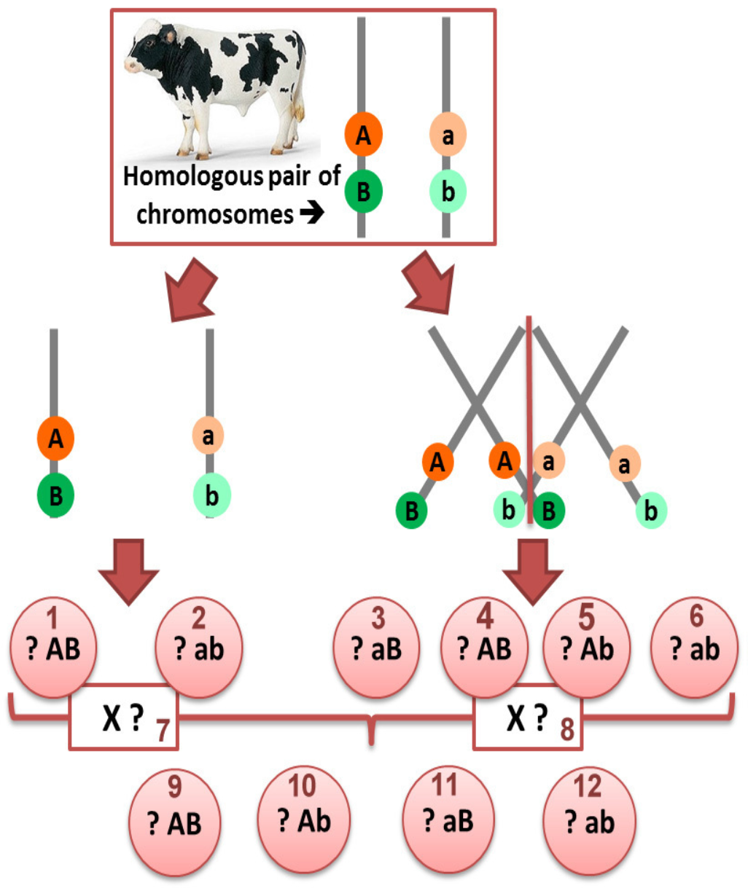
Indeed, if we consider two loci linked with a frequency of recombination equal to 20%, then in 80% of the cases there is no recombination during meiosis when in 20% of case there is.
Hence, the heterozygous parent actually produces (?%):

Slide 15
Exercise
Therefore, if we mate this heterozygous parent for two linked genes with an homozygous parent for the same loci, in the offspring we expect (?%):
Source:- Charlotte DEZETTER. Genetics of dairy production. E-learning course from ESA

Slide 16
THANK YOU

