Slide 1
PROCESSING OF MILK (Part-1)
BY-
Dr. SUSHMA KUMARI
HOD,
DEPT. OF LPT,BVC,
Bihar Animal Sciences University, Patna

Slide 2
Milk processing
1. Collection
2. Cooling
i. In-can or can immersion method
ii. Surface coolers
iii. In- tank or bulk tank coolers
3. Pre- heating- for efficient filtration/ clarification.
4. Filtration- removal of visible foreign matter.
by cloth or strainer.
5. Clarification- removal of foreign matter by clarifier

Slide 3
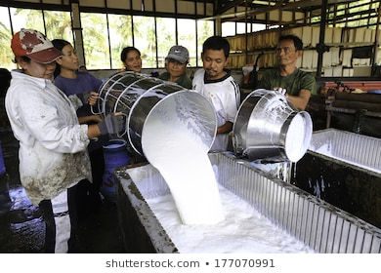
Milk collection

Slide 4
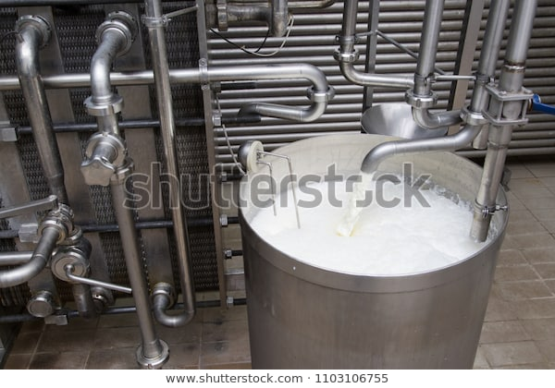
Milk Collection

Slide 5
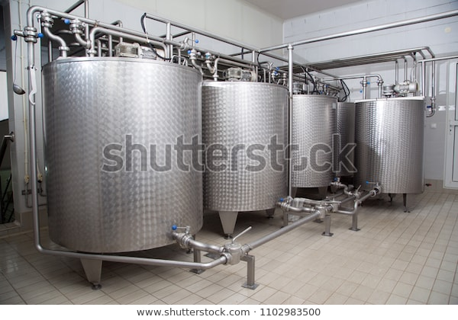
Milk storage tank

Slide 6
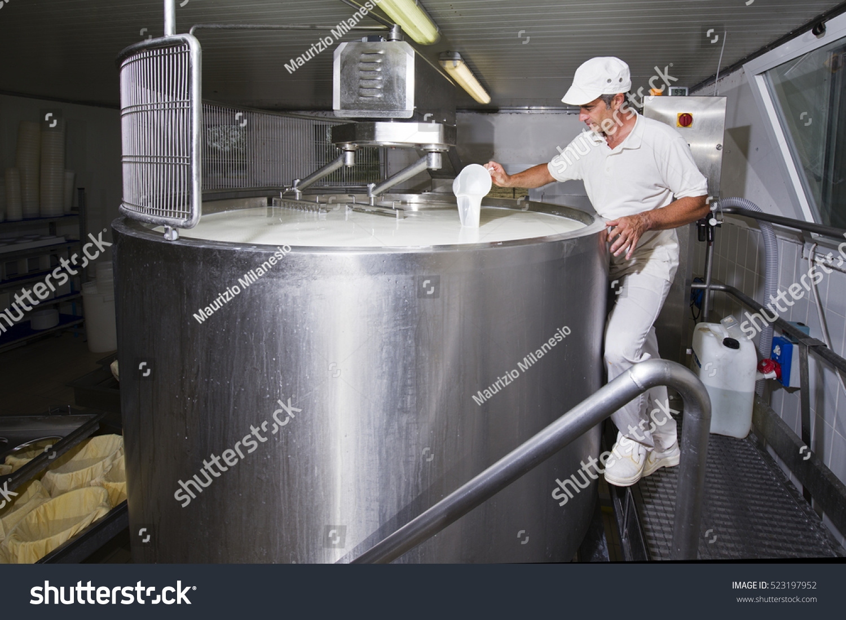
Milk sampling

Slide 7
6. Standardization- refers to the adjustment
i.e. level of fat & SNF % to a desired value.
Can be done by –
Addition of milk or cream with higher or lower fat % or by removal.
7.Pasteurization- term coined by Louis Pasteur of France.
Methods of Pasteurization-
(i) Batch/ Holding / LTLT- 63 C for 30 min. in water jacketed vat.
(ii )HTST- 72 C for 15 sec by plate heat exchanger.

Slide 8
THANKS

