Slide 1
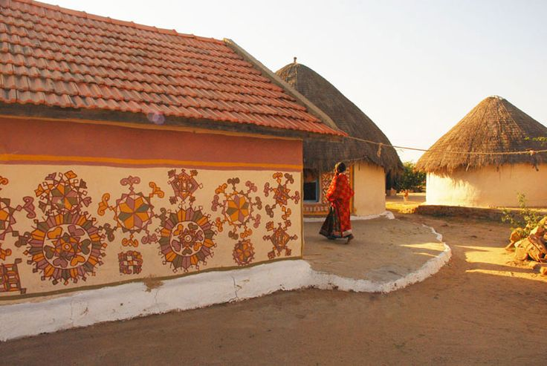
UNIT-02 (EXTENSION EDUCATION AND DEVELOPMENT)
Dr. Puspendra Kumar Singh
Department of Veterinary & Animal Husbandry Extension Education, BVC

Slide 2
Panchayat Raj
(Democratic Decentralization)
Democracy Greek roots -‘demos’ – the people ‘cracy’ - rule of
Decentralization –
Devolution of central authority among local units close to the area served.

Slide 3
Meaning of Democratic Decentralization
The governance of the people, by the people & for the people.
System of Govt, horizontally it is a network of Panchayat & vertically an organized growth of Panchayat.
Rule by majority and consultation
Pooling the intelligence and experience

Slide 4
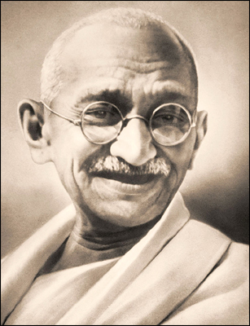
Gandhiji asserted that
“Unless panchayats were invested
with adequate powers, villagers
cannot have real Swaraj.”
In January 1957, GOI appointed a committee under the chairmanship of Balwantray Mehta to review the CD programme.
Committee recommended a three-tier system of local government.
Launched “Panchayat Raj” by Jawaharlal Nehru.

Slide 5
Difference between CD PROGRAMME & PRI
CDP relies entirely on persuasion,
works with ad-hoc groups through
their natural leaders
While, PRI functions on the basis of legal compulsion, works with entire community through its chosen leaders, according to some laid down procedure, discharge functions as the state or central govt. agent

Slide 6
Need for democratic decentralization
After independence Indian administration was described as democracy at the top and dictatorship at the bottom.
People were not associated with the administration in lower tiers, from the district downwards.
CDP review committee recommended in their report that
“the time had arrived for India to have greater faith and trust in the people for their own welfare. ”

Slide 7
Implementation
Approved by NDC in 1958
Pilot blocks : Madras state – 1957
Andra Pradesh – July 1958
Rajasthan – pioneer state – 2 Oct.1959
Andhra Pradesh – 1 Nov. 1959
Maharashtra –1962
Inter state variation
To grant constitutional status & uniformity, 73rd Amendment Act, 1992 w.e.f. 24th April 1993.
Ministry of Panchayati Raj- 27th May 2004

Slide 8
Constitution (73rd Amendment) Act, 1992
Establishment of Gram Sabha
Establishment of three tier (Middle level not in the states having population less than 20 lakh)
Member selection by indirect election, whereas president decided by direct election
Ex-officio member at every level
1/3 reservation for women
Reservation to SC, ST in proportion to their population
Term of five years
State finance commission governing financial authority
State election commission to conduct election
Representatives & officials training

Slide 9
Finding of survey conducted before enforcement of 73rd Amendment
Findings:
Out of the chairpersons of panchayat
25% big farmers
77% from upper class
Only 7% SC & 15% ST
3% women (41% SC)
13% graduates,24% primary level, 7% illiterate
Extremely poor deliberations in panchayat level meeting
During 12 month of survey, 39% sample panchayat did not conduct meeting even once
Women entrance in panchayat due to persuasion of family, community or political parties
However, women show greater maturity in outlook, enthusiasm, consciousness of their role & responsibilities

Slide 10
After enforcement of 73rd amendment, it is hoped that PRI will emerge more strong & dynamic
However, success will depend on the extent transfer of rural development functions & devolution of financial & administrative powers

Slide 11
Three tier system
Village level (grassroot) – Village/Gram Panchayat
Block level (middle) – Panchayat Samitis
District level (apex) – Zila Parishad
Recommendation of Committee
New bodies were to have wide power & adequate finance
Administrative decentralization for effective execution
Administrative system under control of elected bodies

Slide 12
Election to PRI
Under the supervision of Panchayat Raj Election Commission of the state
Members of Panchayats elected indirectly
President of Village Panchayat has to be decided by direct election.

Slide 13
Reservation of seats
Reservation for the weaker sections (SC & ST) in proportion to their population & area to ensure participation in decision making process
1/3 seats reserved for women (including SC, ST women’s reserved seats)
Not less than 1/3 of the total number of chairpersons reserved for women likewise SC & ST categories.

Slide 14
Tenure
Five years for every Panchayat unless dissolved earlier

Slide 15
Resources
Authorized to levy, collect and appropriate suitable local taxes
State grants
State Finance Commission appointed to review, to assess financial position of Panchayat and to recommend to the states the pattern of distribution of funds between the state and PRIs.

Slide 16
Extension Organization in PRI
Non - Official
Official
Parliament
National Development Council
Prime Minister (Chairman)
Secretary
Ministry of Panchayat Raj
National Level
State Legislative Development Committee
Chief Minister (Chairman)
State chamber of PR
State Dev.Commissioner
Additional ..,,.. ..,,..
Panchayat Raj ..,,.. ..,,..
State Level
District Level
Secretary, CEO/Collector/Dy.Commissioner
Chairman, Zilla Parishad
Block Level
Chairman, Panchayat Samiti
Panchayat Union Commissioner/BDO
Village Level
President, Village Panchayat
Village Development Officer
Villagers

Slide 17
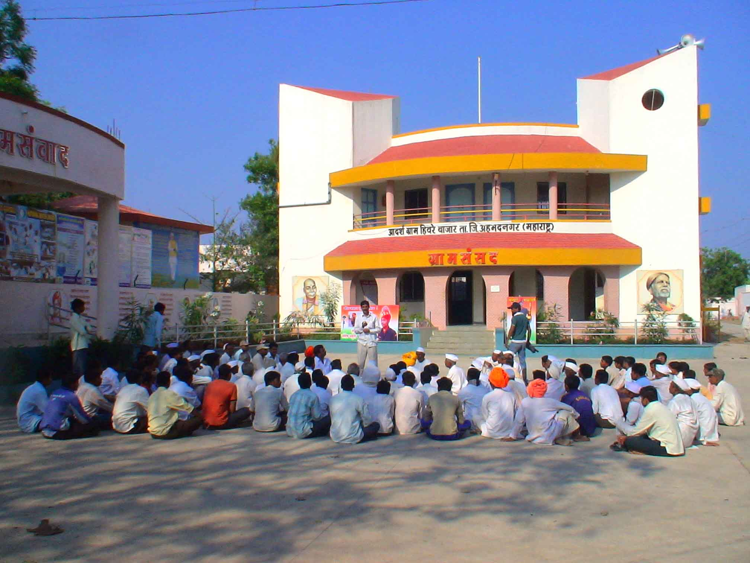
Gram/Village Panchayat
Gram Sabha consists of all adult members registered as voters
It provides effective peoples’ participation
It considered as the only means of direct democracy where all important decisions have to be arrived
Also, serve the purpose of training ground especially the younger generation
Gram Sabha has to meet atleast thrice in a year
Quorum shall be 1/3
Presided over by President

Slide 18
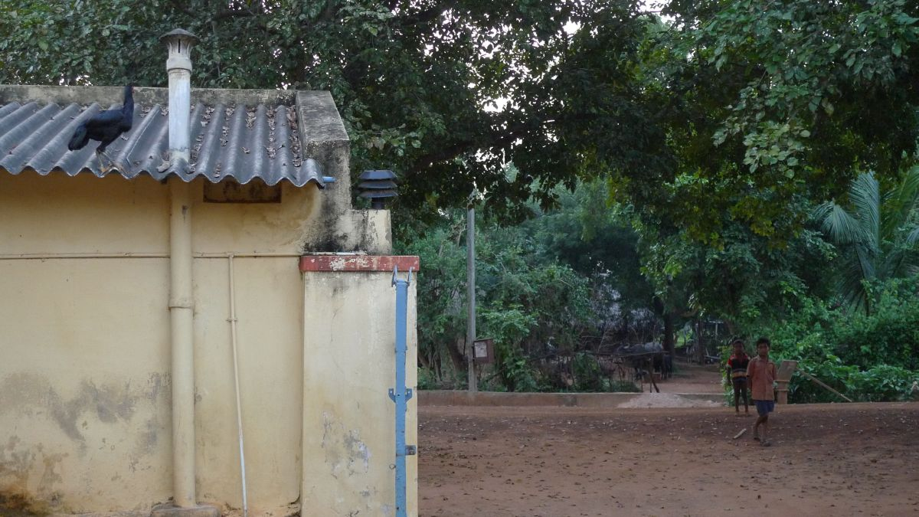
Functions of Gram Panchayat
Constitution, repair and maintenance of ward
Lighting
Construction of drains & disposal of sewage
Cleaning of streets & improvement of sanitary condition
Provisions for public latrines & its cleanliness
Opening and maintaining burial grounds
Sinking & repairing of wells, repair and maintenance of ponds, tanks, construction and maintenance of water works.

Slide 19
Powers of Gram Panchayat
Planting and preservation of trees
Lighting of public roads & places
Control of fairs and festivals
Construction of works of public utility, provision of facilities for safety, health, comfort, conveyance, culture or recreation.
Opening and maintenance
Public markets, Cart stands, Halting places, Public cattle sheds, Public slaughter house, Reading home, Community TV sets, Playgrounds, Parks, Sports clubs, Literacy centres for imparting social education.

Slide 20
Taxation and finance of Gram Panchayat
Shares of local cess, house tax, vehicle tax, stamp duty surcharge, house tax matching grants, tolls, fee for markets, income from endowment, share of entertainment tax, fine and penalties.
Economic development and social justice
Each village panchayat will prepare a plan for economic development and social justice including implementation of programmes and schemes of the government.

Slide 21
Functions Panchayat Samiti
Construction& maintenance of Public roads, house for the poor, shops and stalls, elementary schools.
Maintenance of dispensaries, maternity & child welfare centres
Preventive & remedial measures of epidemics or malaria
Control of notified fairs and festivals
Veterinary relief
Regulation of buildings
Opening & maintenance of public market
Maintenance of statistics of birth and deaths
Promotion of agriculture, cottage industries
Other duties mentioned by the govt. relating to agri., AH, village industries and schemes for economic development and also reviews of schemes, programmes & other activities

Slide 22
Taxation and finance of Panchayat Samiti
Shares of local cess, house tax, matching grants, rental of common property resources, local educational grants, local road grants, fee on licences, fees levied by public market, fees for temporary occupation, receipts from dispensaries and income from endowments, entry/parking fee for vehicles.
Proportionate share from tax, income from ferries, interest on investments, fines and penalties.

Slide 23
Economic development and social justice
Each panchayat union/samiti will prepare a plan for economic development and social justice including implementation of programmes and schemes of the government.

Slide 24
Zilla Parishad
Functions:
Advise on all matters of development undertaken by panchayats and panchayat unions to the Government
Watching and reviewing the progress of the programme
Taxation and finance
All grants, all rents from lands or other property, interest on securities and penalties

Slide 25
Economic development and social justice
Each District panchayat will prepare a plan for economic development and social justice including implementation of programmes and schemes of the government.
District planning committee
MP, MLAs, Chairman of the district panchayat
Functions:
Consolidate the plans ZP, PS, GP, Municipal Councils & Municipal Corporations
Prepare a draft of development plan for the whole district

