Slide 1
Receptor for Peptide Hormone
VBC-612

Slide 2
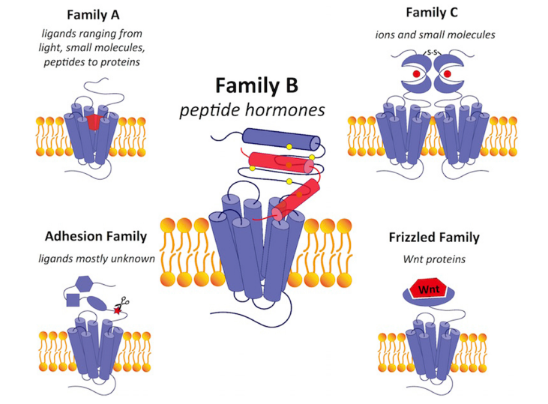
A comparison of GPCRs in family B with GPCRs in the other four families
Notes:
Culhane KJ, Liu Y, Cai Y and Yan ECY (2015). doi: 10.3389/fphar.2015.00264

Slide 3
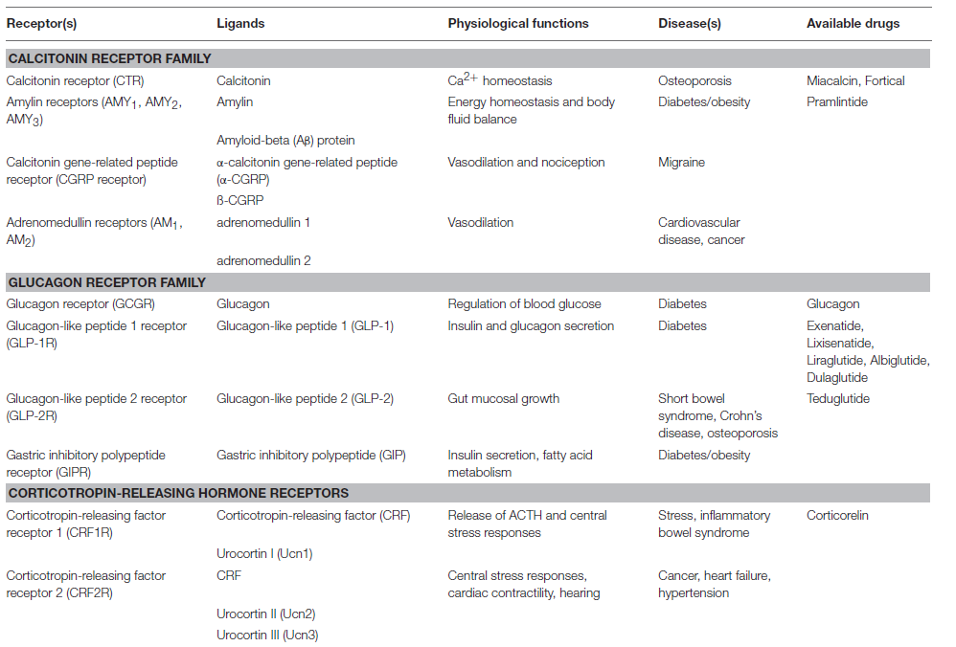

Slide 4
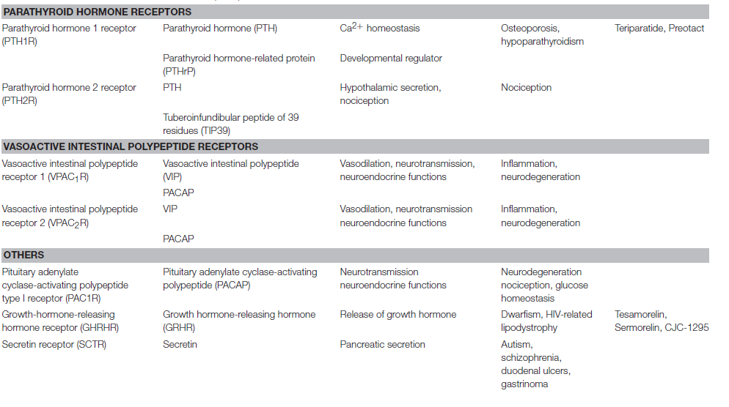

Slide 5
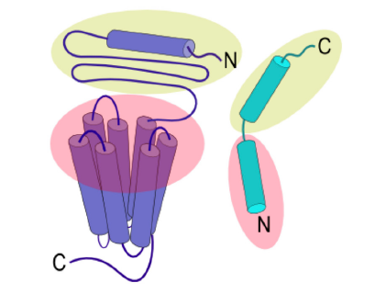
Two-domain binding model of family B GPCRs

Slide 6
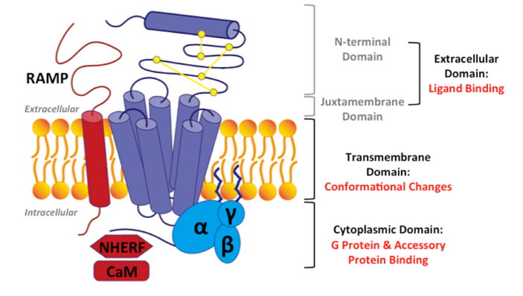
Structural model for family B GPCRs

Slide 7
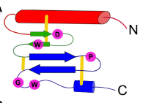
The three-layered a-b-ba foldfortheN-terminaldomain offamilyBGPCRs.

