Slide 1
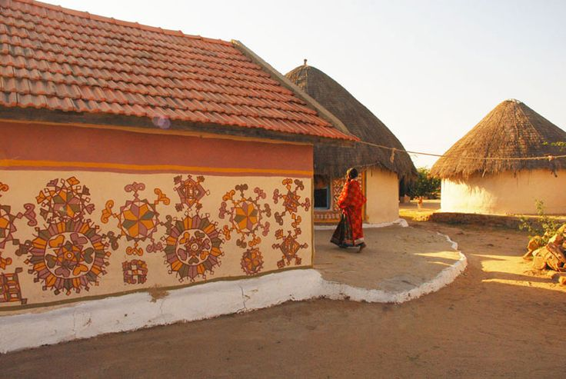
UNIT-02 (EXTENSION EDUCATION AND DEVELOPMENT)
Dr. Puspendra Kumar Singh
Department of Veterinary & Animal Husbandry Extension Education, BVC

Slide 2
Extension Education and Development
3rd Year, VAHEE

Slide 3
Topics covered
Post Independent rural development programmes

Slide 4
Stage II: Post-Independence Era (1947-52)
Grow More Food Campaign – 1947
Etawah pilot project – Col. Albert Mayor- 1948
Nilokheri Project – S.K.Dey – 1948
Adarsh Sewa Sangh – Col. Shitole

Slide 5
Grow More Food Campaign (1947)
India’s first organized effort to increase food production
Enquiry committee (Chairman V.T.Krishnamachari)
Committee recommendations:-
Formation of development blocks
Revenue officer as development or extension officer
Technical officers
Village level worker for every 5 – 10 villages
Commission prescribed CD & rural extension

Slide 6
Etawah Pilot Project (1948)
Col. Albert Mayor in Mehewa village (Etawah district, UP)
Pilot project in rural planning & development
Regarded as forerunner of the CD projects
Concept of Multipurpose Village Level Worker
Objectives: -
To see what degree of production & social improvement initiative & cooperation could be obtain from a compact area.
To see how quickly results could be achieved and
To see whether results achieved/permanent/reproducible
Approach:-
Educative & persuasive
Demonstration method was used to convey new ideas.
Achievements: -
Villagers participation
Successful & pattern was accepted
Finally merged with NES block

Slide 7
Nilokheri Project (1948)
S.K.Dey
Nilokheri (Punjab)
Also c/a “Mazdoor Manzil”
Objectives: -
To rehabilitate 7000 displaced persons from Pakistan
To attain self sufficiency in all essential aspects of life
Achievements: -
Agro-industrial economy for the future pattern
of development of rural area.

Slide 8
Adarsh Sewa Sangh
Col. Shitole
Pohri (Gwalior)
232 villages
Rural reconstruction society formed at each village
Published monthly journal “Rural India” devoted to planning & community projects
Objectives: -
To increase per capita income

Slide 9
Major limitations of the above pre and post independence program
Individualized, Isolated, discontinuous attempts
Lacking Govt. backing & financial support
Staff - inadequate, inexperience and untrained
Plans, programs & organizations were lacking / weak
Lack of parallel programs of supplies, services, guidance & supervision
Proper methods & skills of approach not fully realized
Research & evaluation was lacking
Limited co-ordination with other development depts.
Lack of people involvement in planning & execution

Slide 10
Stage III: CD & NES Era (1952 - 60)
Community Development Programme-1952
National Extension Service -1953
Community Development Block- 1954
Panchayat Raj - 1957

Slide 11
Community Development Programme (CDP) in India
Result of GMF Enquiry report & Etawah Project
First major rural development programme & first organised effort at rural reconstruction, launched after independence in 2nd October 1952.
An instrument to transform the social and economic life of the village community.
Initially, it covered 55 projects with a wide range of programmes for developing agriculture, animal husbandry, rural industries, education, housing, rural communication etc.
Objectives:-
To achieve socio-economic transformation
To design administrative organization

Slide 12
National Extension Service
Inaugurated on Oct. 2nd, 1953
Operational unit – NES block – converted into CD block
Design to provide the essential basic staff and a small fund for the people to start the development work on the basis of self help

Slide 13
Community Development Block (1954)
A block – administrative unit of planning & development
CD block comprises about
100 villages 60,000 to 70,000 people Area 400-500 sq. km
Created post of BDO supported by 8 extension officers from dev. depts.
CD (method) and NES (agency)
The main lines of activity - Agriculture and related matters, Irrigation, Communications, Education, Health, Supplementary employment, Housing, Training, Social Welfare

Slide 14
Stage IV: Intensive Agricultural Development Era (1960 – onward)
Agricultural Universities – 1960
Scheme for technological development:
I. A. D. P. (Intensive Agriculture district programme) - 1960-61 (Package Programme)
I. A. A. P. (Intensive Agricultural Area Programme ) - 1964
I. C. D. P. (Intensive Cattle Development Programme) – 1964-65
H. Y. V. P. (High Yielding Variety Programme) – 1966-67

Slide 15
Scheme for development with social justice
S.F.D.A. (Small Farmers Development Agency ) - 1970-71
M.F.A.L. (Marginal Farmers And Agricultural Labourers Development Agency ) - 1970-71
D.P.A.P. (Drought Prone Areas Programme) - 1970-71
Desert Development Program – 1973-74
T & V (Training & Visit System) - 1974
I.C.D.S. (Integrated Child Development Service) – 1974
Minimum needs programmes -1977

Slide 16
Scheme for development with social justice
I. R. D. P. (Integrated Rural Development Programme) - 1978-79
T.R.Y.S.E.M. (Training of Rural Youth for Self-Employment) – 1979
N.R.E.P. (National Rural Employment Programmes (NREP) – 1980
D.W.C.R.A.(Development of women and children in Rural Areas) – 1982
N.A.E.P. (National Agriculture Extension Project) - 1983
Rural landless employment guarantee program – 1983
ToT programme - 1985

Slide 17
Scheme for development with social justice
Employment & Training for Women Program – 1987
Women’s Development Corporation–1986-87
J.R.Y. – 1989
Local Area Development Project of MP–1990
Rashtriya Mahila Kosh – 1992-93
Mahila Samriddhi Yojana – 1993

Slide 18
Scheme for development with social justice
Small Farmers Agri Business Consortium (S.F.A.C.) – 1994
Distance Learning – 1994-95
Indira Mahila Yojana – 1995
Social Economic Program – 1995-96
S.G.S.Y. – 1999
Jawahar Gram Samriddhi Yojana–1999
Agro-clinic Yojana – 2000
Sampoorna Gramin Rojgar Yojana– 2001

Slide 19
Scheme for development with social justice
M.W.S. (Million Wells Scheme)– 1988-89
National Watershed Development Project – 1991
P.U.R.A. (Providing Urban Amenities to Rural Areas )– 2004
N.R.E.G.A. (National Rural Employment Guarantee Act, 2005)
Mahatma Gandhi National Rural Employment Guarantee Act", MGNREGA 2006

Slide 20
ICAR frontline Extension programme
National demonstration Project (NDP) -1965
Krishi Vigyan Kendra (K. V. K.) – 1974
Operational Research Project (O.R.P.) – 1979
Lab to Land programme (L.L.P.) - 1979
Technology Assessment and Refinement-Institute Village Linkage Programme (TAR – IVLP) – 1995
Technology Mission on Oilseeds (T. M. O.) – 1986
Technology Mission on Dairy Development (T.M.D.D.)- 1989

Slide 21
ICAR frontline Extension programme
National Agricultural Research Project (N.A.R.P.) – 1979
National Agricultural Technology Project (N.A.T.P.) – 1998
National Agricultural Innovation Project (N.A.I.P.) – 2006
National Agricultural Development Programme (N.A.D.P.)/(RKVY) – 2007

