Slide 1
Department of Veterinary Medicine Bihar Veterinary College, Patna – 800 014 (BASU, Patna)
Diseases of Respiratory System
(Rhinitis)
Dr. Ranveer Kumar Sinha Assistant Professor cum Junior Scientist
E-mail: ranveervet@rediffmail.com

Slide 2
History(Anamnesis)
Imp. Point:
Viral diseases is seen mostly in young dog.
Pulmonary neoplasm is seen mostly in old animal.
Small toy breed of dog often suffer from tracheal collapse.
Duration of present illness.
History of drenching.
Detail of previous treatment.

Slide 3
Physical Examination
Inspection:
Nasal discharge:- haemoptysis, epistaxis
Nasal passage
Abnormal swelling
Palpation:
Cough may be induced by pinching the larynx trachea or closing the nostril.
Percussion:
Auscultation:
Thoraco-centesis: 6th or 7th intercostal space
Faecal Exam: to recover egg or larva of lung worm.
Exercise tolerance test: time taken to return to normal respiratory rate after exercise

Slide 4
Acute Rhinitis (Coryza or Nasal Catarrh)
Definition:
It is the inflammation of the mucous membrane of the nose and usually involving the upper part of the trachea, it may be acute or chronic.
Etiology:
Primary causes
Inhalation of irritant vapour as ammonia or chlorides.
Presence of foreign bodies in the nose as dust particles.

Slide 5
Etiology
Secondary causes
Sudden exposure from hot to cold, this will reduce the resistance of the body & organism become pathogenic which are normally commensals in the upper respiratory tract like Strept., Staph., Coryne. & Pasteurella, to become pathogenic, active and then attack the mucous membrane.
Extension of inflammation from other parts of respiratory tract as laryngitis or even pharyngitis.
Bold causes, "in the course of some diseases as"
Glanders.
Strarngles.
Necrotic rhinitis of sheep.

Slide 6
Etiology
Viral causes:
Malignant catarrhal fever of cattle.
Mucosal disease.
Render pest.
Blue tongue disease.
Infectious bovine rhinotracheitis.(I.B.R.).
Equine viral rhinopneumonietis.
Swine influenza.
Parasitic causes:
Ostrus ovis of sheep.
Blood flukes as S. Nagalis of cattle.

Slide 7
Clinical Signs
Clinical signs:
Redness and swelling of mucous membrane of the nose.
Bilateral nasal discharge which usually begins watery in character then mucopurualnt & purulent.
Swelling of the submaxillary L.N.
Difficulty of swallowing "dysphagia".
Sometimes the discharge rises up and blocks the nose leading to a condition of "snorting".
When there is irritation the animal rubs its nose against any hard objects.
There may be lacrimation and bleeding.
Prognosis:
Favorable but when the causes are not treated it leads to chronic rhinitis.

Slide 8
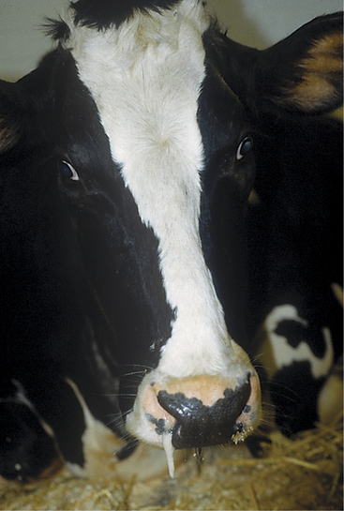

Slide 9
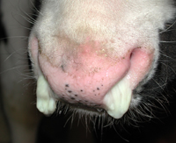

Slide 10
Diagnosis and Treatment
Diagnosis:
Clinical findings.
Sudden onset.
The character of the discharge which usually begins watery. When the animal rubs its nose against objects, ulcerations & abrasions will be formed.
Enlargement of submaxilary L.N.
Conjunctivitis specially in sheep.
Chronic rhinitis may extend to other parts as nasal sinus giving rise to sinusitis.
Extension of the inflammation to the lung.
Treatment:
Put the animal in a well ventilated space away from draughts.
Complete rest of the animal & give only laxative, easily digestive food.
Removal of exudates from each nostril by flushing with physiological saline.
Systemic antibiotic
Antihistaminic in case of allergic rhinitis
Apply medicated steam inhalation(Eucaliptus oil, Turpentine oil, Tr. Benzoin)
Nasal decongestant may be used in small animal.

Slide 11
Chronic Rhinitis
This takes more longer time than the acute type & it means that the case was either acute type and neglected or the stimuli acted slowly till it produces the condition
Etiology:
Neglected acute cases of rhinitis.
Accompanied with some chronic diseases of respiratory tract as chronic alveolar emphysema of horses as well as glander & T.B.

Slide 12
Clinical Signs
Clinical signs:
Mucoid nasal discharge, sometimes it may be transparent in color.
The mucous membrane of the nose is swollen & bluish or brownish.
Sometimes there is stenosis of the nasal cavities, due to swelling of the mucous membrane, accompanied by snorting which is due to breathing from the mouth.
There may be ulcers & abrasions on the surface of the nose, due to the fact that the animal shakes its head and tries to get rid of the discharge by rubbing the nostrils against objects.

Slide 13
Differential Diagnosis
Chronic rhinitis need care in its diagnosis, since some infectious disease gives the same symptoms as
Glanders
The nasal discharge is unilateral.
Non inflammatory swelling of the submaxillary lymph node.
Ulceration & abrasions in the nostrils.
Positive Malline Test.
Strangles
The submaxillary lymph node is inflammed and tend to form abscess.

Slide 14
Differential Diagnosis
Sinusitis
On percussion, there will be dull sound with severe painful response.
The nasal discharge is unilateral & is intermittent.
Infections of the teeth
Careful examination of the teeth with smelling of the mouth will be helpful in differentiation.
Tuberculosis (TB)
Must be excluded by application of Tuberculin Test.

Slide 15
Differentiation between acute & chronic rhinitis
Acute rhinitis | Chronic rhinitis
Watery nasal discharge | Mucoid nasal discharge
Mucous memb. Is swollen & redden | Mucous m. is swollen &bluish
Swelling of the submaxillary L.N. | Swelling of submaxillary L.N.followed by dysphagia
Stenosis of the nostril | The animal rubs its nose against objects

Slide 16
THANKS YOU !

