Slide 1
Routine Activities at Livestock Farm Complex
Prepared by-
Dr Dushyant Yadav
Assistant Professor cum Jr. Scientist
Department of Livestock Farm Complex (VGO)
Bihar Veterinary College, BASU, Patna-800014

Slide 2
Units of Livestock Farm Complex
Cattle and Buffalo Unit
Sheep and Goat Unit
Bull Centre
Poultry Unit (Main Campus & Central Poultry Farm)
Fodder Production Unit
Vermi-compost Unit
Silage Making Unit
Urea Treatment Unit
Farm equipments

Slide 3
Routine Activities at LFC
Feeding
Milking
Cleaning and Sanitation
Production of Vermi-compost
Production of Silage
Mineral mixture production
Data Recording
Health Management
Reproductive Management of adult and heifers
Research Activities
Extension Activities etc.

Slide 4
Some Common Activities
Milking-
04:30 AM and 03:30 PM
Feeding- Before the milking
Cleaning- 6 am and as per requirement
Health check up- daily

Slide 9
Bachaur Cattle

Slide 10
Sahiwal Cattle

Slide 11
Jersey Cross

Slide 12
H.F. Cross

Slide 13
Upgraded Murrah and Nili Ravi Buffalo

Slide 14
Milk Collection Unit

Slide 15
Sheds for Cattle and Buffalo

Slide 16
Animal Mat

Slide 17
Resting area-open paddock

Slide 18
Calf Shed

Slide 19
Heifers

Slide 20
Sick Animal Room

Slide 21
Weighing Bridge

Slide 22
Concentrate storage

Slide 23
Bull Unit

Slide 24
Bachaur Bull

Slide 25
Murrah and Nili Ravi Buffalo Bull

Slide 26
Sheep Unit

Slide 27
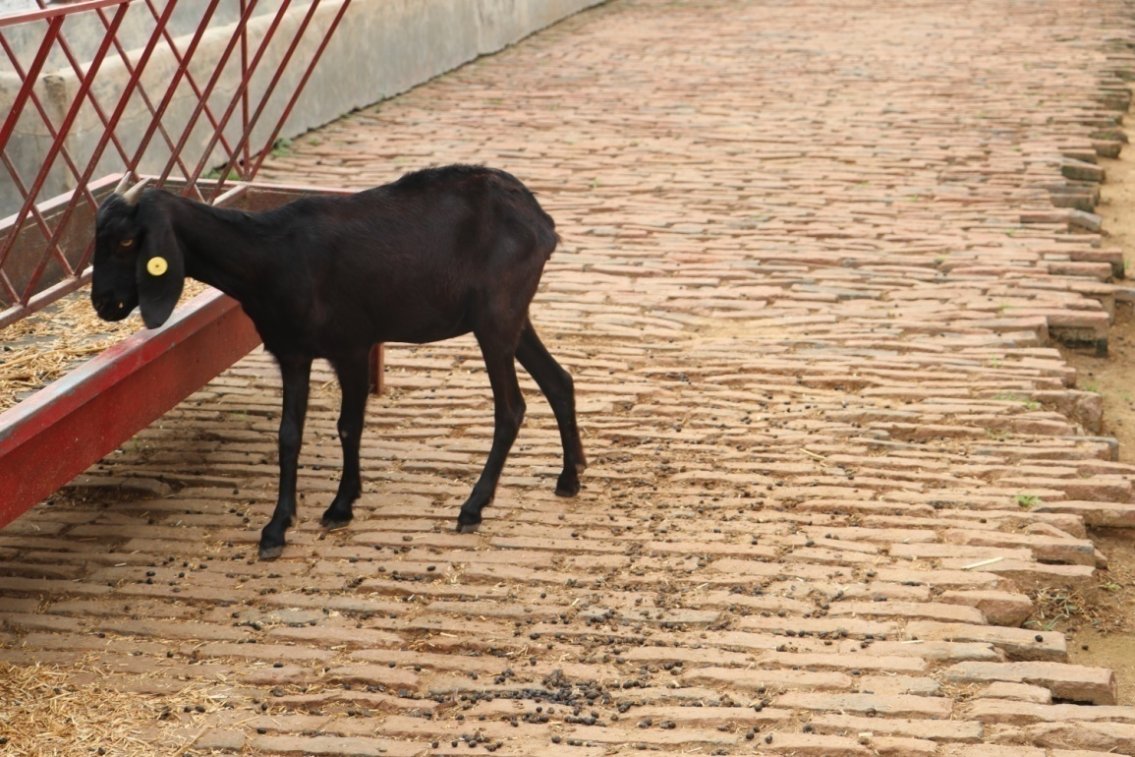
Goat Unit

Slide 28
Poultry Unit

Slide 31
Brooder House

Slide 32
ETT and IVF Lab

Slide 33
A.I. Unit

Slide 34
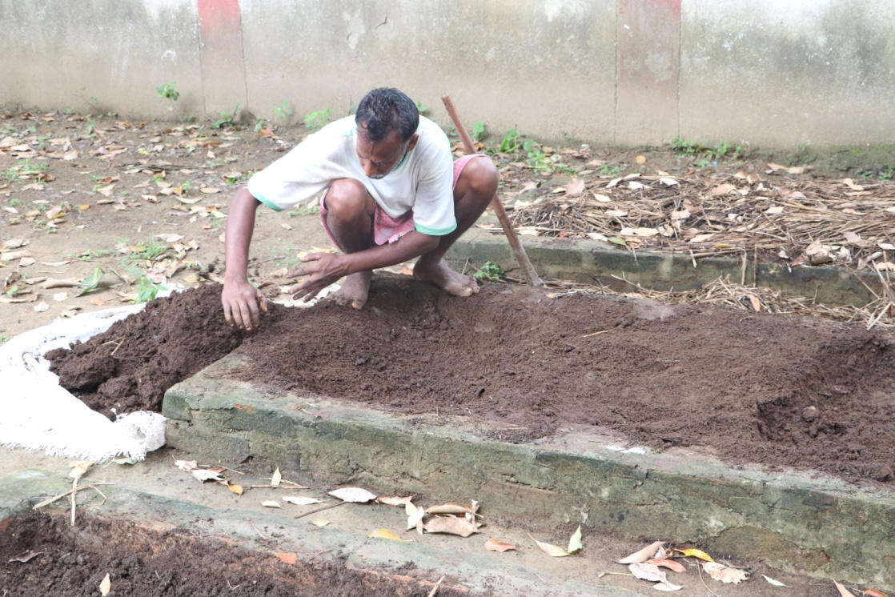
Vermi-compost Unit

Slide 35
Silage Production Unit

Slide 36
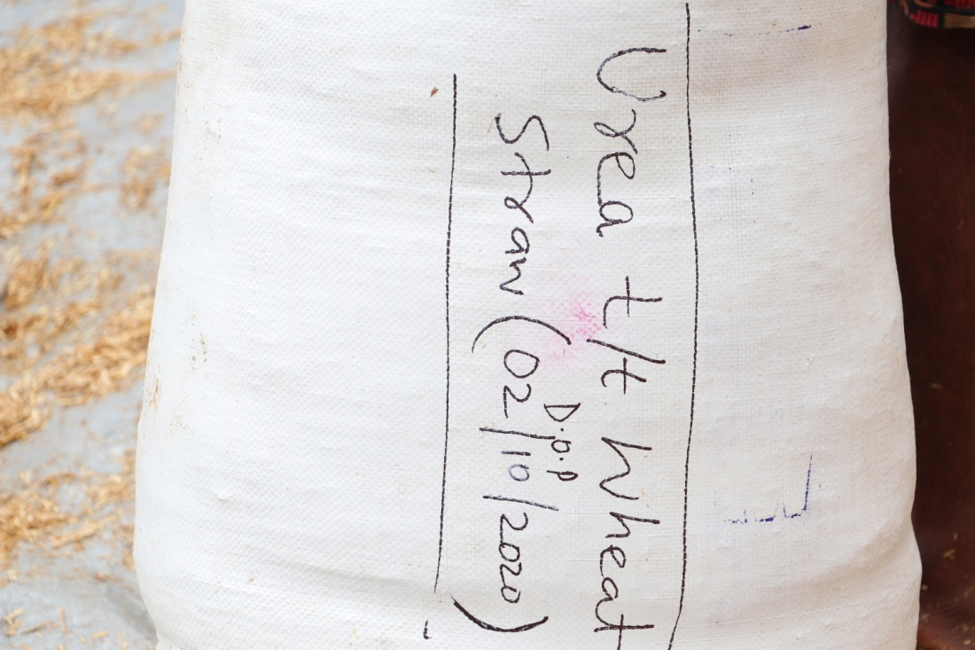
Urea Treated Wheat Straw

Slide 37
Farm Equipments

Slide 43
Fodder Production Unit

Slide 46
THANK YOU

