Slide 1
Swine Erysipelas
By- Dr Pallav Shekhar
Assistant Professor
VMD
BVC Patna
VCM 605

Slide 2
SWINE ERYSEPELAS
It is an important disease of pigs caused by a Gram-positive bacteria and characterized by arthritis, vegetative endocarditis and rhomboid shaped erythematous skin lesions. It is also known as diamond skin disease.
Etiology
Erysepalothrix rhusiopathie
Gram-positive, rod shaped, pleomorphic

Slide 3
Etiology
Erysipelothrix rhusiopathiae
Gram positive rod.
Pigs of all age are susceptible
Young suckling pigs are susceptible
Human beings are also susceptible.

Slide 4
SWINE ERYSEPALAS
Pathogenesis
Infection enters through skin 0r Ingestion
Bacteremia or septicemia
Localizes in joints,
skin and
heart valves
Hyperemia Urticaria patches Cauli flower like lesion
Thickening of Vegetative endocarditis
joint capsules
NEPHRITIS?

Slide 5
SWINE ERYSEPALAS
Characteristic symptoms
Arthritis
Erythema on skin, later sloughing of skin and patches on abdomen

Slide 6
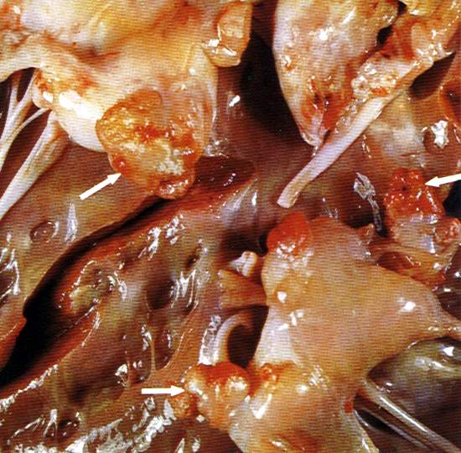
SWINE ERYSEPALAS
Macroscopic features
Arthritis
Erythema or sloughing of skin
Vegetative endocarditis- nodular mass of over growth on valves
Hypertrophy of left ventricle

Slide 7
SWINE ERYSEPALAS
Microscopic features
Infiltration of lymphocytes in joint capsules
Fibrinous exudate with necrosis, leucocytic infiltration and colonies of bacteria in heart lesions
Necrosis in skin sections

Slide 8
Clinical Findings
Acute form
Sudden Death
Fever 108 F
Ocular discharge
Shifting lameness
Diamond Skin Lesion
Chronic form
Dyspnoea
Cyanosis
Joint enlarged, hot, painfull
Ankylosis
Alopecia
Hyperkeratosis
Sloughing of tail and ear tip

Slide 9
SWINE ERYSEPALAS
Diagnosis
Symptoms and lesions
Isolation of bacteria
Hematology reveals monocytosis
Demonstration of bacteria in tissue sections using special stains.

Slide 10
Differential Diagnosis
Hog Cholera
Salmonellosis
Enteritis, tremors, convulsion

Slide 11
Treatment and Prevention
Treatment
Penicillin 50,000IU/Kg bwt i/m for 3 days.
Cortisone 75 mg s/c for arthritis
Prevention
Vaccination
Live attenuated or tissue culture vaccine

Slide 12
Treatment
Surgical extirpation.
X ray irradiation.
Streptomycin 2-3 gm in lesion along with parentral route.

Slide 13
t h a n k s !

