Slide 1
Traumatic Reticulo-peritonitis (Hardware Disease)
VCP-II Dr. Anil Kumar
Asst. Professor
Dept. of VCC, BVC

Slide 2
Traumatic Reticuloperitonitis (Hardware Disease)
Consequence of perforation of the reticulum
Most common in mature dairy cattle, occasionally seen in beef cattle, and rarely reported in other ruminants.
Aetiology:
Accidental ingestion of foreign body through feed or while grazing in the pasture.
• Lack of oral discrimination in animal
Incomplete mastication of feed before swallowing.
• Tendency to lick metallic object
• Greedy feeding
Pathogenesis:
Swallowed metallic objects directly falls into the reticulum or pass into the rumen
Carried over the rumino-reticular fold into the cranio-ventral part of the reticulum

Slide 3
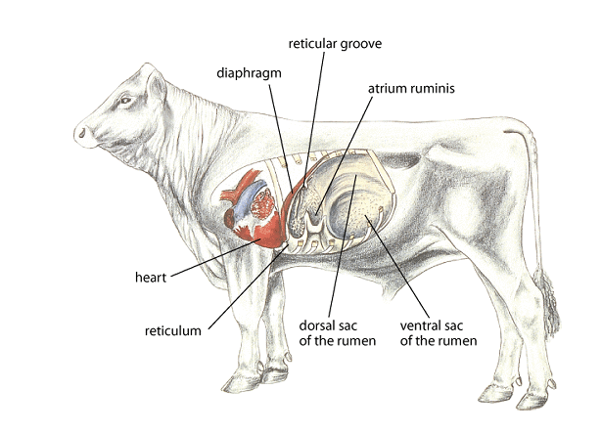
Source: MSD Veterinary Manual

Slide 4
The is elevated reticulo-omasal orifice tends to retain heavy objects in the reticulum, and the honeycomb-like reticular mucosa traps sharp objects.
Contractions promote the penetration of the wall by the foreign object.
In late pregnancy uterus give compression on rumino-reticulum wall and straining during parturition increase the likelihood of an initial penetration of the reticulum and may also disrupt adhesions caused by an earlier penetration
Reticulum (Honey Comb)
(Serem et al., Inter J Vet Sci, 2018, 8(2): 73-78)

Slide 5
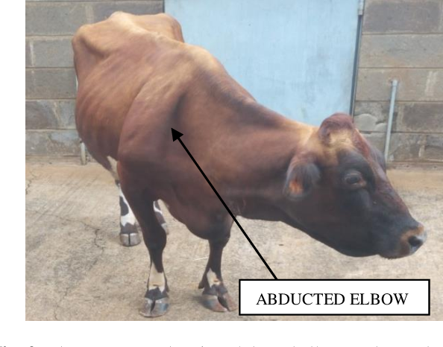
Perforation of the wall of the reticulum allows leakage of ingesta and bacteria, which contaminates the peritoneal cavity.
Initially, peritonitis is generally localized and adhesions takes place
The object can penetrate the diaphragm and enter the thoracic cavity (causing pleuritis and sometimes pulmonary abscessation) and
The pericardial sac causing pericarditis and sometimes followed by myocarditis

Slide 6
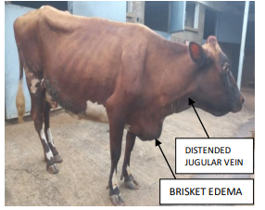
Clinical Findings:
Sudden onset of rumino-reticular atony and a sharp fall in milk production
Mildl increased temperature
HR: Normal or slightly increased
Respiration: Usually shallow and rapid
Arched back; anxious expression; a reluctance to move; and an uneasy, careful gait
A grunt produced by applying pressure to the xiphoid or by firmly pinching the withers

Slide 7
Placing a stethoscope over the trachea and applying pressure or pinching the withers at the end of an inspiration.
Tremor of the triceps and abduction of the elbow may be seen.
Bilateral jugular extension
Chronically:
The feed intake and fecal output are reduced, and milk production also remain reduced
As the acute inflammation subsides, there is less abdominal pain and temperature become normal
Some may develop vagal indigestion due to adhesion on ventromedial reticulum.
IF HEART or LUNG INVOLVED:
There is depression, tachycardia (>90 bpm), and pyrexia (104°F)—in both pleuritis or pericarditis
Pleuritis is manifest by fast, shallow respiration
Muffled lung sounds
Pleuritic friction rubs

Slide 8
Thoracentesis givess several liters of septic fluid
Traumatic pericarditis HAVE muffled heart sounds
Pericardial friction rubs or gas and fluid splashing sounds (washing machine murmur) can be heard on auscultation at initial episodes
Jugular vein distention and congestive heart failure with marked submandibular and brisket edema is a frequent sequela of traumatic reticulopericarditis with GRAVE PROGNOSIS.
Penetration through the pericardium into the myocardium LEAD TO extensive hemorrhage into the pericardial sac or ventricular arrhythmias and sudden death.
Diagnosis:
History (when available) and clinical findings
Laboratory tests (neutrophilia with a left shift, ↑Plasma fibrinogen )
May have marked hypokalemic, hypochloremic metabolic alkalosis
Peritoneal fluid analysis (d-dimer and the neutrophil percentage )for peritonitis

Slide 9
Magnetic compass
Ultrasonography using a 3-MHz transducer is the most accurate way to diagnose localized peritonitis near the reticulum at the ventral abdomen and characterize the reticular contraction frequency
Lateral radiographs of the cranio-ventral abdomen can detect metallic material in the reticulum
Electronic metal detector
Treatment:
Surgical or Medical
Medical treatment involves:
Use of antimicrobials to control the peritonitis and a magnet to prevent recurrence.
Because of the mixed bacterial flora in the lesion, a broad-spectrum antimicrobial agent such as oxytetracycline (16 mg/kg/day, IV) should be used.

Slide 10
Penicillin (22,000 IU/kg, IM, once to twice daily) is widely used and effective in many cases despite its limited spectrum.
Surgical Methods:
Rumenotomy with manual removal of the object(s)
Antimicrobials peri-operatively
Prevention:
Avoiding the use of baling wire, passing feed over magnets to remove metallic objects.
Keeping cattle away from sites of new construction, and completely removing old buildings and fences.
Additionally, bar magnets may be administered PO, preferably after fasting for 18-24hr .
Usually, the magnets remains in the reticulum and holds any ferromagnetic objects on its surface.
To minimizes the incidence of TRP, giving magnets to all herd replacement heifers and bulls at 1 yr of age are recommended

